Slide 1




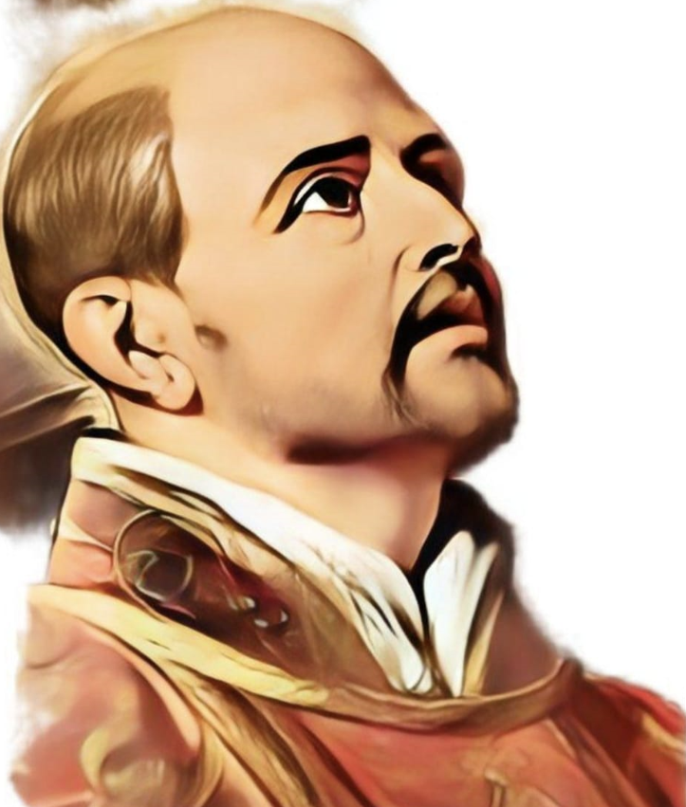
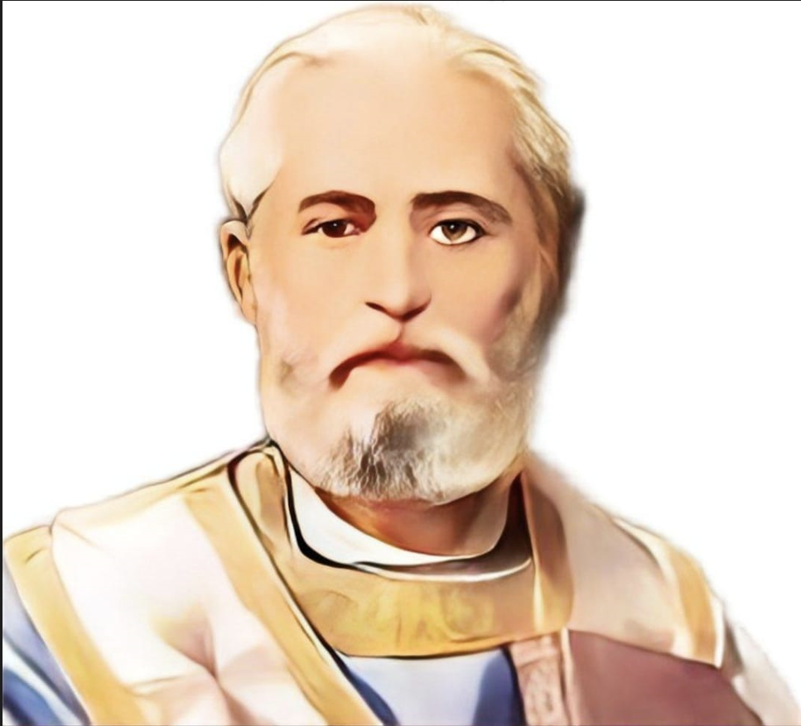
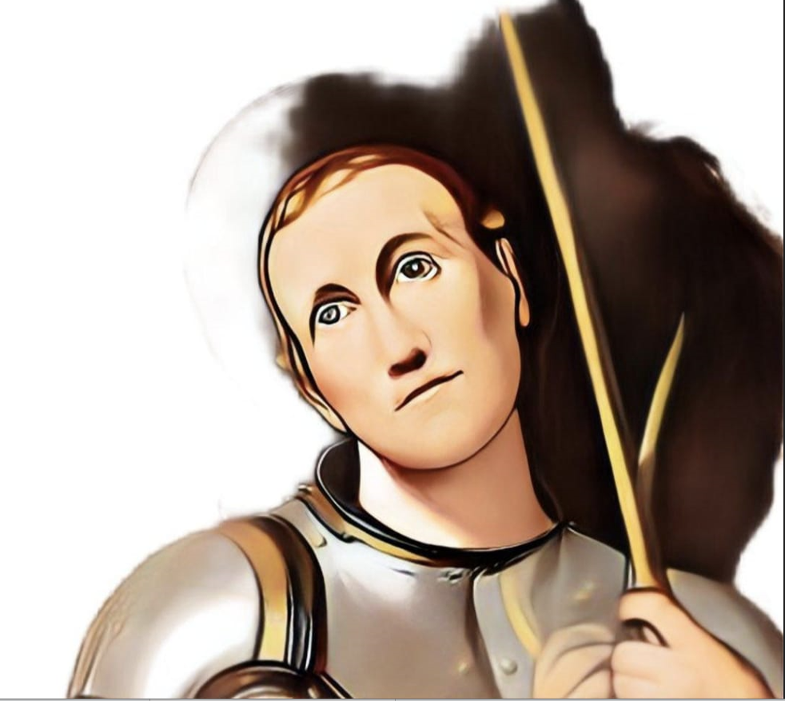
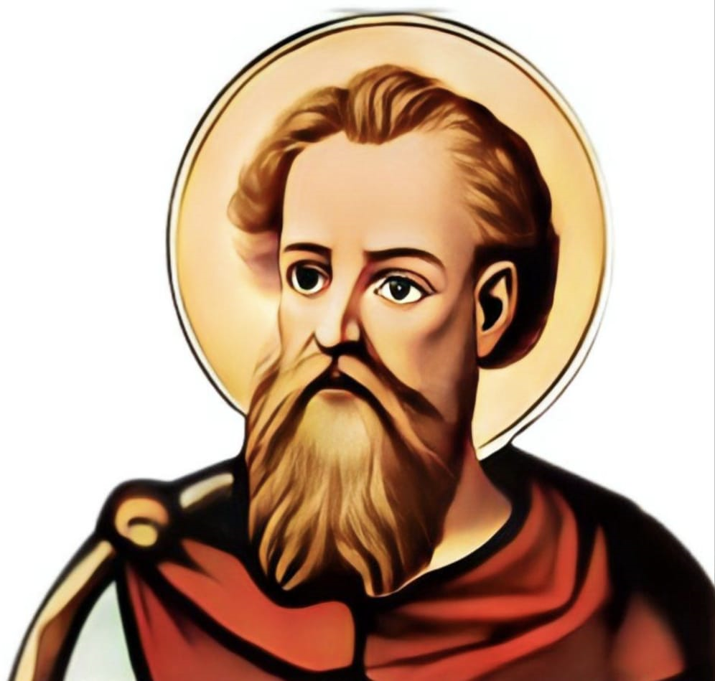
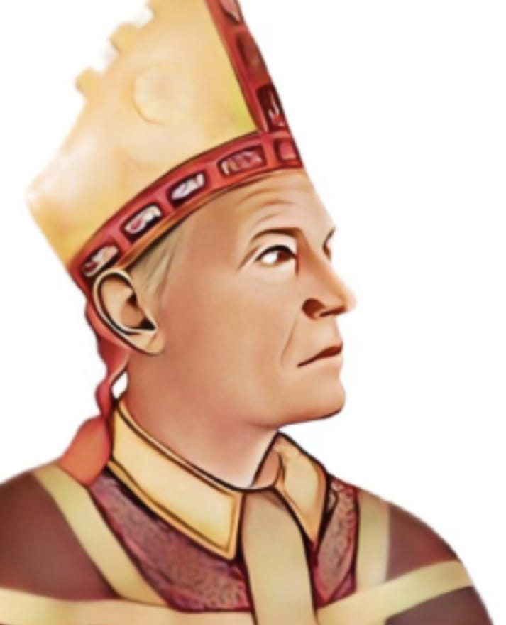
St Edmund’s Celebration Assembly!
30th NOVEMBER 2023
RE Thematic Week

Slide 2



St Edmund’s Catholic Primary School
…through Christ we learn…
Executive Headteacher: Mrs A. Ruthven
Head of School: Mr A. Antoniou
St Edmund’s Catholic Primary School Mission
Our Mission
Through Christ We Learn

Slide 3
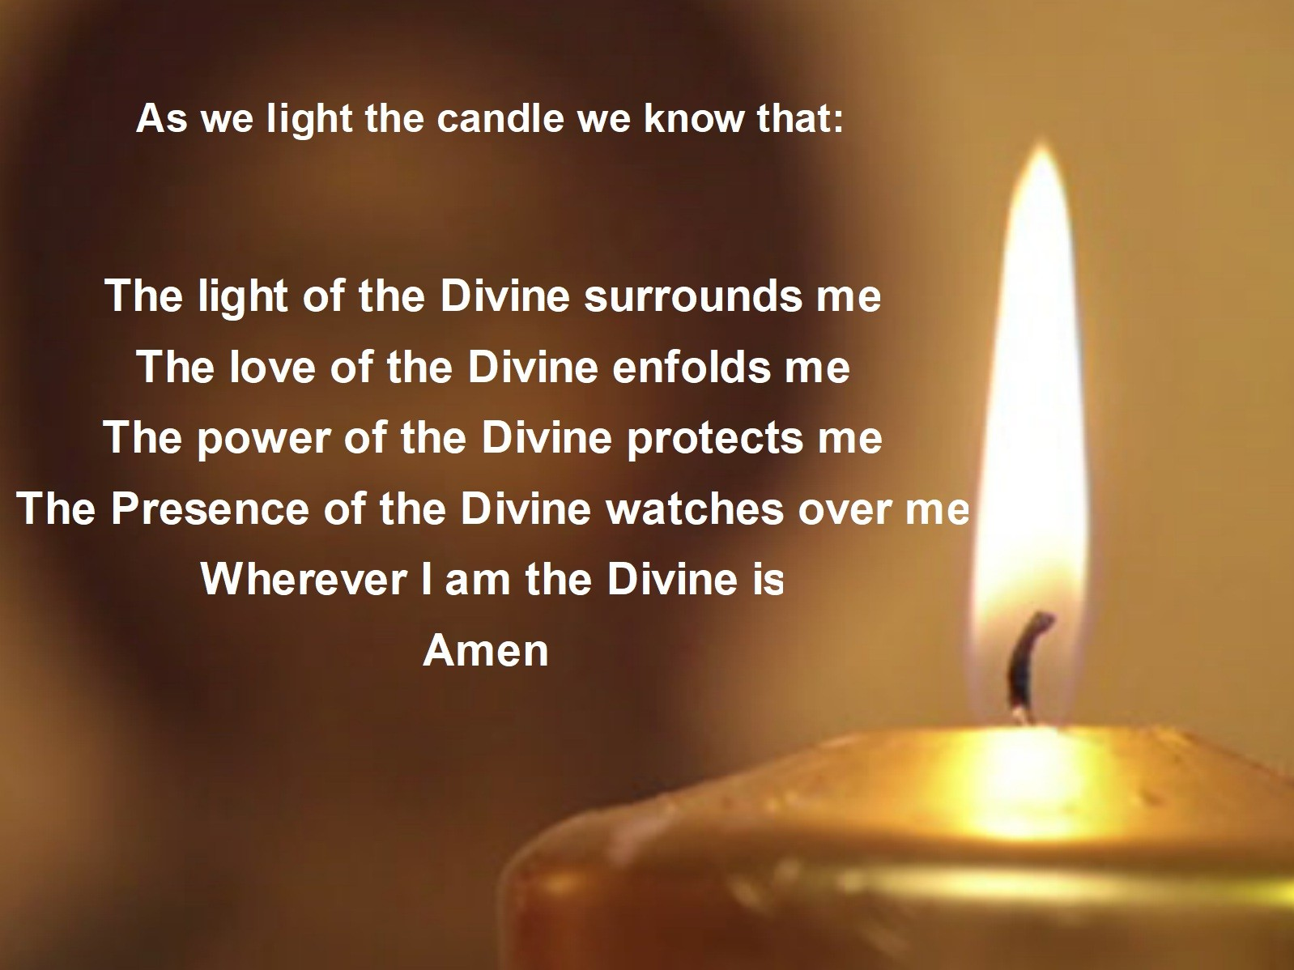

We Gather

Slide 4
Year 1 – Saint Teresa of Calcutta

Slide 5
Year 2 – Saint Paul

Slide 6

Year 3 – Saint Patrick

Slide 7
Year 4 – Saint Ignacio de Loyola

Slide 8
Year 5 – Saint Thomas Becket

Slide 9
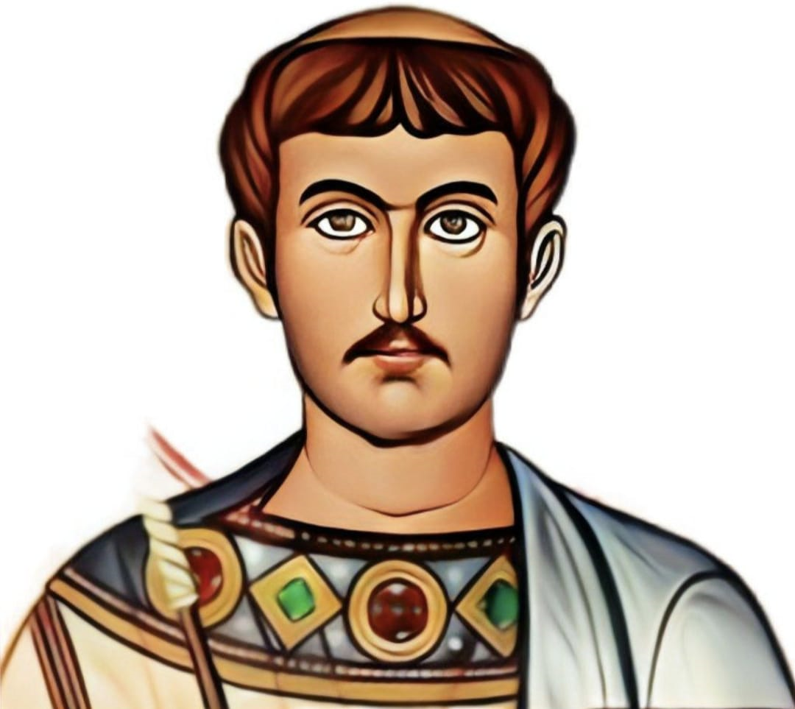
Year 6 – Saint Lawrence

