Slide 1


Slide 2

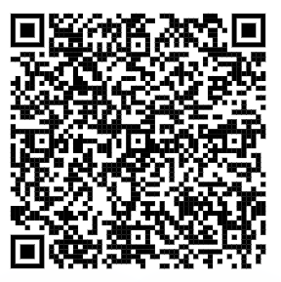
RE Pupil Voice St Edmunds Spring 1-2024

Slide 3
Do you enjoy R. E. lessons?

Slide 4
How much do you learn in R. E. ?

Slide 5
Are you looking forward to R. E. lessons?

Slide 6
Do you know Catholic Social Teaching?

Slide 7
Do you do Collective Worship in school?

Slide 8
Do you have prayers in school?

Slide 9
Do you know your class Saint?

