Slide 1
Coronavirus Covid19

Slide 2
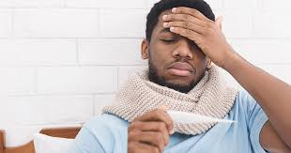
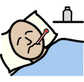
Coronavirus is a new type of flu. A flu will make you feel sick, but it is ok, you will feel better again.

Slide 3
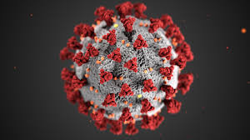
Coronavirus can be called Covid19.

Slide 4
I will hear the word coronavirus on the tv, radio and from adults or children talking about it. This is because it has spread to a lot of countries. This is ok.

Slide 5
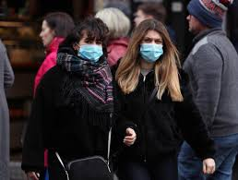
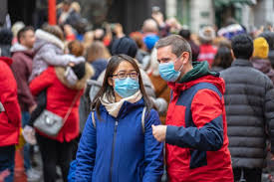
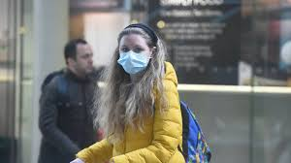
I might see people wearing masks in the street. This is ok. They are just trying to stay safe.

Slide 6
Some people are using scary words when they are talking about coronavirus and this is making people worry. I need to stay calm.

Slide 7
Things that will help me stay calm are: I can not watch the news or listen to people when they talk about it. I can read happy stories. I can watch happy films or programs about nature. I can play with my toys, draw or colour in. I can bake with an adult.

Slide 8
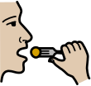
I can keep safe from coronavirus by: Washing my hands with soap and hot water for 20 seconds. I will wash my hands before I eat my food. I will wash my hands after I sneeze, blow my nose or touch my mouth. I will wash my hands after I go to the toilet. It will be safer with my lovely clean hands!

Slide 9
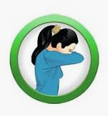
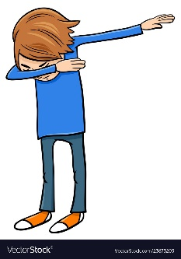
I will not bite my nails or put my hands in my mouth. I will cover my mouth when I cough or sneeze. If I am not feeling well, I will tell a grown up. I will not give my friends or staff high 5s, hugs or fist bumps until everyone is feeling better. I can do other things to be friendly, like give them a wave, an elbow bump or a dab!

Slide 10
My school might need to close for a while- everyone will stay at home instead. It will be closed to let everyone get better. A grown up will let me know when I can go back to school

Slide 11
When schools are closed, I will need to stay at home and not go outside or to other places. This is to keep everyone safe and stop the virus spreading. This is ok.

Slide 12
Just like other types of flu, coronavirus will go away soon. I don’t need to feel worried, but if I do I can talk to an adult. I will keep safe!

