Slide 1
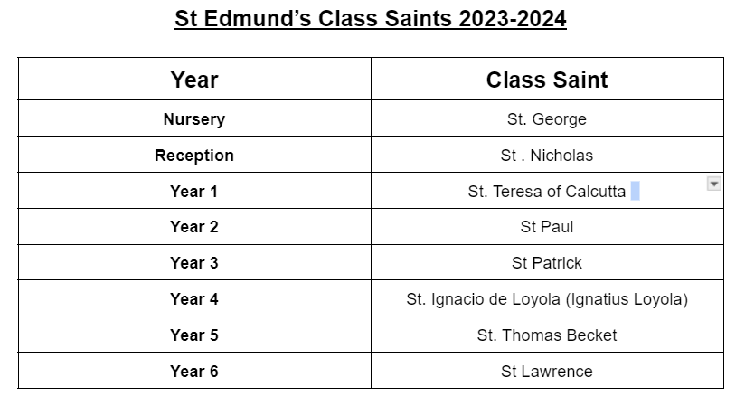
Use the following websites to research the different class saints:
Answer the following questions in your own words.
Date of birth:
Date of death:
Day of remembrance:
What is he the saint of:
BRIEF story of their life:
Fun fact:
Include a picture of the saint
as well.

Slide 2
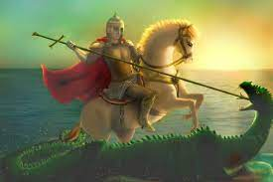
Date of birth:
275 AD
St. George
BRIEF story of their life:
St George was a Roman soldier and was tortured and decapitated under the Diocletian's persecution in 303 AD for being a Christian.
Date of death:
23rd April 303 AD
Day of remembrance:
23rd April
Fun fact:
People believe St George had nine lives as he was crushed between two spiked wheels and boiled in molten lead, but neither of them managed to kill him.
What is he the saint of:
He is the patron saint of knights, soldiers, scouts, fencers and archers.

Slide 3
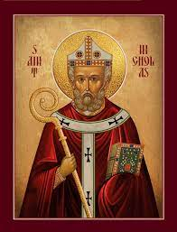
Date of birth:
15 March 270 AD
St. Nicholas
BRIEF story of their life:
St Nicholas was a Christian bishop who helped the people in need. He was then transformed into the character known as Santa Clause.
Date of death:
6 December 343 AD
Day of remembrance:
December the 6th
FUN FACT:
In the 11th century, sailors from the Italian cities of Venice and Bari stole the bones of St. Nicholas. In an act known as the “holy robbery”.
What is he the saint of:
St Nicholas is the patron saint of sailors,merchants,archers,repentant thieves,children,brewers, pawnbrokers and students.

Slide 4
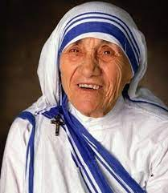
Date of birth:
26 August 1910
St. Teresa of Calcutta
BRIEF story of their life:
St. Teresa was a nun who dedicated her life to serving the poor, sick, orphaned, and dying.
She started a group called the Missionaries of Charity to take care of people all over the world who needed love and help.
Date of death:
5 September 1997
Day of remembrance:
5 September
What is she the saint of:
World Youth Day, The Missionaries of Charities, and co patron saint of the Archdiocese of Calcutta.
FUN FACT:
St. Teresa was awarded the Nobel Peace Prize because she helped so many people.

Slide 5
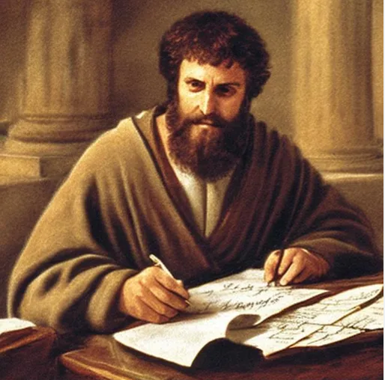
Date of birth:
4 AD
St. Paul
BRIEF story of their life:
St. Paul tried to stop people from following Jesus, but saw a vision of Jesus and changed his mind. He then travelled far and wide, telling lots of people about Jesus and helping to start many churches.
Date of death:
65 AD
Day of remembrance:
29 June
What is he the saint of:
Missionaries, theologians and evangelists.
FUN FACT:
St. Paul wrote many letters supporting Jesus and Christians. Many of these are now in the bible.

Slide 6
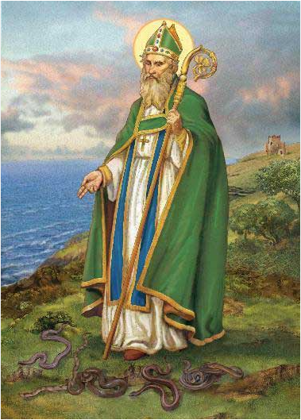
Date of birth:
385 AD
St. Patrick
BRIEF story of their life:
St. Patrick was born in Britain and travelled to Ireland as a missionary, spreading Christianity across the country and becoming Ireland's most famous patron saint.
Date of death:
17th March 461 AD
Day of remembrance:
17 March
FUN FACT:
Legend has it that St. Patrick was attacked by snakes when he was praying. He then chased all snakes out of Ireland and there are still none to this day.
What is he the saint of:
Patron Saint of Ireland

Slide 7
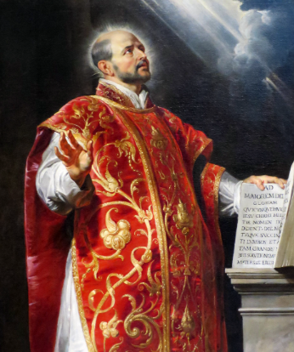
Date of birth:
23 October 1491
St. Ignacio de Loyola (Ignatius Loyola)
BRIEF story of their life:
St. Ignatius was a brave soldier from Spain who became a priest after he was hurt in battle. He started a religious group called the Jesuits, who travelled all over the world teaching people about God and doing good deeds.
Date of death:
31 July 1556
Day of remembrance:
31 July
What is he the saint of:
Soldiers, accidents and injuries, the Jesuits.
FUN FACT:
St. Ignatius wrote a book called “Spiritual Exercises” which is still read by people today.

Slide 8
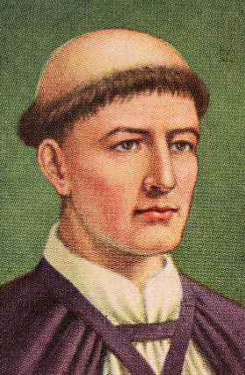
Date of birth:
21 December 1119
St. Thomas Becket
BRIEF story of their life:
St. Thomas Becket worked as the Chancellor for King Henry II, helping to run the country. Later, he became the Archbishop of Canterbury and fought hard to defend the rights and privileges of the Church against the king’s influence.
Date of death:
29 December 1170
Day of remembrance:
29 December
What is he the saint of:
City of London
FUN FACT:
St. Thomas was killed by the knights of King Henry II because he fought to protect the church’s independence from the king.

