Slide 1


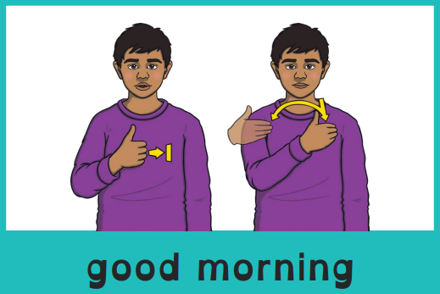
Good morning, everyone.
Celebration of the Word Assembly - 17/11/2025
Hajni

Slide 2

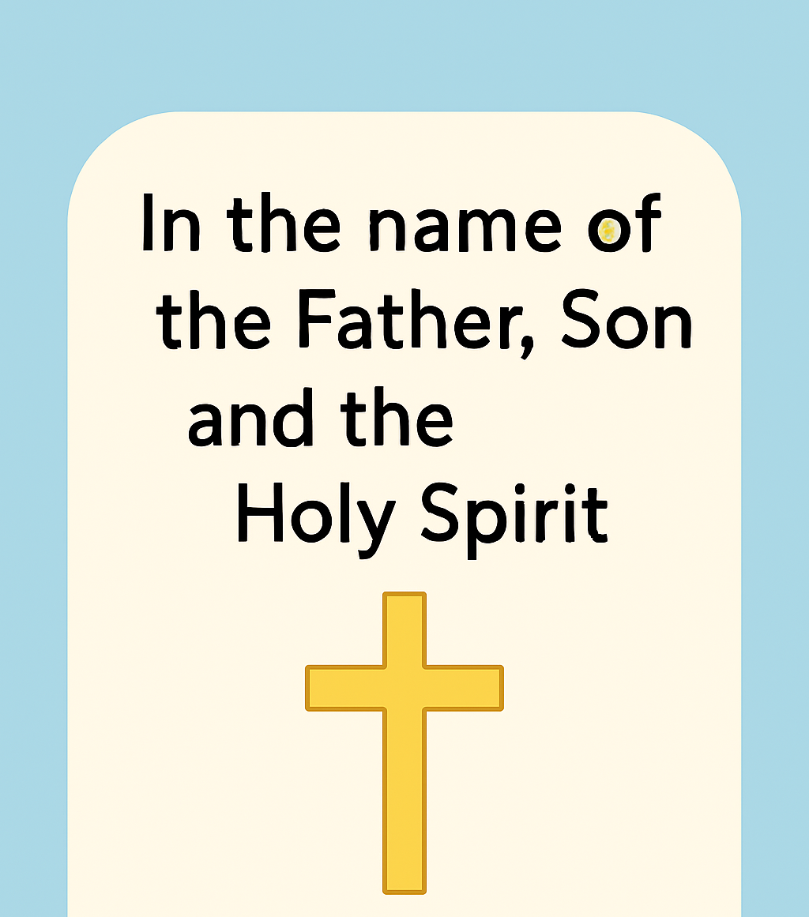
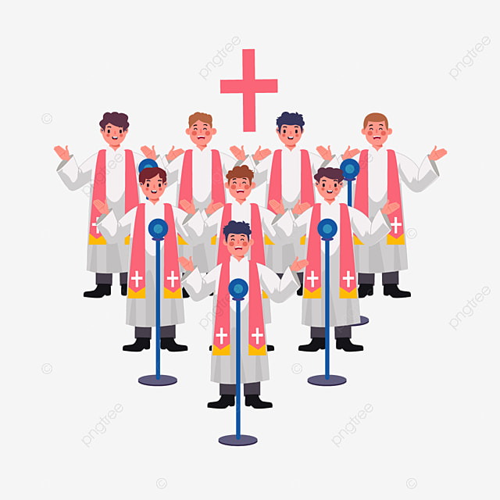
Through Christ We Learn

Slide 3
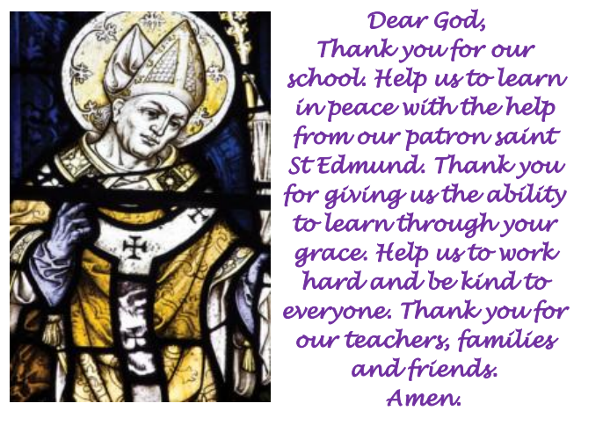
St Edmund’s School Prayer

Slide 4
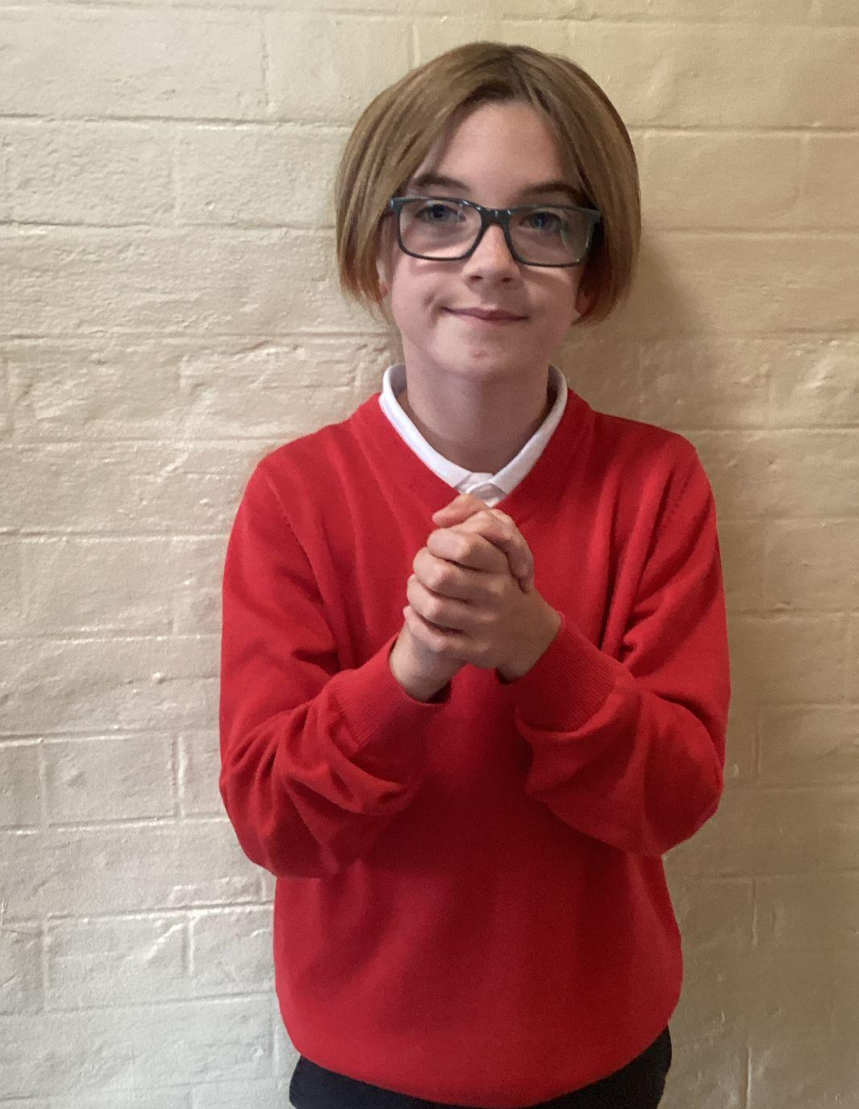
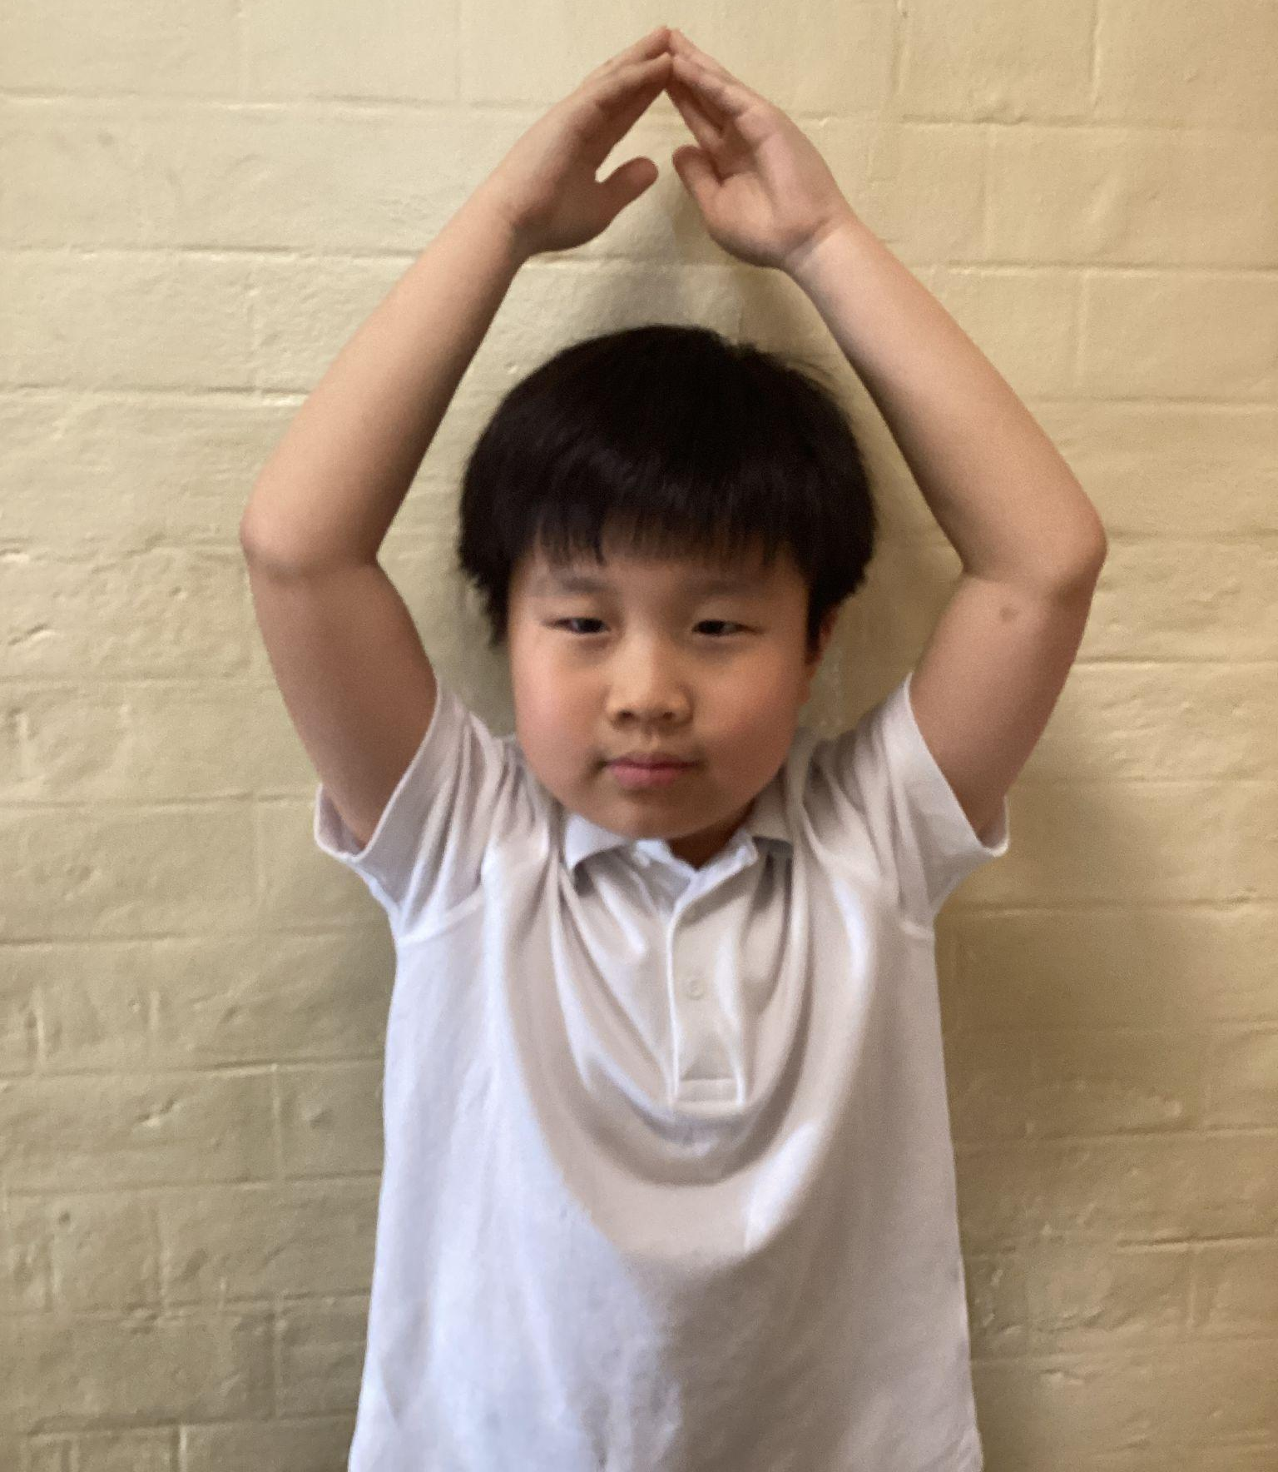
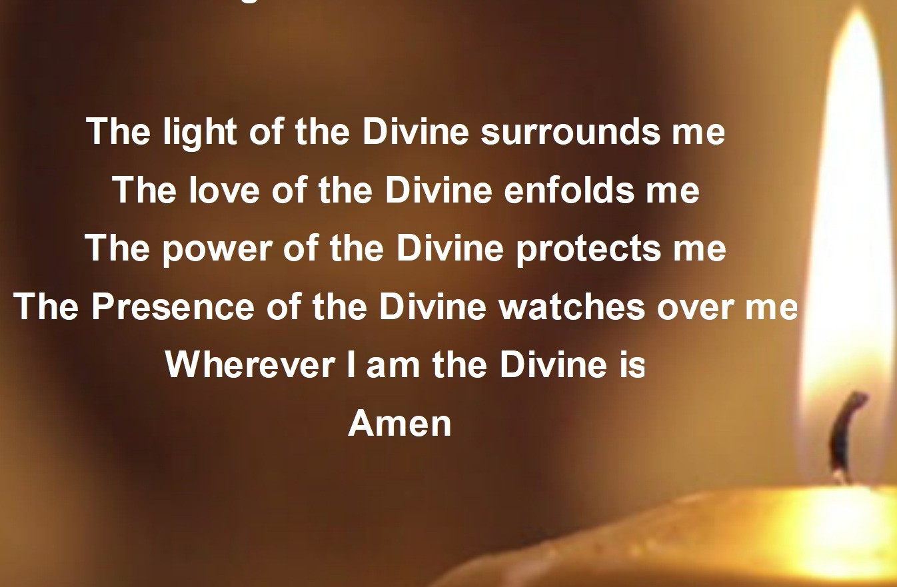
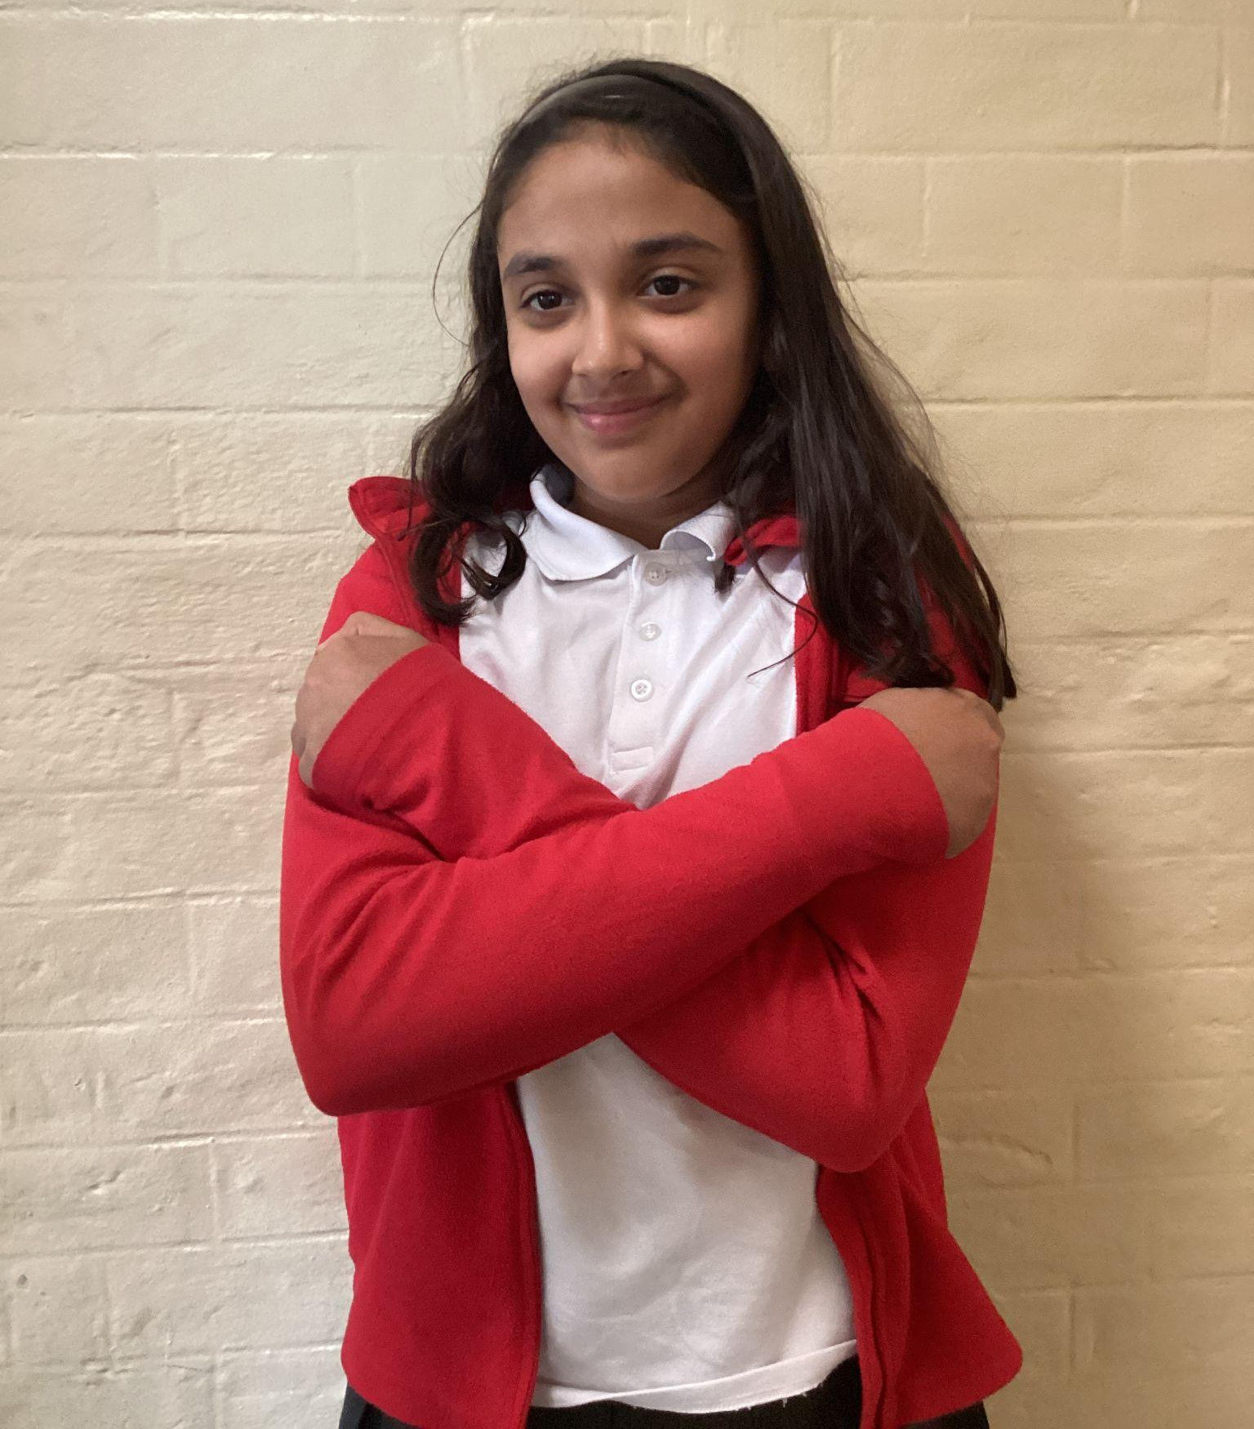
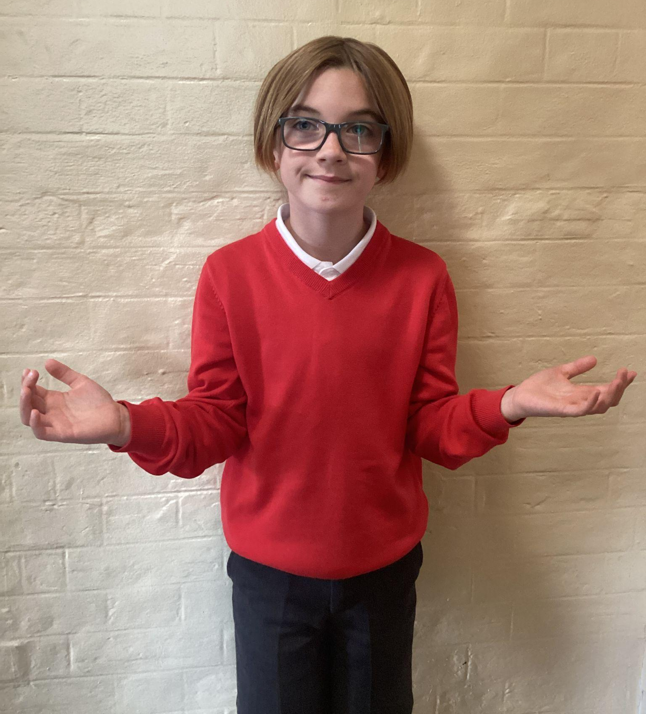
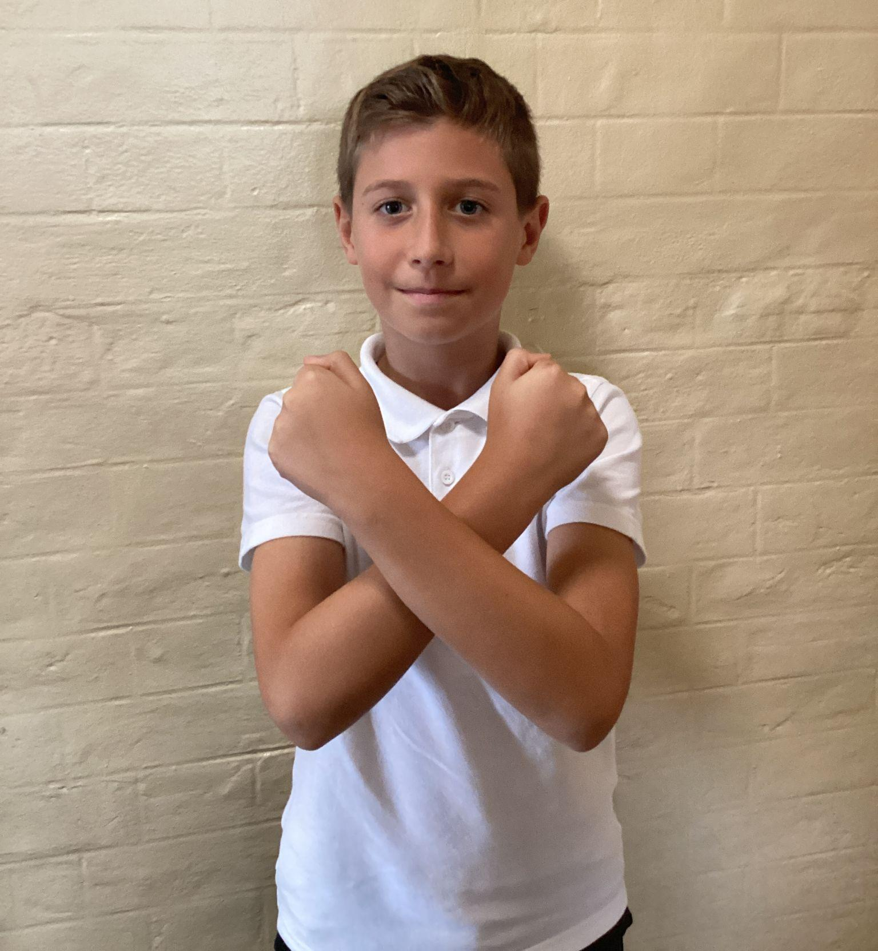
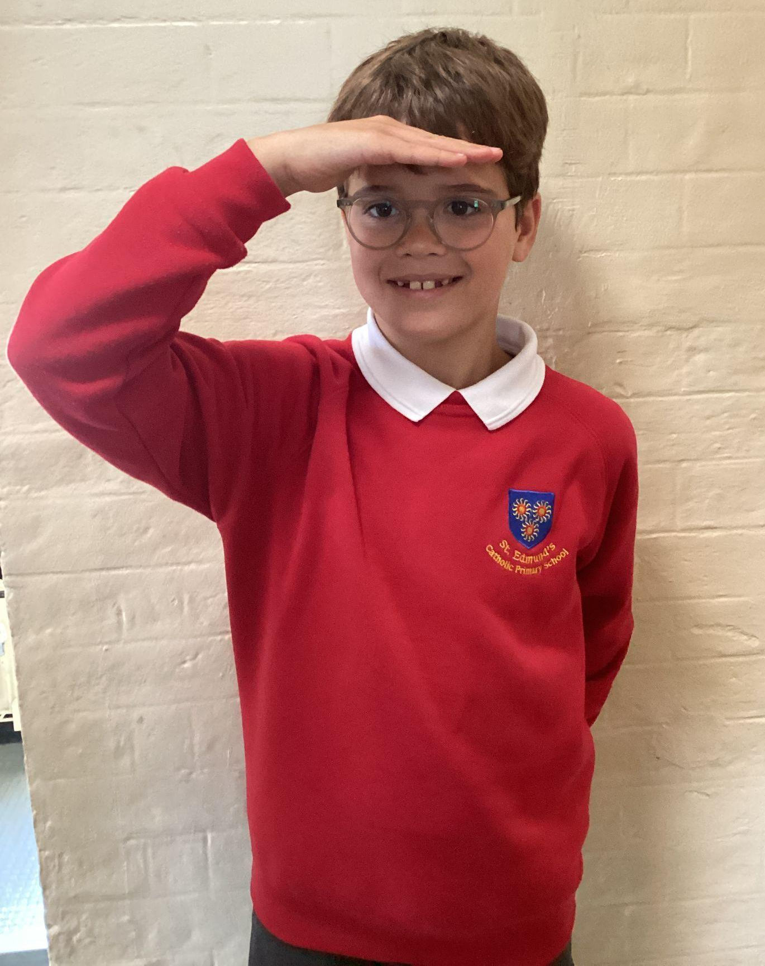
Please repeat after me
1. Light
6. Amen
2. Love
5. Wherever I am.
3. Power
4. Presence

Slide 5
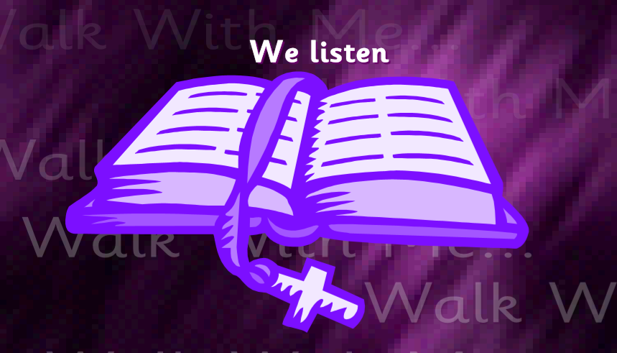
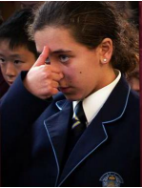
The Lord be with you.
All: And with your spirit.
A reading from the Holy Gospel according to Luke.
All: Glory to You, Oh Lord.

Slide 6
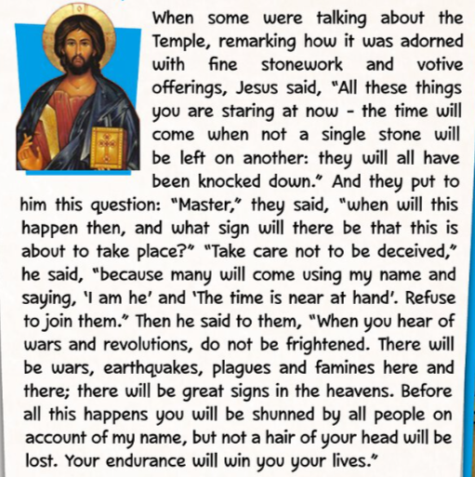
The Gospel of the Lord.
ALL: Praise to you Lord Jesus Christ.
Luke 21:5-19

Slide 7
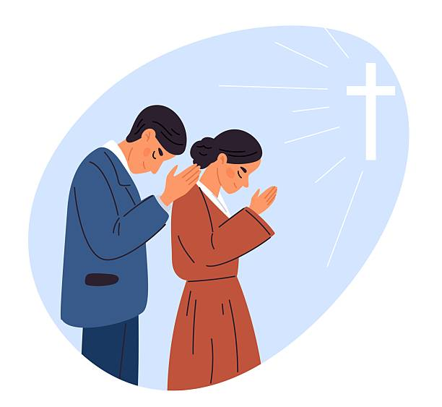
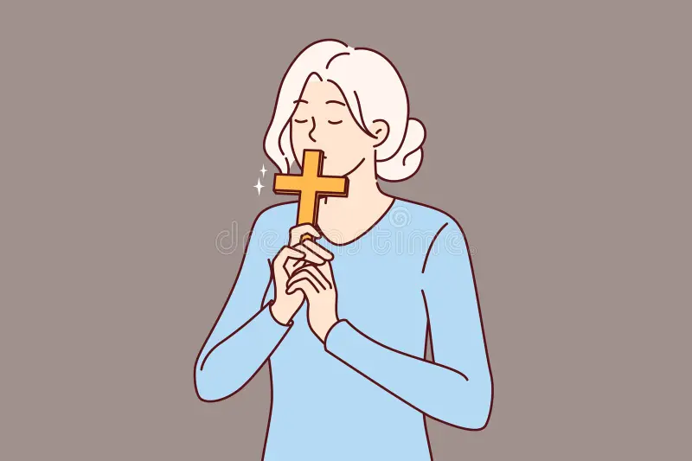

What is this week’s Word?
FAITHFULNESS

Slide 8
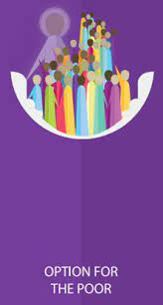

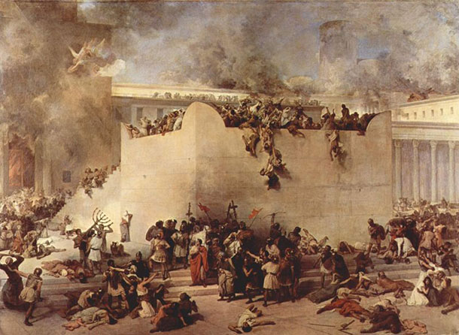
How does the Wednesday word link to
Catholic Social Teaching, RE or Scripture?
FAITHFULNESS

Slide 9
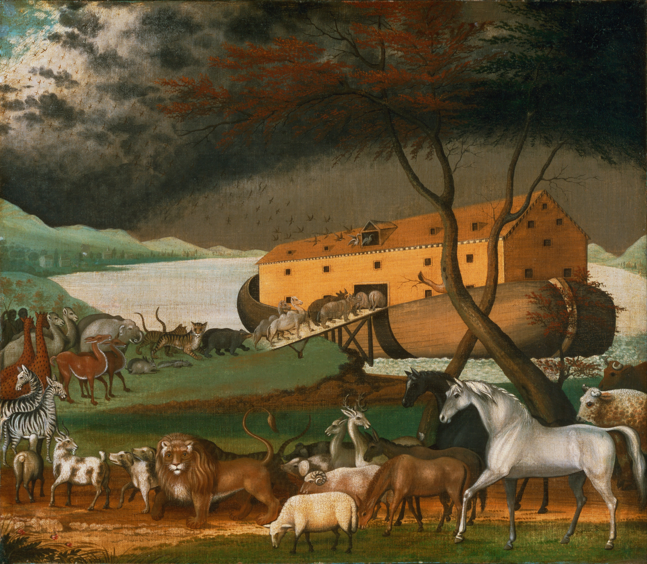
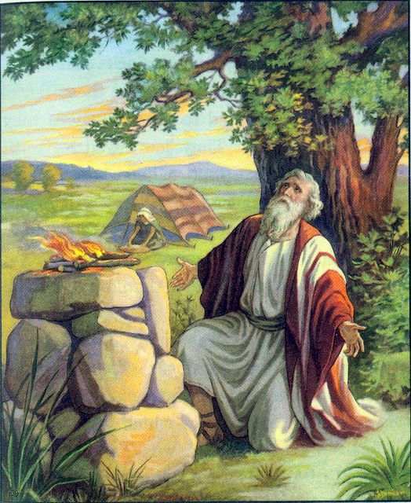
Are there any other scriptures that link to our Wednesday Word, Faithfulness?
Noah’s Ark —
Genesis 6–9
Abraham Trusts God — Genesis 12:1–4

Slide 10
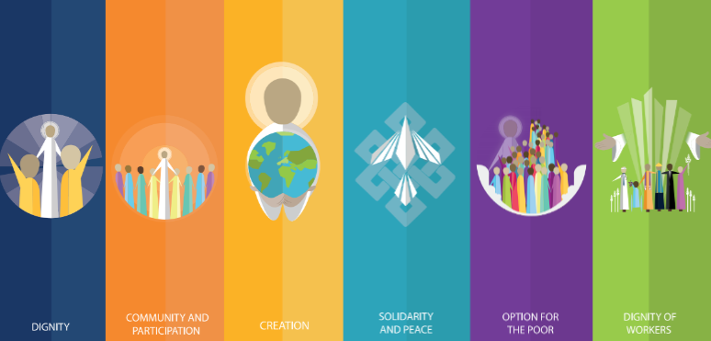
Catholic Social Teaching
Catholic Social Teaching teaches us to live this way by loving, caring for, and respecting all people.
Faithfulness means staying true to God, helping our family and friends, doing what is right even when it’s hard, and being kind to everyone.

Slide 11

Close your eyes and accept Jesus in your hearts
Think about someone you love—your family, friends, or even God. Being faithful means staying true to them, keeping your promises, and helping them when they need you.
Imagine yourself doing something kind or helping someone today. That is how we show God’s love and follow what He wants us to do.

Slide 12

We Respond
Dear Lord Jesus,
Show us how to be faithful this week by praying to who is in need.
Amen.

Slide 13


Slide 14
Act of Dedication
P&J: God is our faithful friend.
All: We promise to be a faithful friend, just like Him.
P&J: The world may change but God will stay the same.
All: God’s love for us will last forever.
Amen.

Slide 15
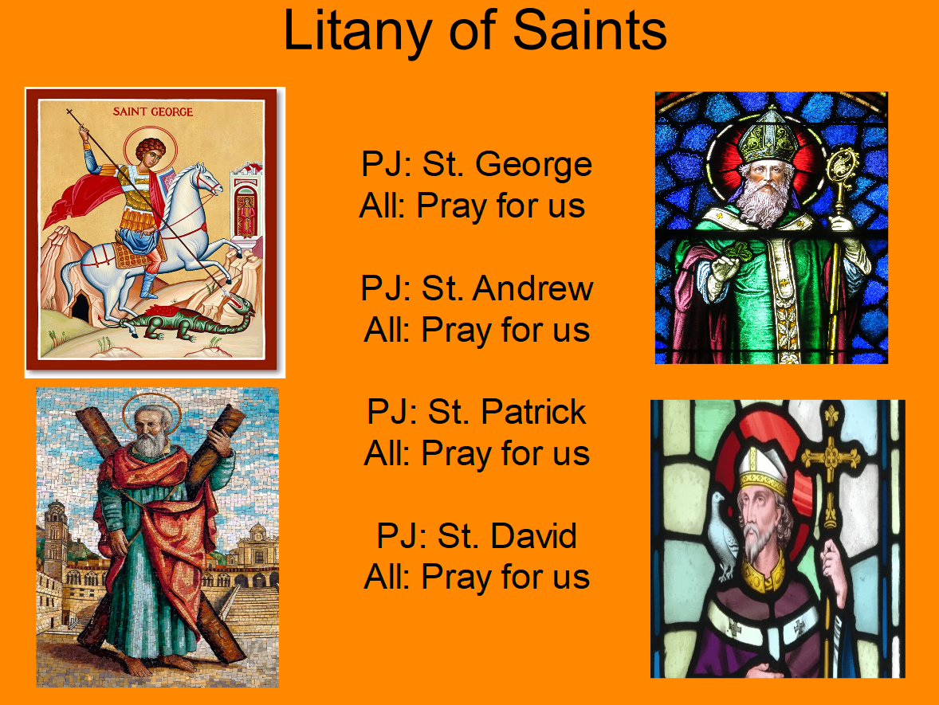
Litany of Saints
PJ: St.
All: Pray for us
PJ: St. All: Pray for us
PJ: St.
All: Pray for us
PJ: St.
All: Pray for us

Slide 16
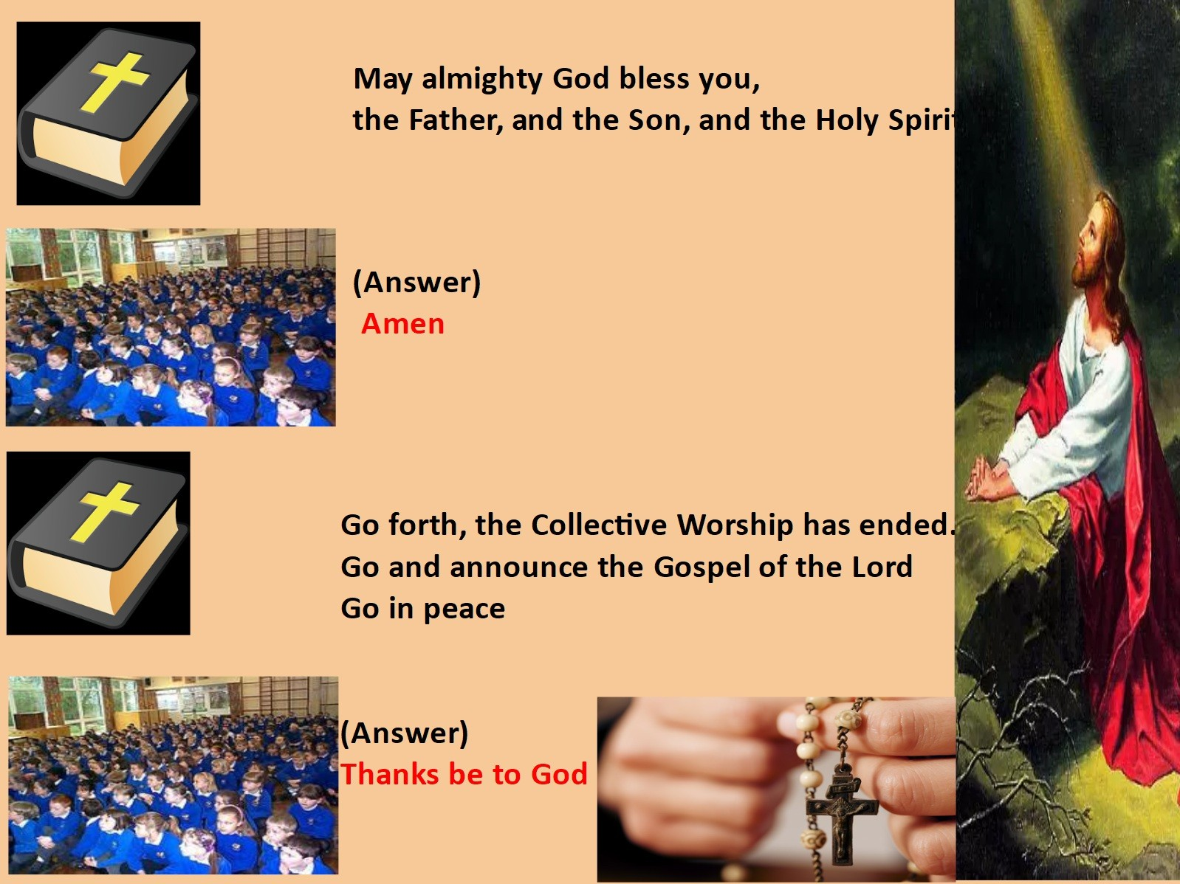
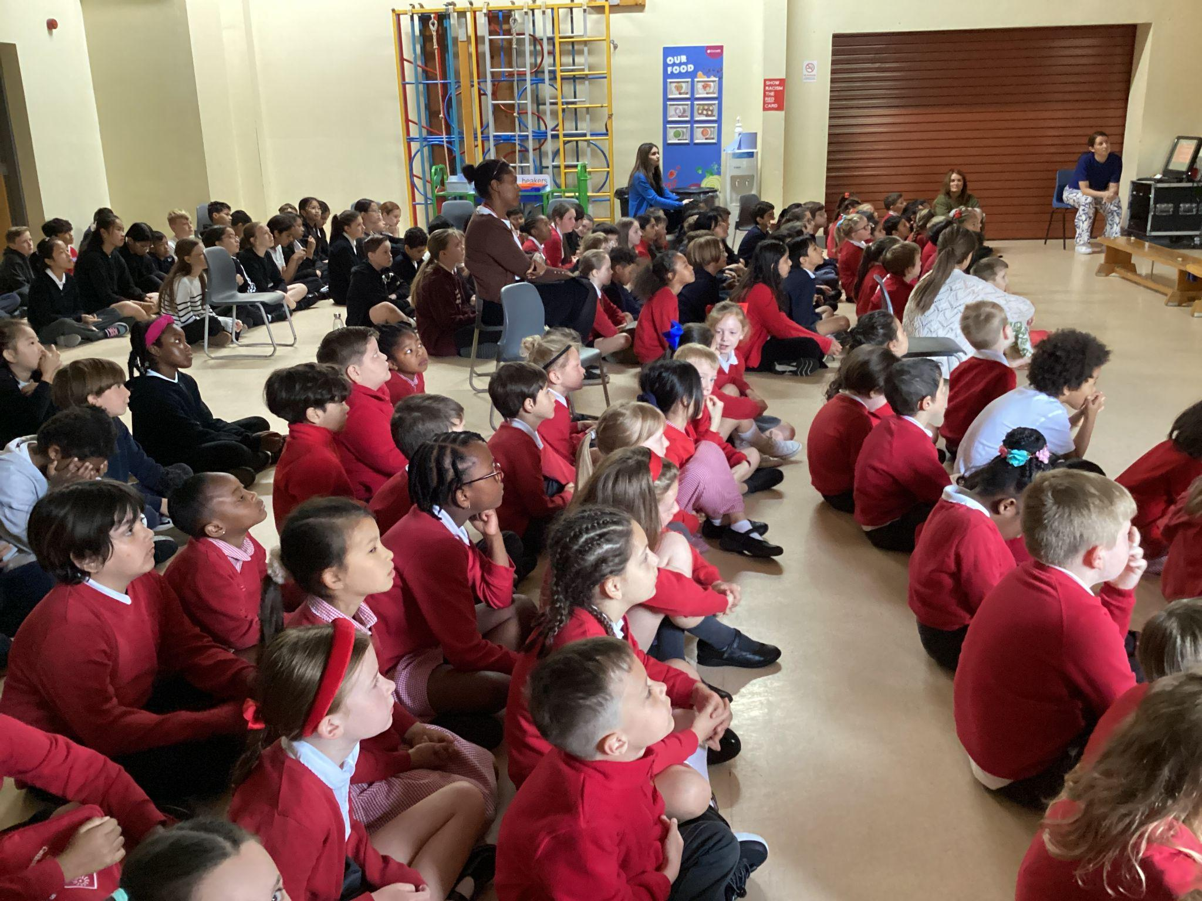
We Go Forth

Slide 17

Thank you for coming to the Celebration of the Word.

Slide 18
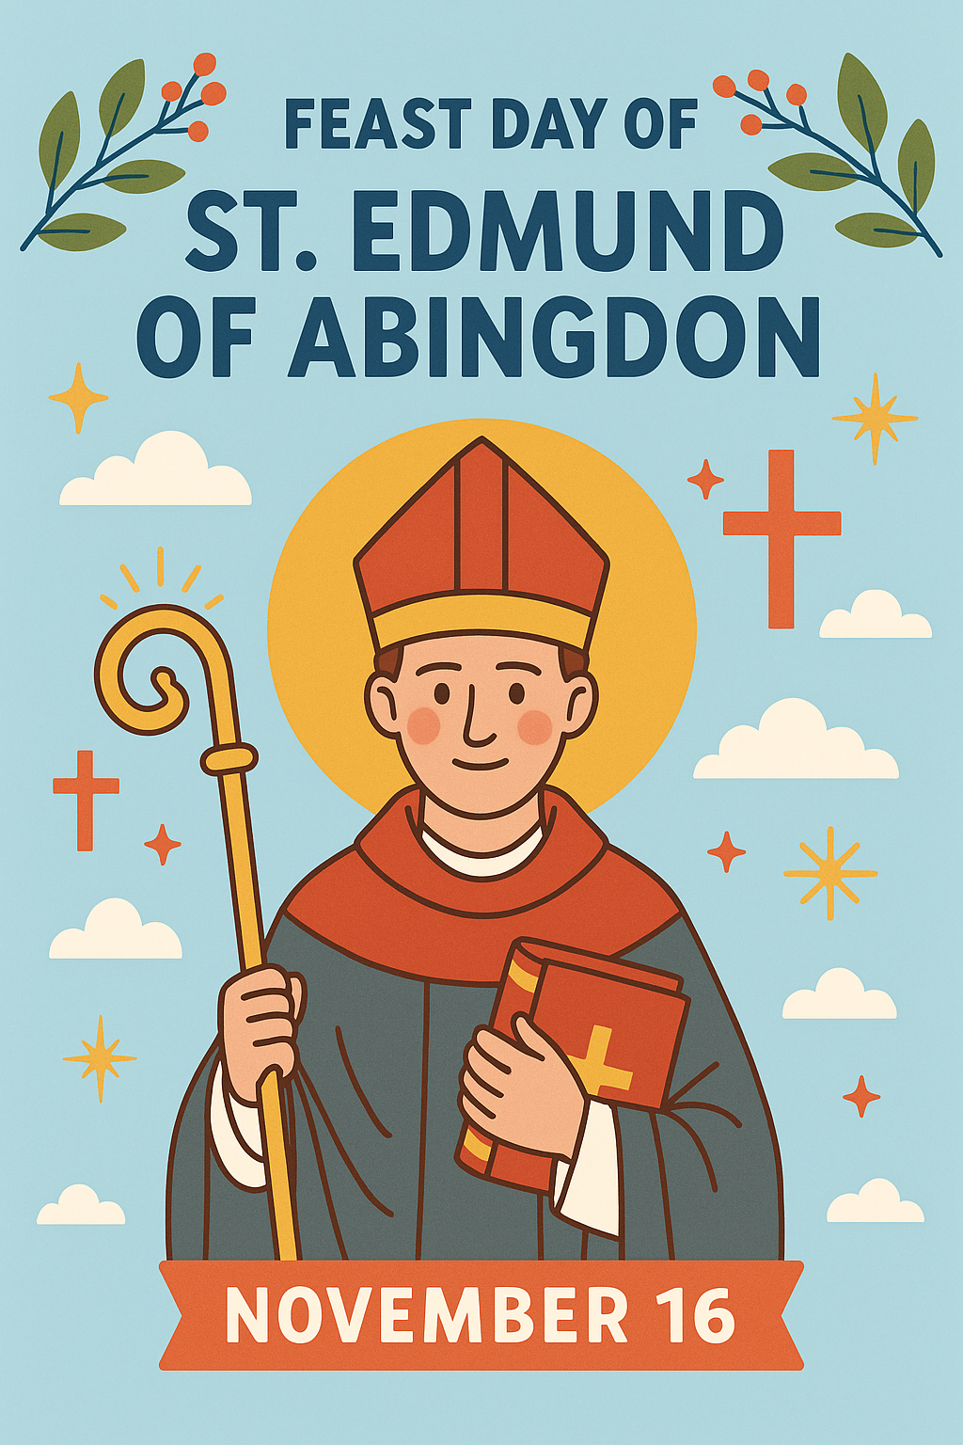
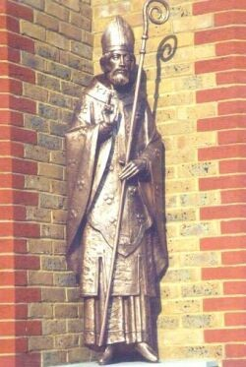
St Edmund Of Abingdon
(1175-1240)

Slide 19


The patron of our school and church
Edmund is known as Edmund of Abingdon because he was born in Abingdon, near Oxford, in 1175.
When he was about sixteen, Edmund’s mum sent him, with his brother Robert, to university in Paris. Mabel was a strong influence in Edmund’s life and taught him to pray.

Slide 20

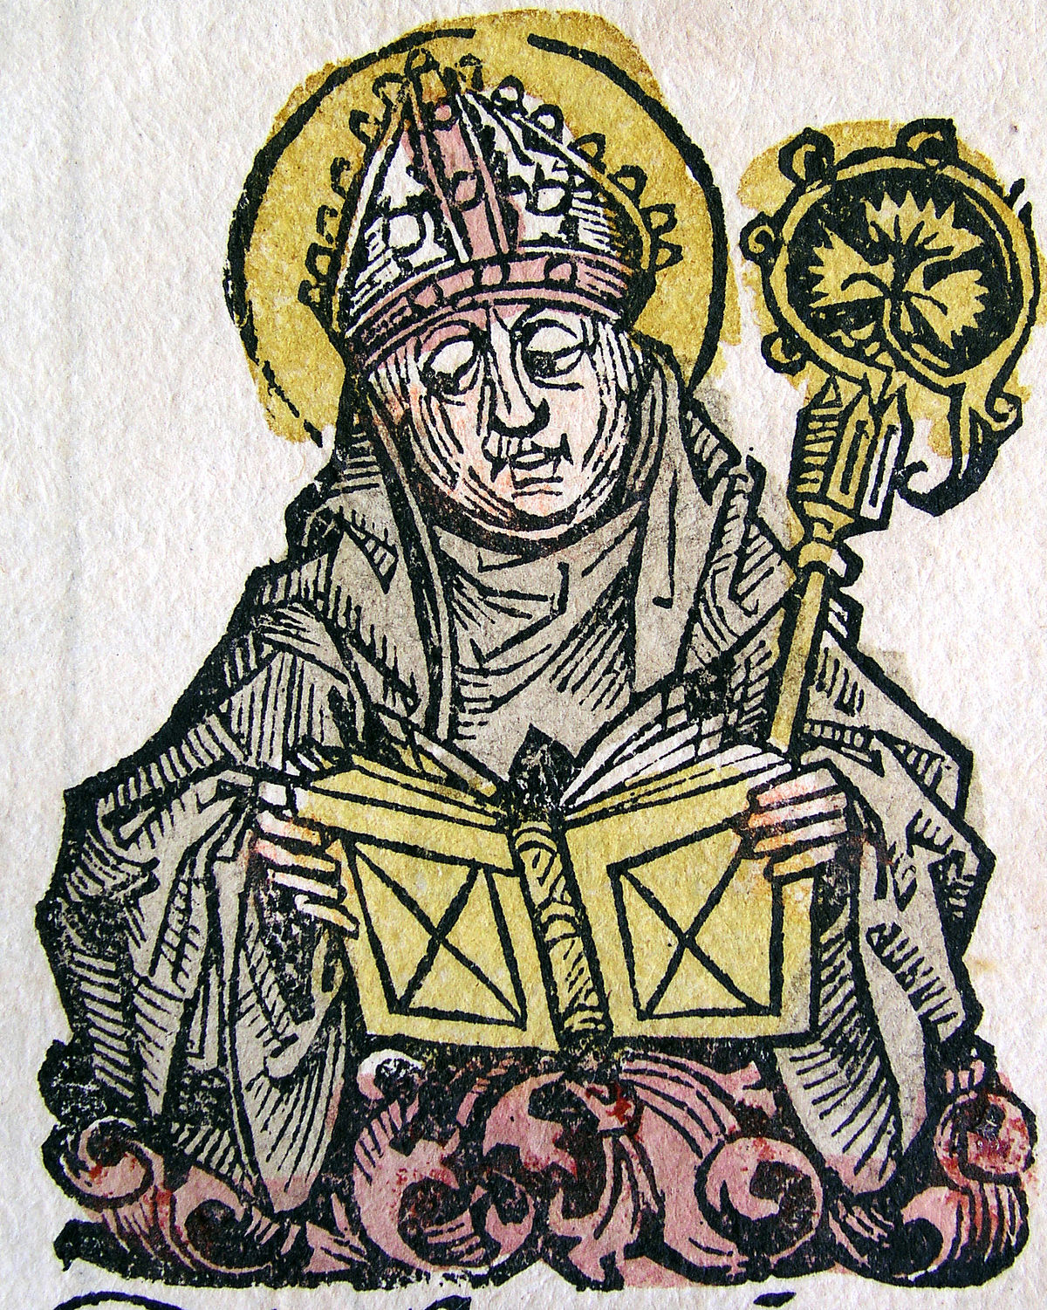

Edmund, the professor
He taught Latin and Maths at Oxford University.
Edmund taught for six years, and then he had a dream about his mother, which he interpreted as a message to turn to more serious studies. So he went back to Paris and studied theology, became a priest and taught Theology at Oxford.

Slide 21
Archbishop of Canterbury
Edmund is known as a peacemaker.
In 1233, England was on the verge of a civil war. Edmund went to confront the King and plead for peace.
The King had listened to Edmund, and a civil war was avoided.
In 1234 Pope Gregory IX made Edmund Archbishop of Canterbury.

Slide 22
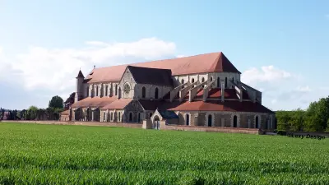
He became a Saint...
While journeying to Rome, Edmund felt sick and died on 16th November 1240, in Pontigny, France. He was buried there at the abbey and many miracles took place at his tomb.
Within six years, the Pope
declared him a saint.

Slide 23

Our school badge is based on St Edmund’s Coat of Arms
Coats of Arms tell us about the person they belong to.
Originally it was used to mark documents and to identify people.
The three suns on the right hand side show us what is most important to him: the Holy Trinity.

Slide 24

St Edmund’s Day School Activity
Write why you would like to be like Saint Edmund on a paper leaf and put it on our tree.

