Slide 1


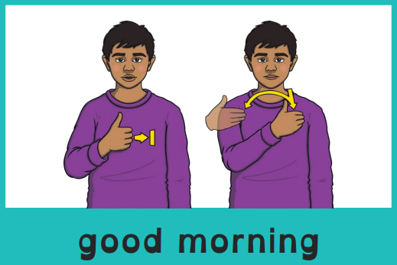
Good morning, everyone.
Celebration of the Word Assembly - 21/10/2025
Hajni

Slide 2

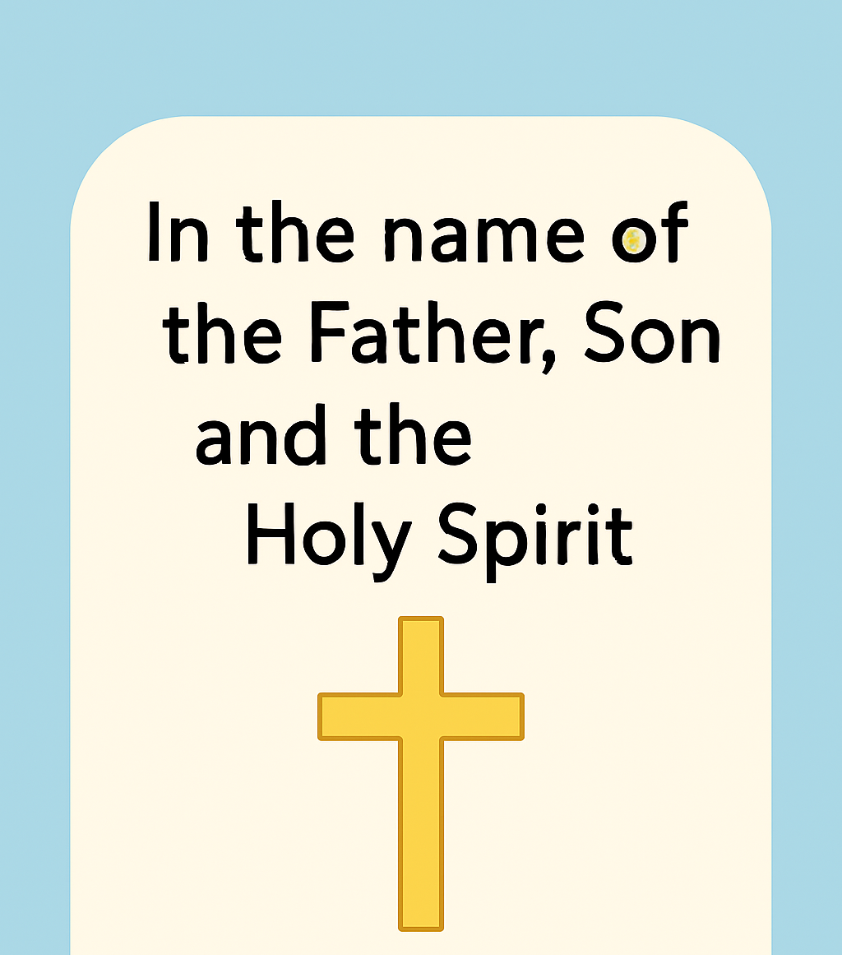
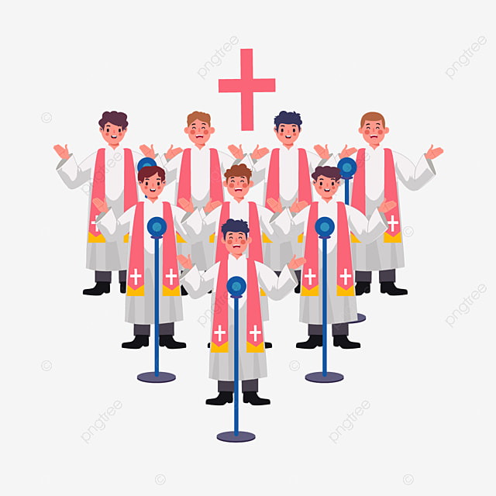
Through Christ We Learn

Slide 3
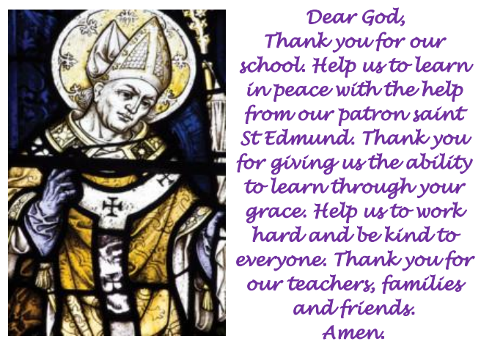
St Edmund’s School Prayer

Slide 4
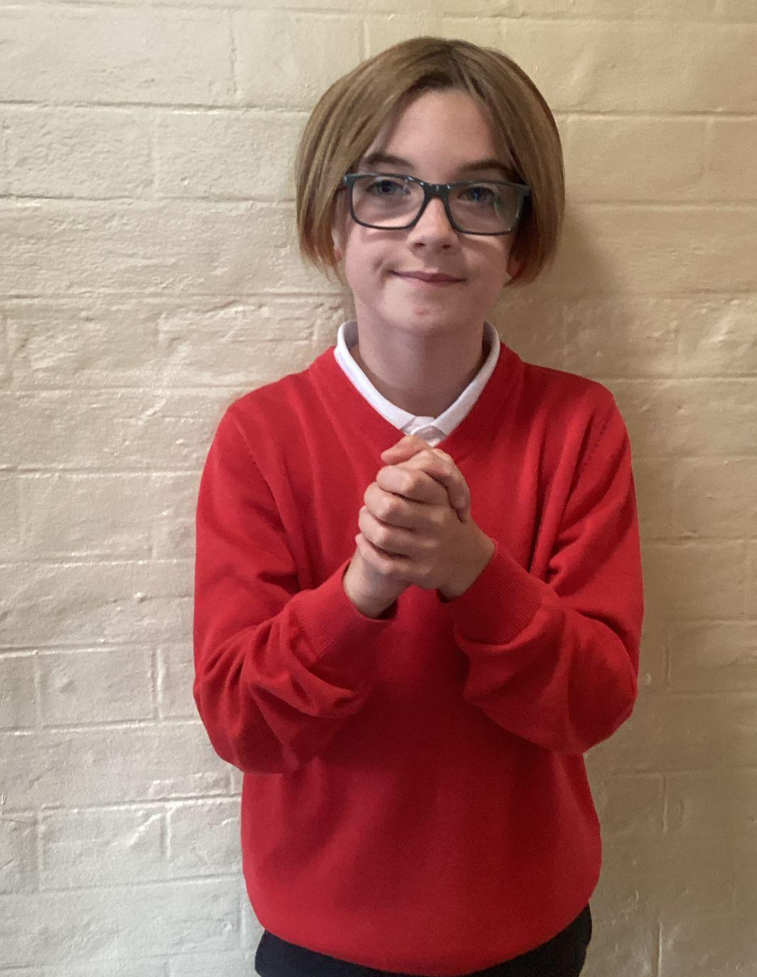
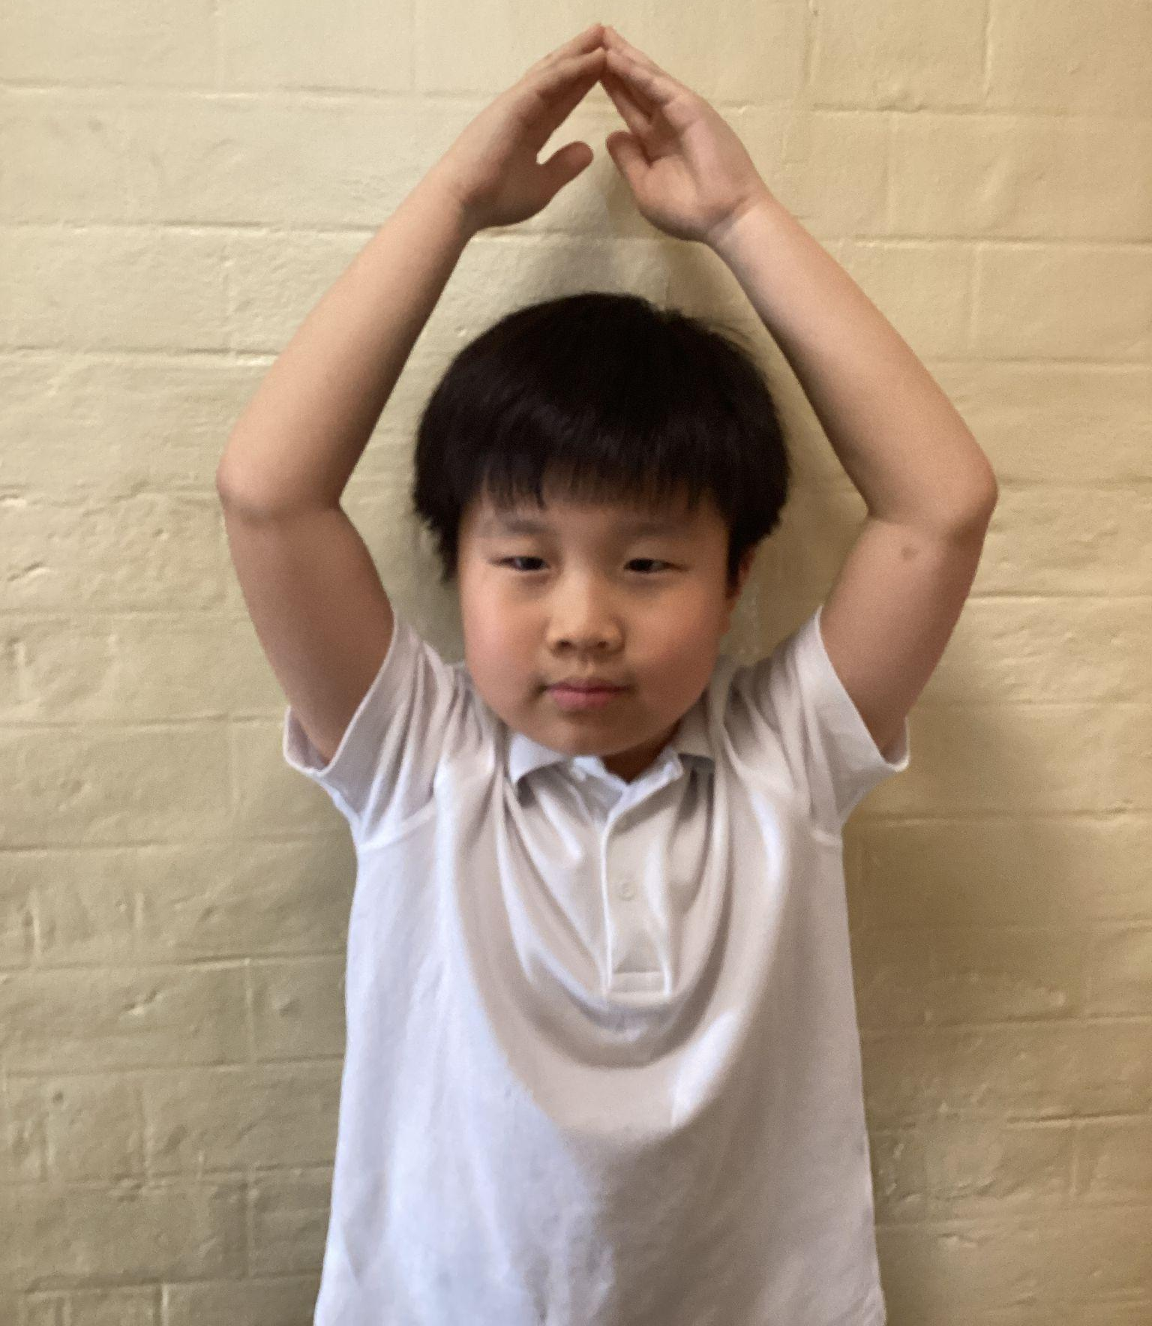
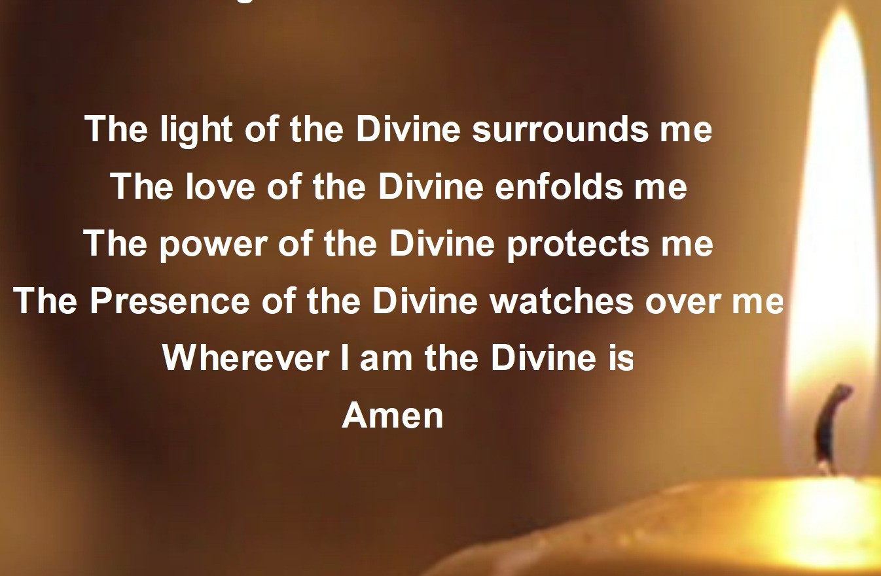
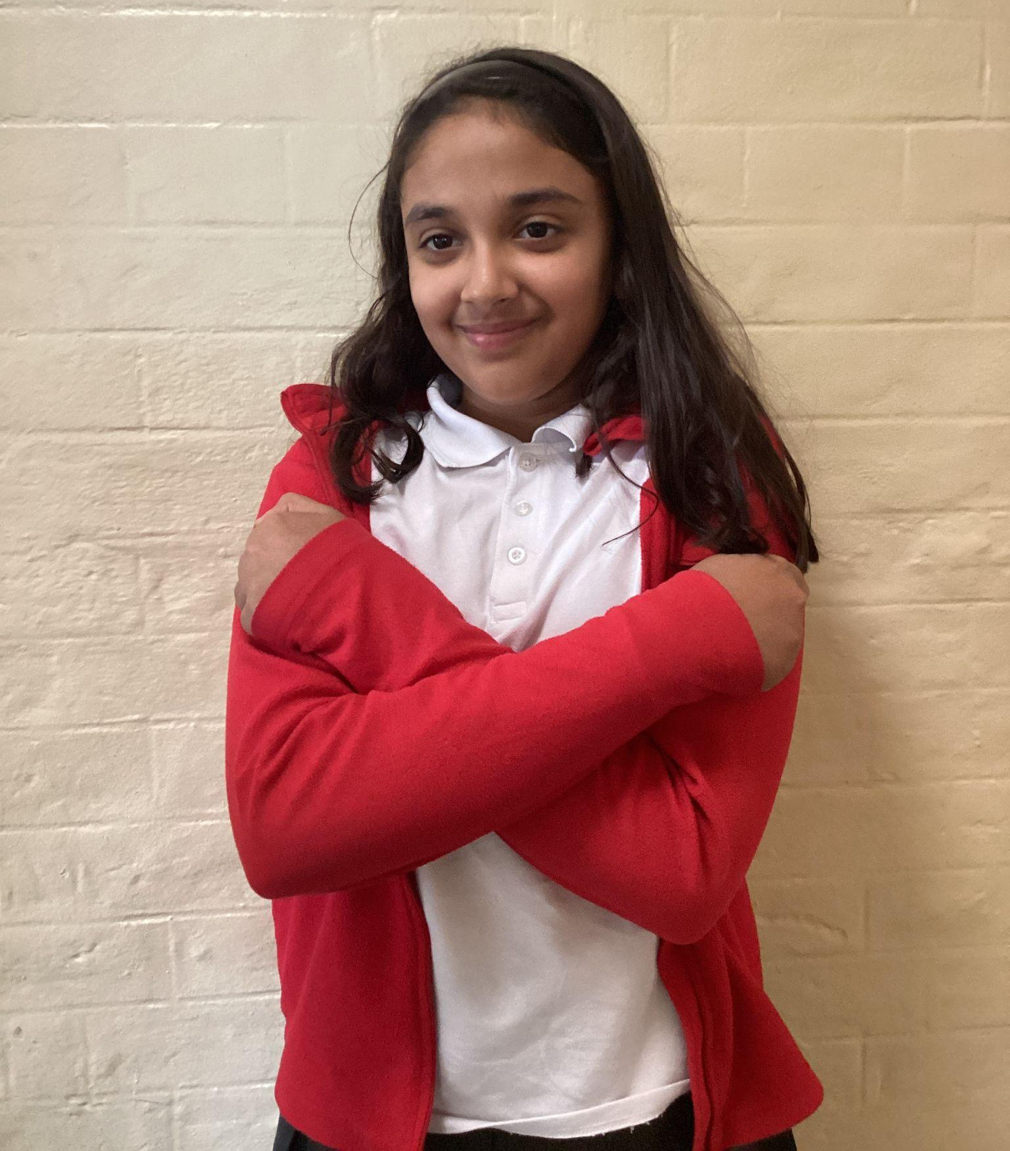
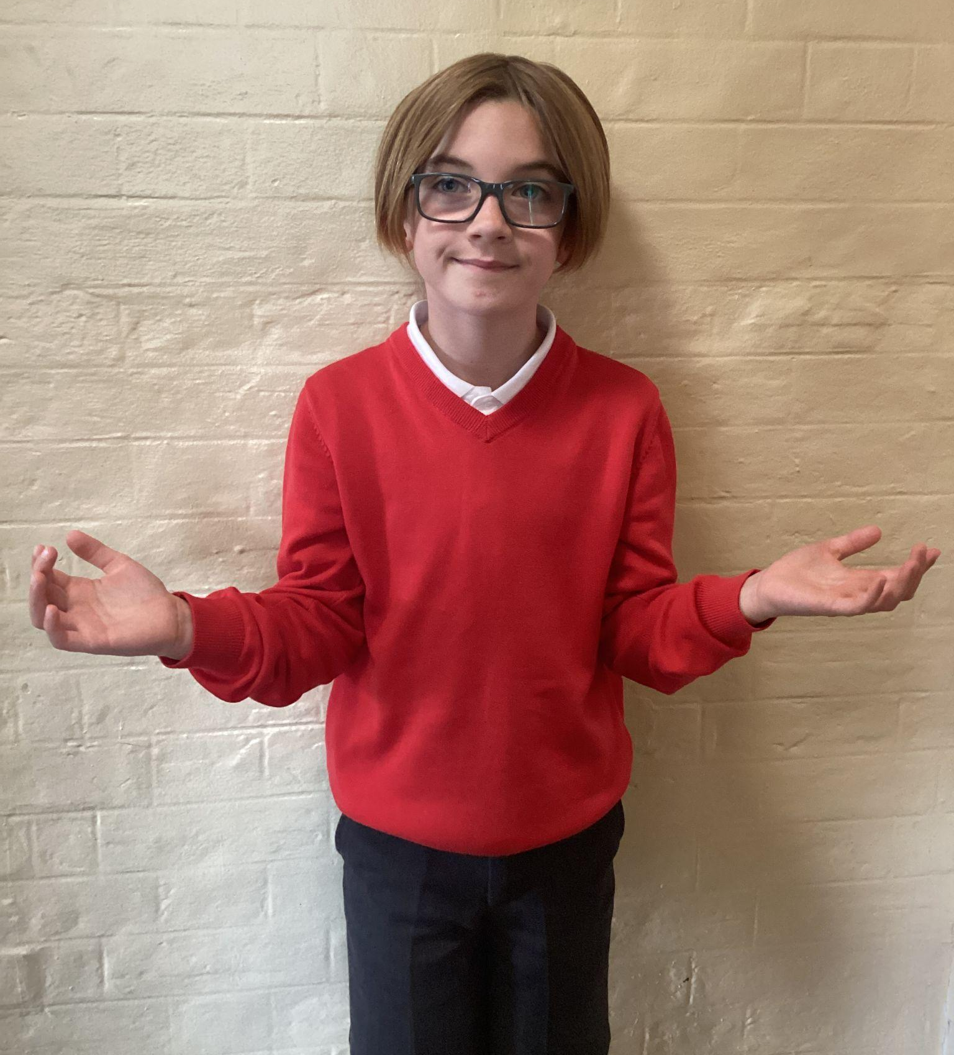
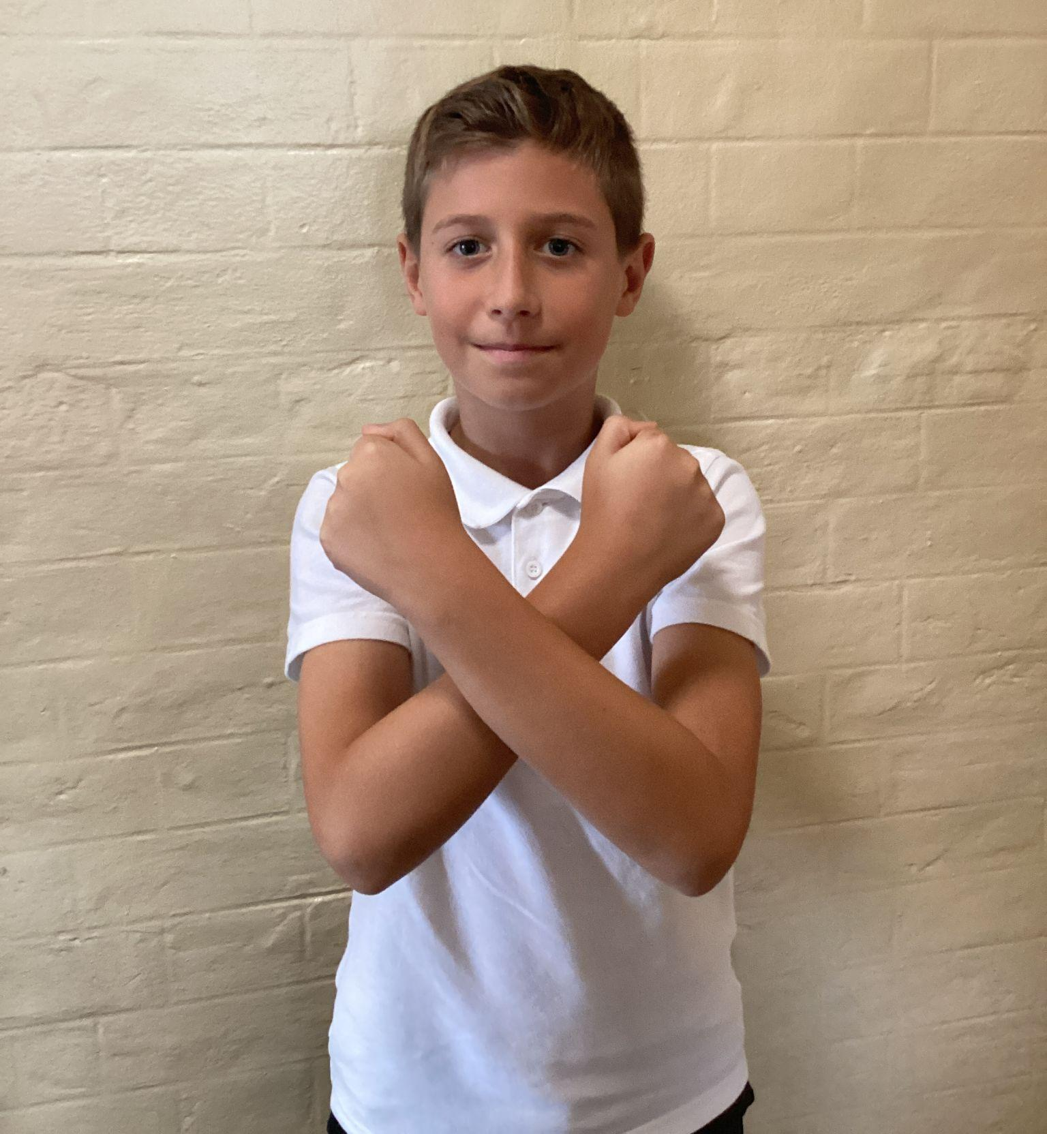
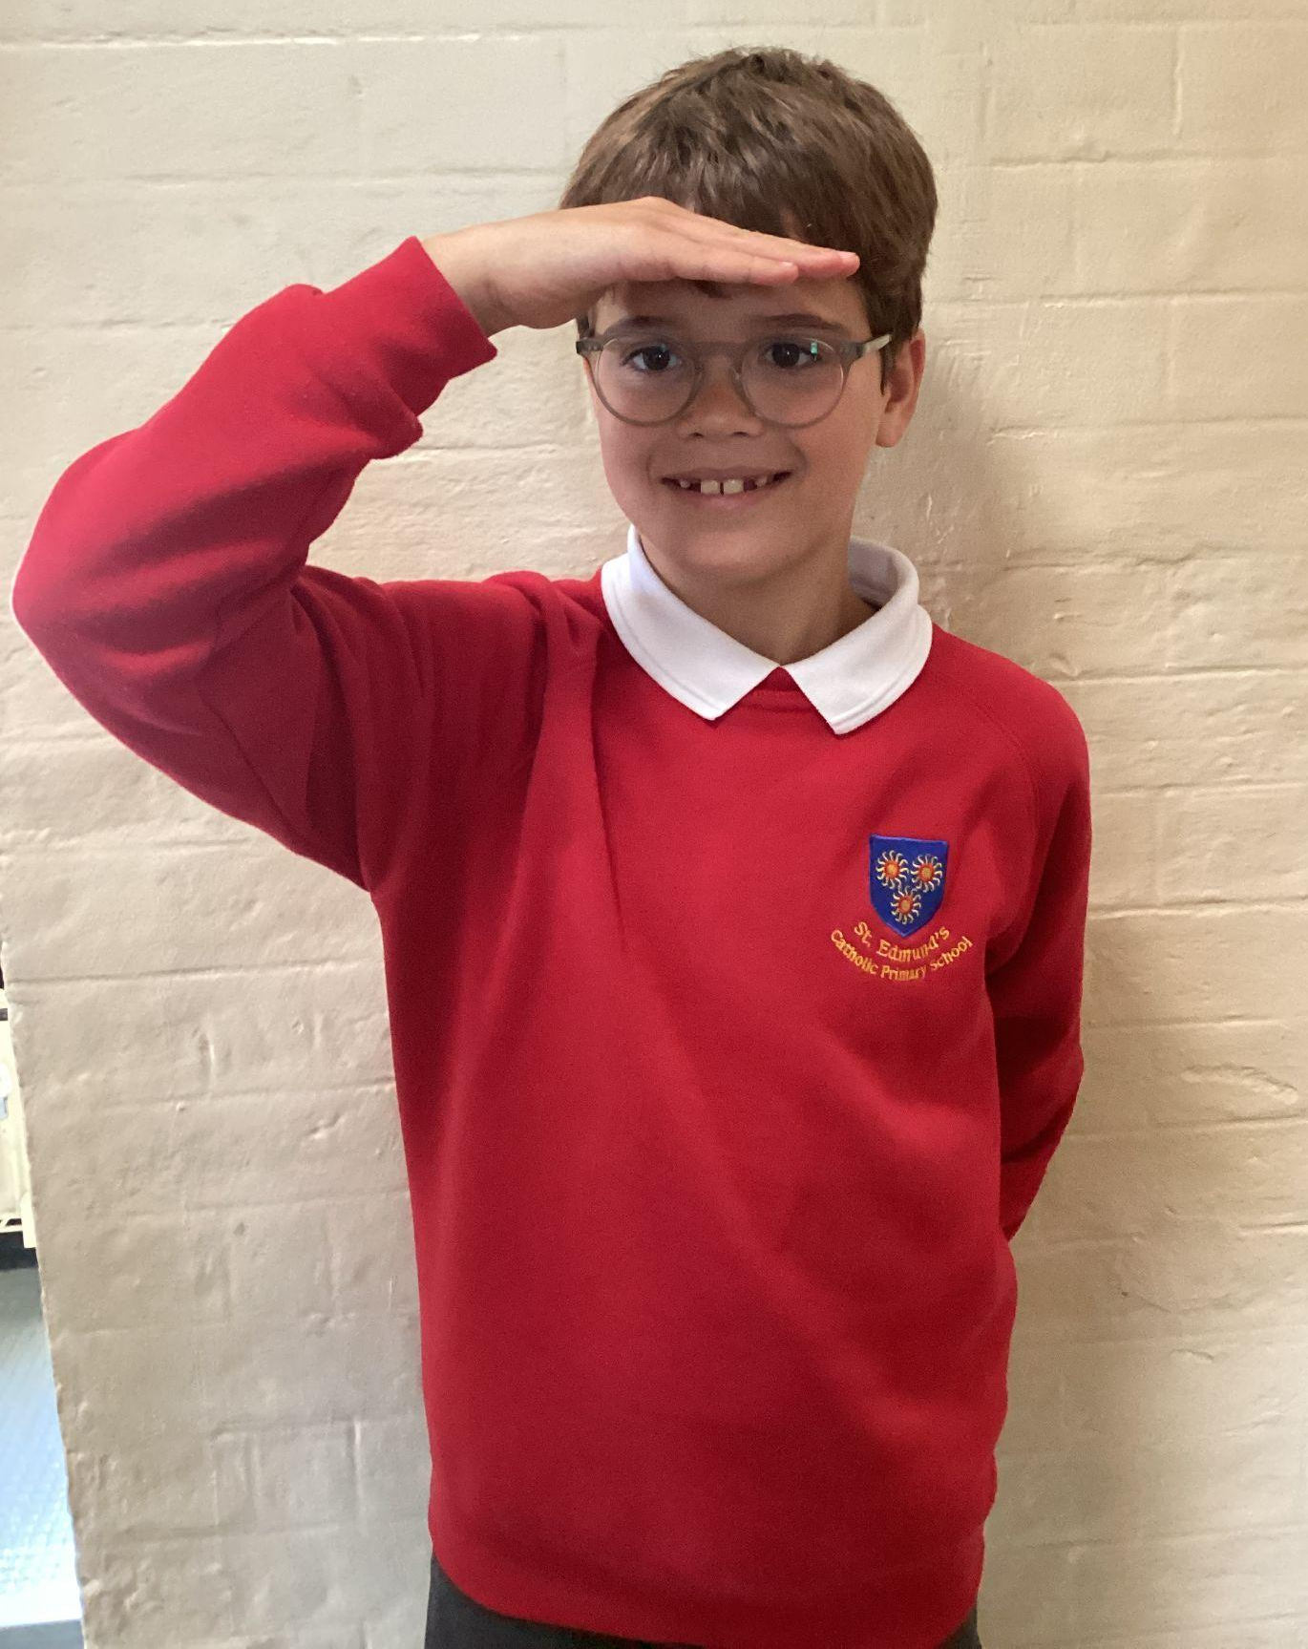
Please repeat after me
1. Light
6. Amen
2. Love
5. Wherever I am.
3. Power
4. Presence

Slide 5
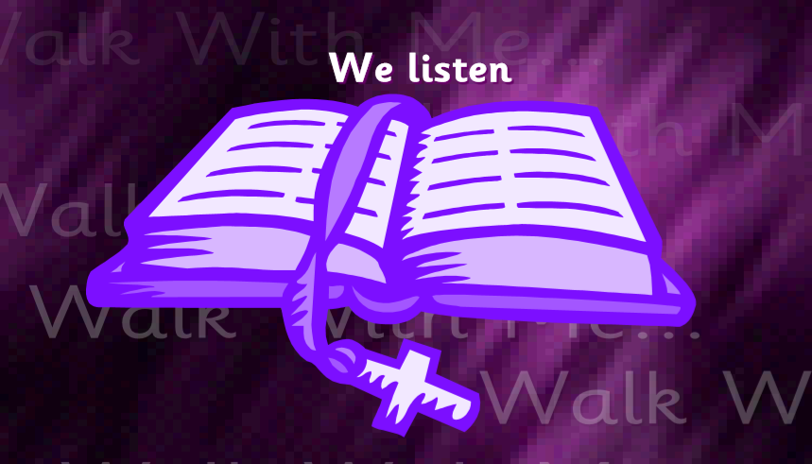
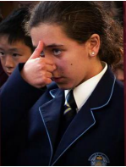
The Lord be with you.
All: And with your spirit.
A reading from the Holy Gospel according to Luke.
All: Glory to You, Oh Lord.

Slide 6
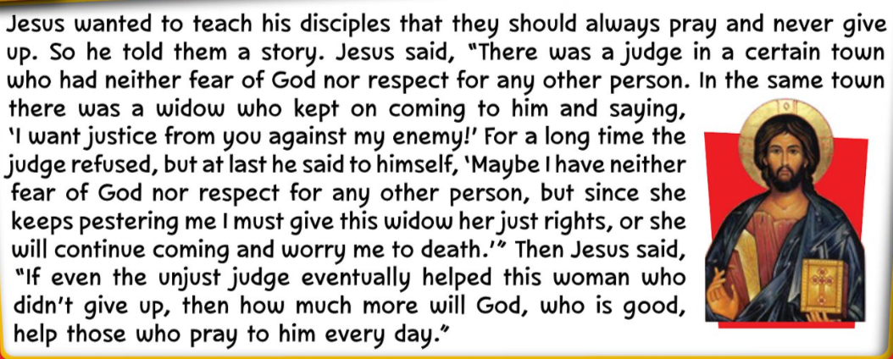
Luke 18:1-8
The Gospel of the Lord.
ALL: Praise to you Lord Jesus Christ.

Slide 7
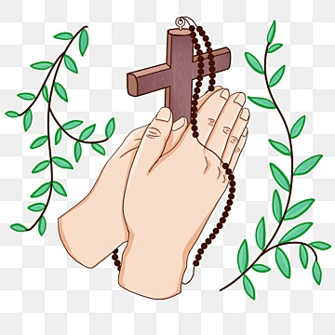
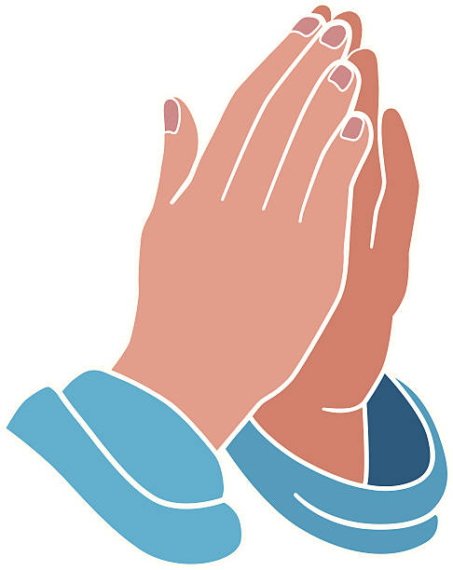
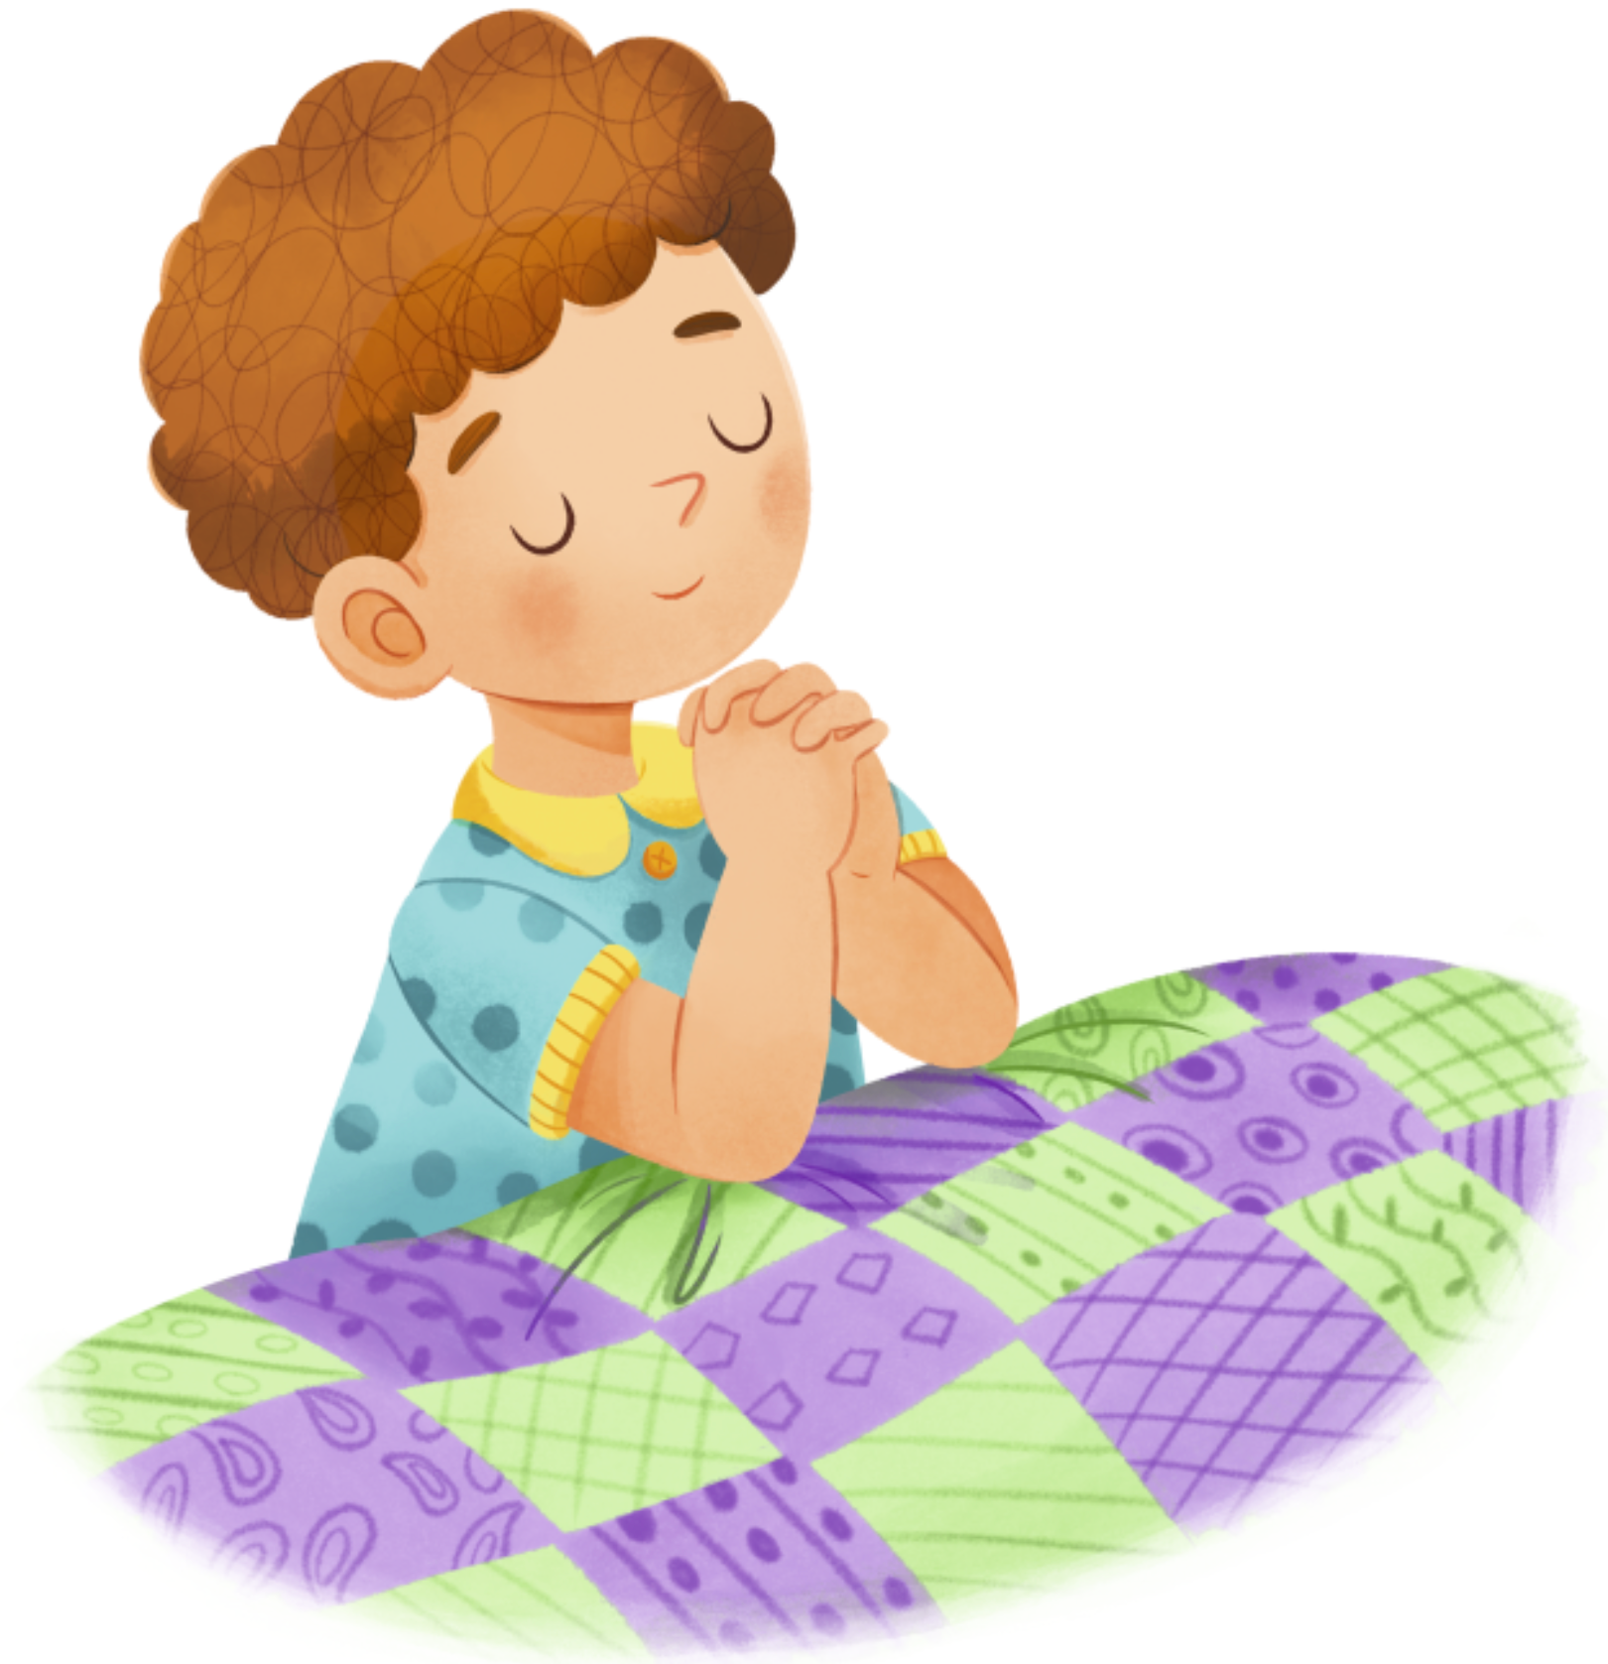
What is this week’s Word?
PRAYER

Slide 8
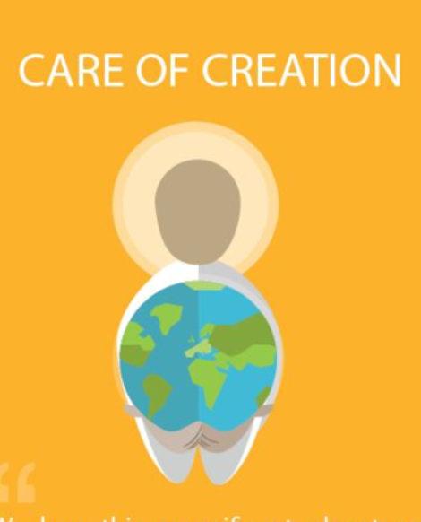

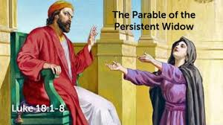
How does the Wednesday word link to
Catholic Social Teaching, RE or Scripture?
PRAYER

Slide 9
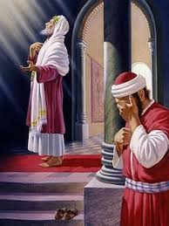
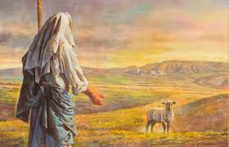
Are there any other scriptures that link to our Wednesday Word, PRAYER?
The Parable of the Lost Sheep
(Luke 15:3–7)
The Pharisee and the Tax Collector
(Luke 18:9–14)

Slide 10

Catholic Social Teaching
When we pray, we talk to God and listen to Him.
It reminds us that everyone is special and made by God.
When we pray, we ask God to help us be kind, fair, and loving —
the same things Catholic Social Teaching asks us to do in our world.

Slide 11
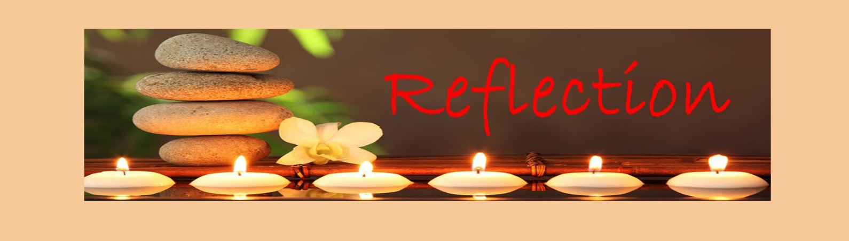
Close your eyes and accept Jesus in your hearts
We remember that God is with us, even when we can’t see Him.
Prayer helps us feel calm and safe.
It’s our time to talk to God, to say thank you, or to ask for help.
When we pray, we open our hearts to love and kindness.

Slide 12

We Respond
Dear Jesus,
Thank you, God, for always listening to me.
Help me to be kind and caring every day.
Amen.

Slide 13
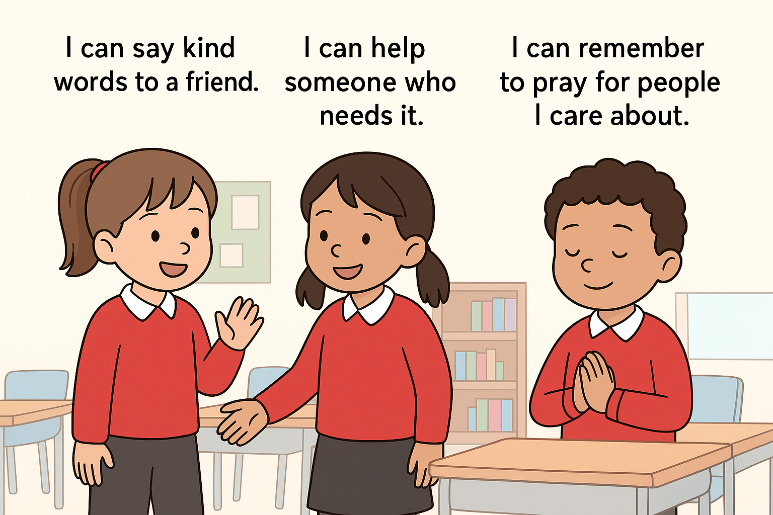
Your Mission for this week

Slide 14
Act of Dedication
P&J: Today, we offer ourselves to God.
We promise to try our best to be kind, caring, and loving, just like Jesus.
All: Lord, help me to be kind, caring, and loving every day.
Amen.

Slide 15
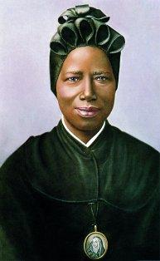
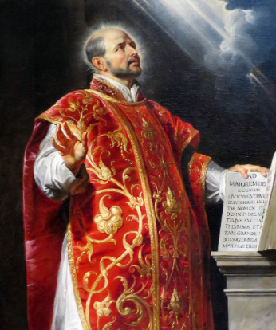
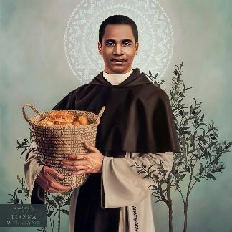
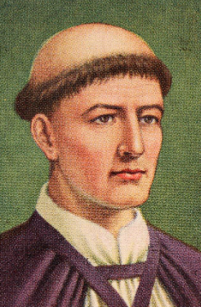
Litany of Saints
PJ: St. Josephine Bakhita
All: Pray for us
PJ: St. Martin de Porres
All: Pray for us
PJ: St.Ignacio de Loyola
All: Pray for us
PJ: St. Thomas Becket
All: Pray for us

Slide 16
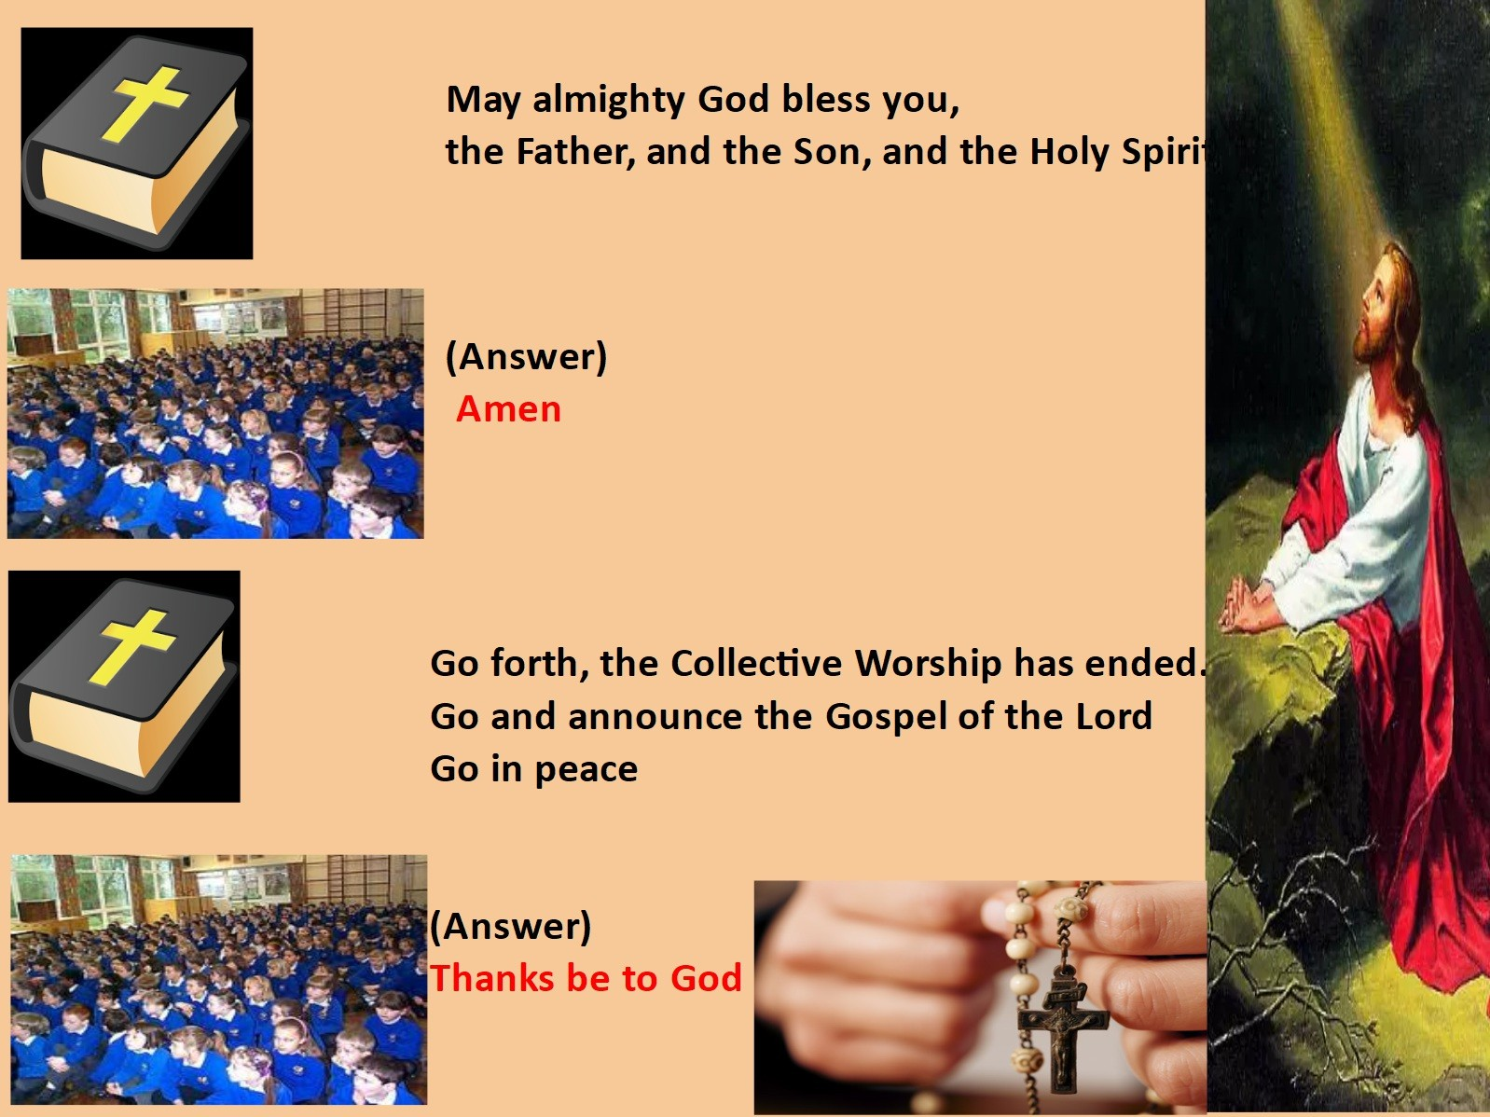
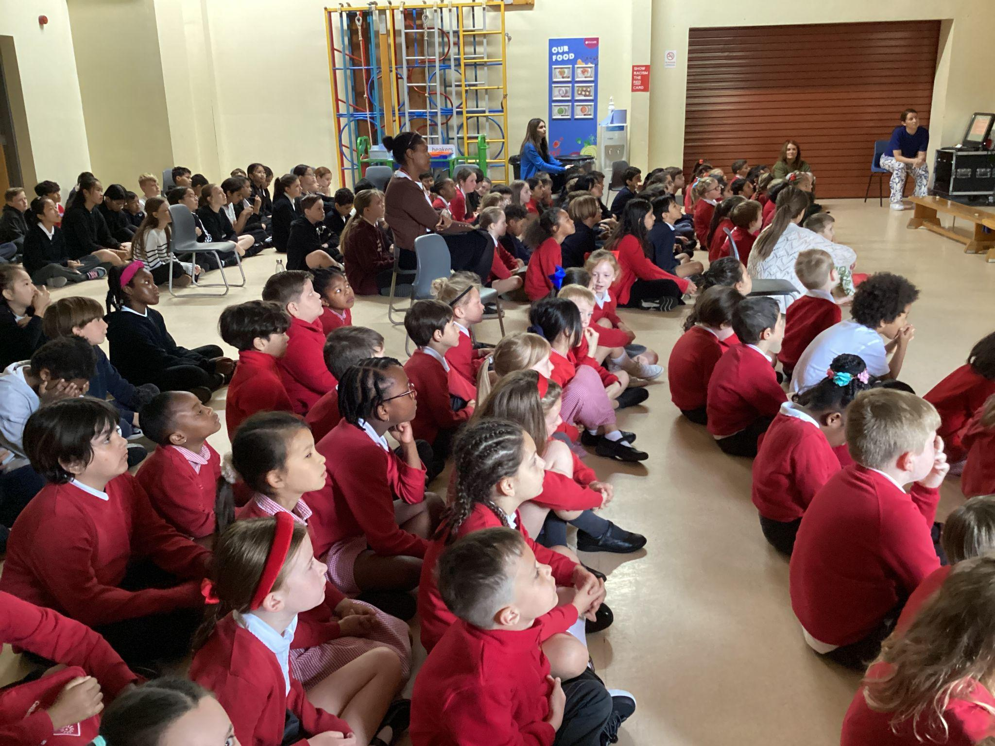
We Go Forth

Slide 17

Thank you for coming to the Celebration of the Word.

