Slide 1

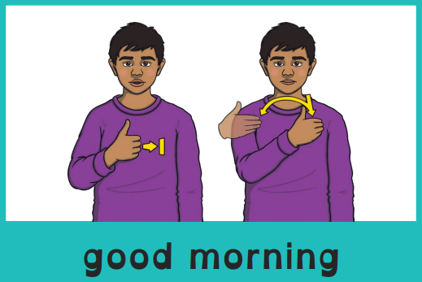

Good morning, everyone.
Celebration of the Word Assembly - 14/10/2025
Hajni

Slide 2



St Edmund’s Catholic Primary School
…Through Christ we learn…
Executive Headteacher: Mrs A. Ruthven
Head of School: Mr A. Antoniou
Our Mission
Through Christ We Learn

Slide 3

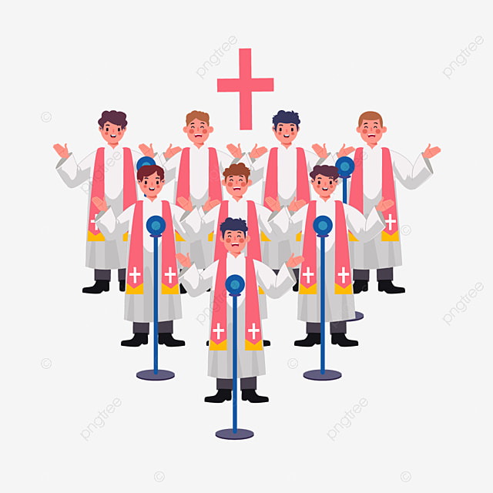

Slide 4
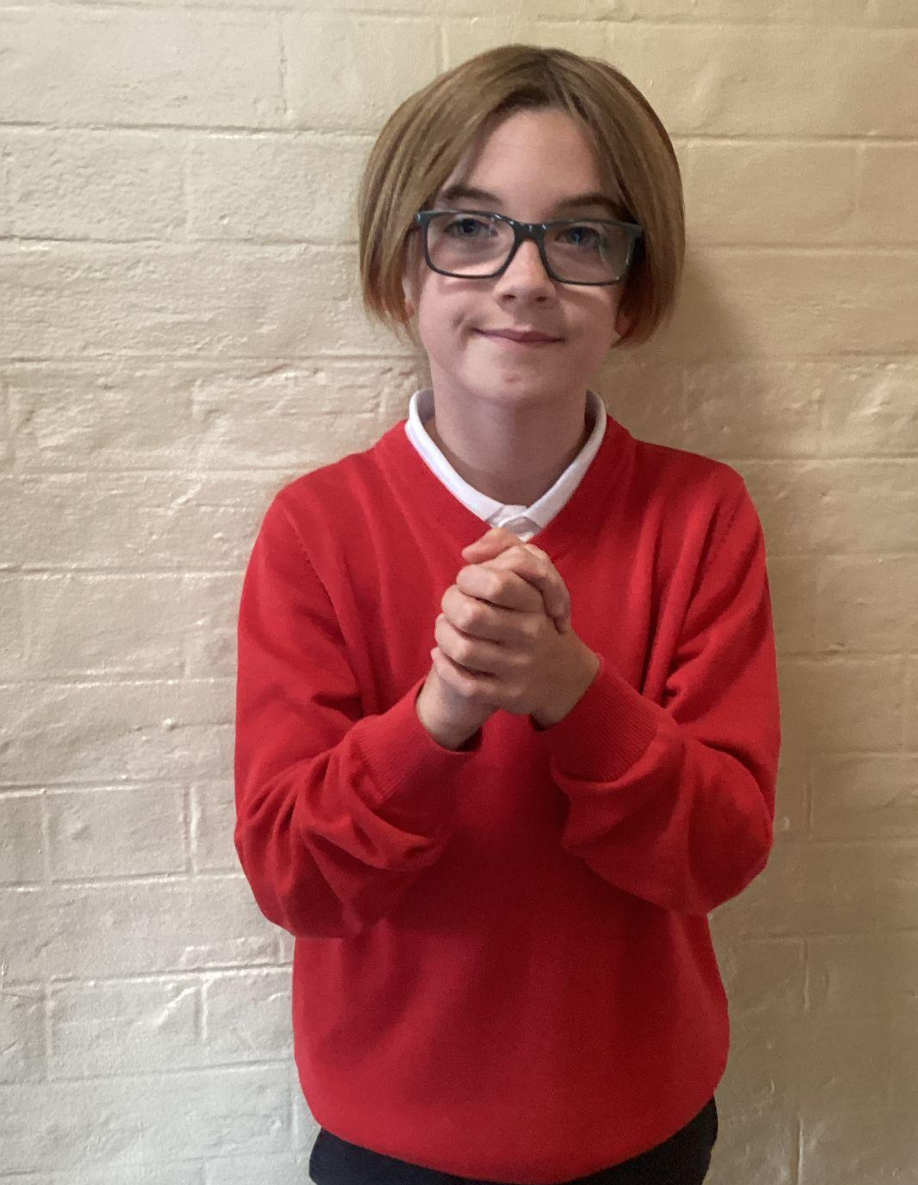
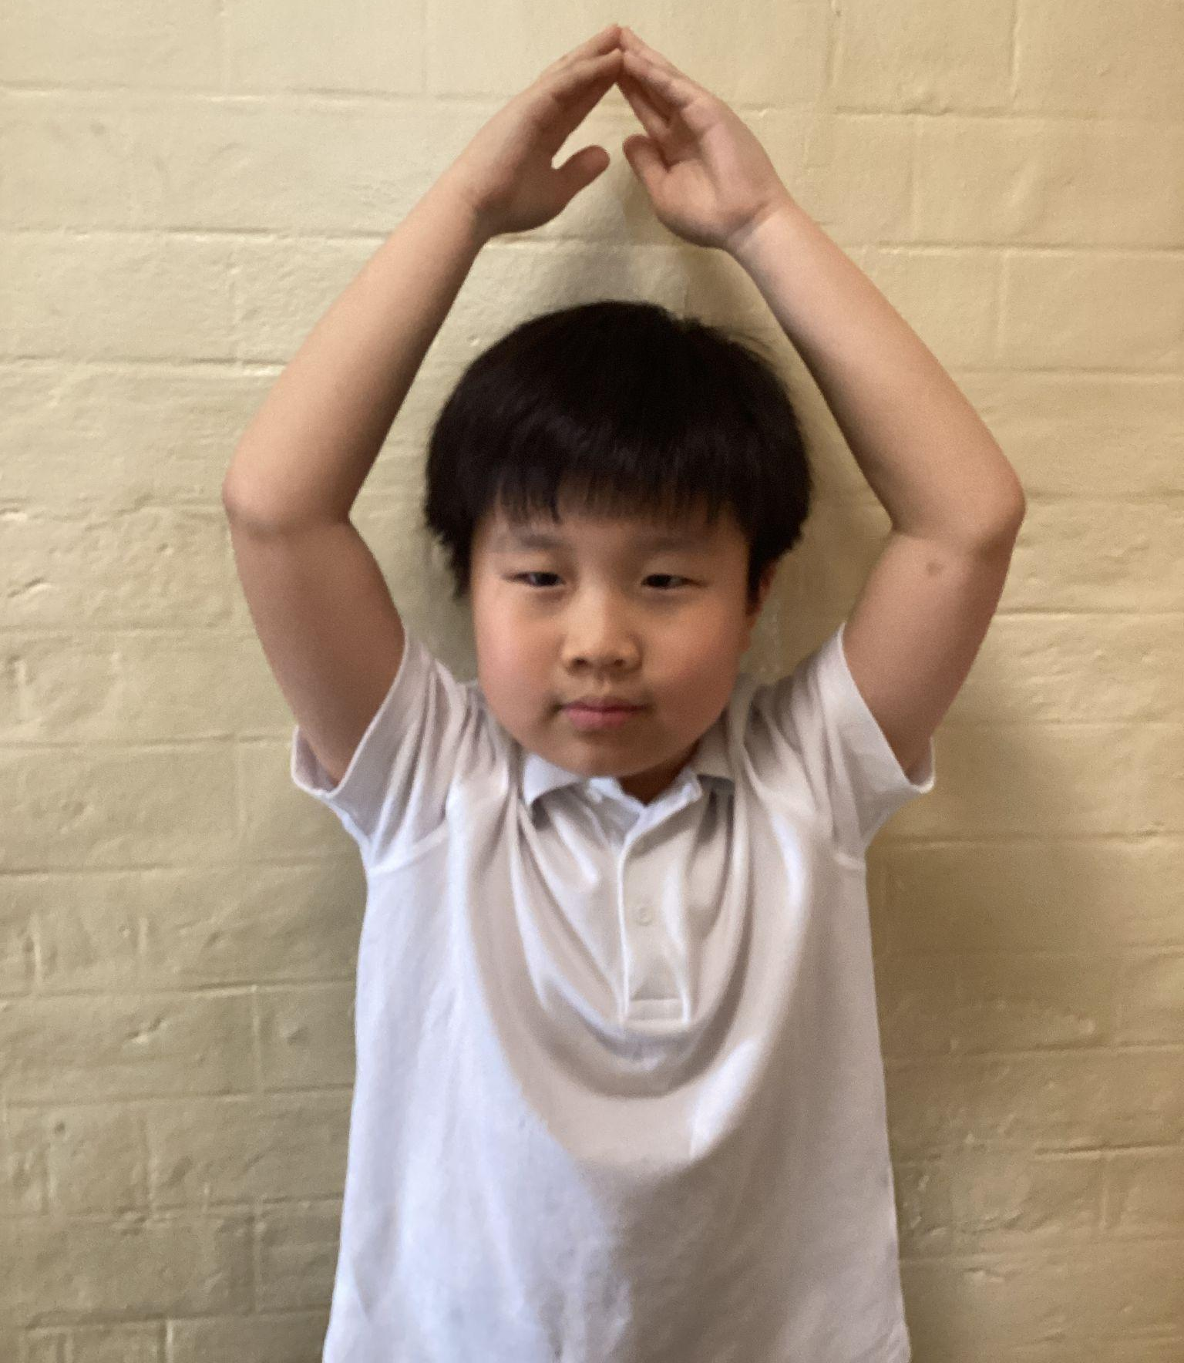
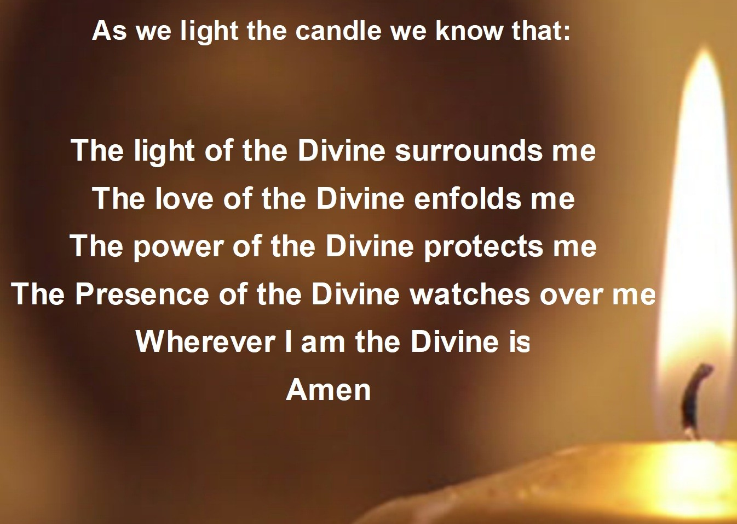
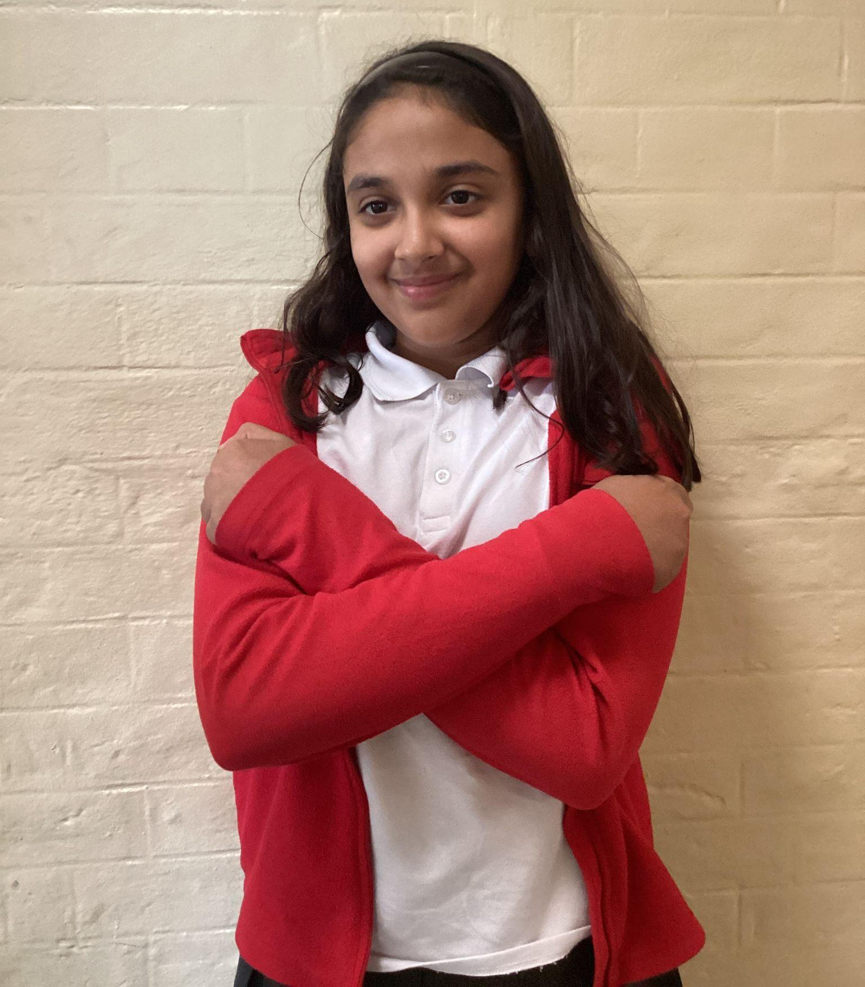
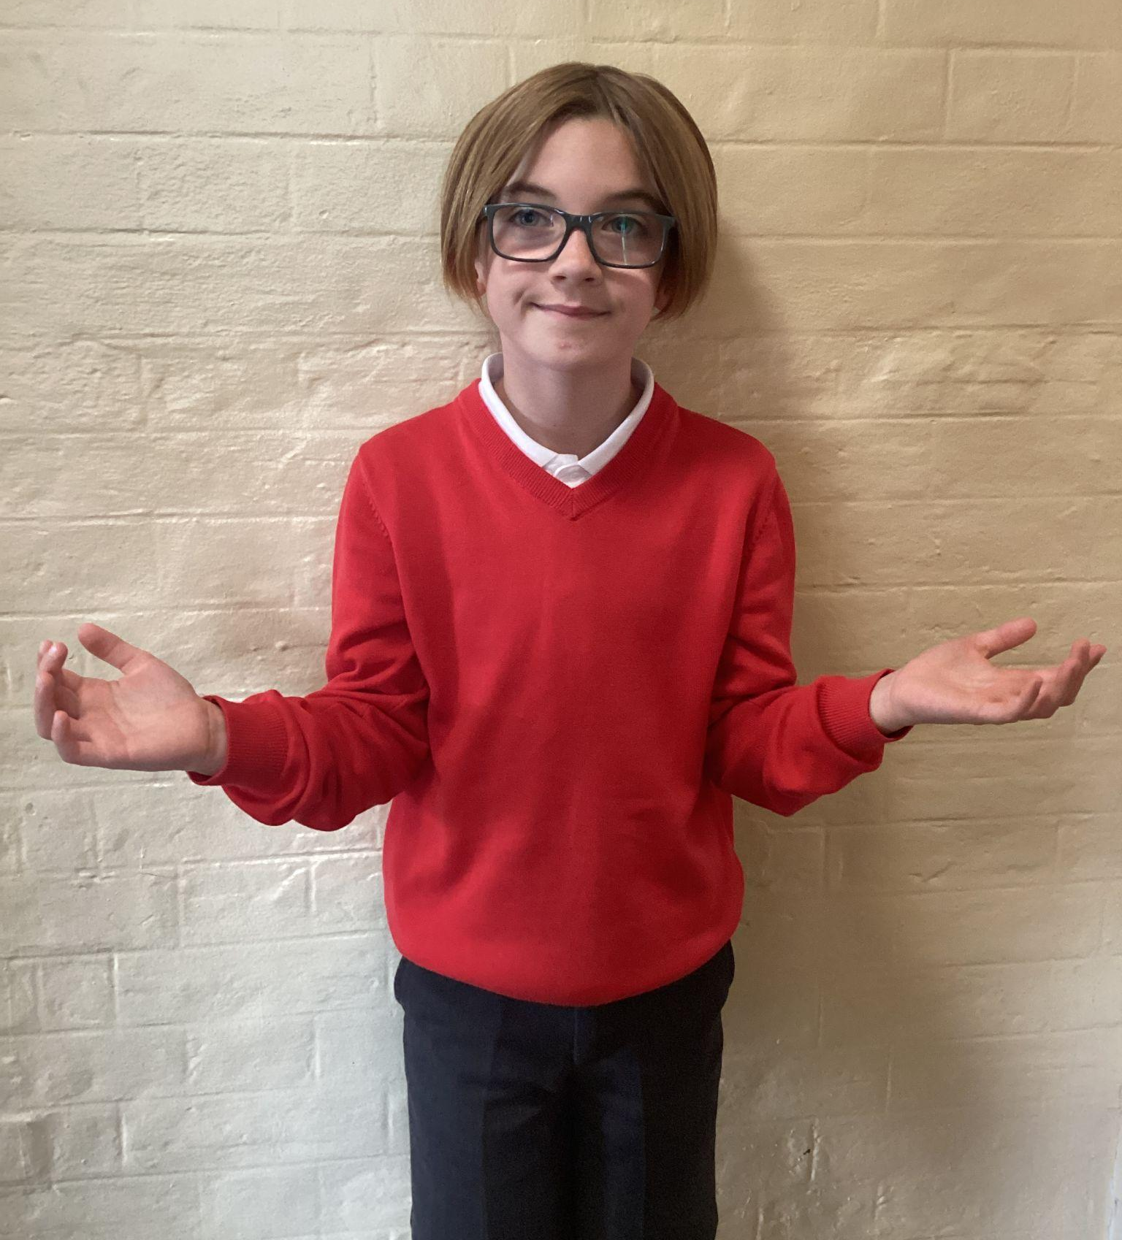
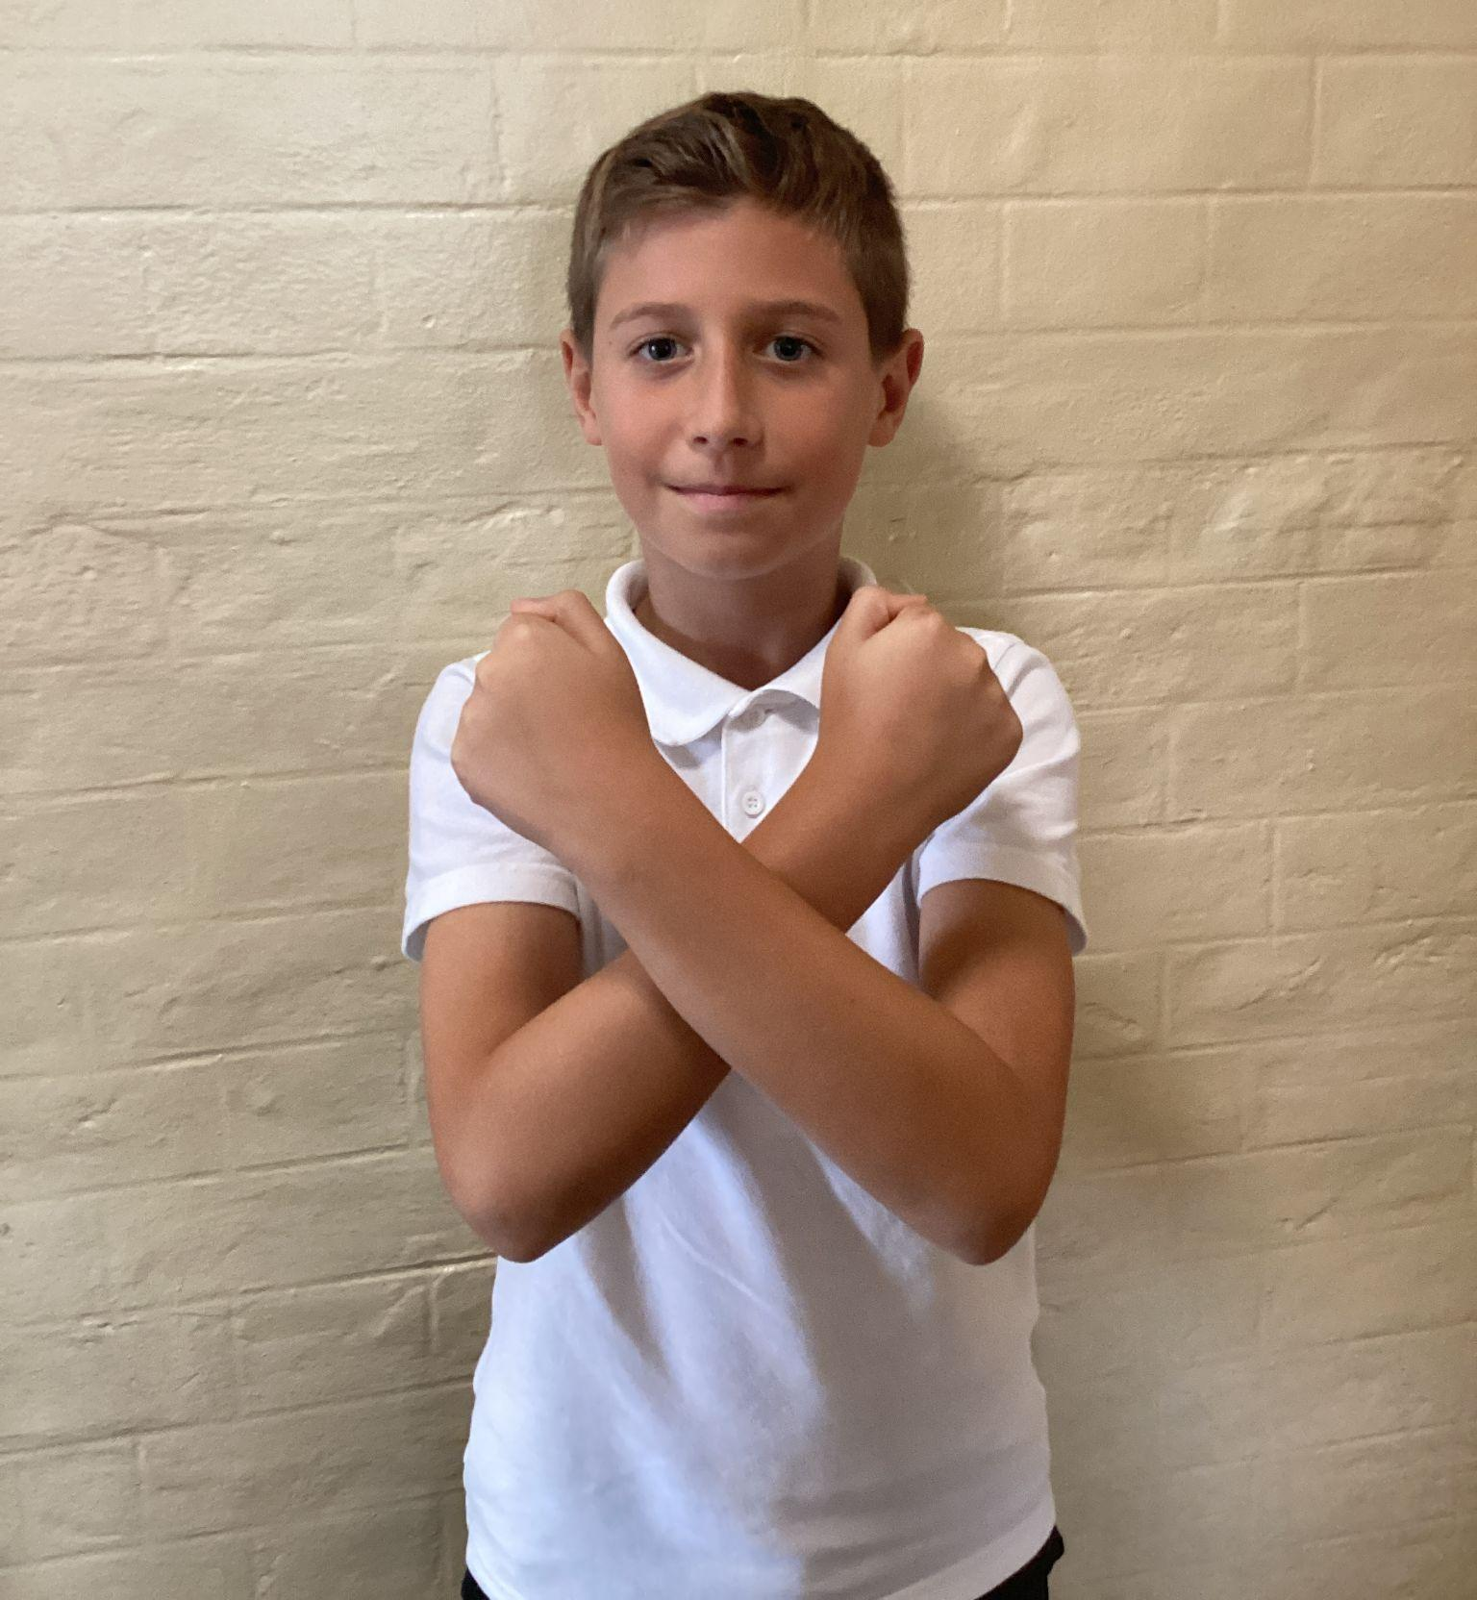
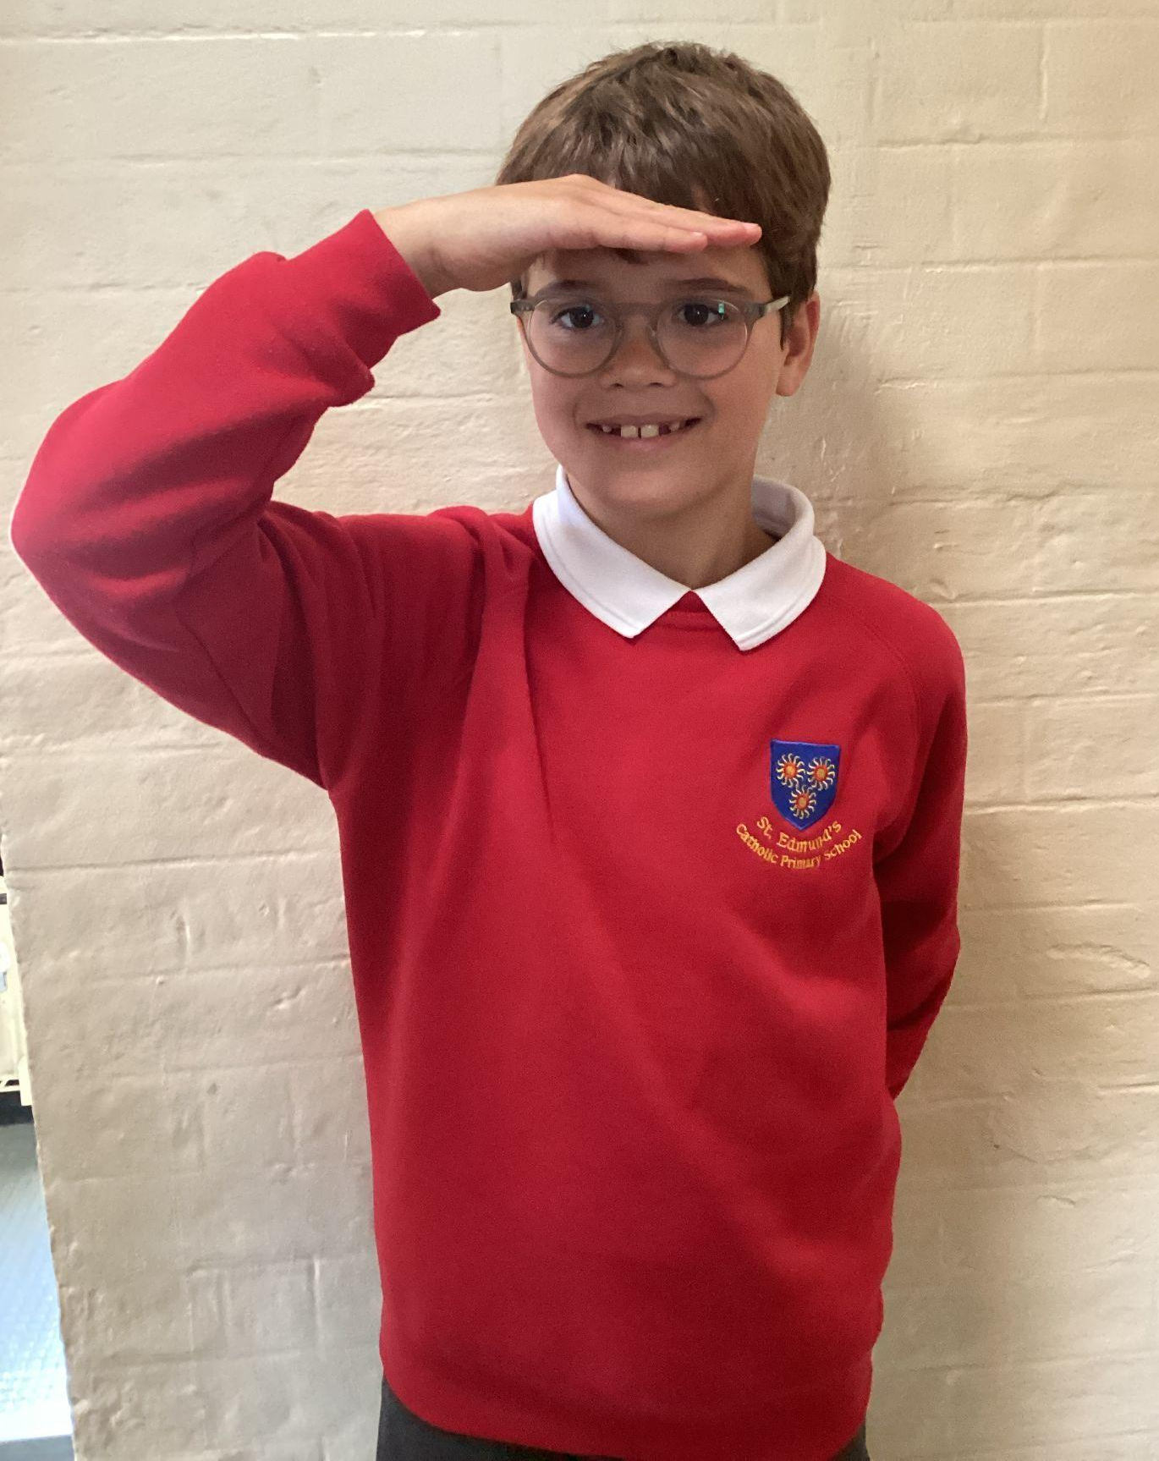
Please repeat after me
1. Light
6. Amen
2. Love
5. Wherever I am.
3. Power
4. Presence

Slide 5
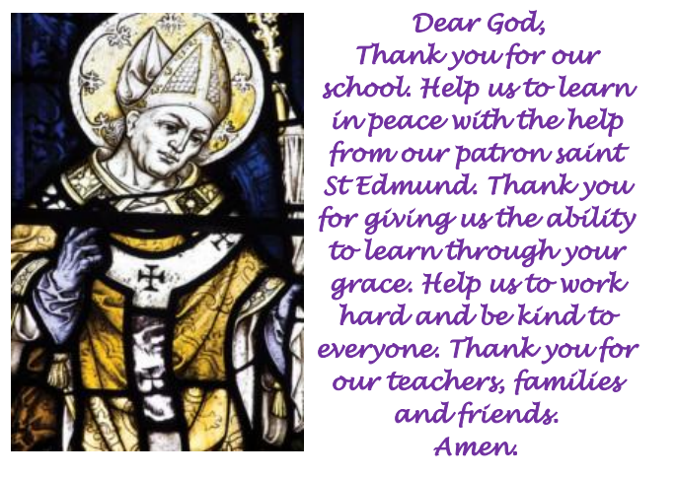
St Edmund’s School Prayer

Slide 6
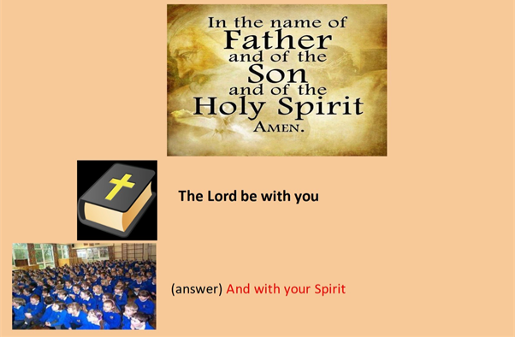
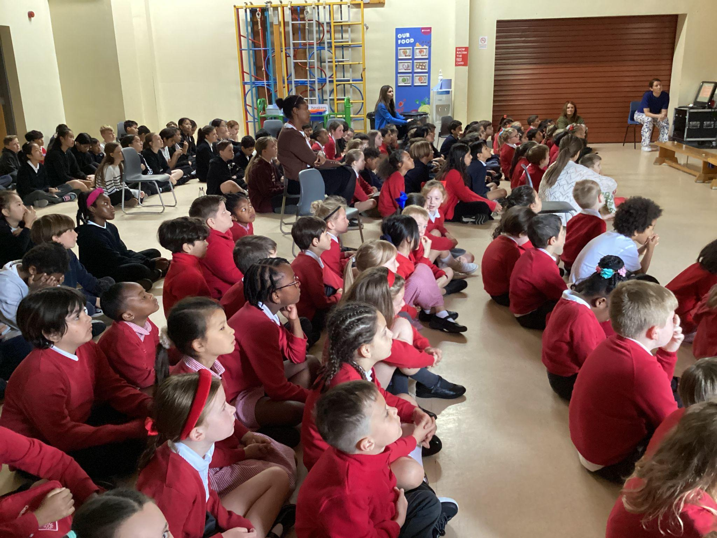
We are ready to receive the message of God.
Please make the sign of the cross

Slide 7
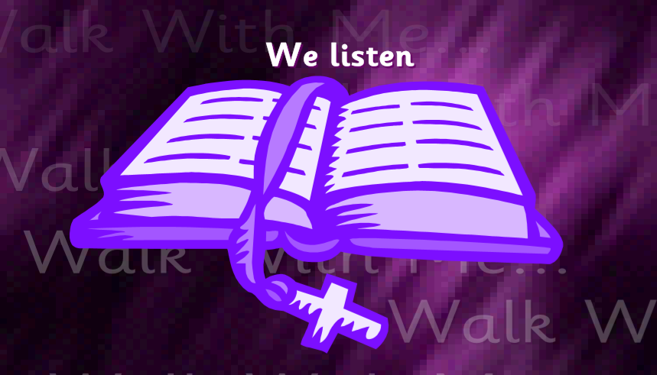
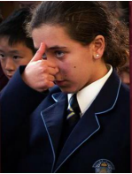
A reading from the Holy Gospel according to Luke.
All: Glory to You, Oh Lord.

Slide 8
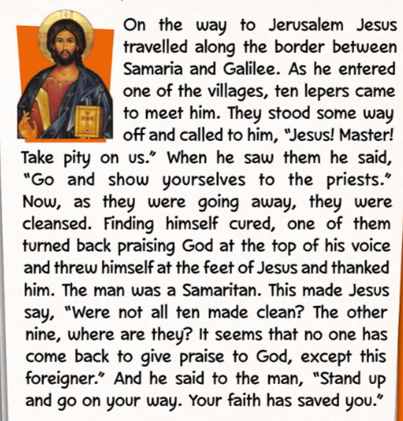
Luke 17:11-19
The Gospel of the Lord.
ALL: Praise to you Lord Jesus Christ.

Slide 9

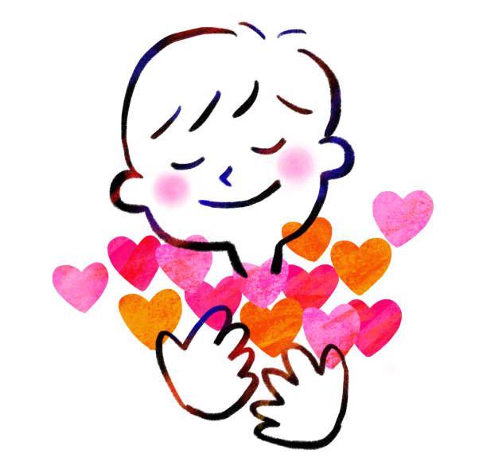
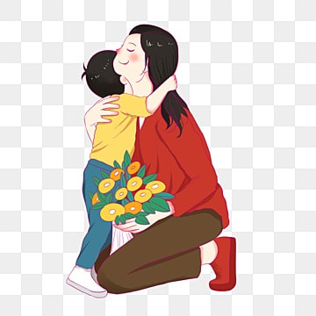
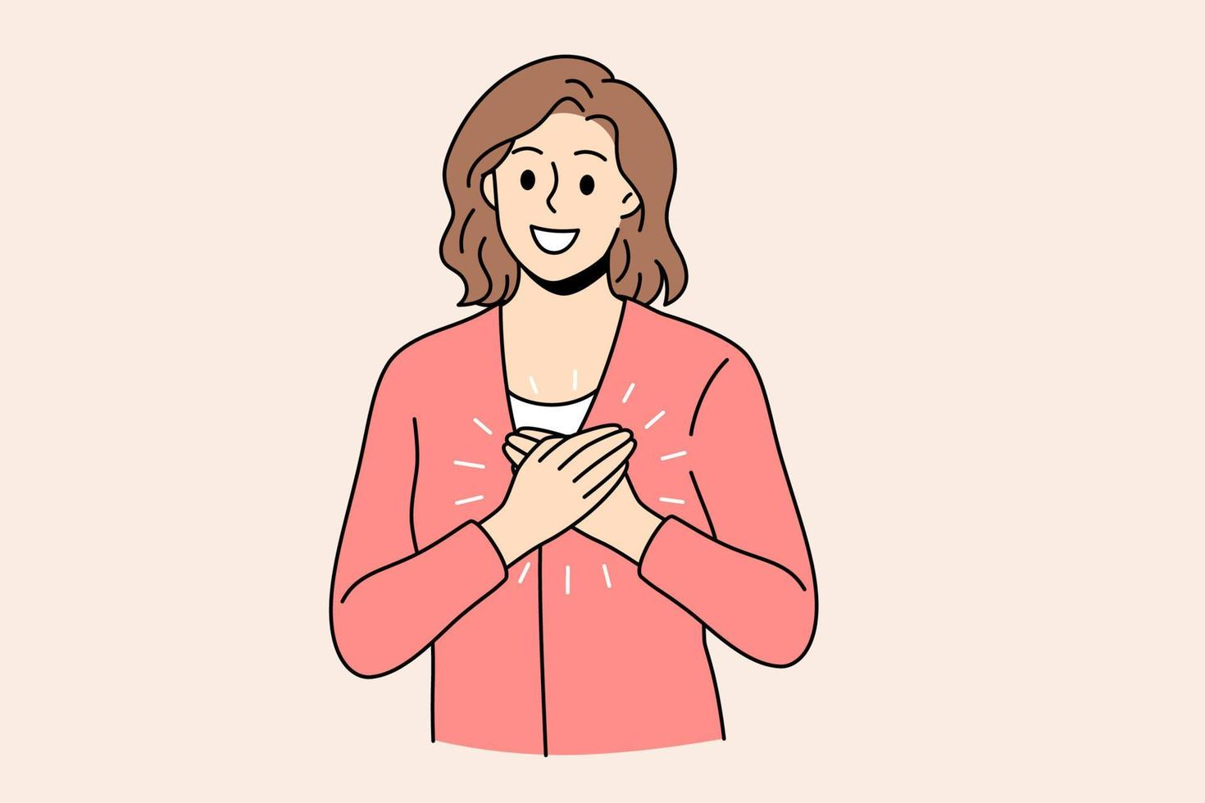
What is this week’s Word?
THANKFULNESS

Slide 10


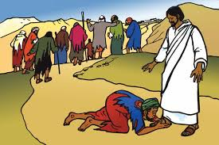
How does the Wednesday word link to
Catholic Social Teaching, RE or Scripture?
THANKFULNESS

Slide 11
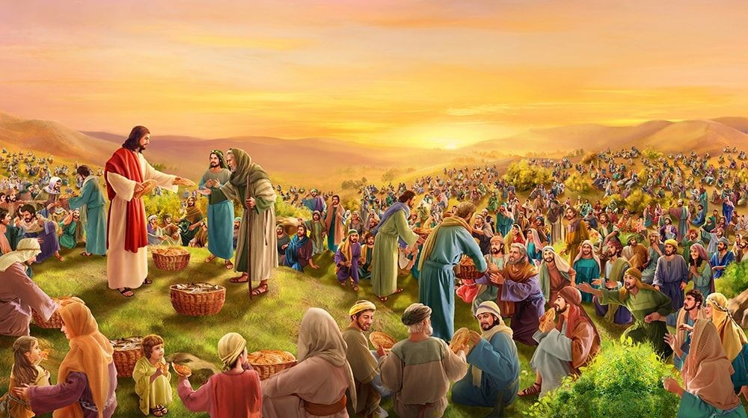
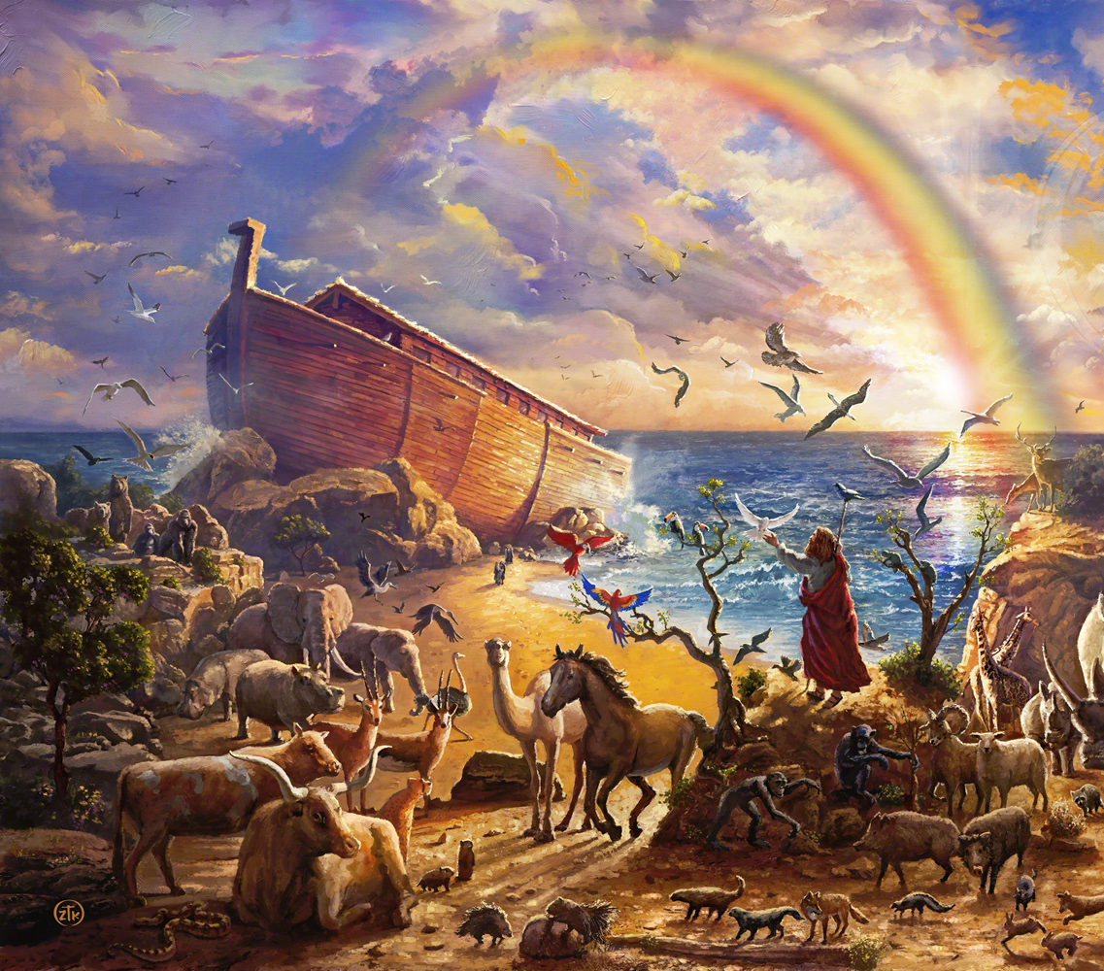
Are there any other scriptures that link to our Wednesday Word, THANKFULNESS?
The Feeding of the 5,000 (John 6:1-14)
Noah and the Ark (Genesis 6–9)

Slide 12

Catholic Social Teaching
Catholic Social Teaching teaches us to care for others and appreciate God’s gifts. Being thankful helps us notice the good things in our lives and inspires us to share and help others. Thankfulness shows kindness, love, and respect for everyone around us.

Slide 13
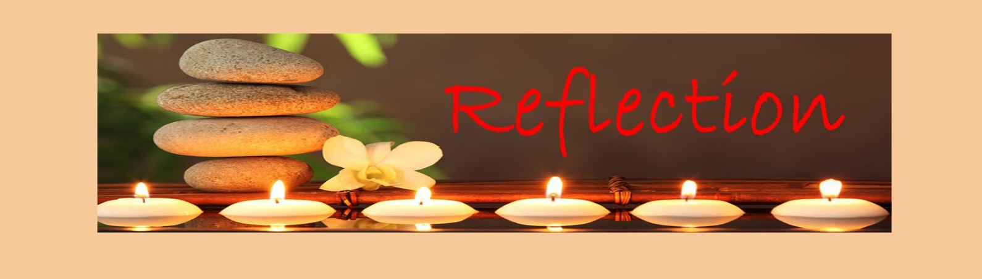
Close your eyes and accept Jesus in your hearts
Today, I am thankful for all the good things in my life – my family, my friends, my school, and the world around me. Being thankful helps me see God’s gifts and reminds me to be kind and share with others.
I want to say “thank you” for everything I have and use it to make the world a better place.

Slide 14

We Respond
Dear Jesus,
We thank God for all the good things in our lives.
Help us to be kind, share with others, and show our gratitude every day.
Amen.

Slide 15
Your Mission for this week
Look around your classroom or home and find one small thing you are thankful for.
Write a short thankful prayer about it and put it in the class prayer box.

Slide 16
Act of Dedication
P&J: We promise to be thankful for God’s gifts and show kindness to others every day.
All: Lord, help us to be grateful and kind.
Through Christ we Learn.
Amen.

Slide 17
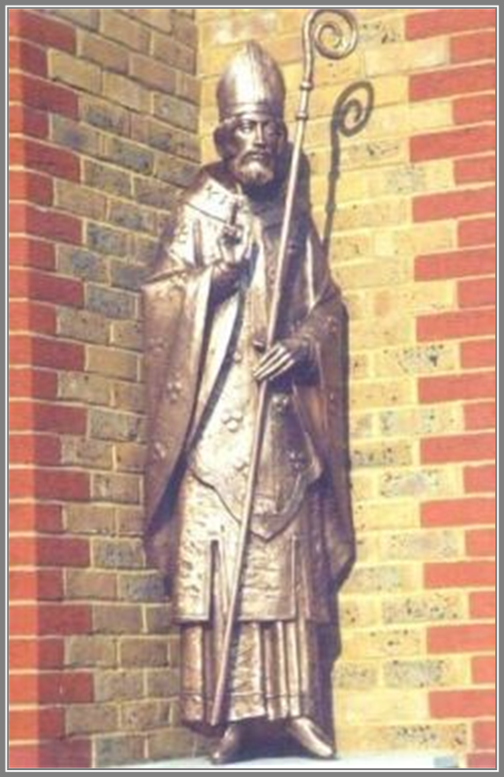
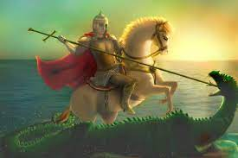
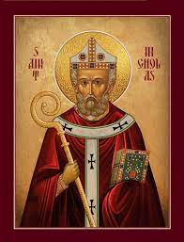
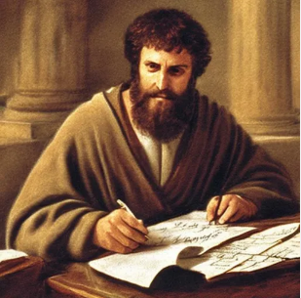
Litany of Saints
PJ: St. Edmund
All: Pray for us
PJ: St. George
All: Pray for us
PJ: St. Nicholas
All: Pray for us
PJ: St. Paul
All: Pray for us

Slide 18
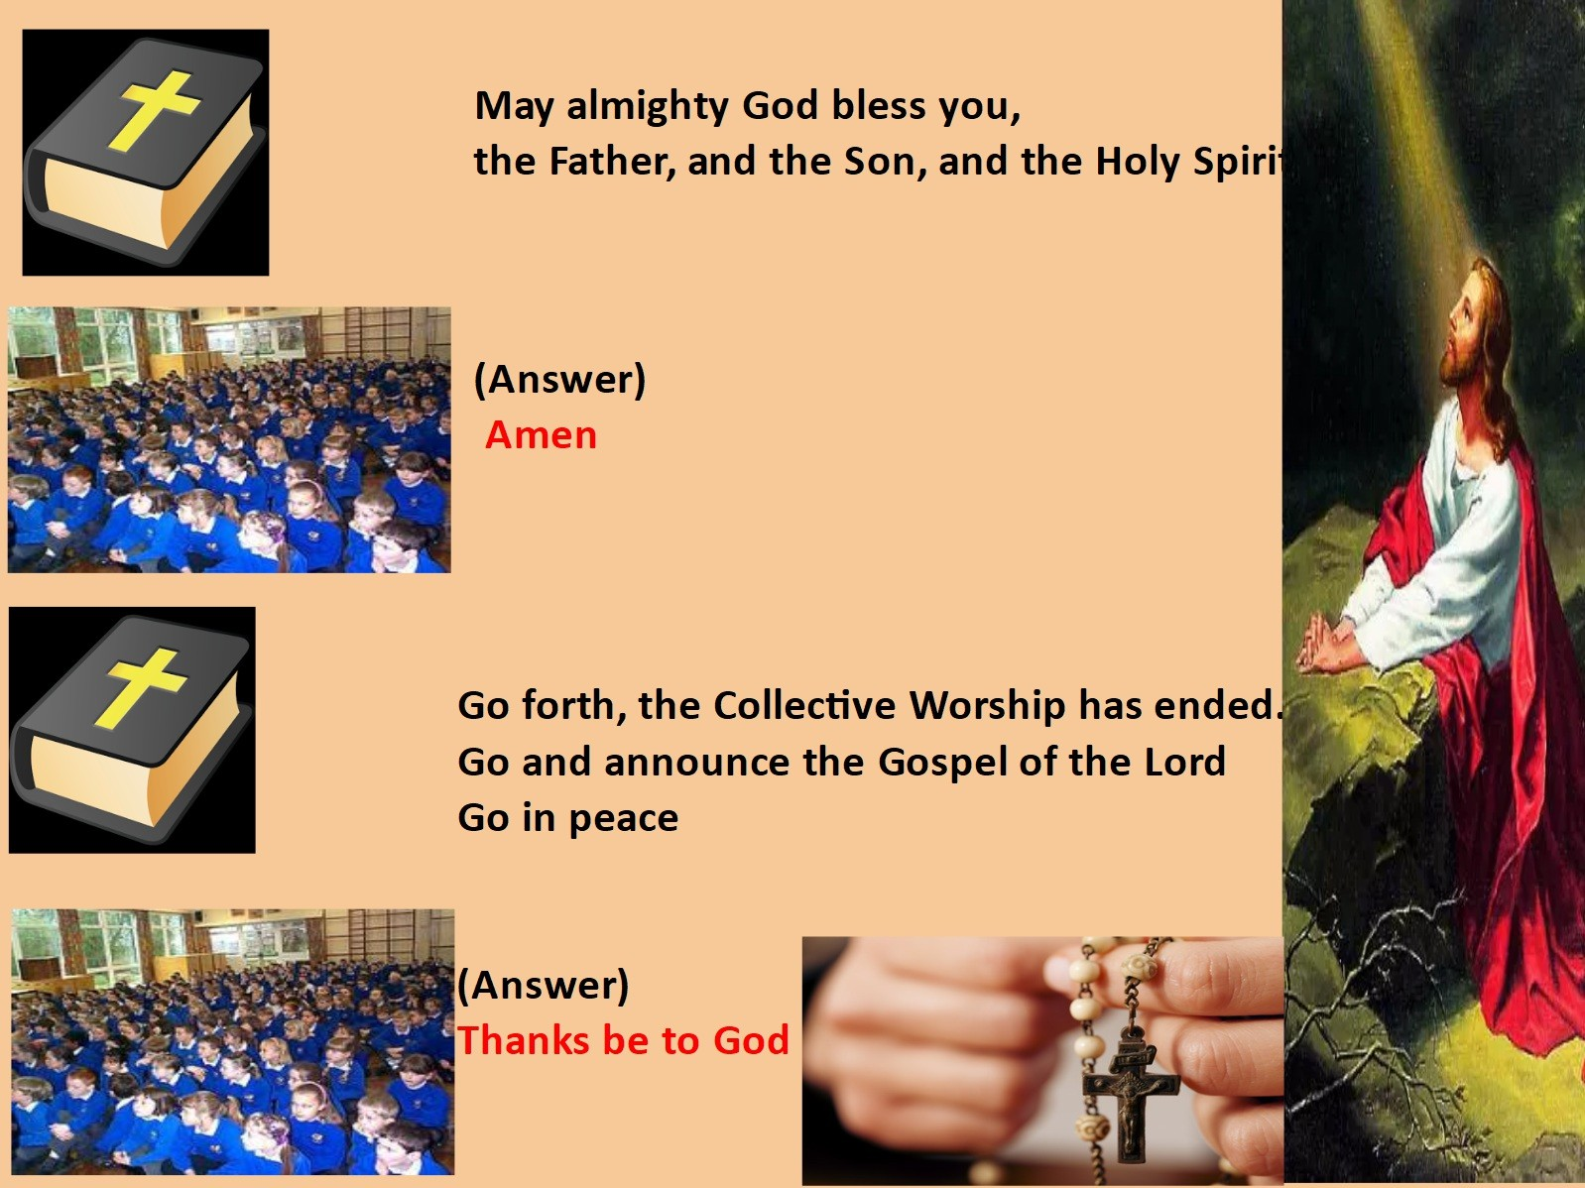
We Go Forth

Slide 19

Thank you for coming to the Celebration of the Word.

Slide 20


Slide 21
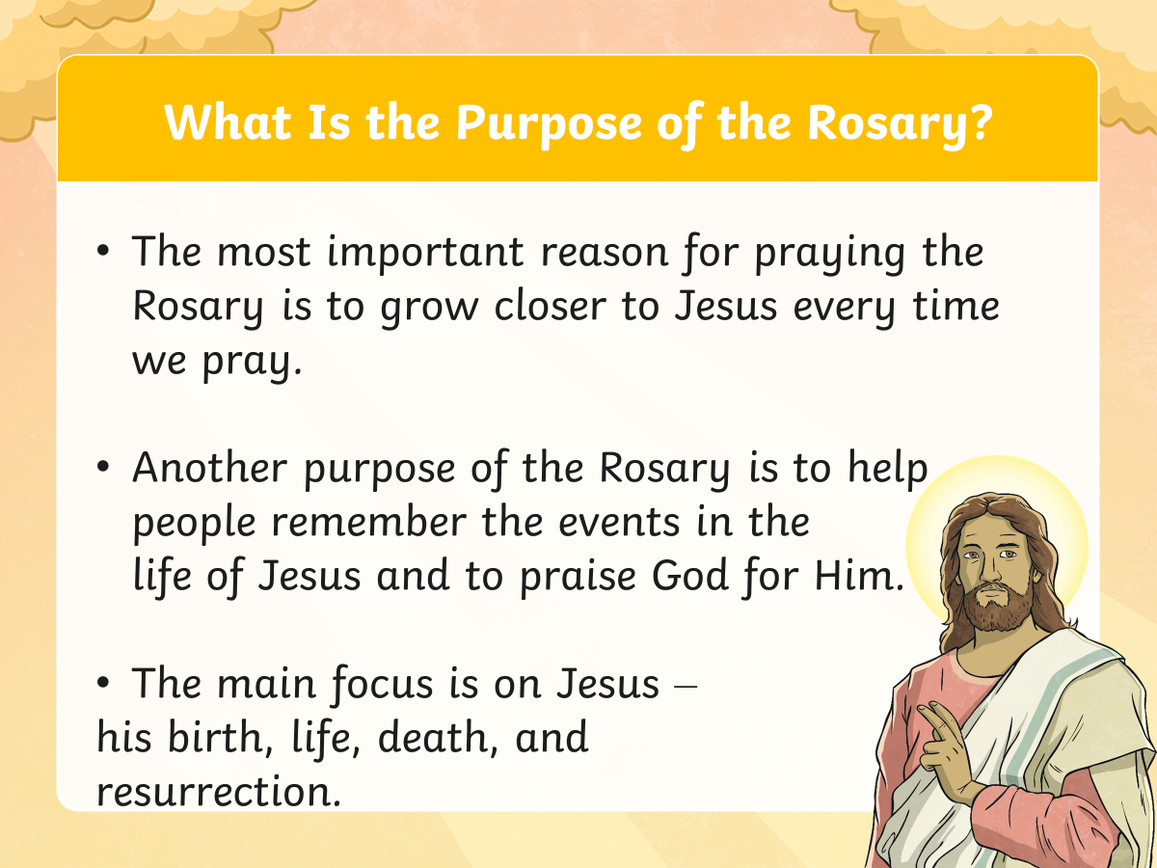

Slide 22
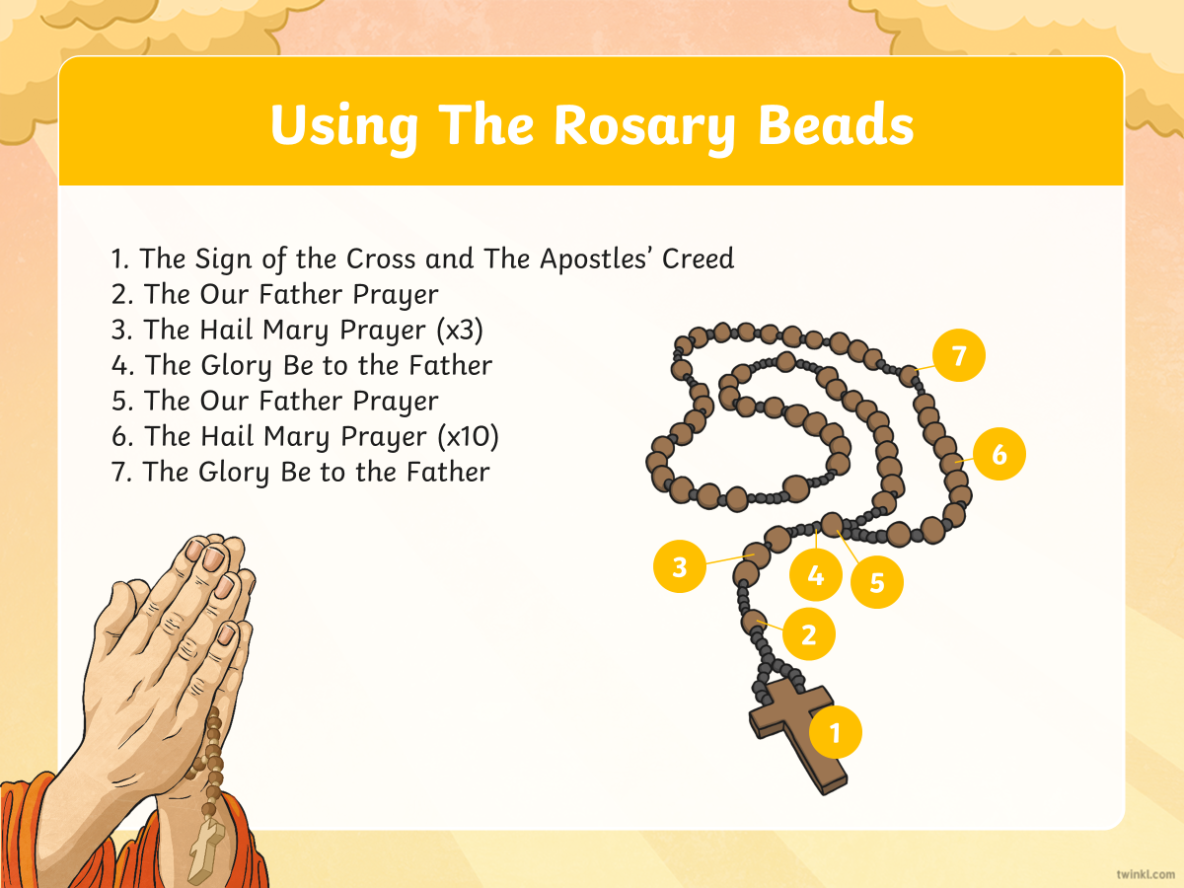

Slide 23
Our Father
Our Father, who art in heaven,
hallowed be Thy name;
Thy kingdom come; Thy will be done
on earth as it is in heaven.
Give us this day our daily bread;
and forgive us our trespasses,
as we forgive those who trespass against us;
and lead us not into temptation,
but deliver us from evil.
Amen.

Slide 24
Hail Mary
Hail Mary, full of grace,
the Lord is with thee;
blessed art thou among women,
and blessed is the fruit of thy womb, Jesus.
Holy Mary, Mother of God,
pray for us sinners,
now and at the hour of our death.
Amen.

Slide 25
The Glory Be
Glory be the Father, and to the Son,
and to the Holy Spirit,
as it was in the beginning, is now, and ever shall be,
World without end.
Amen

Slide 26
