Slide 1
St Edmund’s Catholic Primary School
…through Christ we learn…
Executive Headteacher: Mrs A. Ruthven
Head of School: Mr A. Antoniou
St Edmund’s Catholic Primary School Mission
Our Mission
Through Christ We Learn

Slide 2
We Gather
Please repeat after me

Slide 3
Please repeat after me
Please make the sign of the cross

Slide 4
Wednesday Word
Invitation

Slide 5
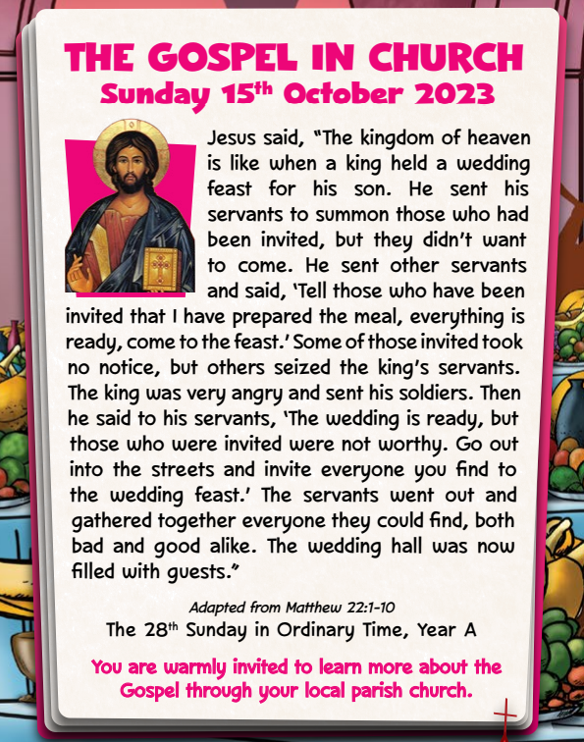
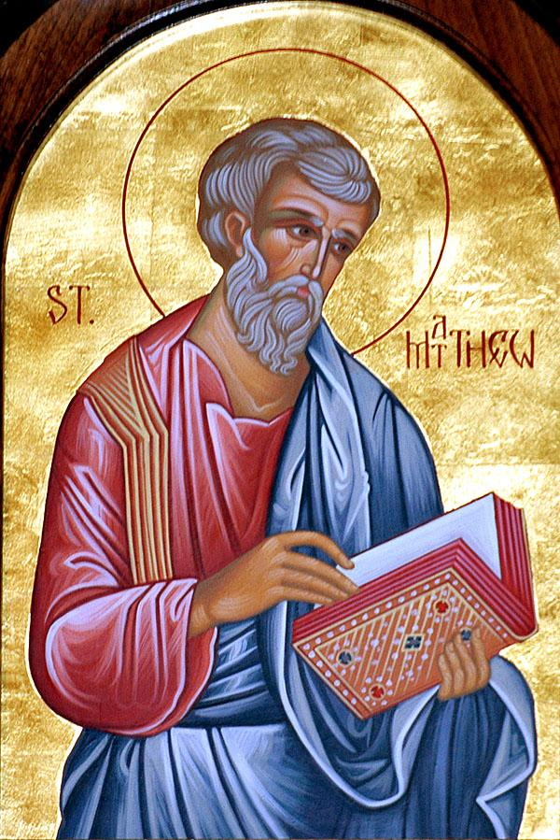
We Listen
Gospel Reading
Matthew 22:1-10

Slide 6
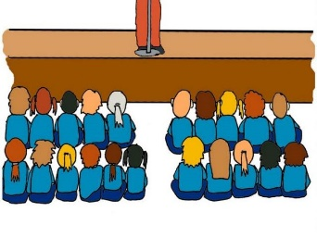
My dear children,
In this Sunday’s Gospel God is like the king, inviting us to a feast.
We are reminded that we are invited to share in God’s life: to celebrate belonging to the family of God, living in peace with everyone.
God’s invitation is not just for certain people but for all of us. God’s banquet starts here on earth and continues right into heaven.
The Lord Be With You
And with your Spirit

Slide 7
Close your eyes and accept Jesus in your hearts.
Every moment God is inviting us into a loving relationship.
We accept God’s invitation through loving him and all those around us.
Can you think about someone you could invite to play to make them feel loved? This week, let us accept God’s invitation and ask him to guide us in all we do each day.

Slide 8
We Respond

Slide 9
We Go Forth

