Slide 1


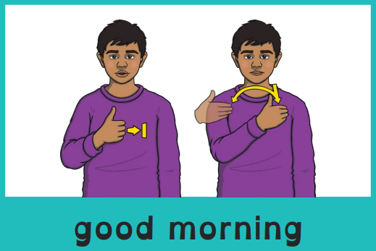
Good morning, everyone.
Celebration of the Word Assembly - 04/11/2025
Hajni

Slide 2


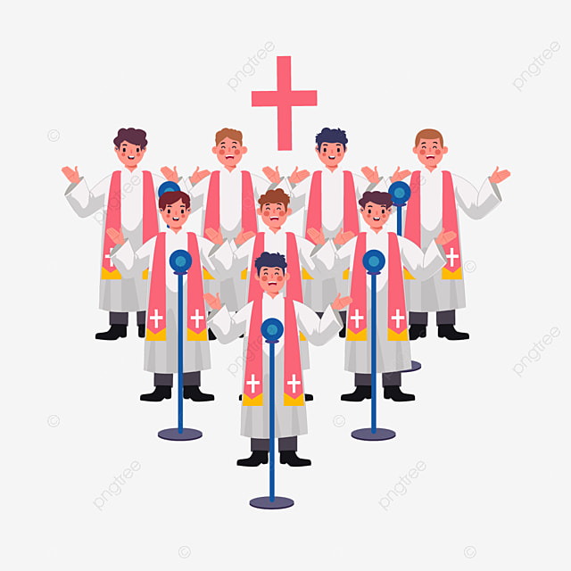
Through Christ We Learn

Slide 3
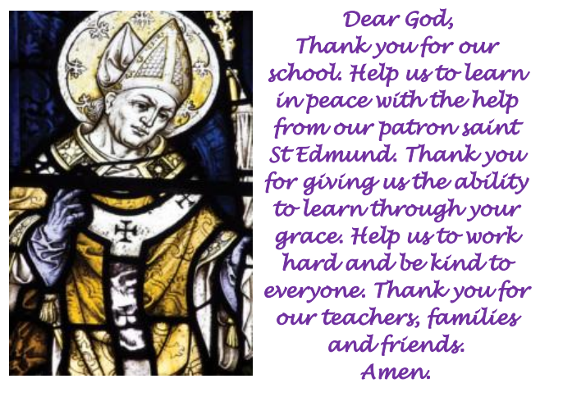
St Edmund’s School Prayer

Slide 4
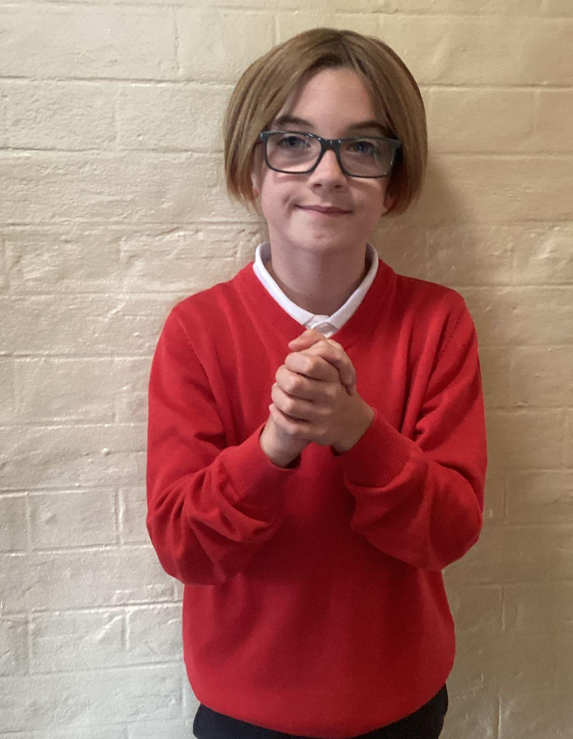
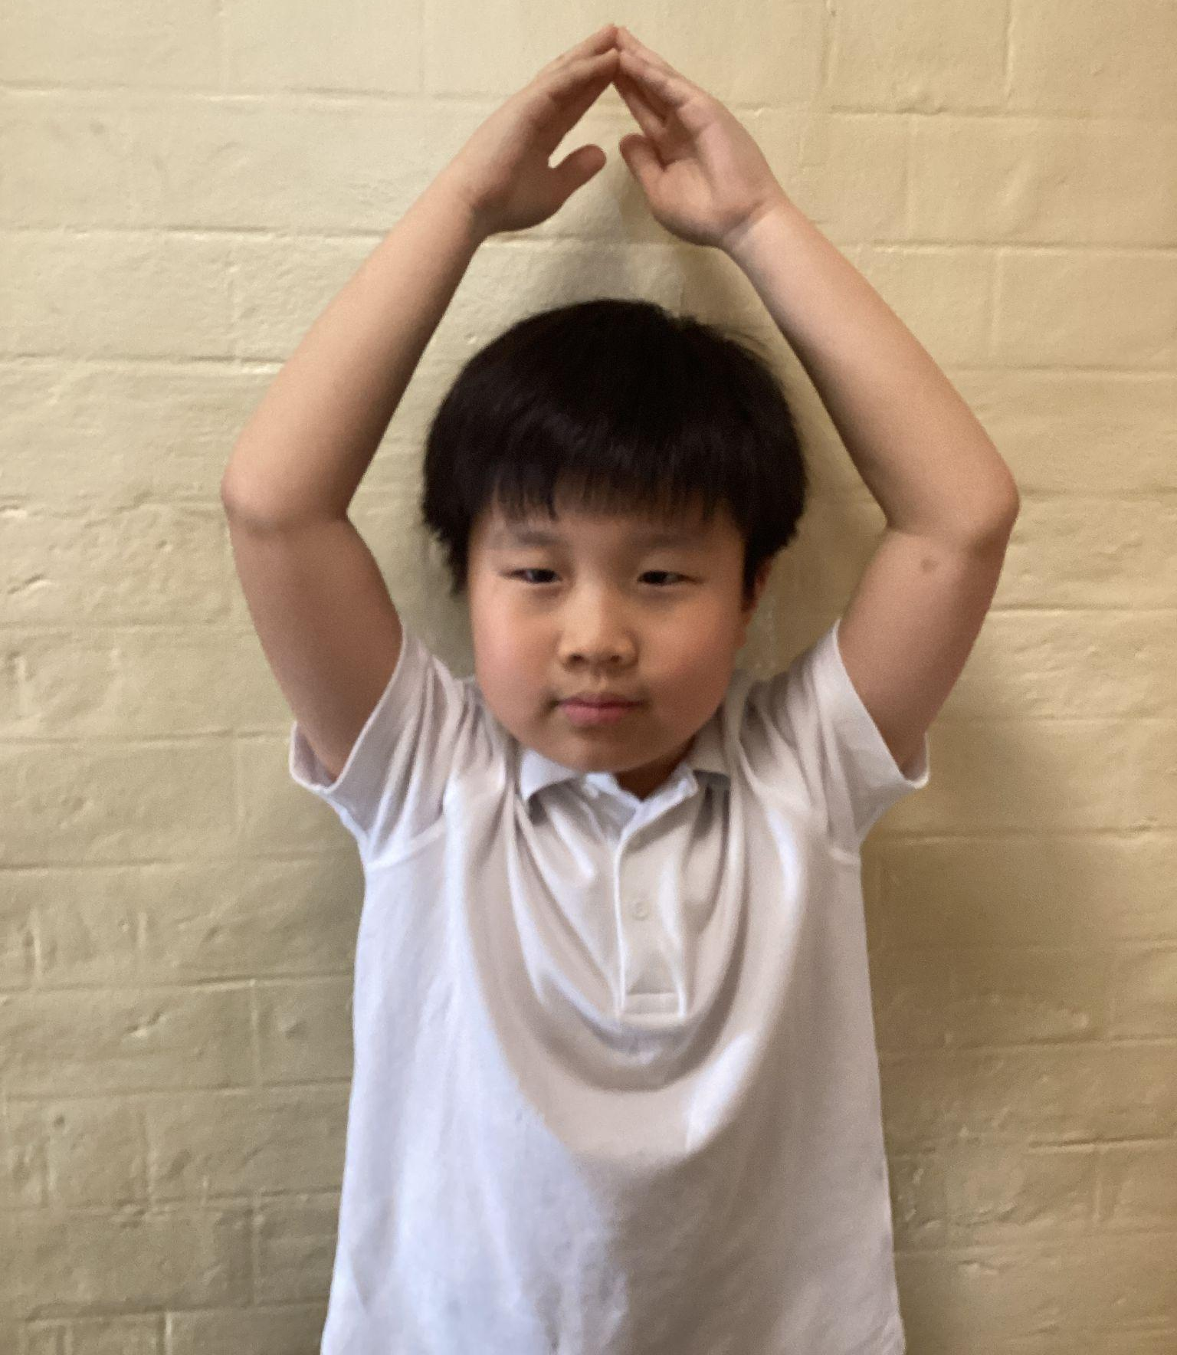
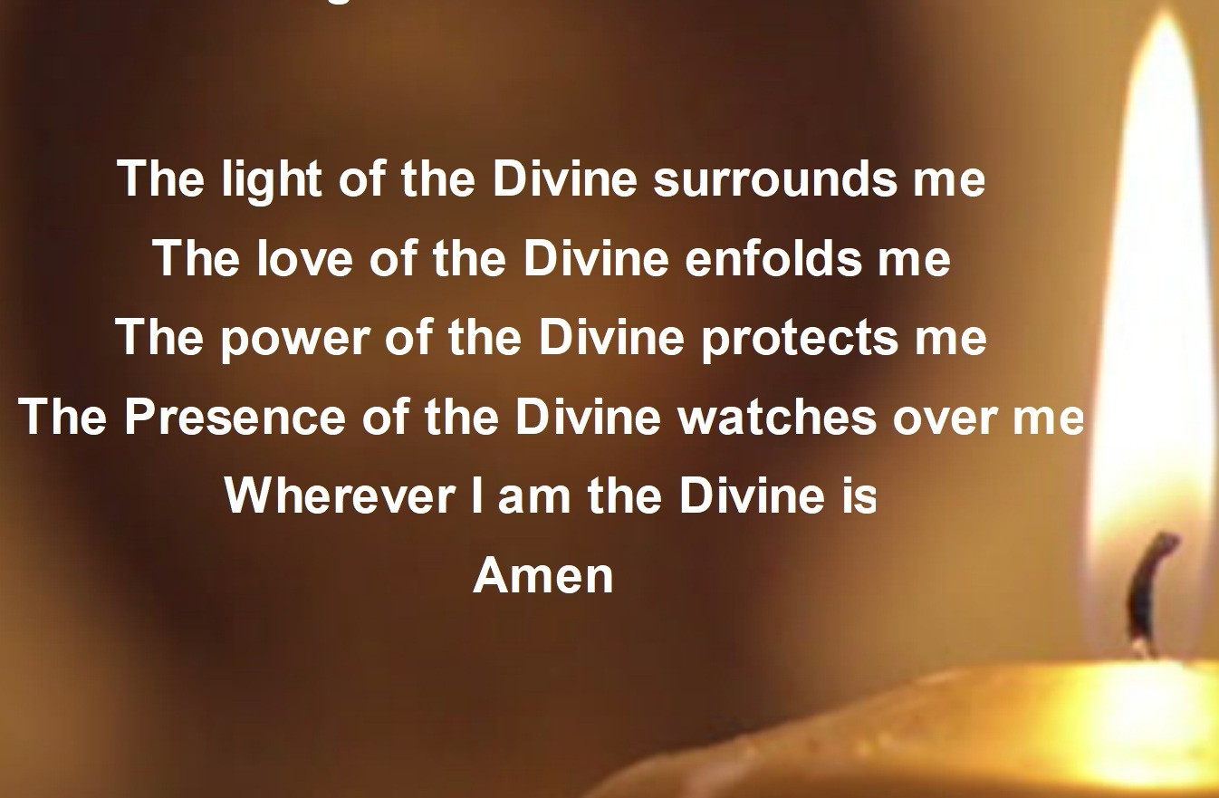
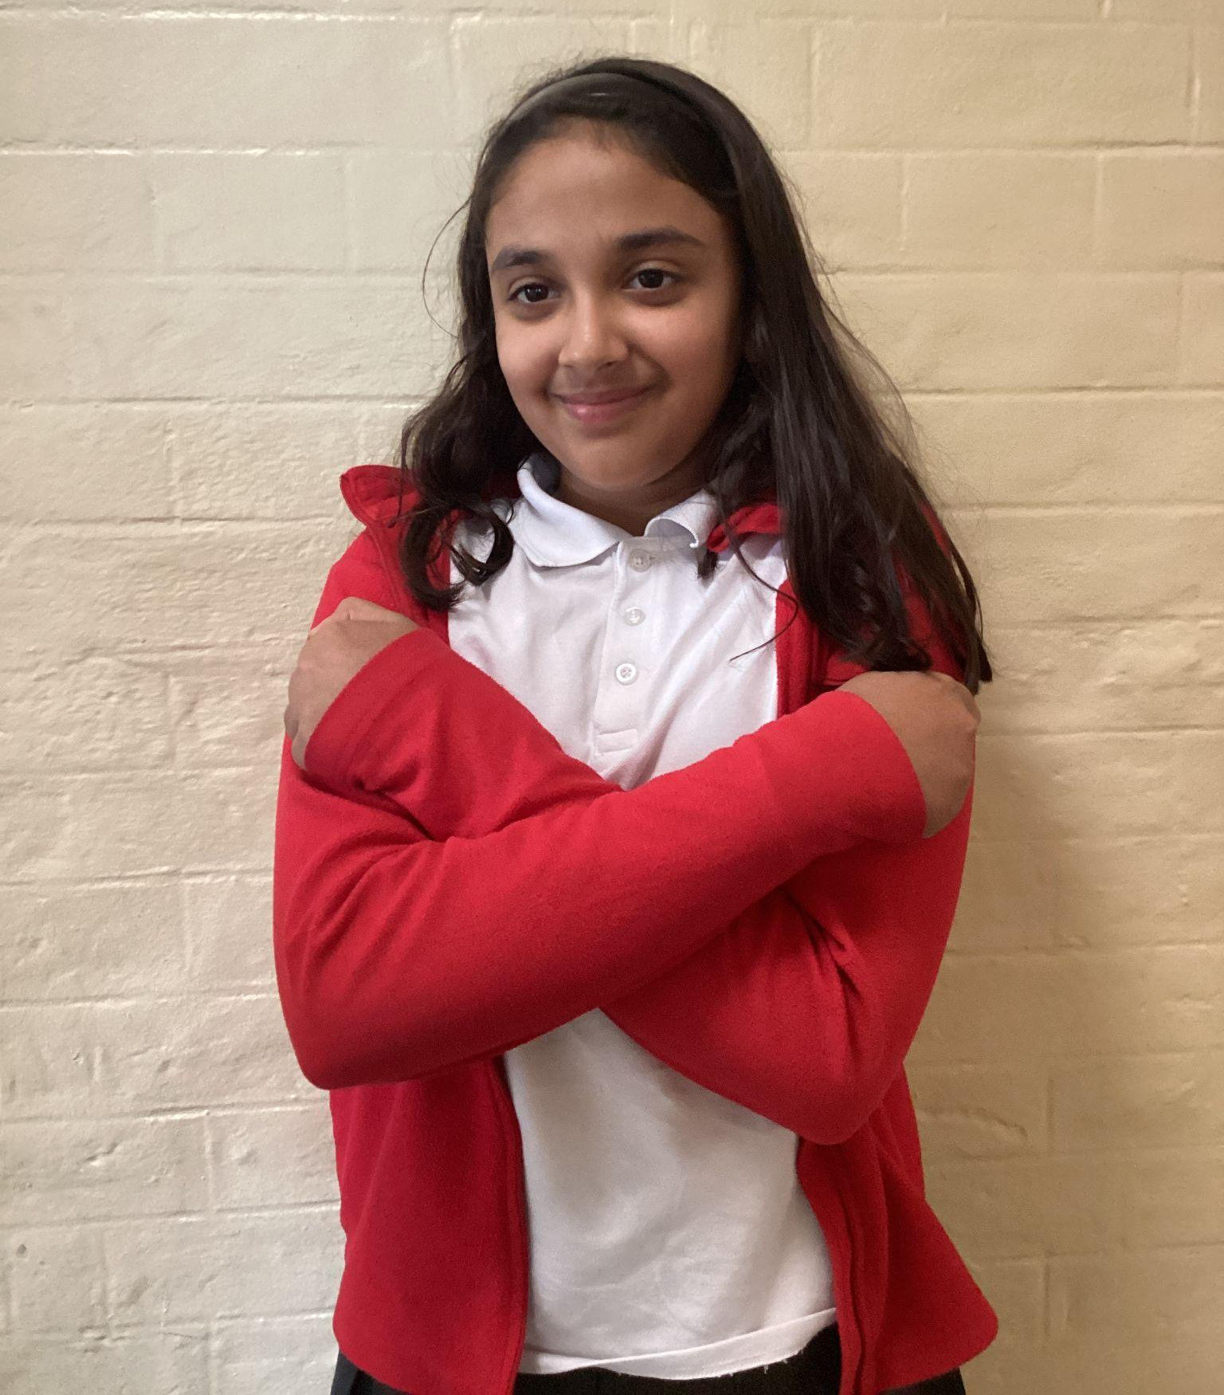
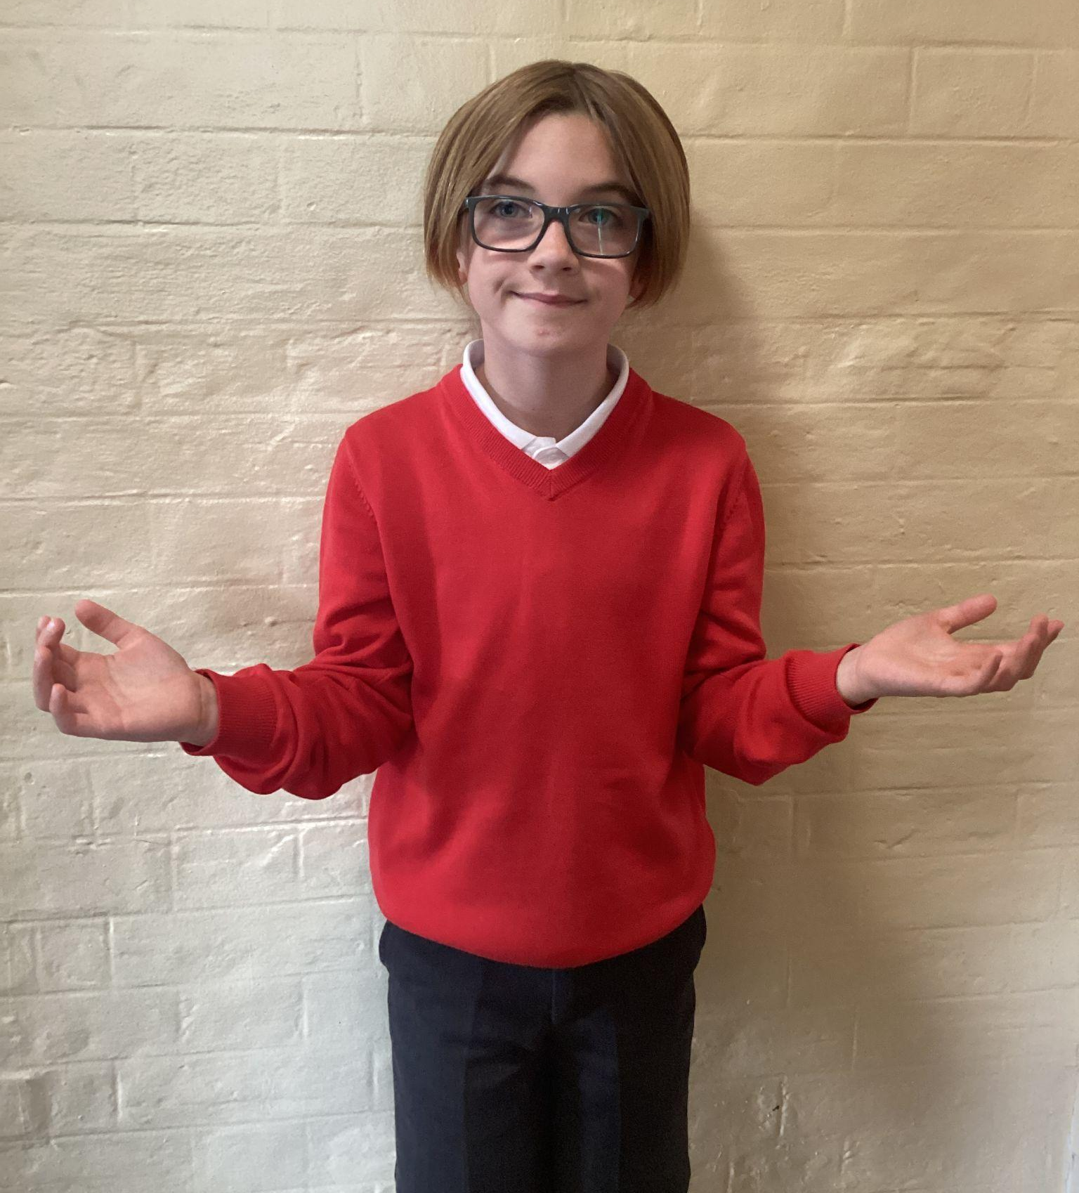
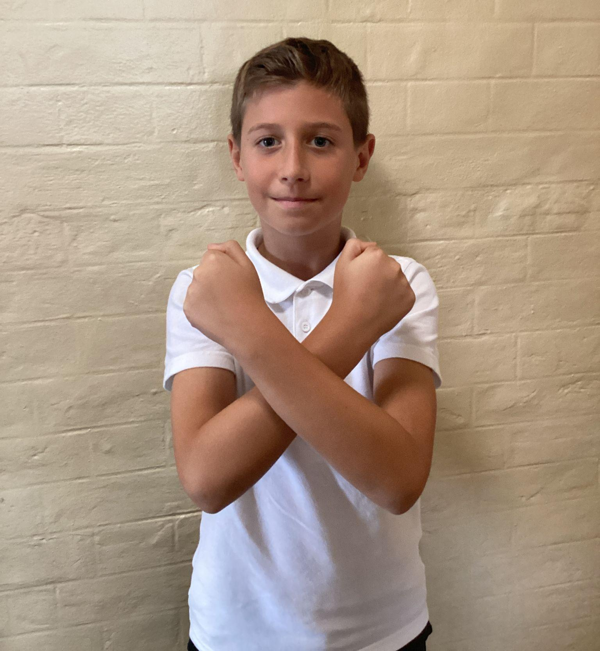
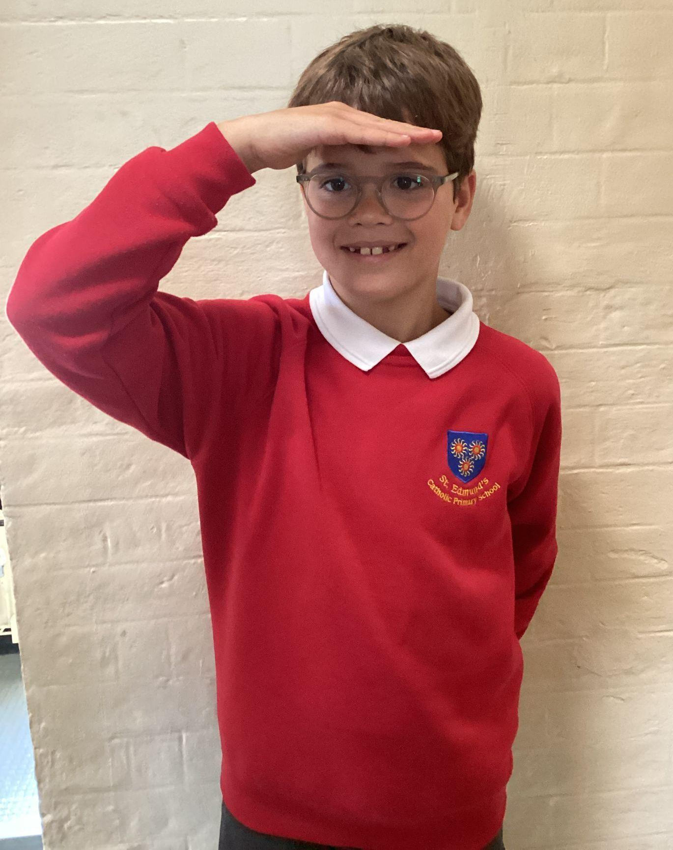
Please repeat after me
1. Light
6. Amen
2. Love
5. Wherever I am.
3. Power
4. Presence

Slide 5
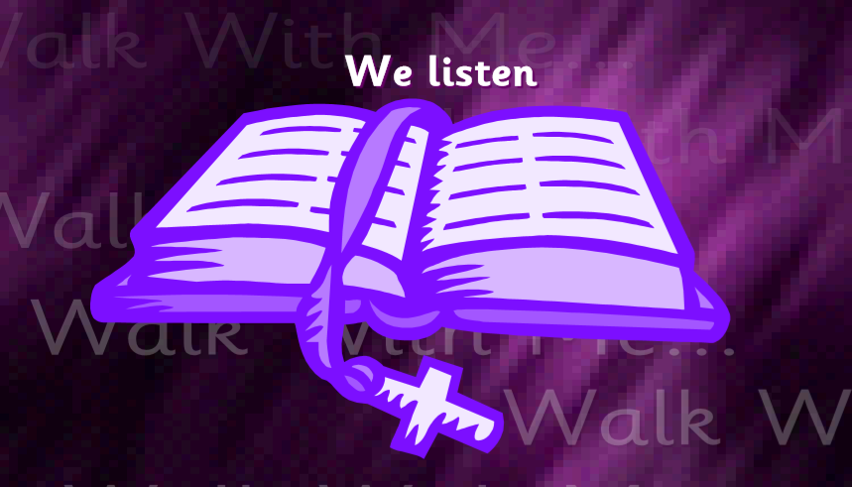
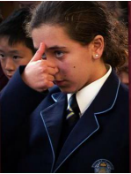
The Lord be with you.
All: And with your spirit.
A reading from the Holy Gospel according to Matthew.
All: Glory to You, Oh Lord.

Slide 6
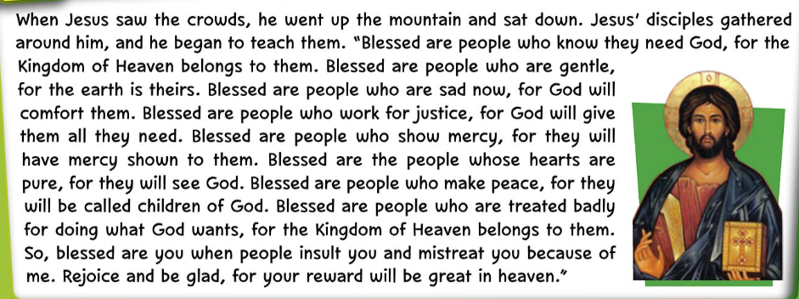
Matthew 5:1-12
The Gospel of the Lord.
ALL: Praise to you Lord Jesus Christ.

Slide 7
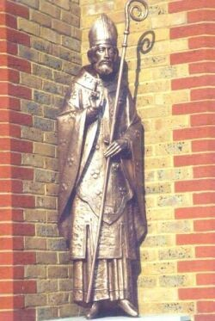
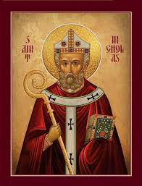
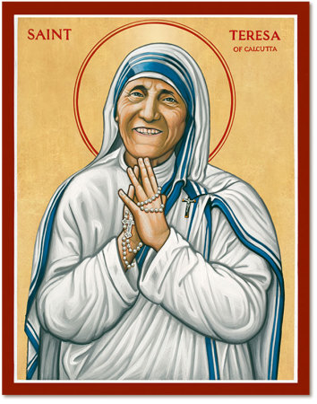
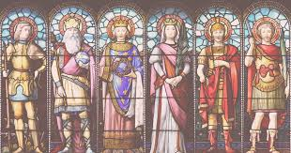
What is this week’s Word?
SAINTS

Slide 8


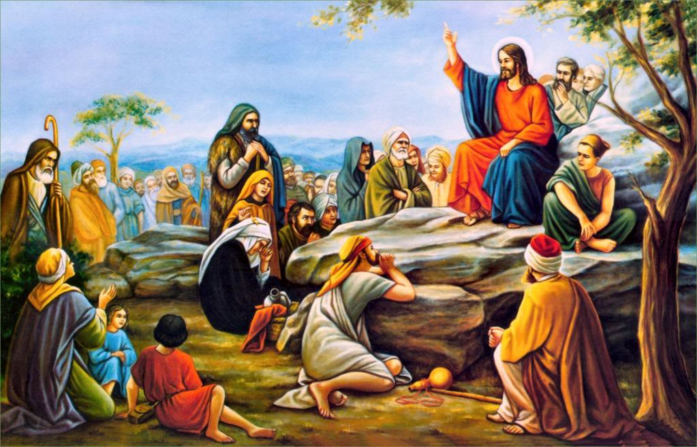
How does the Wednesday word link to
Catholic Social Teaching, RE or Scripture?
SAINTS

Slide 9
Are there any other scriptures that link to our Wednesday Word, SAINTS?

Slide 10

Catholic Social Teaching
Saints show us how to love God and care for others. Catholic Social Teaching teaches us to help those in need, be fair, and treat everyone with respect. Saints are examples of people who lived these values — sharing, being kind, and standing up for what is right.

Slide 11
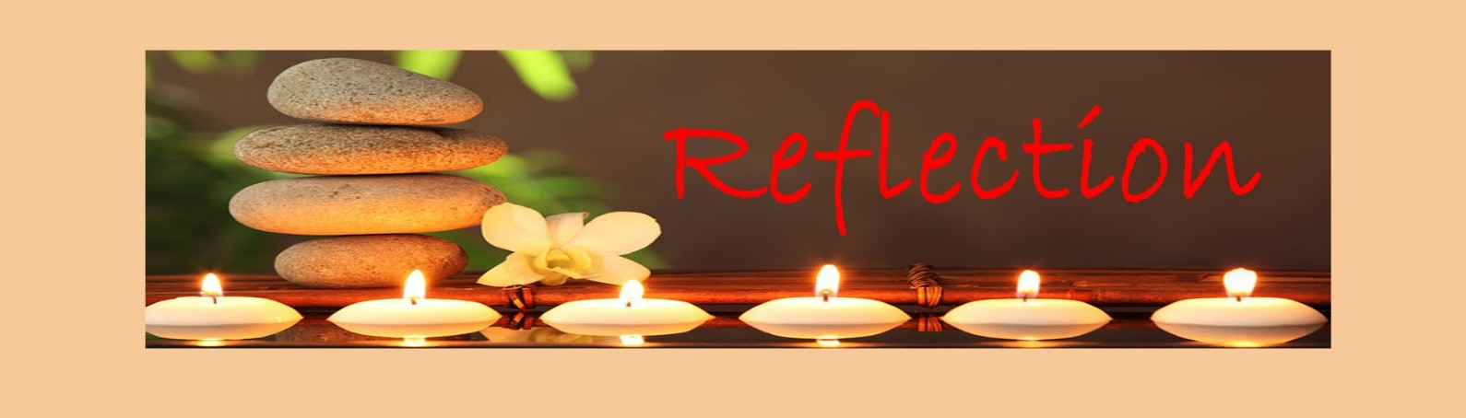
Close your eyes and accept Jesus in your hearts
Saints are people who loved God and tried to do good every day. They helped others, were kind, and followed Jesus’ example. We can be like saints too by being caring, sharing, and doing the right thing, even when it’s hard.
Let’s ask God to help us shine our light like the saints and show His love to everyone around us.

Slide 12

We Respond
Dear God,
Thank You for the saints who showed us how to love and care for others.
Help me to be kind, helpful, and follow Jesus every day.
Amen.

Slide 13


Slide 14
Act of Dedication
P&J: Loving God,
Thank You for the saints who show us how to live with love and kindness.
Help us to follow their example every day.
All: Lord, help us to be kind like the saints.
Amen.

Slide 15
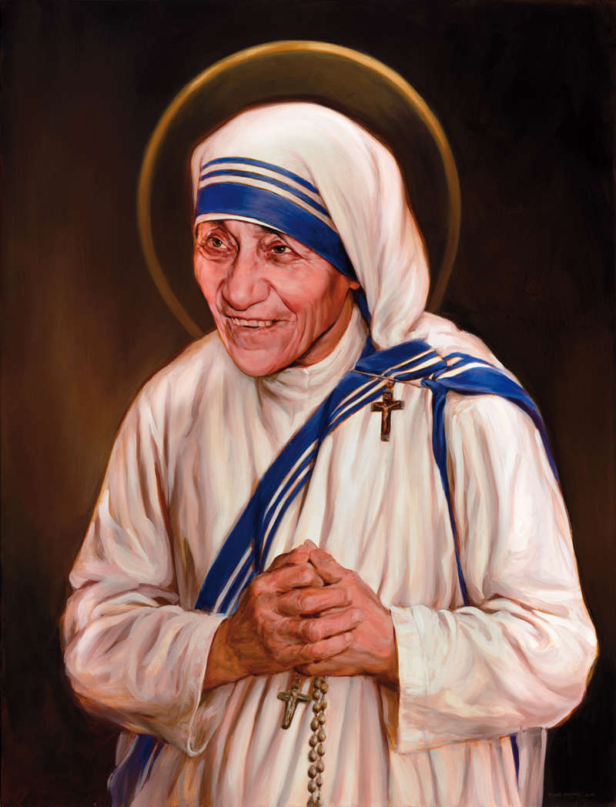
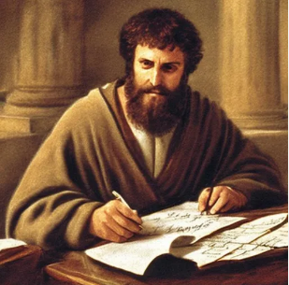
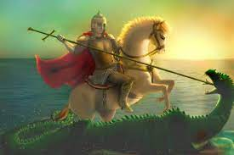
Litany of Saints
PJ: St. Paul
All: Pray for us
PJ: St. Teresa
All: Pray for us
PJ: St. George
All: Pray for us
PJ: St. Nicholas
All: Pray for us

Slide 16
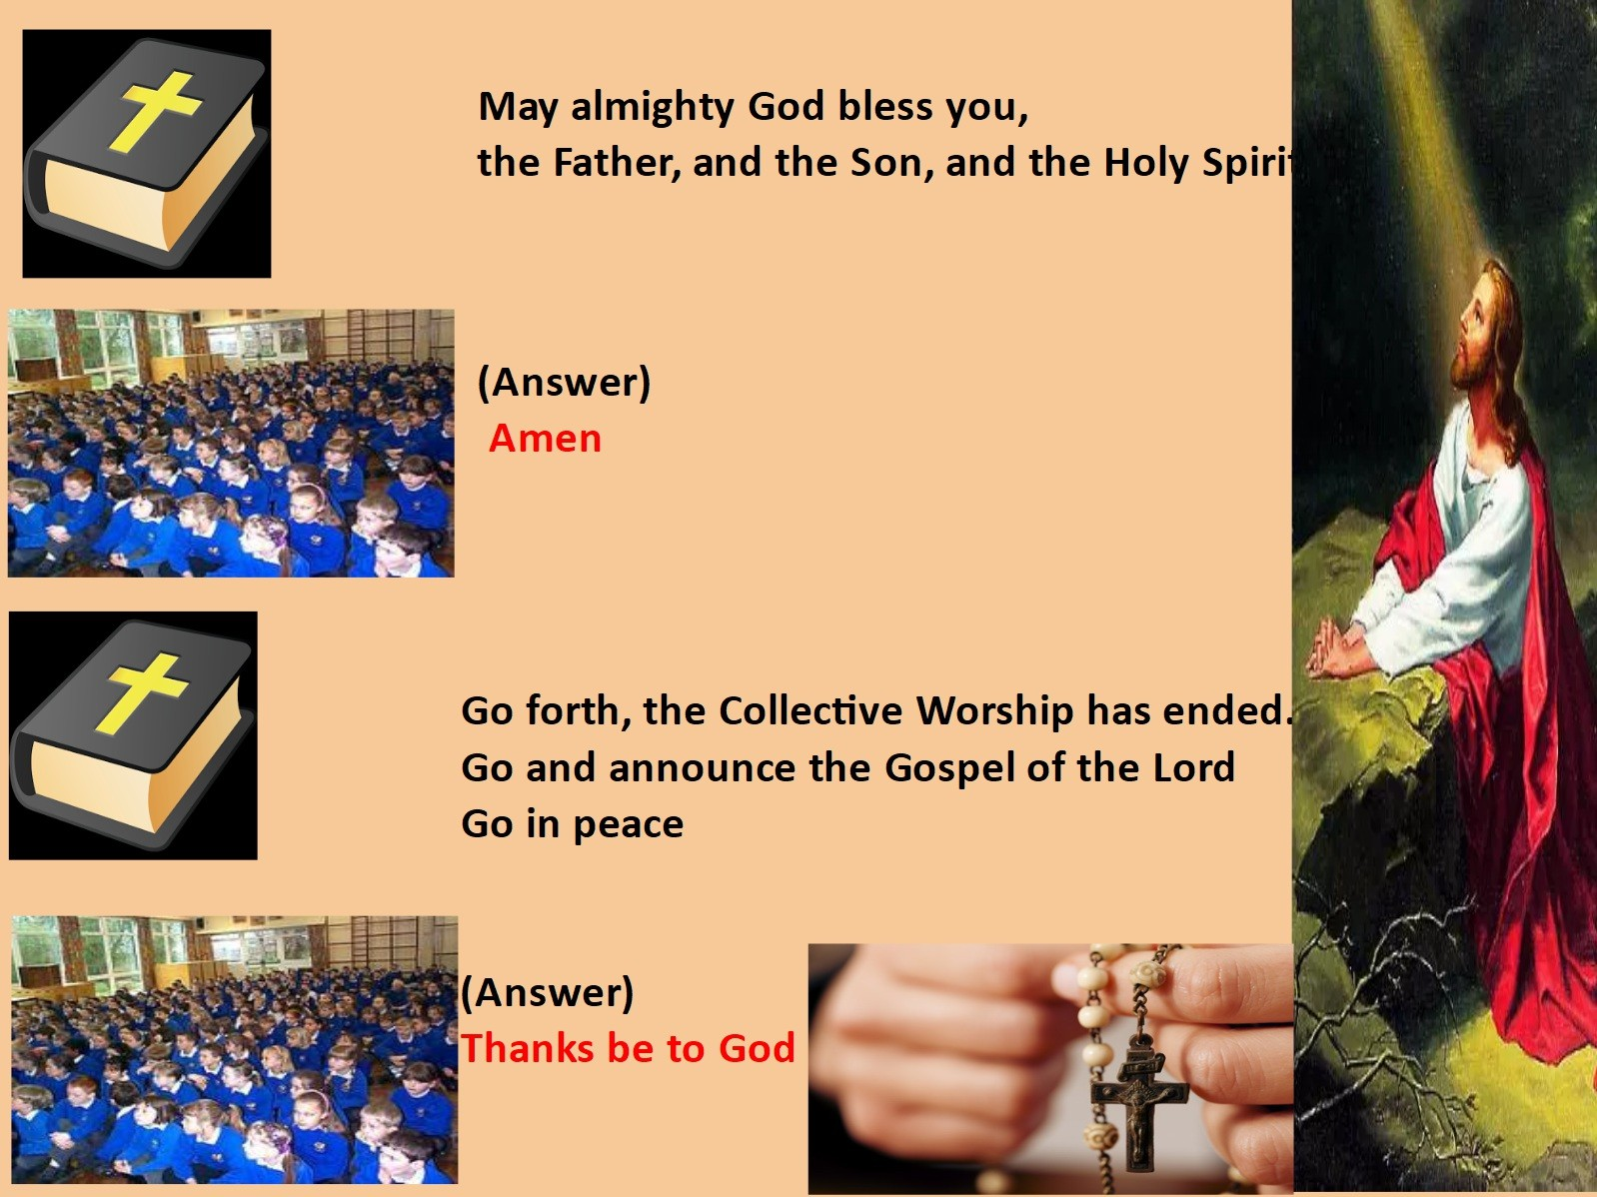
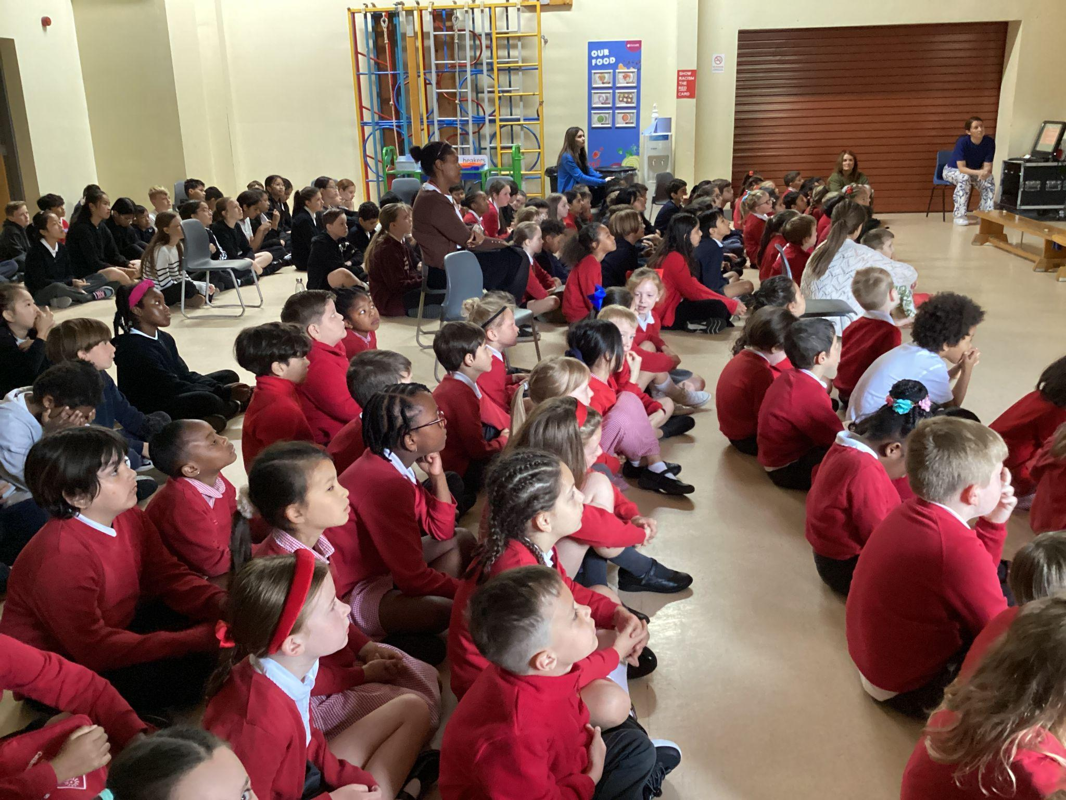
We Go Forth

Slide 17

Thank you for coming to the Celebration of the Word.

Slide 18
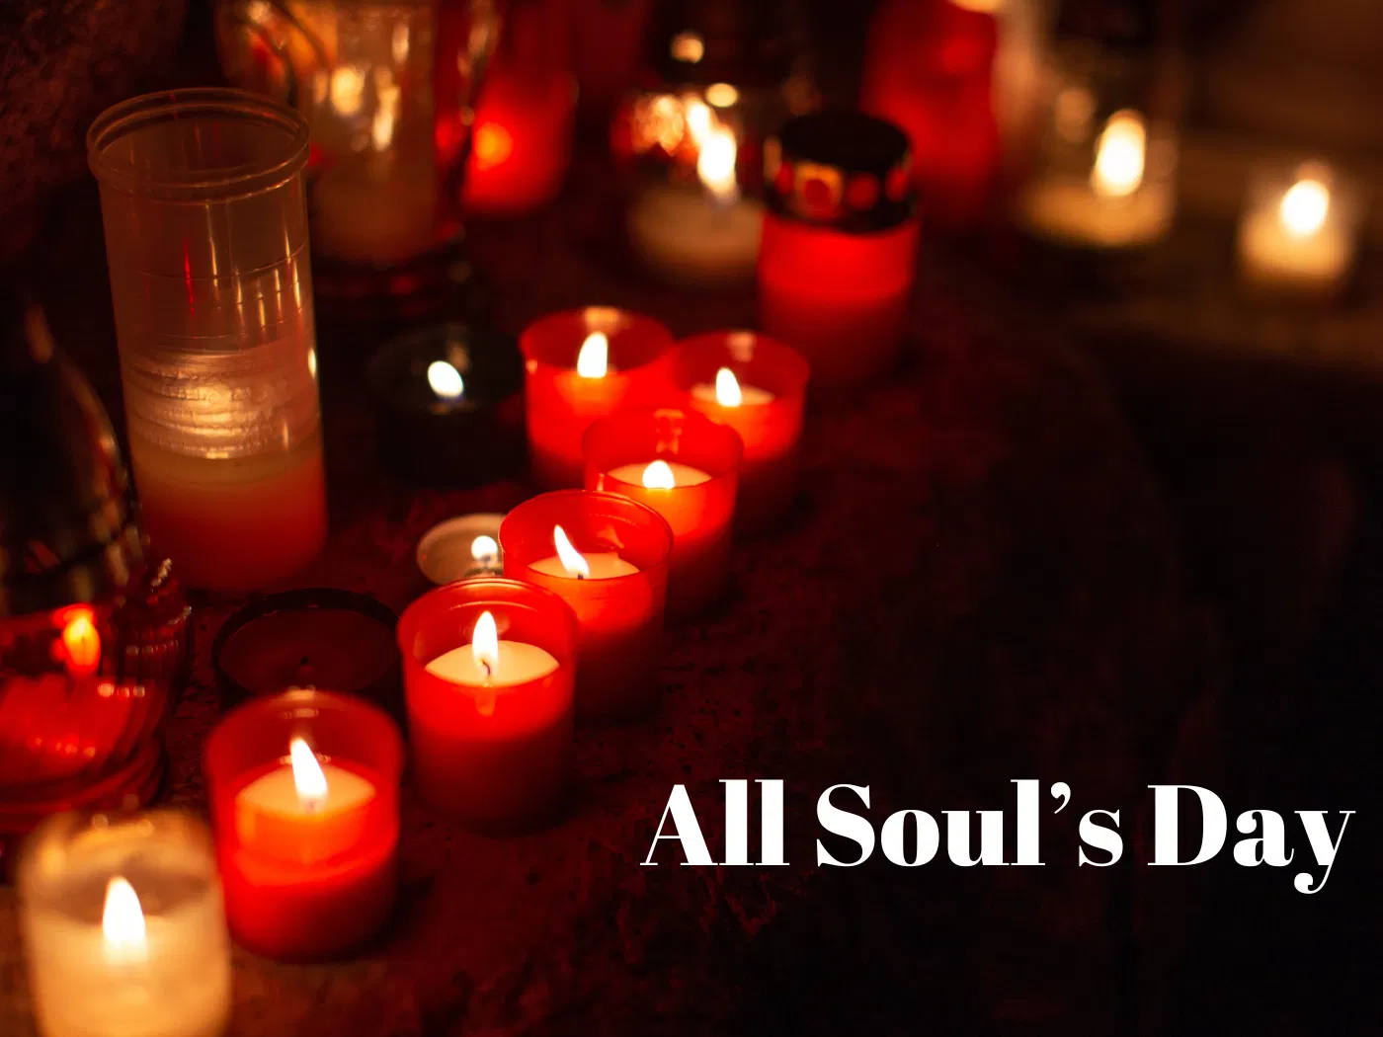
Notes:
https://www.youtube.com/watch?v=h1O9U6QrI70

Slide 19
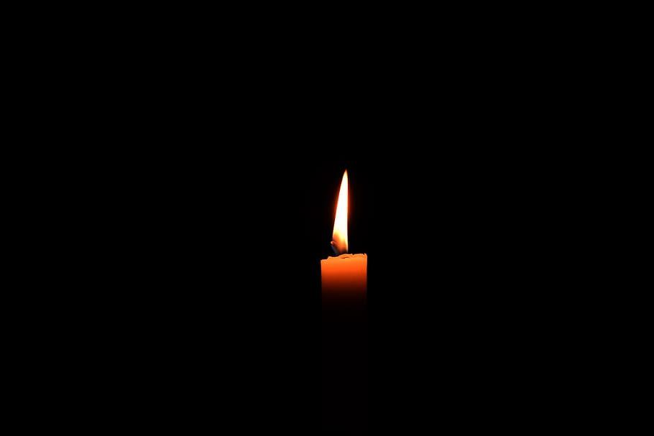
All Souls’ Day Prayer
Dear God,
We remember people who are in heaven with You.
Thank You for loving them
and loving us too.
Please keep them safe and happy with You forever.
Amen.
Notes:
https://www.themark10mission.co.uk/worship-songs/v/this-little-light-of-mine

