Slide 1
Environmental Ambassadors
“Care for Our Common Home — Laudato Si’ in Action”
2025-2026
Environmental Ambassadors 2025–2026
“The Earth is our common home.” – Pope Francis, Laudato Si’

Slide 2
Equality & Inclusion Ambassadors – Action Plan 2025–2026
“There is neither Jew nor Greek, slave nor free, male nor female, for you are all one in Christ Jesus.” — Galatians 3:28
Introduction
At St Edmund’s, we believe that caring for creation is part of our Catholic mission.
Our Environmental Ambassadors are pupil leaders who help our school live out the message of Laudato Si’ – Care for Our Common Home.
They work to:
🌿 Protect and care for God’s creation.
💧 Encourage everyone to recycle, reuse and reduce waste.
🌸 Keep our Prayer Garden and school grounds beautiful.
🕊 Lead the school in prayer and reflection for the environment.
🌍 Live out Catholic Social Teaching: Stewardship of Creation, Solidarity, and the Common Good.

Slide 3
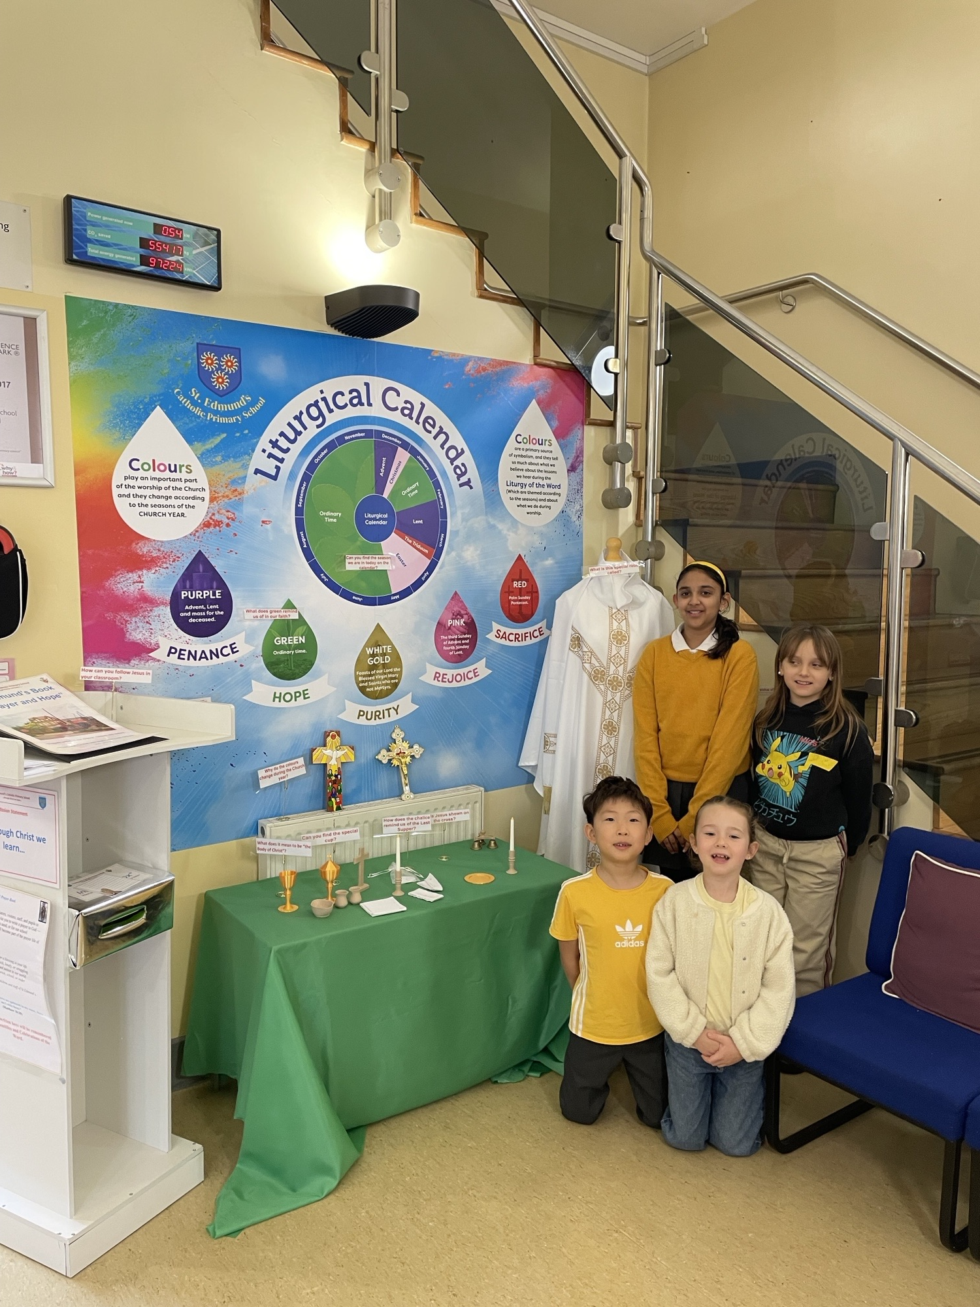
Environmental Ambassadors

Slide 4
Aims & Targets 2025–2026
Our Aims:
To make St Edmund’s a greener, cleaner, and more caring school.
To teach others how small actions make a big difference.
To link our projects to Laudato Si’ and share them in assemblies.
Our Targets:
✅ Reduce waste in classrooms.
✅ Lead a “Switch Off” energy campaign.
✅ Organise a tree or flower planting day.
✅ Help create recycling stations.
✅ Care for the Prayer Garden every week.

Slide 5
“The Earth is crying out, and we must respond.” – Laudato Si’ #49
Pope Francis reminds us that God calls us to care for creation with love and gratitude.
Our ambassadors lead the school in responding to the Laudato Si’ goals, such as:
🌱 Ecological education
🌍 Adopting simpler lifestyles
💚 Community engagement
🤝Solidarity with the poor
Each project we do links back to one of these goals!

Slide 6
🌍 Environmental Ambassadors’ Pledge
Inspired by Pope Francis’ Laudato Si’ – Care for Our Common Home
“The Earth is our home, and we are all brothers and sisters within it.” – Laudato Si’ #92
As an Environmental Ambassador of St Edmund’s Catholic Primary School,
I promise to:
🌿 Care for God’s creation — to protect the Earth, animals, and all living things.
💧 Use resources wisely — to save water, switch off lights, and reduce waste.
🌸 Notice beauty — to thank God for the gifts of nature and help others see it too.
🌍 Take action — to recycle, plant, clean, and care for our Prayer Garden and school grounds.
🤝 Lead by example — to inspire my friends and family to make good choices for our planet.
💚 Pray for the Earth — to ask God to bless all people and creation with peace and healing.

Slide 7
Monitoring & Evidence
We will record our impact through:
📷 Photos of Eco projects, Prayer Garden work, recycling days
🗣 Pupil voice reflections and quotes
📘 Ambassador meeting notes
🧾 Project logs and action plans
💻 Website updates and newsletters
Our Mission in Action
Include placeholders for:
Photos of ambassadors at work
Quotes from pupils about what creation means to them
Future ideas (e.g. “Plastic-Free Week,” “Garden Prayer Circle,” “Save the Bees Project”)

Slide 8


