Slide 1

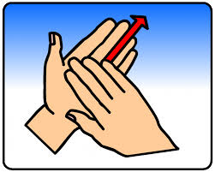
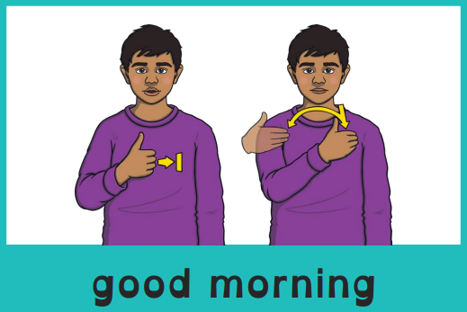
Good morning, everyone.
Celebration of the Word Assembly - 01/12/2025
Hajni

Slide 2

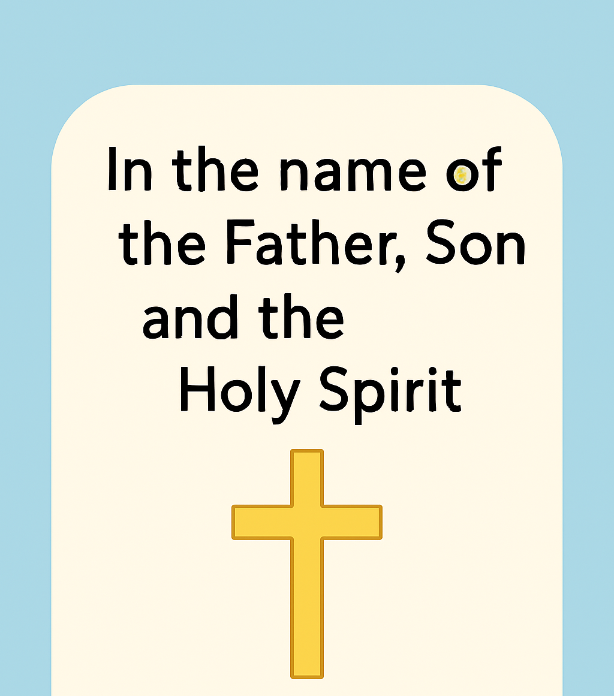
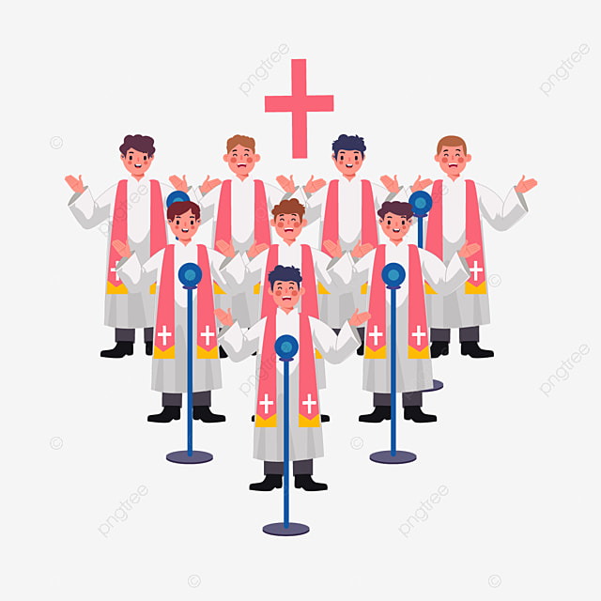
Through Christ We Learn

Slide 3
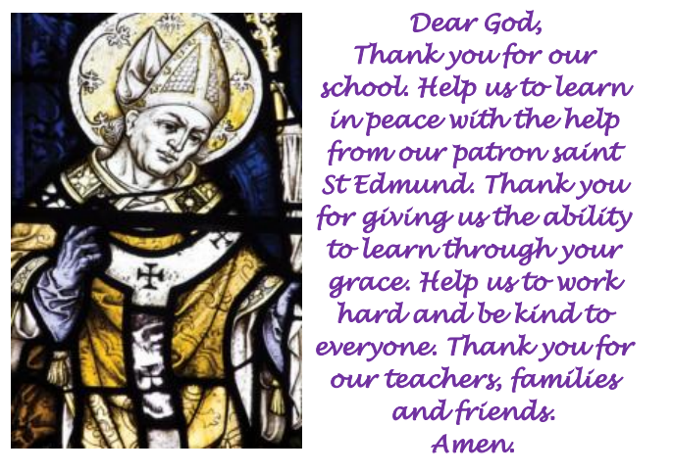
St Edmund’s School Prayer

Slide 4
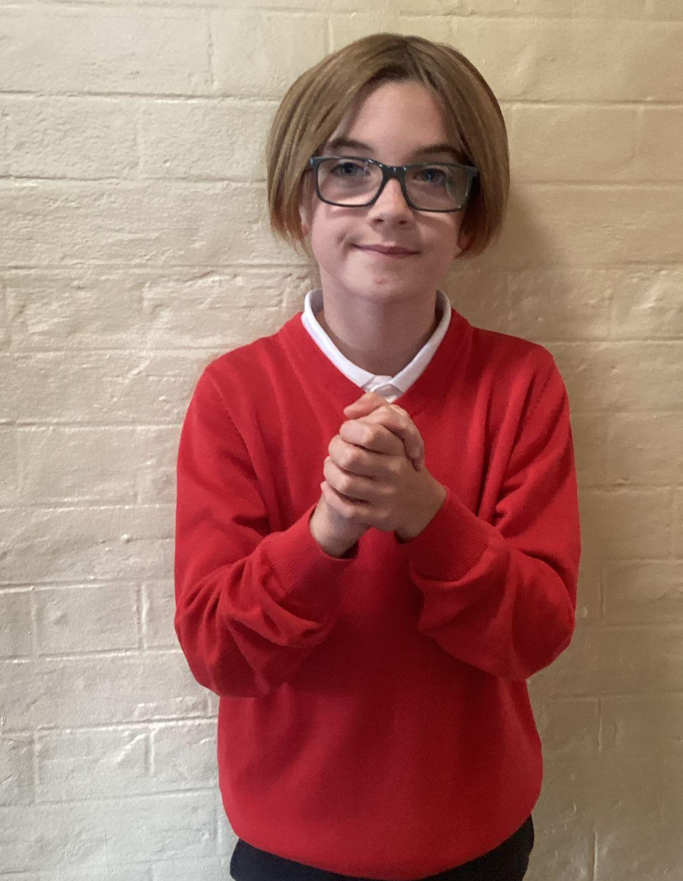
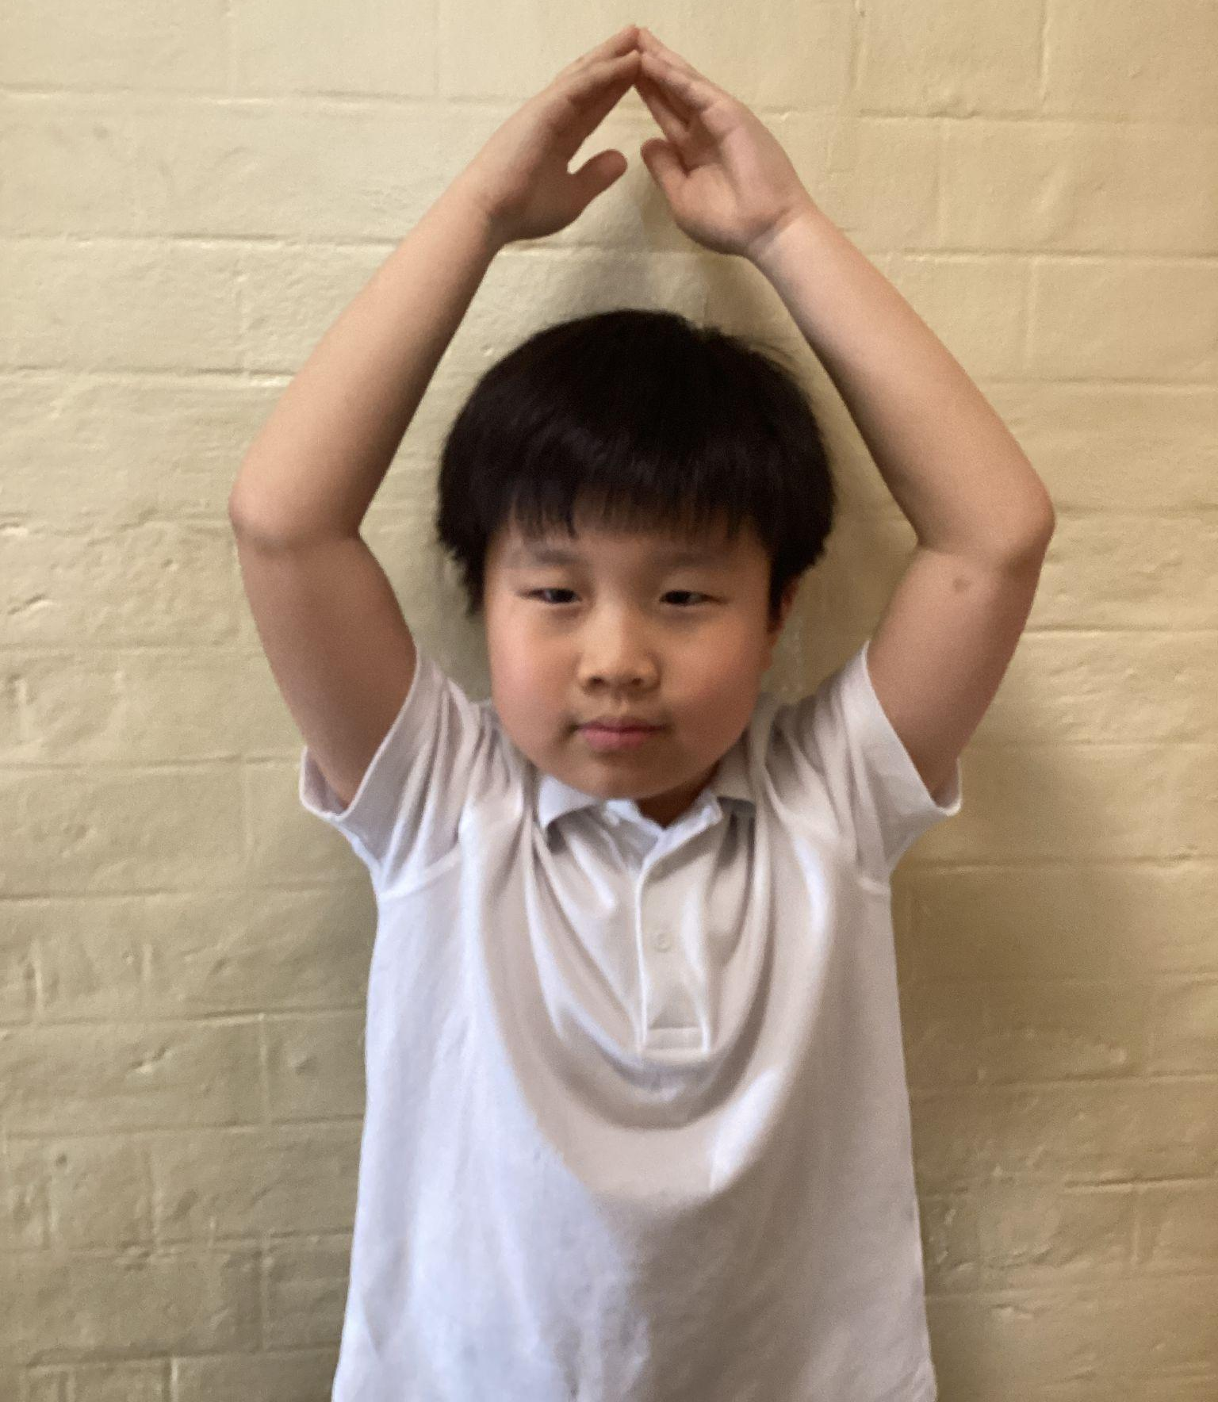
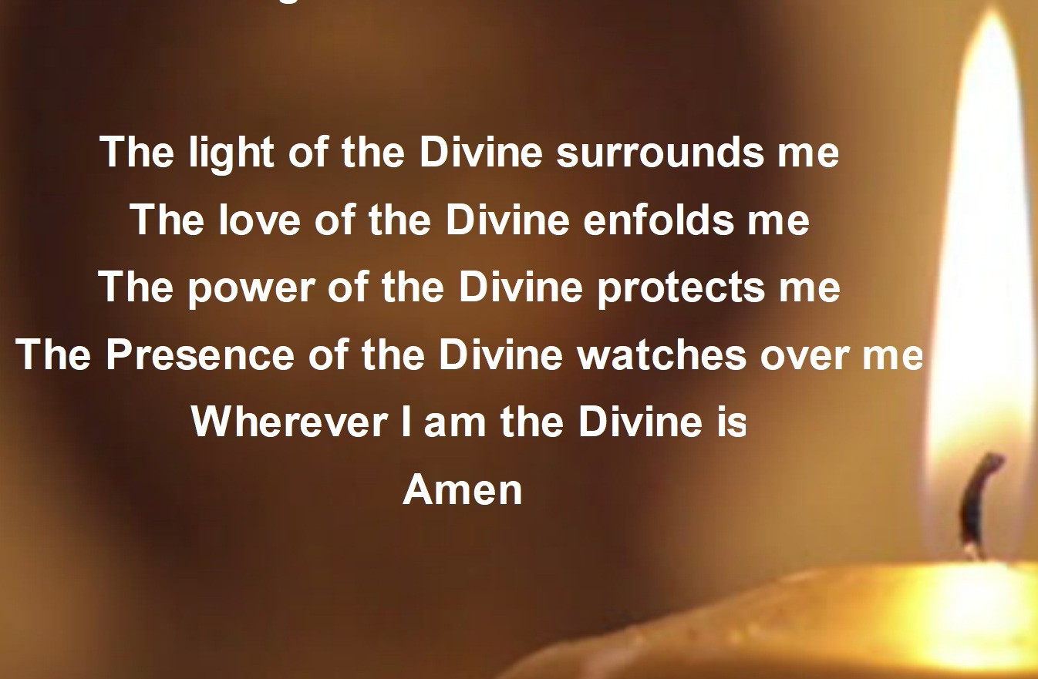
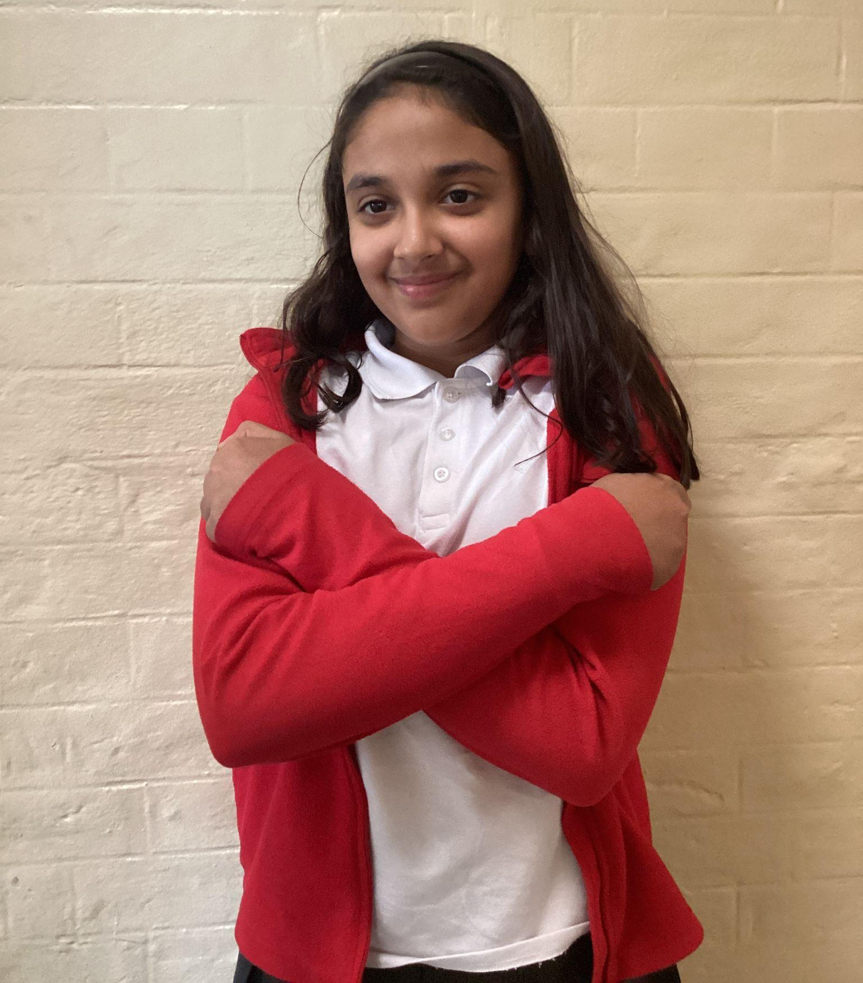
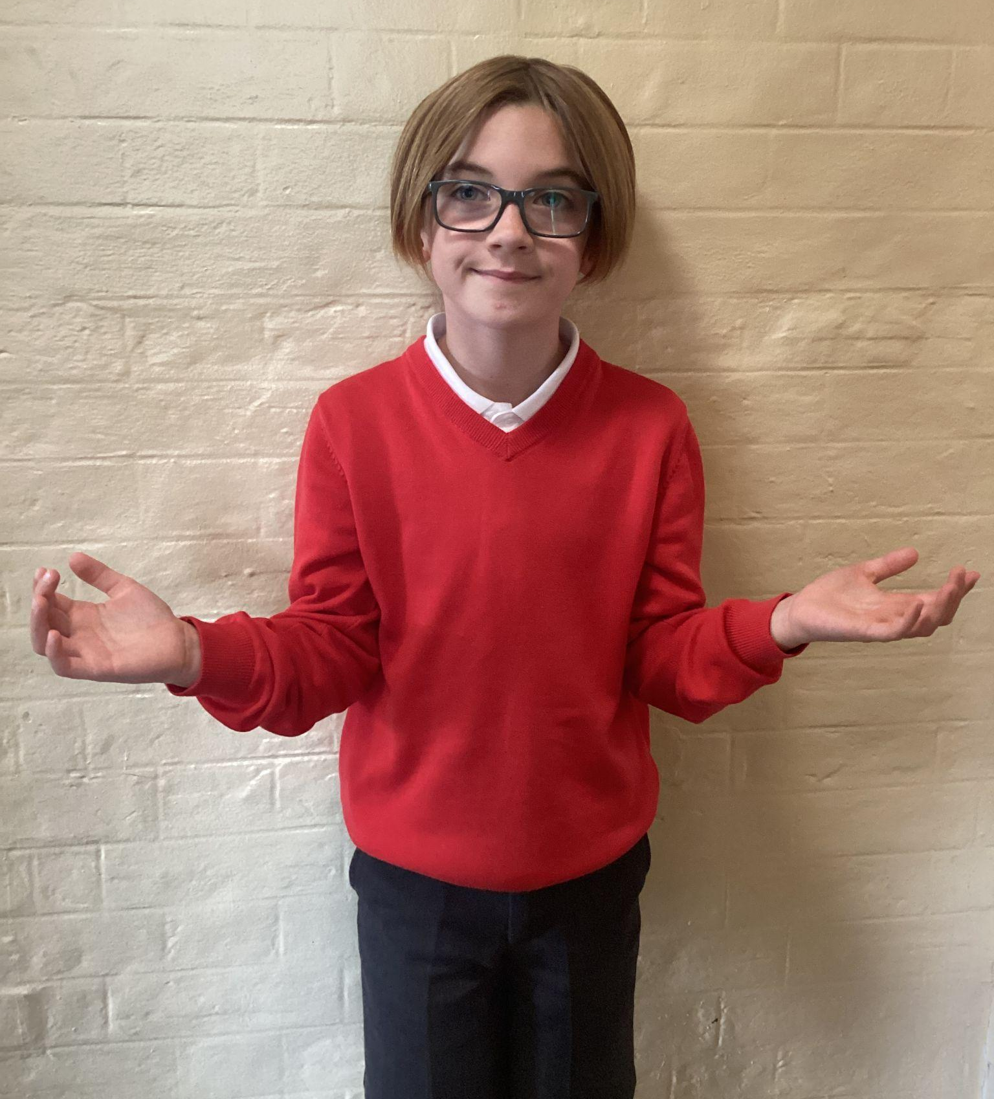
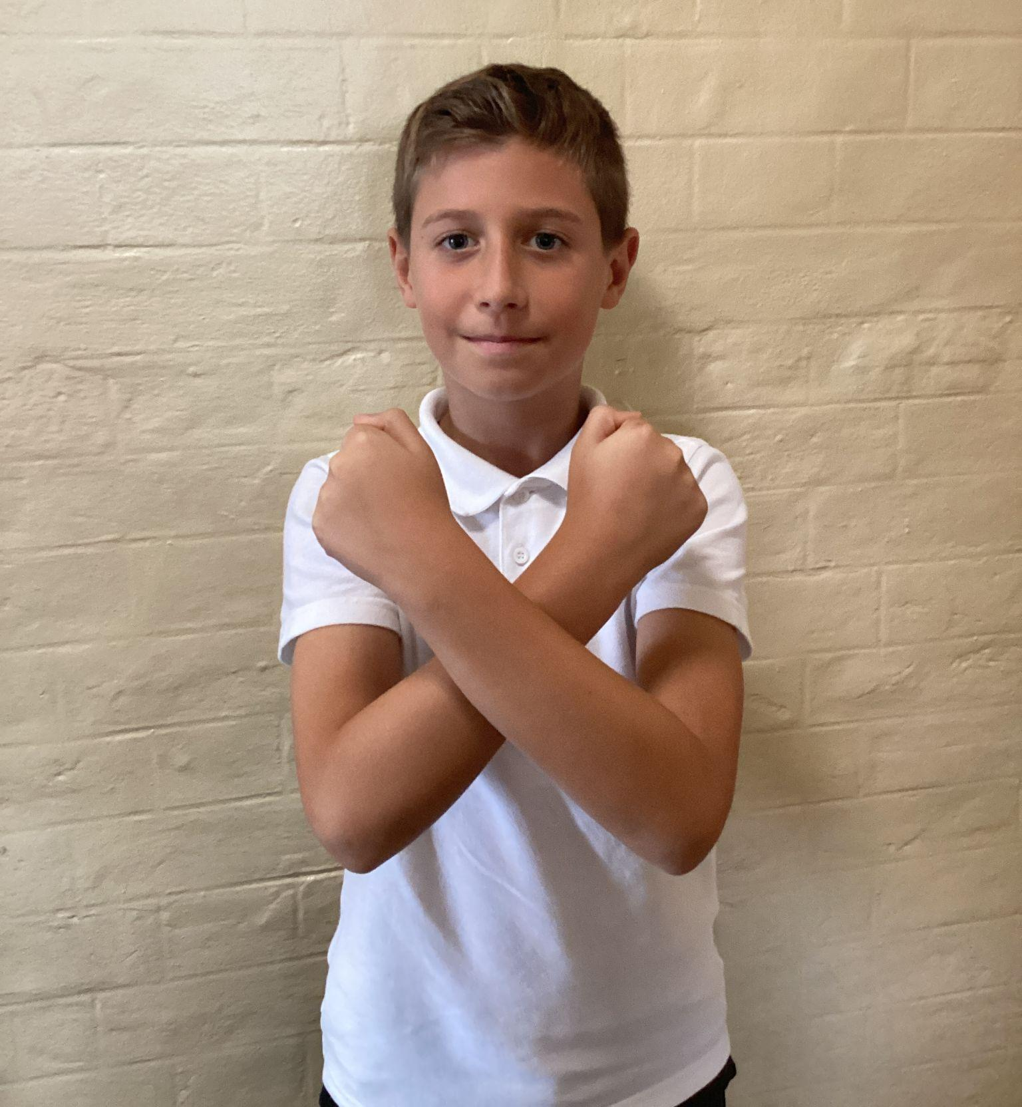
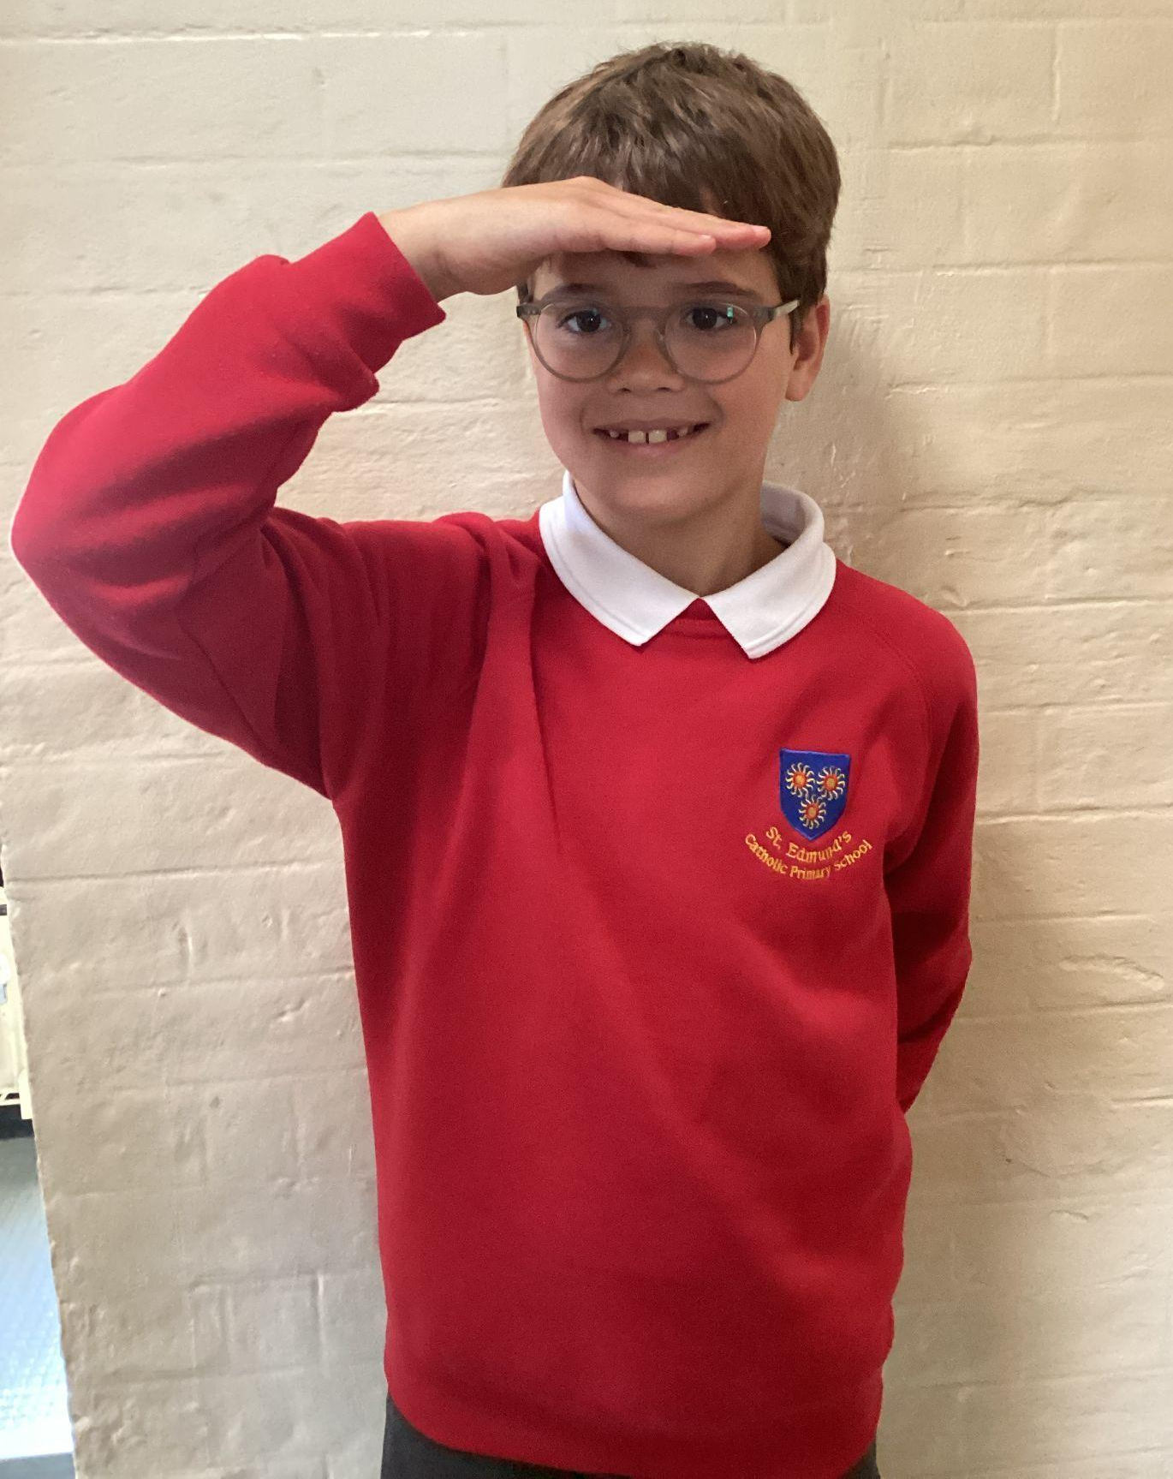
Please repeat after me
1. Light
6. Amen
2. Love
5. Wherever I am.
3. Power
4. Presence

Slide 5
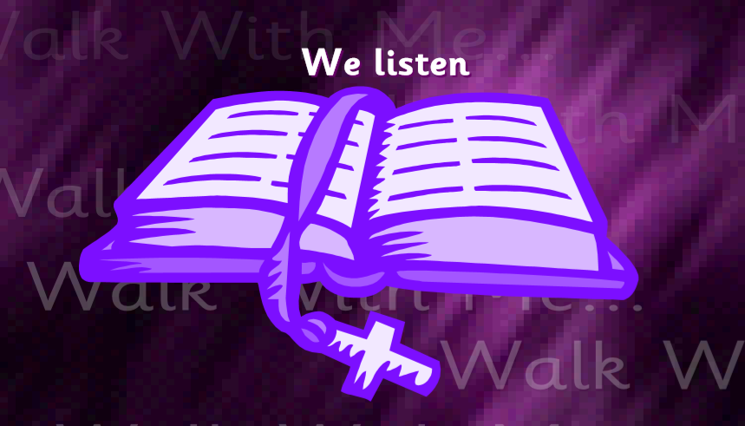
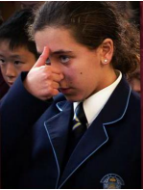
The Lord be with you.
All: And with your spirit.
A reading from the Holy Gospel according to Matthew.
All: Glory to You, Oh Lord.

Slide 6
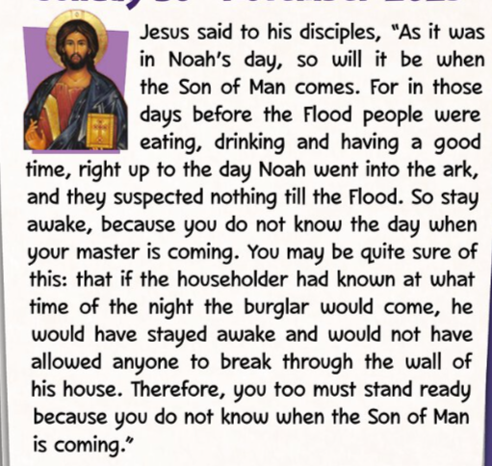
The Gospel of the Lord.
ALL: Praise to you Lord Jesus Christ.
Matthew 24:37-44

Slide 7
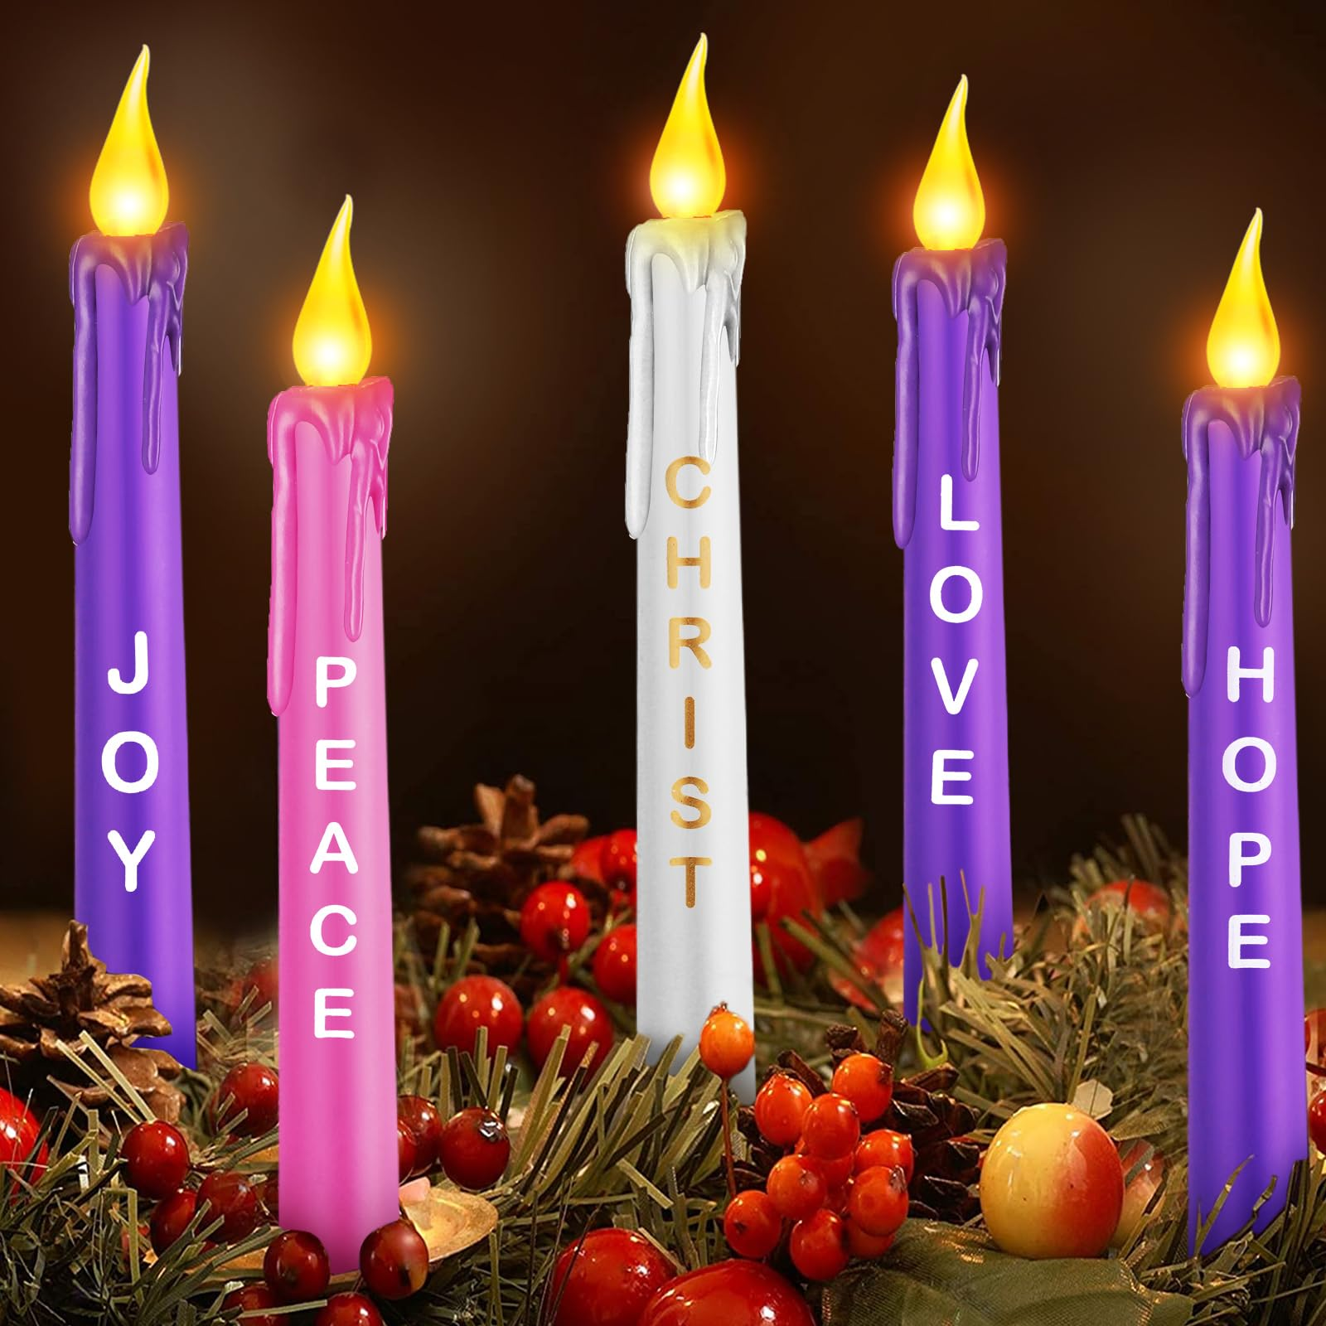
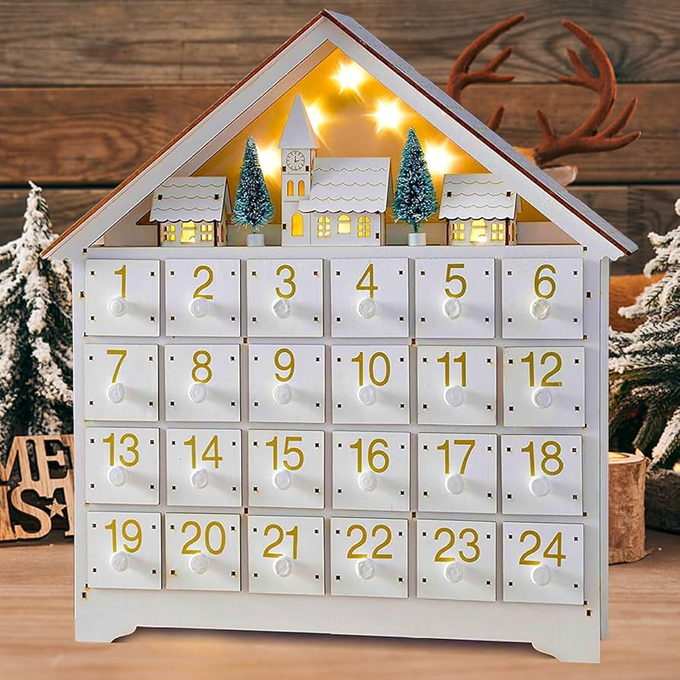
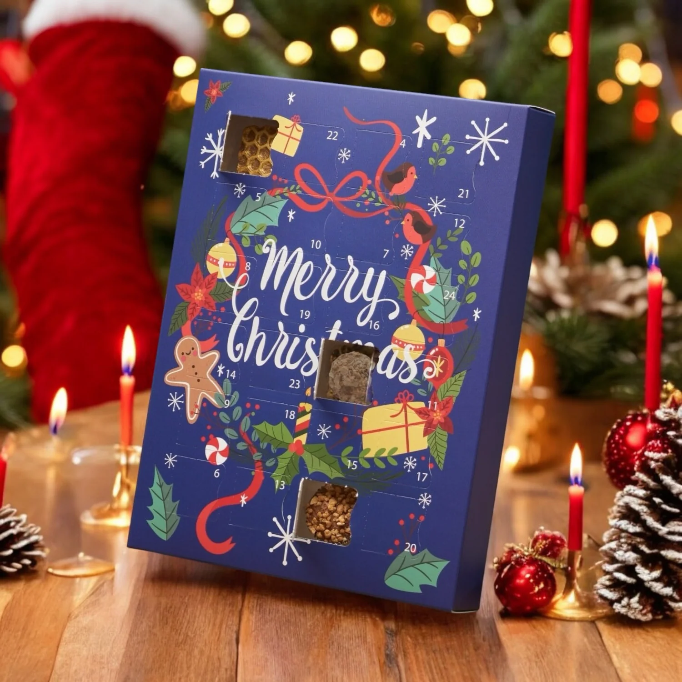
What is this week’s Word?
ADVENT

Slide 8
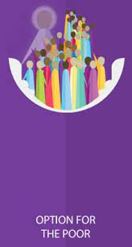

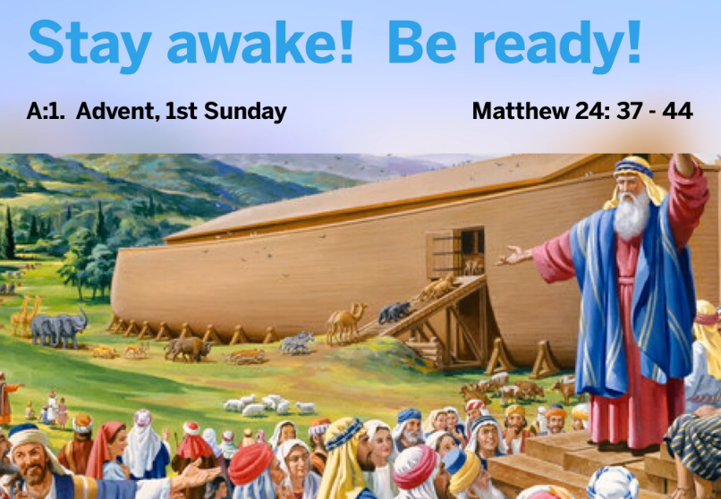
How does the Wednesday word link to
Catholic Social Teaching, RE or Scripture?
ADVENT

Slide 9
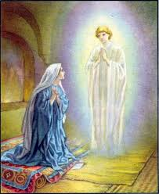
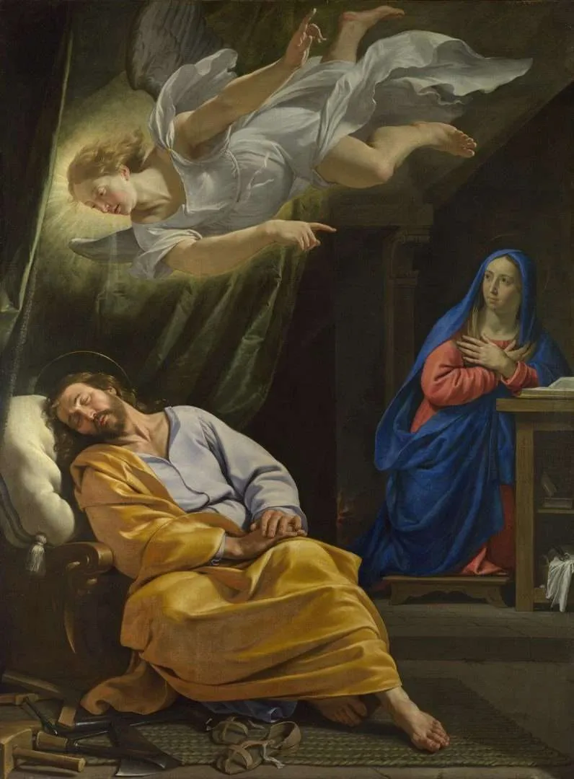
Are there any other scriptures that link to our Wednesday Word, ADVENT?
The Annunciation
Luke 1:26–38
Joseph’s Dream
Matthew 1:18–24

Slide 10

Catholic Social Teaching
Advent is a time when we get our hearts ready for Jesus, and Catholic Social Teaching helps us remember how to do that. During Advent, we think about caring for others, especially people who are lonely, poor, or in need. We remember that every person is special to God, so we should show kindness and respect to everyone.

Slide 11
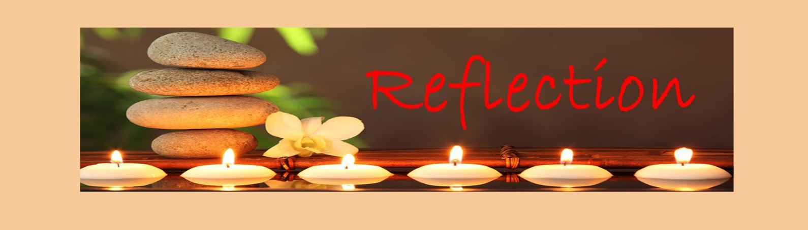
Close your eyes and accept Jesus in your hearts
Imagine a small candle in the darkness. At first, the room is dark… but when the candle is lit, the light begins to grow. It feels warm, peaceful, and full of hope.
Advent is like that little light. Each week, as we light a new candle, we remember that Jesus is coming — the Light of the World. We think about how we can make our hearts ready for Him.

Slide 12

We Respond
Dear Lord Jesus,
help me to share Your light.
Help me to be kind, to bring hope to others,
and to get my heart ready for You this Advent.
Amen.

Slide 13
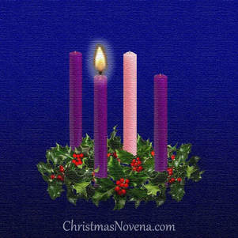
MISSION
We light the first Advent candle and pray together as a class.

Slide 14
Act of Dedication
P&J: Lord Jesus, we dedicate this Advent to growing in Your light through kindness, hope, and love.
All: Come, Lord Jesus, guide my heart.

Slide 15
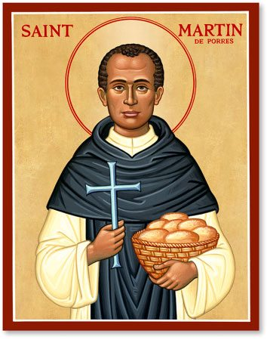
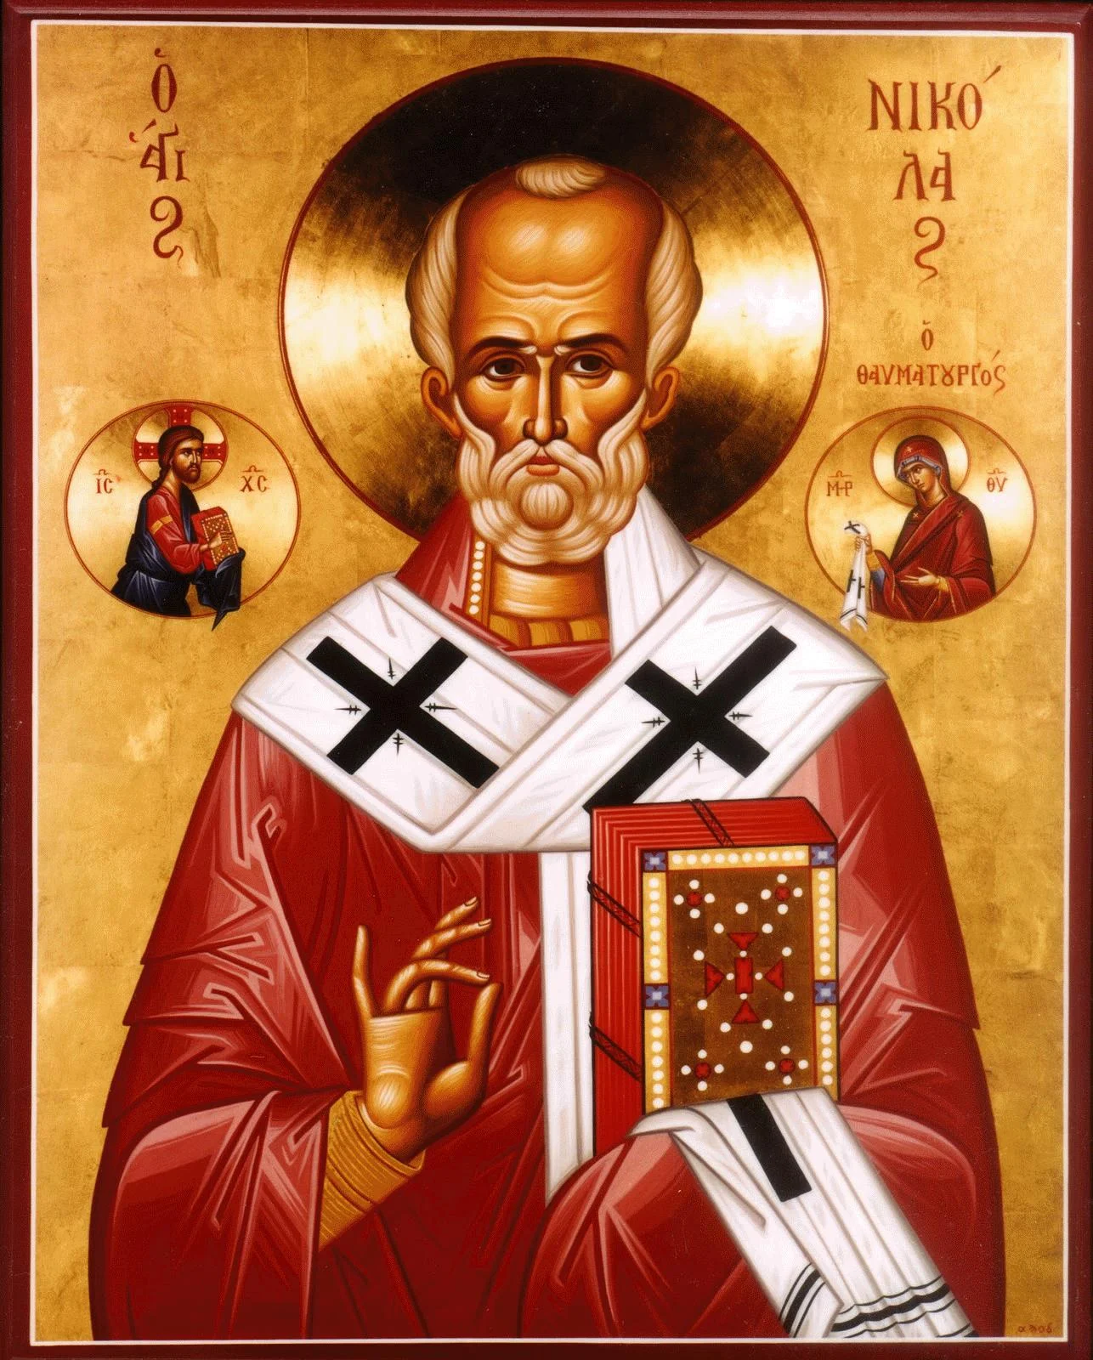
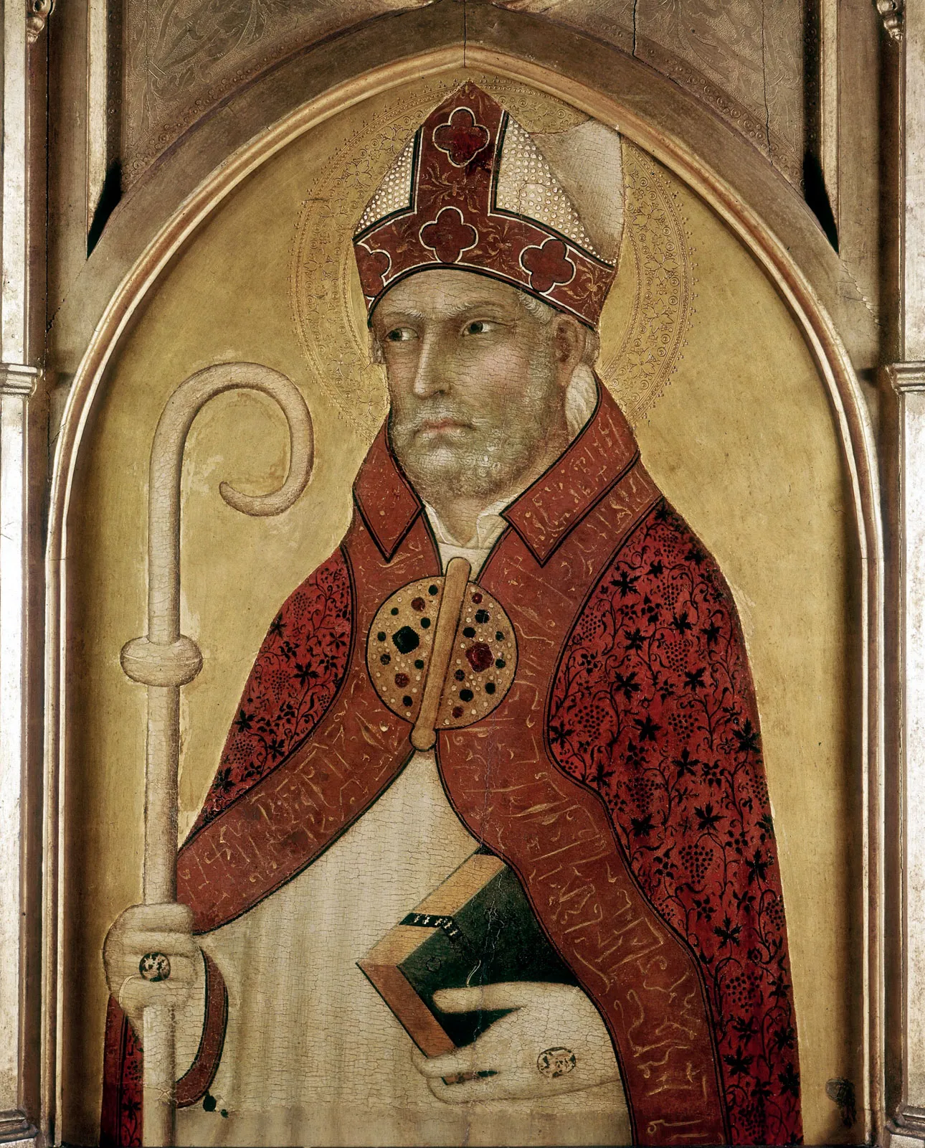
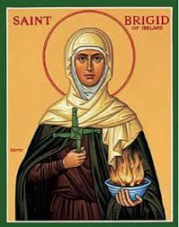
Litany of Saints
PJ: St. Nicolas
All: Pray for us
PJ: St. Martin de Porres
All: Pray for us
PJ: St. Augustine
All: Pray for us
PJ: St. Brigid
All: Pray for us

Slide 16
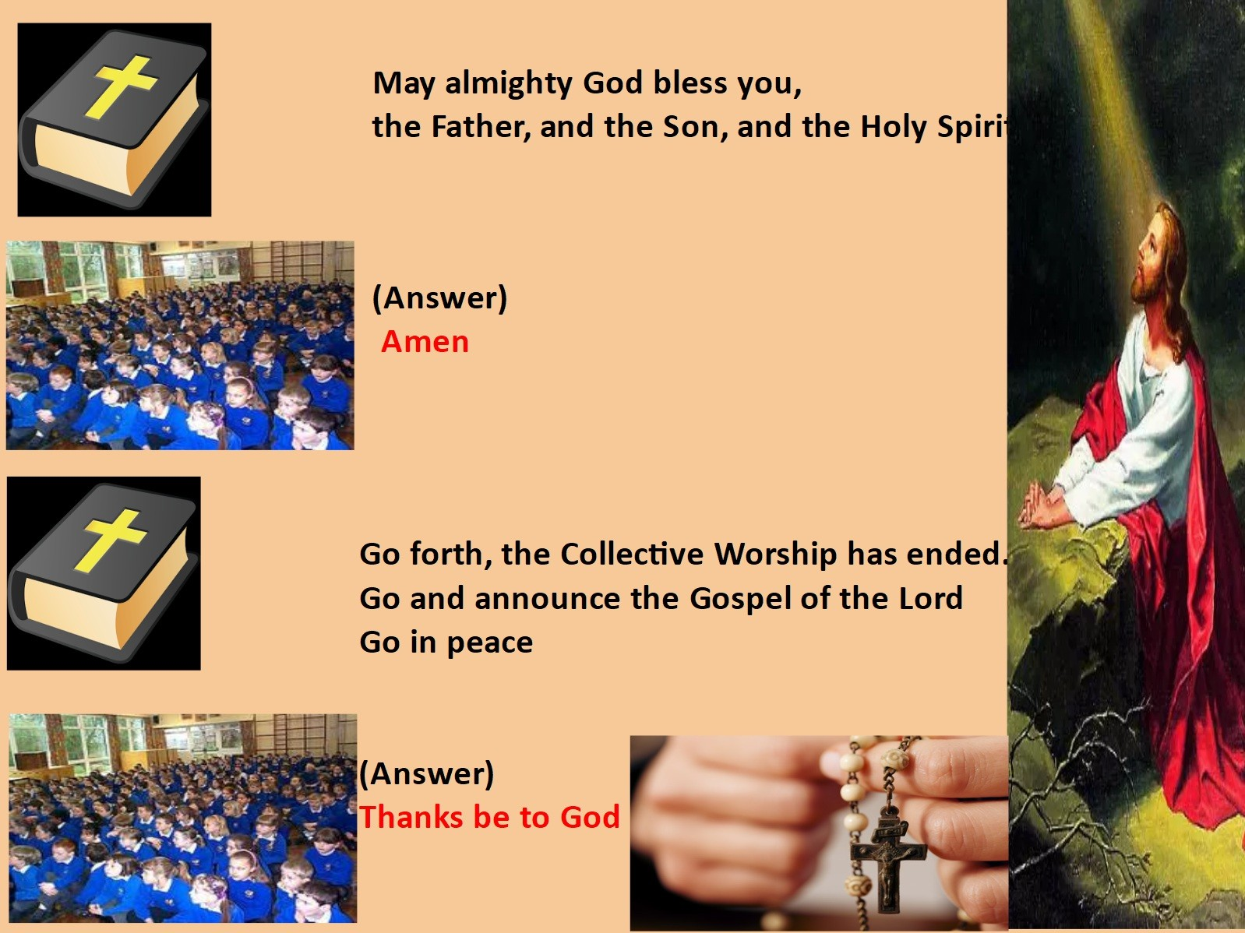
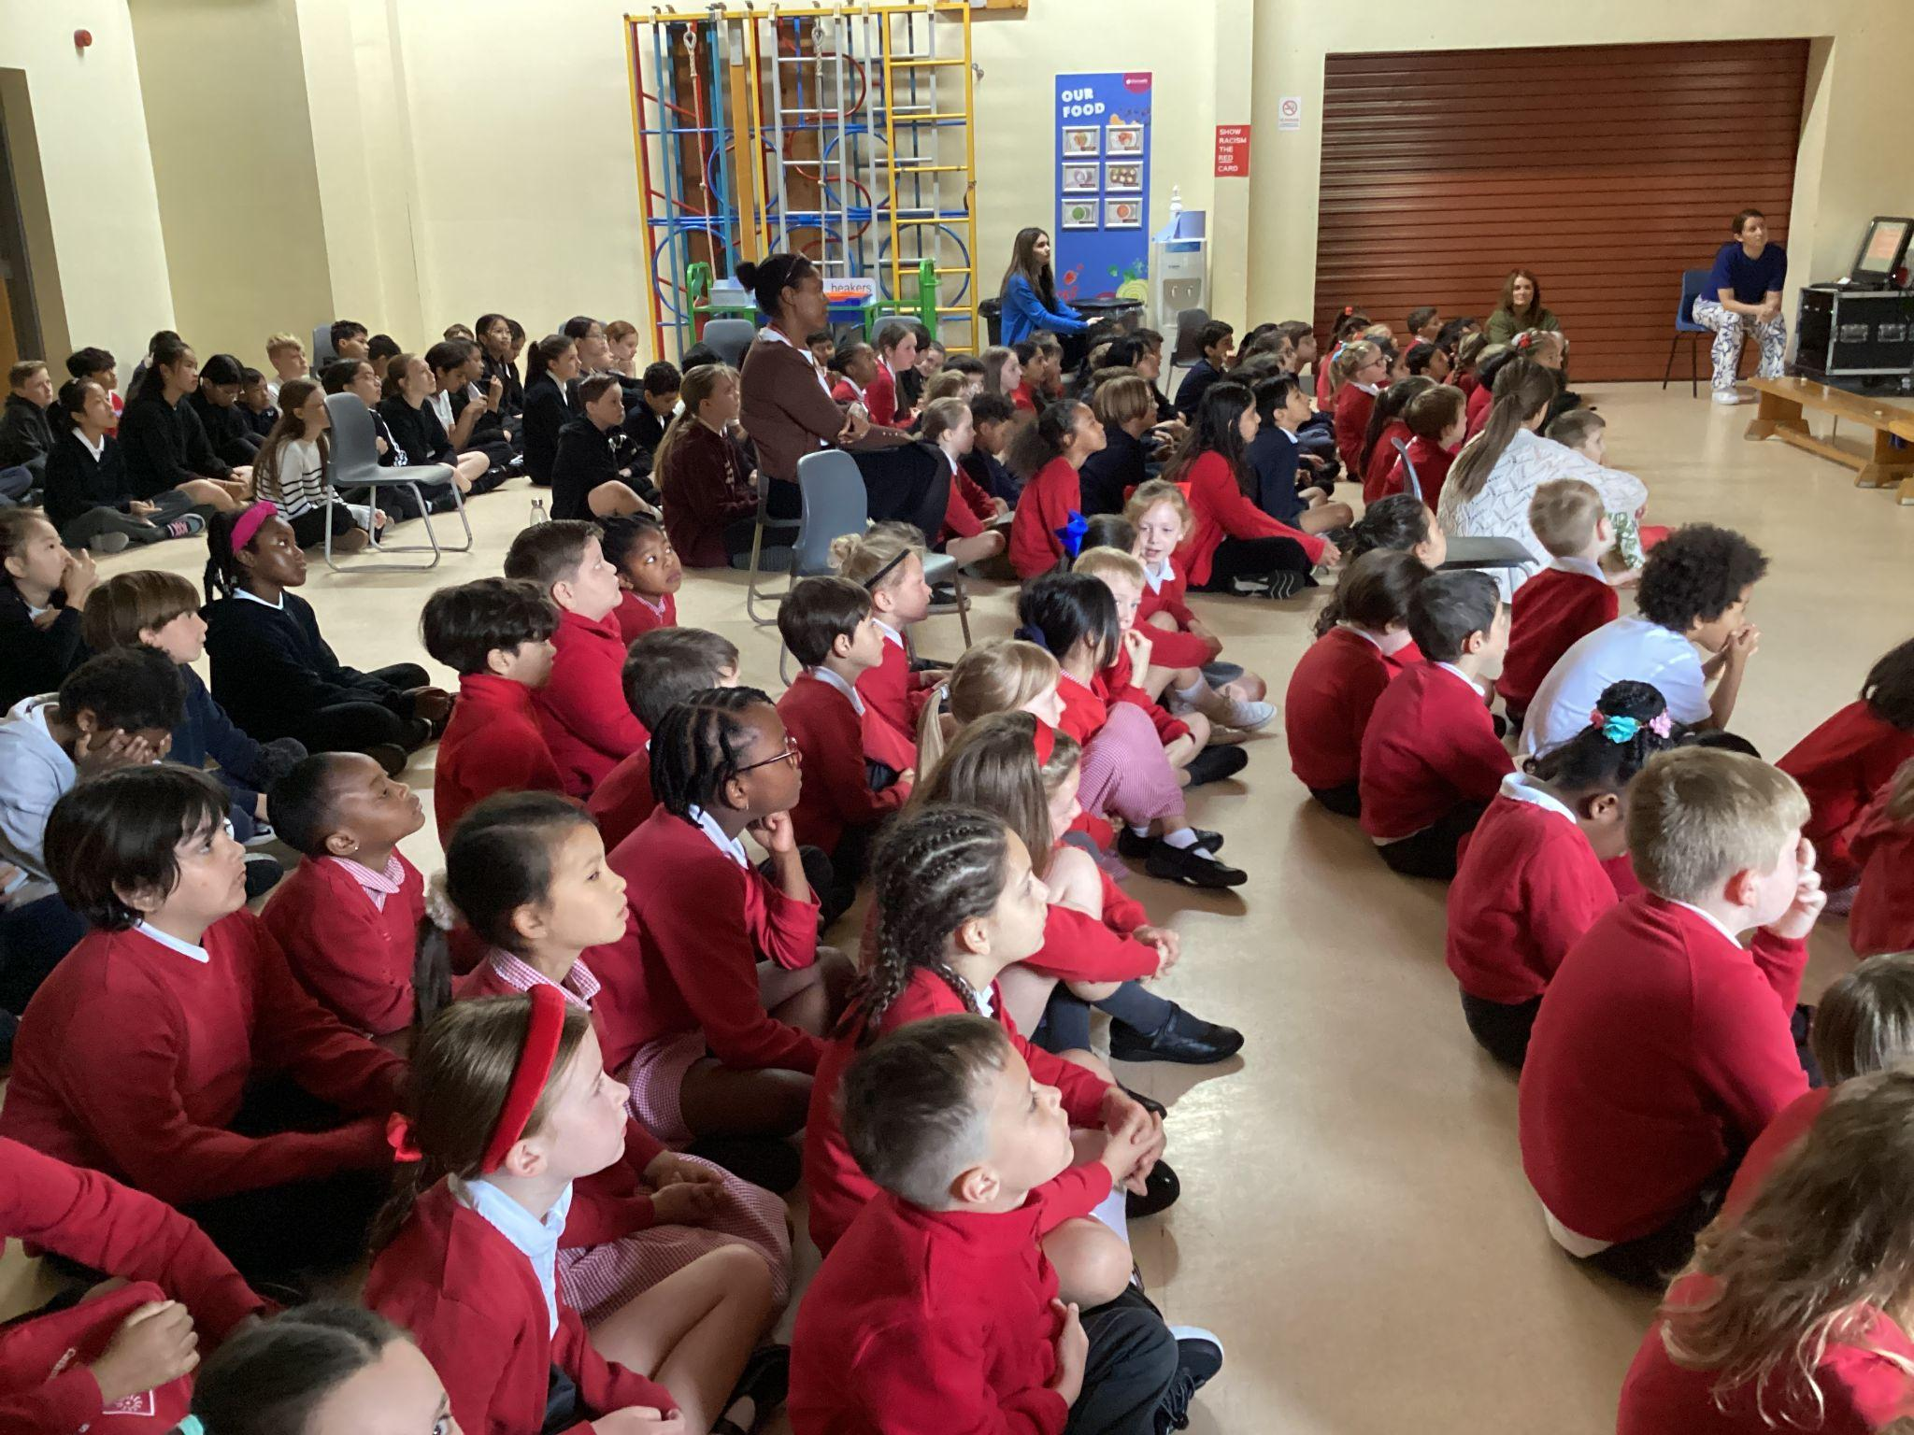
We Go Forth

Slide 17

Thank you for coming to the Celebration of the Word.

Slide 18
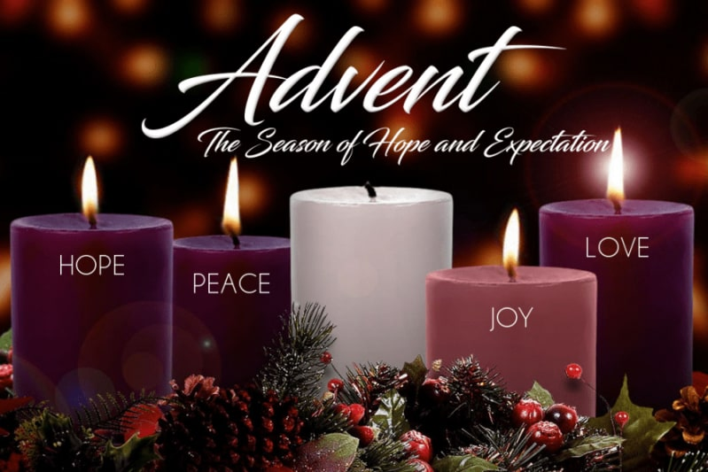

Slide 19
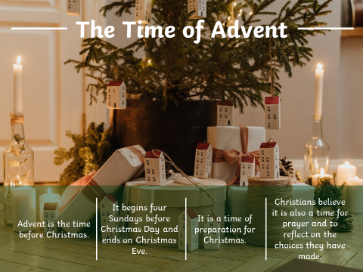

Slide 20
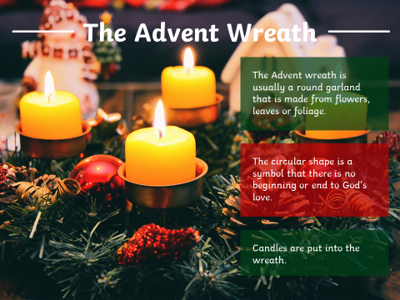

Slide 21
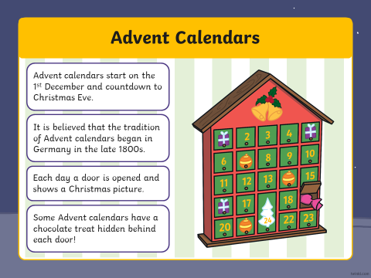

Slide 22
