Slide 1

Key Dates:
Key dates including class assemblies, enrichment days / events and coffee mornings can be found on Class Dojo.
Trips take place each half term and are planned to support the half termly learning. Separate letters will be sent to inform you of details for upcoming class trips. These are also added to the school's calendar on Class Dojo.
PE:
Please ensure your child has the correct PE kit for their timetabled PE days. Children must have a full school PE kit to ensure personal hygiene and safety. Our PE day is on Monday’s.
Homework:
It is very important that children in Year 1 are reading at home every day.
Children should spend a set time each day completing homework and practising spellings to develop good routines. This should include:
Reading their home reading book for 10 minutes each evening. (Please sign and date their Reading Record diary to show that this has been completed.)
Reading their Read Write Inc. phonics story book for 5 minutes each evening.
Practising their weekly spellings every evening. These can be practised in the back of their red spelling exercise books. (Please date each entry as a record of their practise at home.)
Regularly practising their 2, 5, and 10 times tables at home. Consistent revision is key to ensuring that the children are fluent in their times tables. These times tables are foundational to the rest of the maths curriculum as the children progress up the school.
Accessing the home learning sites on Doodle.
Year 1 Curriculum Newsletter
Spring 2025
Dear Parents and Carers,
We would like to welcome you back and hope you all enjoyed a relaxing and productive Christmas break. Thanks to so many of you who supported your children's progress during the holidays by continuing their learning at home.
Please feel free to speak to us about your child’s progress or any concerns you may have. Information about what your child will learn this half term is on the reverse of this newsletter.
We look forward to working with you and your child.
Best wishes,
The Year 1 Team

Slide 2



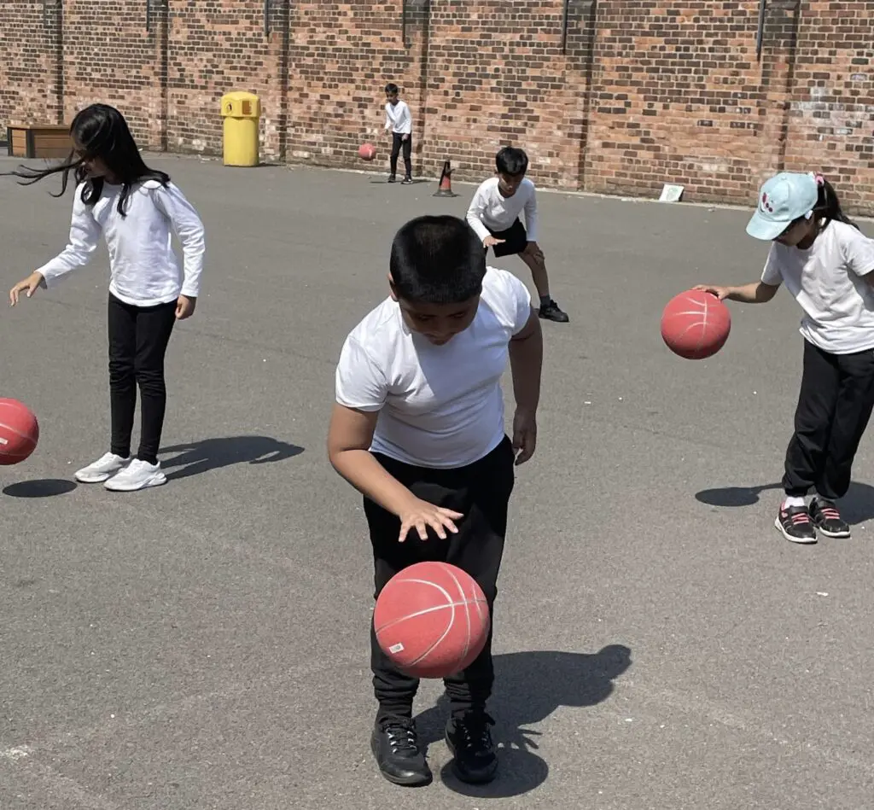


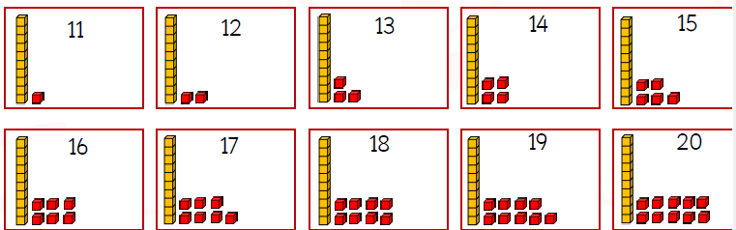

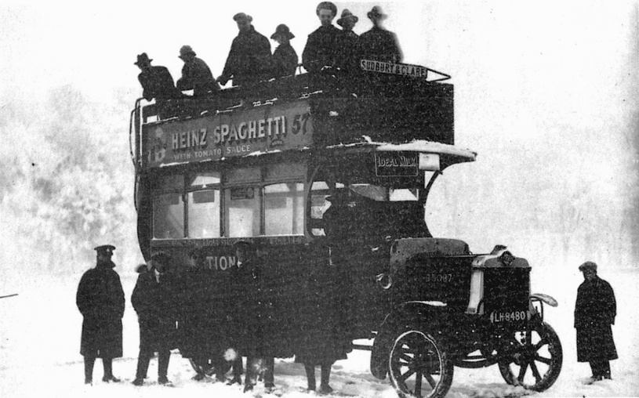
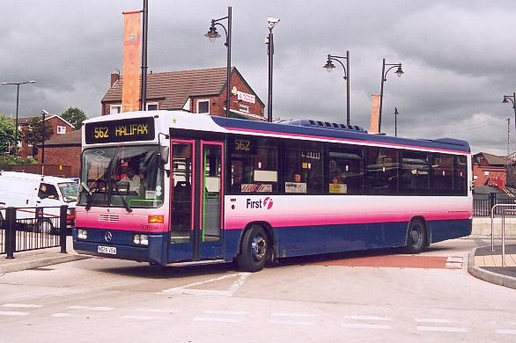
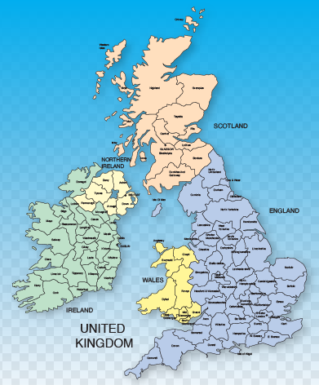
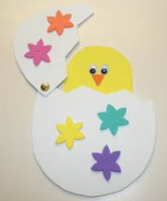
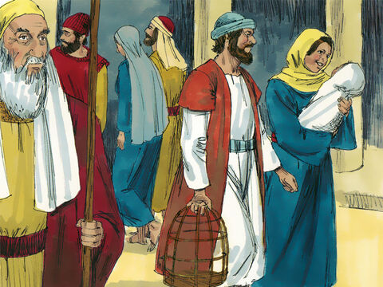
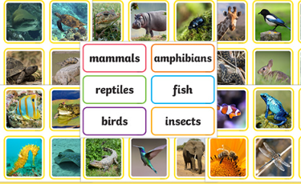
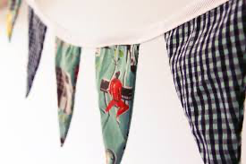
Literacy:
As writers, we will explore narrative stories in order to entertain our reader with an adventure story; moving onto stories about fantasy worlds.
In the second half of term, we will then move onto the genre of Information Texts, where we will be looking at the book Wheels, Wings and Other Things and Poetry.
Computing:
In Computing, we will be learning how to use computers safely and creatively. We will begin with an E-Safety lesson, learning how to search for information safely online and understanding how to use the internet responsibly. Children will then explore digital music, using the programme Purple Mash to play, record and sequence simple melodies. Through these activities, we will develop our confidence using technology, practise basic computing skills, and learn how computers can be used to create and enjoy music.
 | Year 1 Learning Overview Spring
PE:
Our PE unit this term is Ball Skills and Dance. We will practise our throwing and catching skills, and play competitive games to develop flexibility, strength, technique, control and balance.
We will also develop our skills in dance by learning about different ways our body can move.
Maths:
As Mathematicians, we will be learning the following topics: place value within 20, additional and subtraction within 20.
Children will be expected to solve a variety of sums and word problems based on the skills learnt in these mathematical topics.
We will then move on to learning about length and height and mass and volume.
History:
Our History topic this term is Old and New Transport. We will be learning about how transport has changed and how they are different today.
Geography:
Our Geography topic this term is The UK. We will be learning about the geographical features of the UK and learning about the countries and cities within the UK. We will also develop our map skills and observational skills.
Science:
As Scientists, we will be looking at different types of Animals.
We will be categorising different animals, where they live and what they eat.
Design Technology:
In DT, we will start off with designing and making a moving picture, looking at the mechanisms of them and then move on to the topic off Fabric Bunting.
In both topics we will be designing purposeful, functional, appealing products for ourselves and other users based on design criteria.
Religious Education:
In RE, our topic is ‘From Galilee to Jerusalem.’
We will be learning Bible scripture, such as ‘The Presentation’ any how people knew that baby Jesus was special.
We will then move on to Desert to Garden; where we will learn about Lent and the Holy Week.

