Slide 1

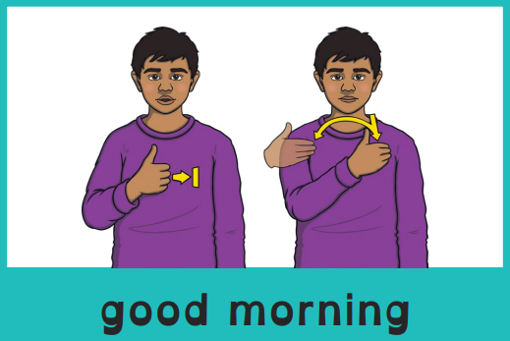
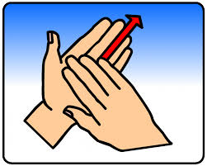
Good morning, everyone.
Celebration of the Word Assembly - 06/10/2025
Hajni

Slide 2



St Edmund’s Catholic Primary School
…Through Christ we learn…
Executive Headteacher: Mrs A. Ruthven
Head of School: Mr A. Antoniou
St Edmund’s Catholic Primary School Mission
Our Mission
Through Christ We Learn

Slide 3

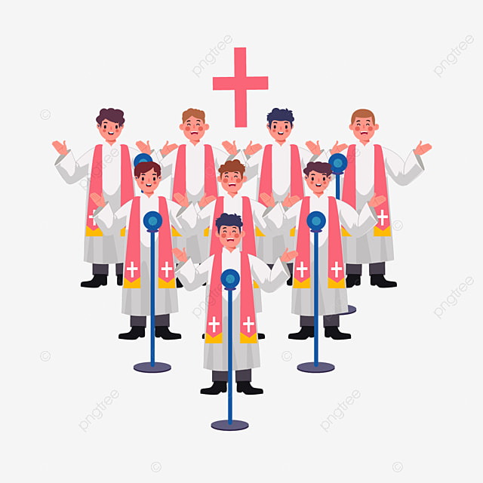

Slide 4
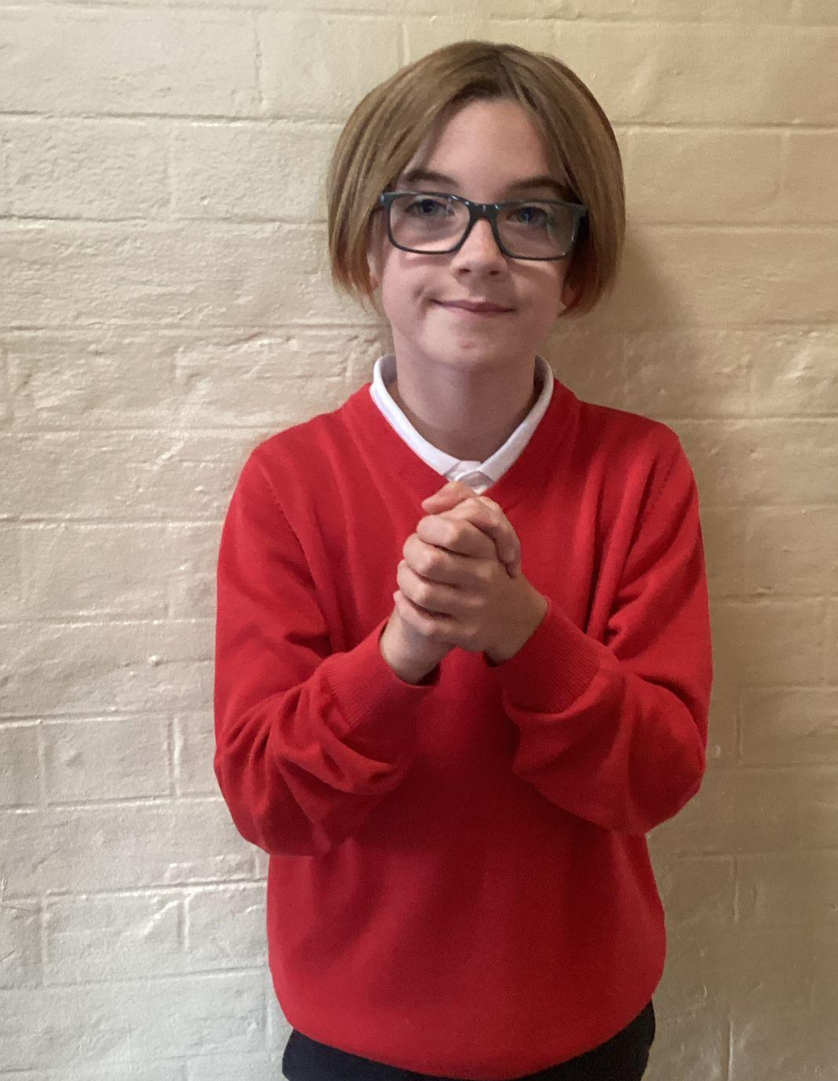
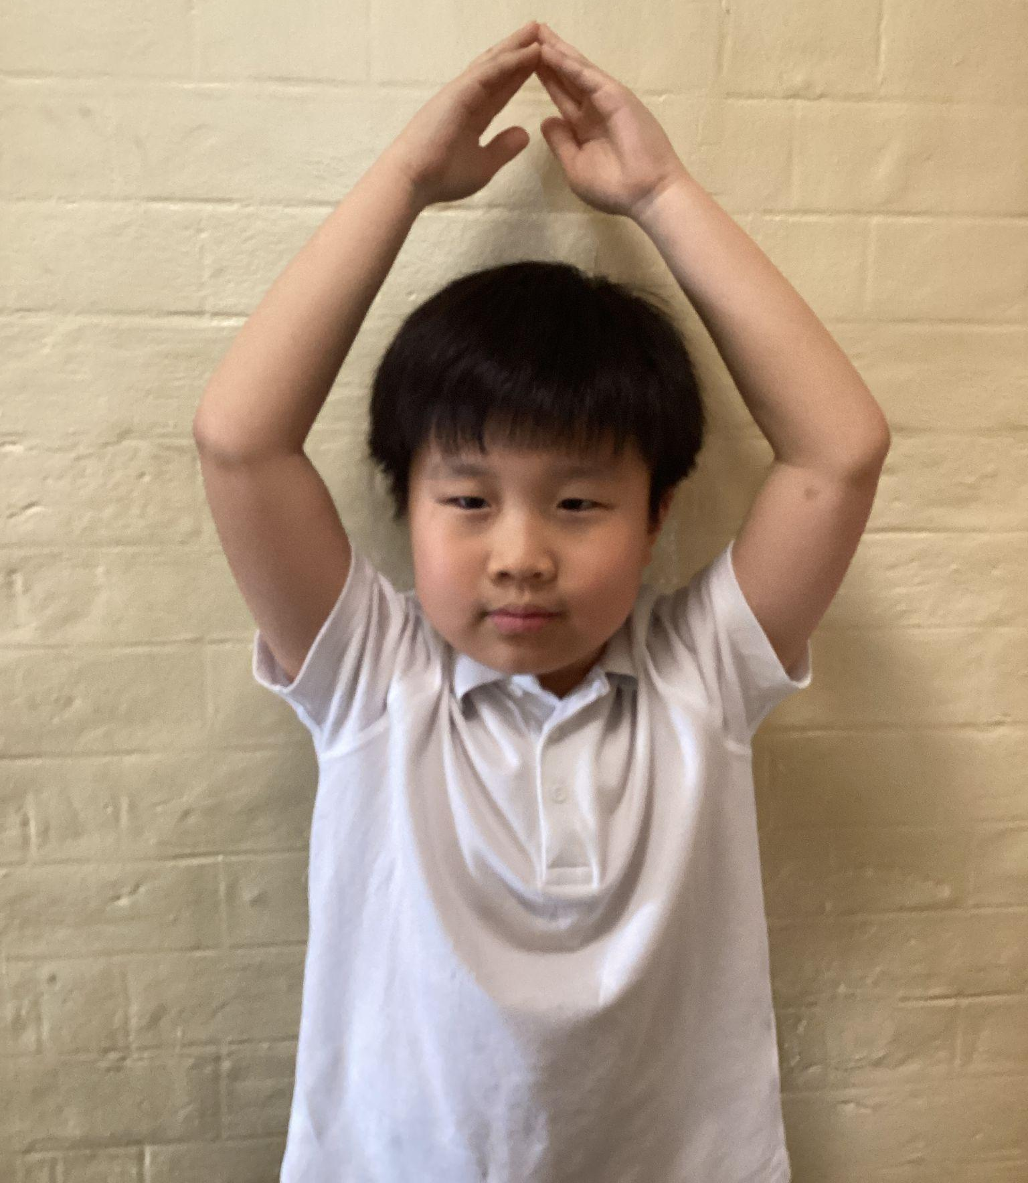
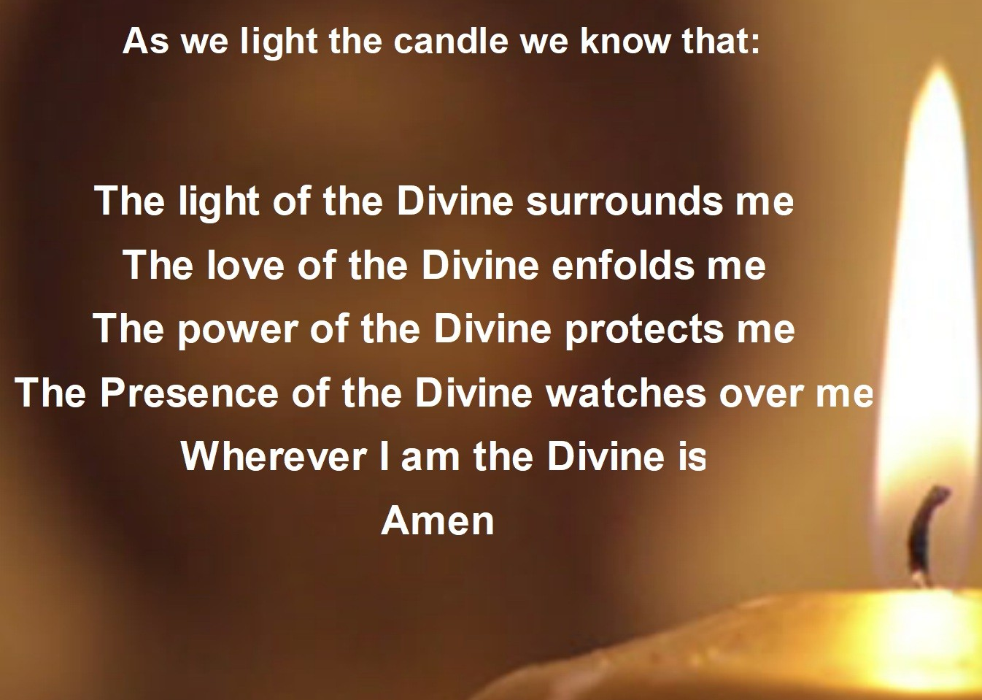
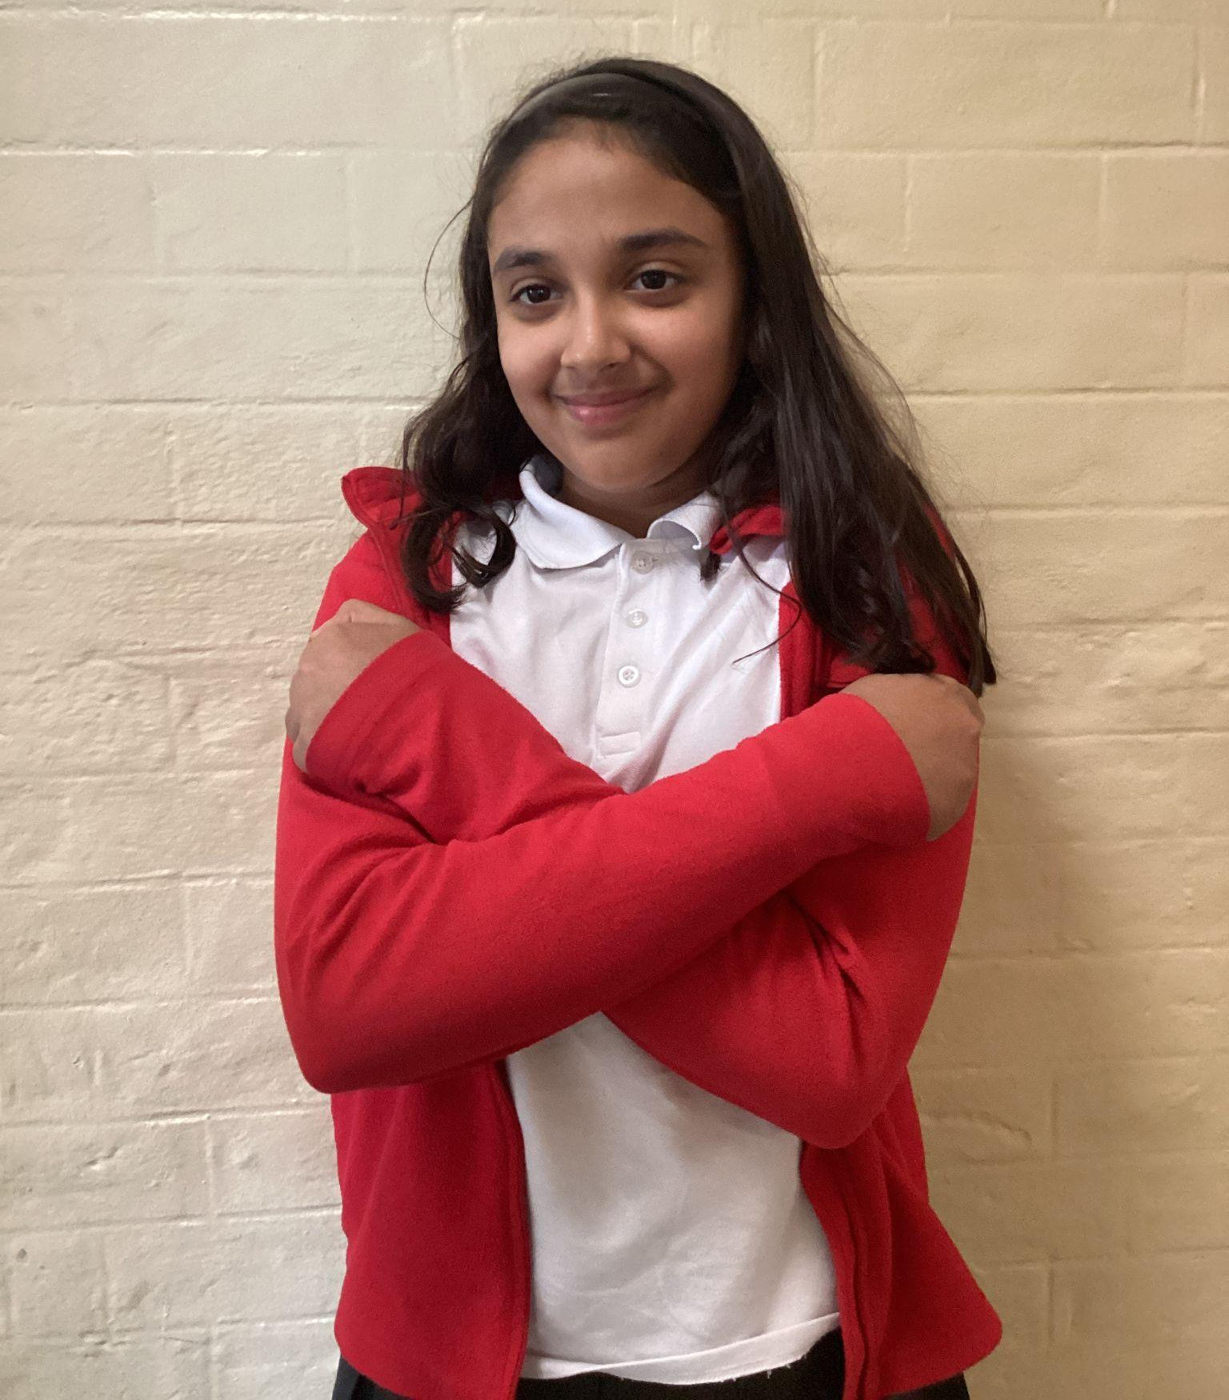
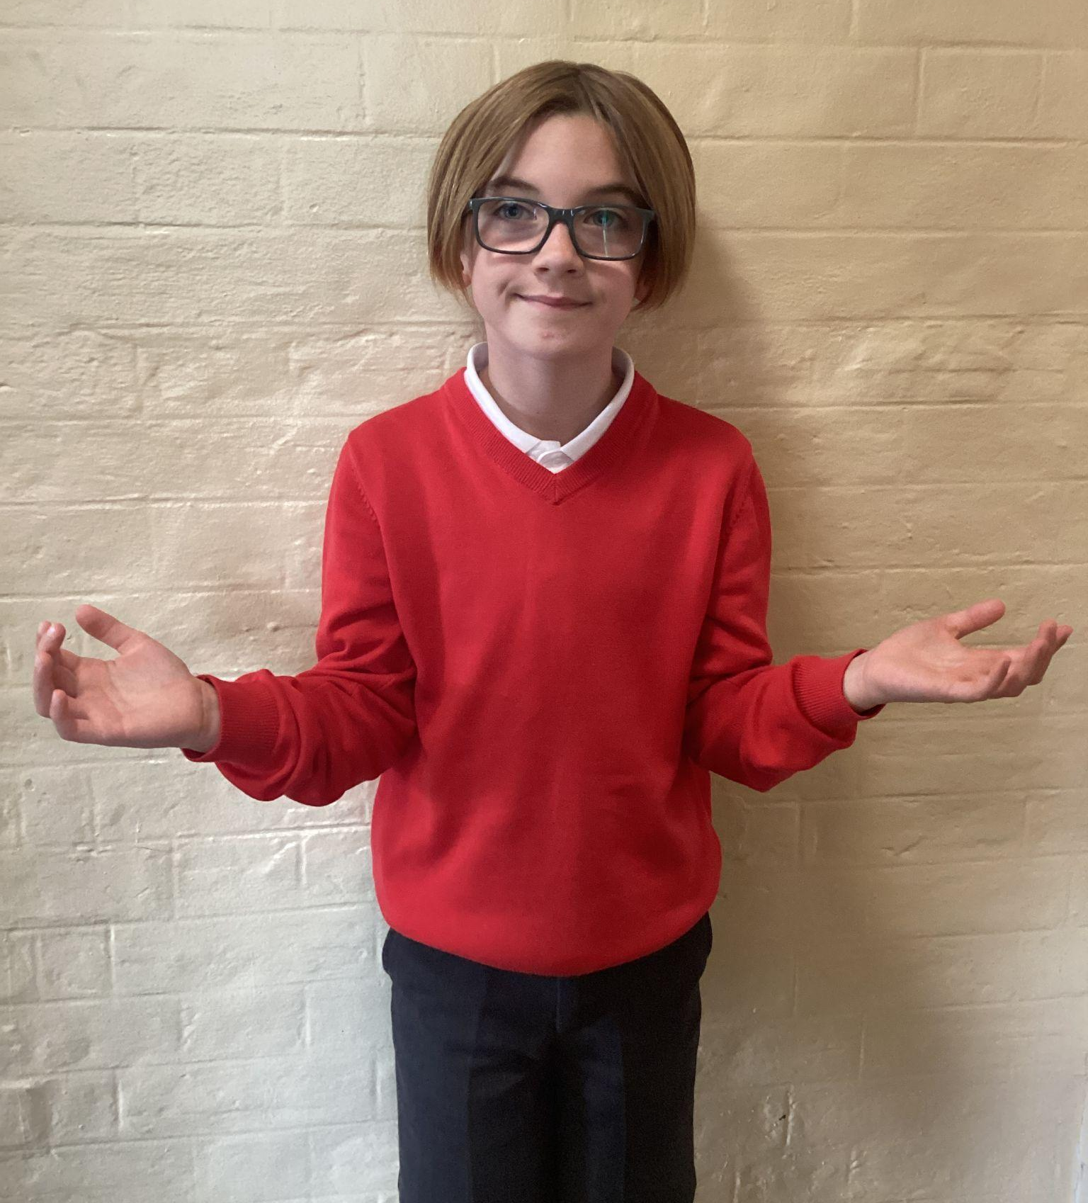
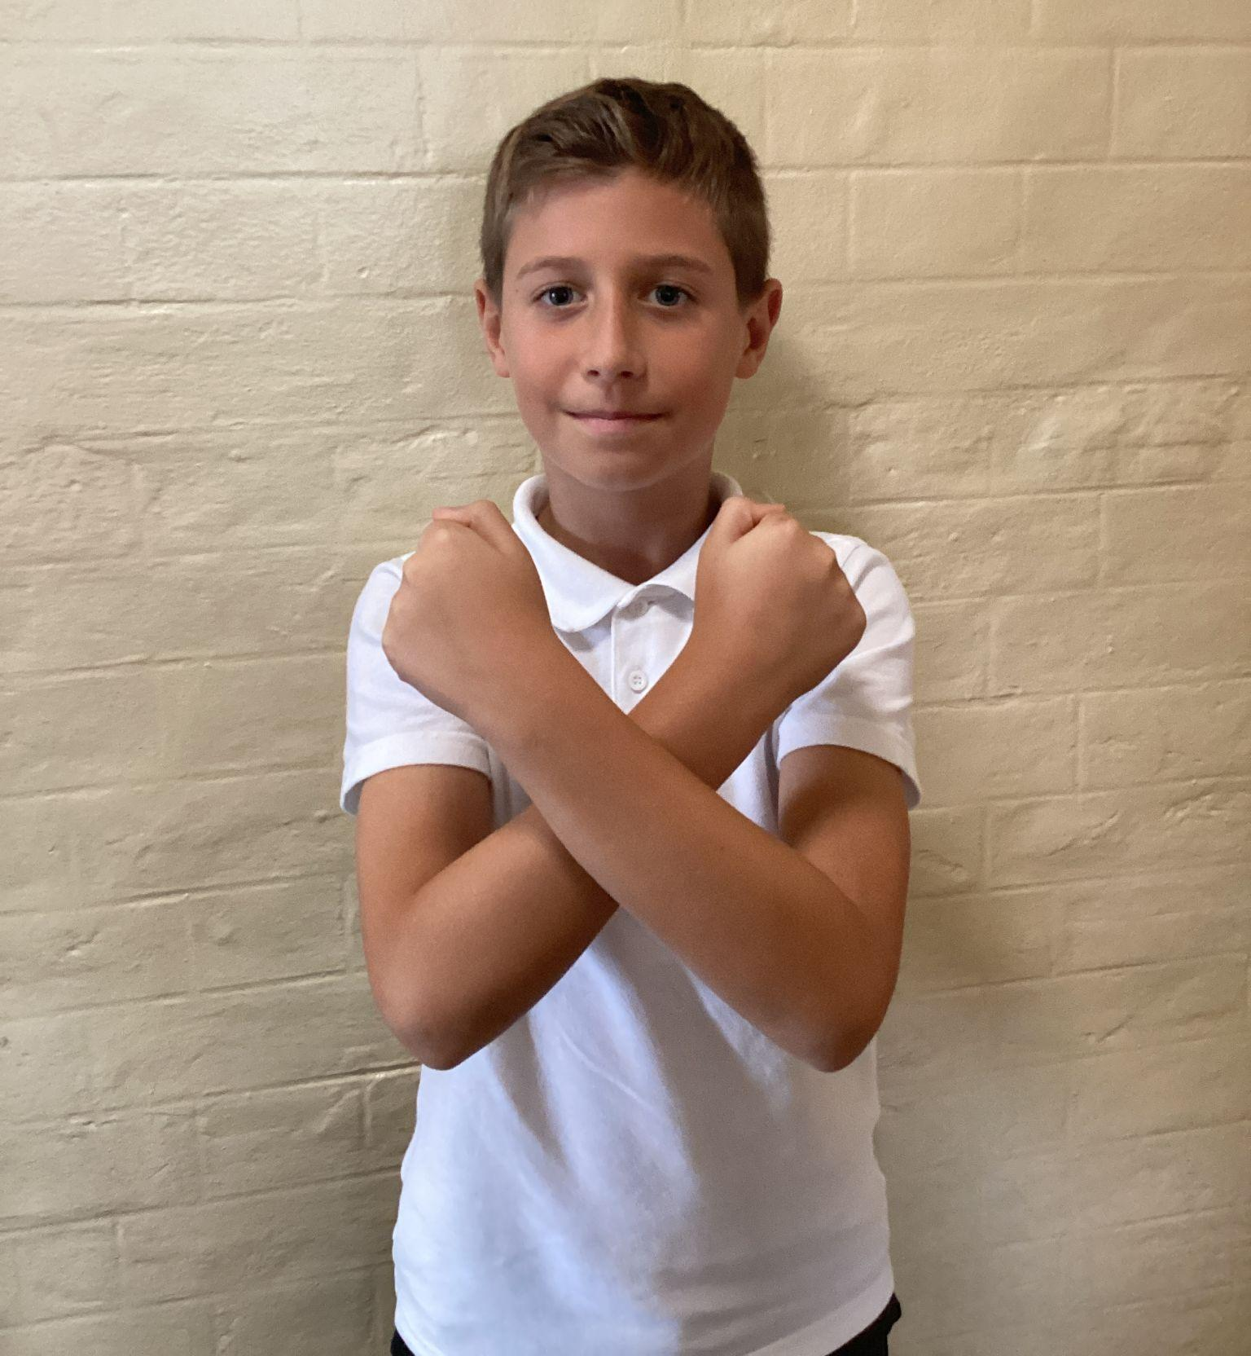
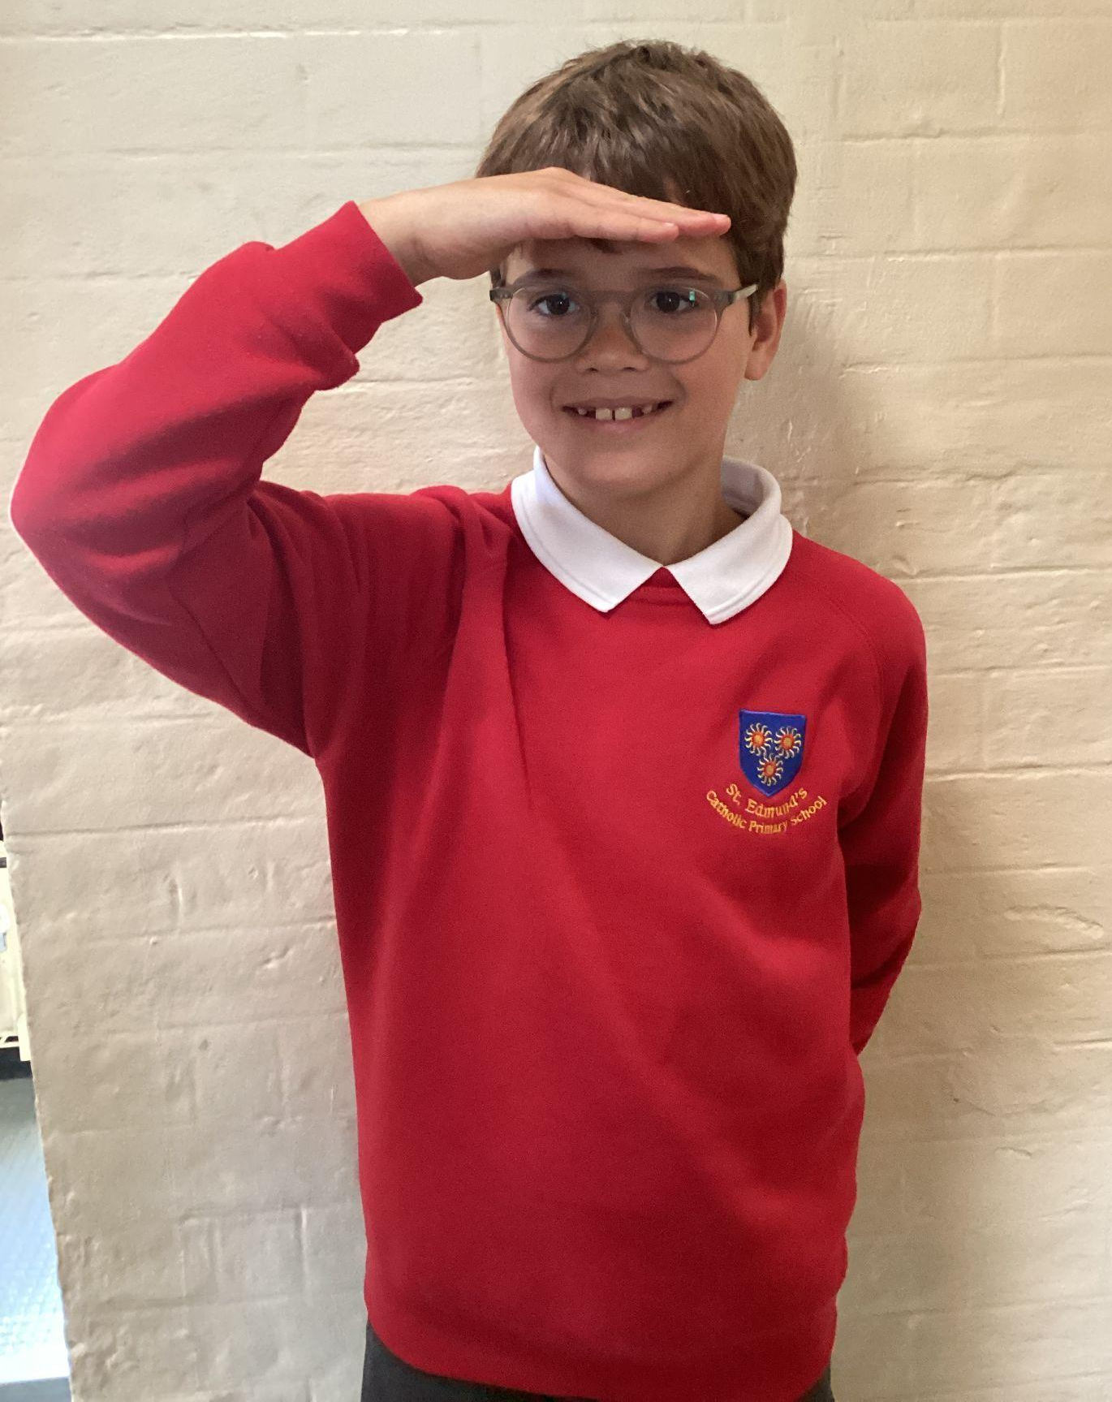
Please repeat after me
1. Light
6. Amen
2. Love
5. Wherever I am.
3. Power
4. Presence

Slide 5
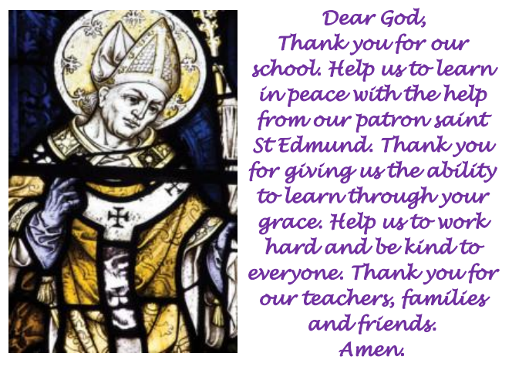
St Edmund’s School Prayer

Slide 6
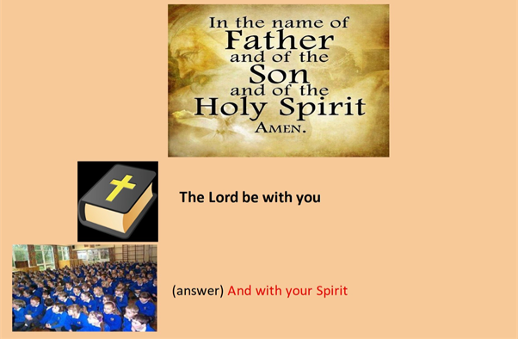
We are ready to receive the message of God.
Please make the sign of the cross

Slide 7
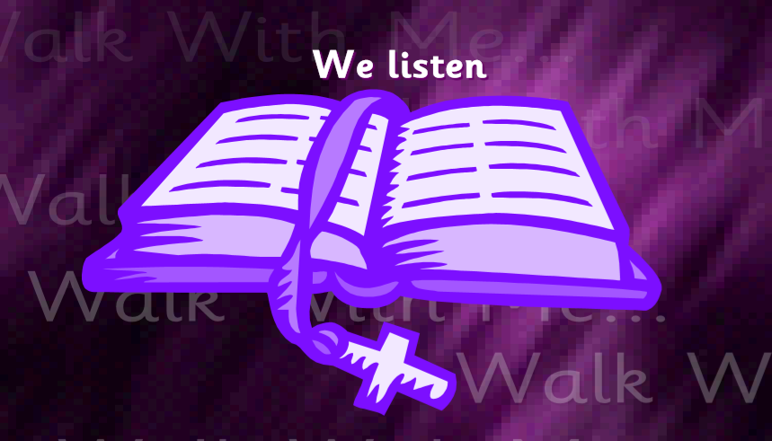
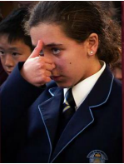
A reading from the Holy Gospel according to Luke.
All: Glory to You, Oh Lord.

Slide 8
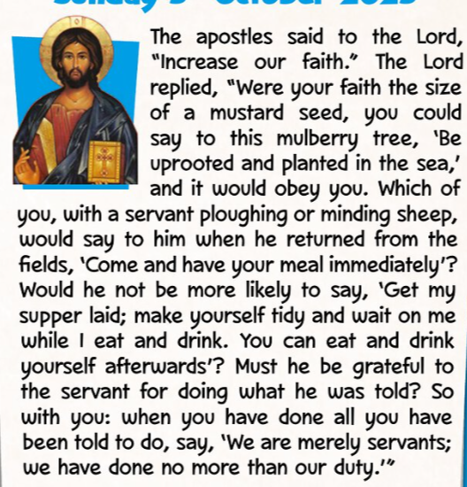
Luke 17:5-10
The Gospel of the Lord.
ALL: Praise to you Lord Jesus Christ.

Slide 9

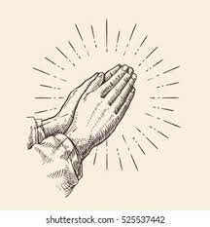

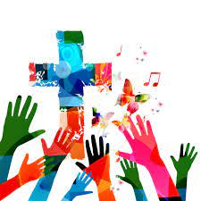
What is this week’s Word?
FAITH

Slide 10
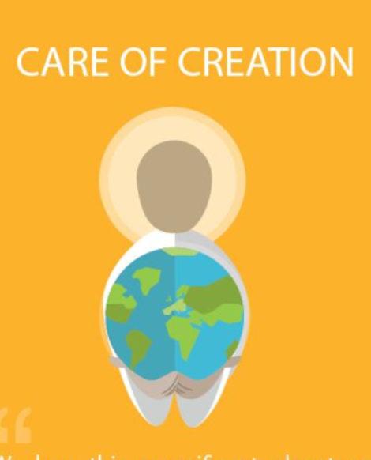

How does the Wednesday word link to
Catholic Social Teaching, RE or Scripture?
FAITH

Slide 11

Catholic Social Teaching
Our FAITH teaches us that God made the world and everything in it. Catholic Social Teaching says we must care for creation, which means looking after the earth, animals, plants, and people. When we care for creation, we show love for God and for others.”

Slide 12
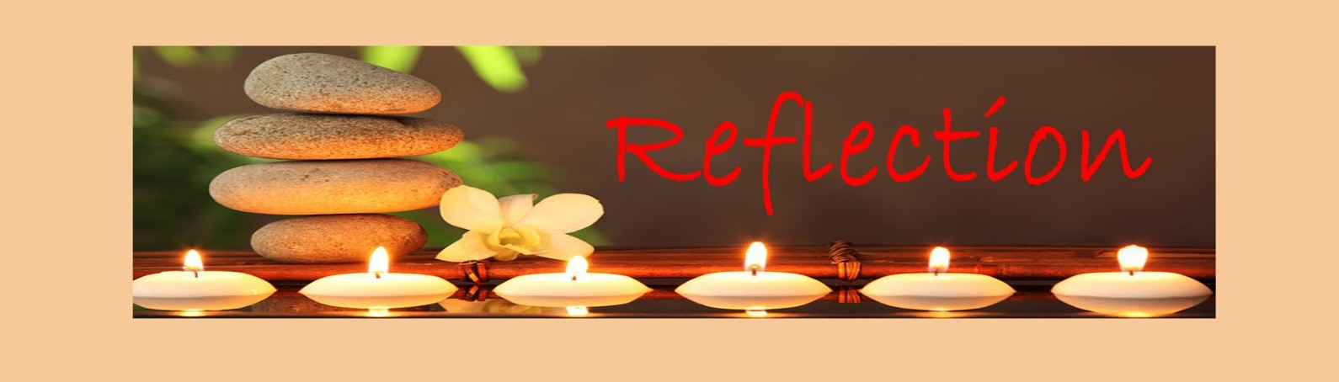
Close your eyes and accept Jesus in your hearts
When I look at the world, I see God’s beautiful gift to us. My faith reminds me to take care of the earth by being kind to nature and thankful for all we have. By looking after creation, I show my love for God and for everyone.

Slide 13

We Respond
Dear Jesus,
Thank you for our beautiful world.
Help me to trust you and have faith every day. Thank you for loving me and guiding me.
Amen.

Slide 14
Your Mission for this week
Your mission is to show your faith this week by doing one kind thing every day.
It could be:
- helping someone,
- saying a prayer, or taking care of God’s creation.
At the end of the week, think about how your actions showed love and faith.

Slide 15
Act of Dedication
P&J: We give our hearts and our hands to God today. We promise to try our best to love, care, and help others in everything we do.
All: Lord, help us to keep this promise and live with love and kindness.
Through Christ we Learn.
Amen.

Slide 16
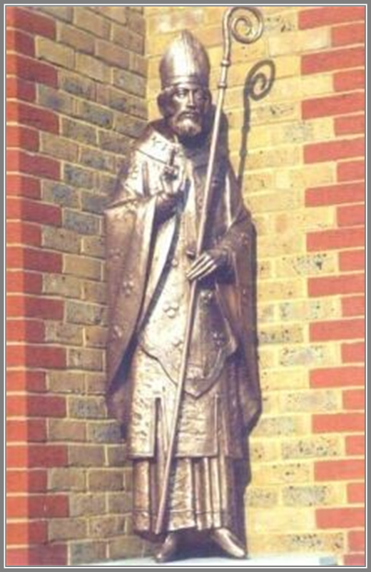
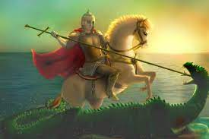
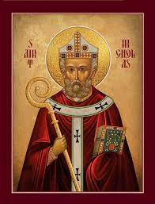
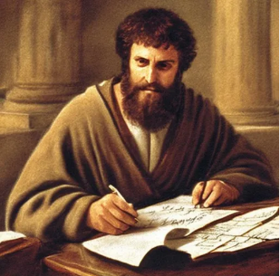
Litany of Saints
PJ: St. Edmund
All: Pray for us
PJ: St. George
All: Pray for us
PJ: St. Nicholas
All: Pray for us
PJ: St. Paul
All: Pray for us

Slide 17
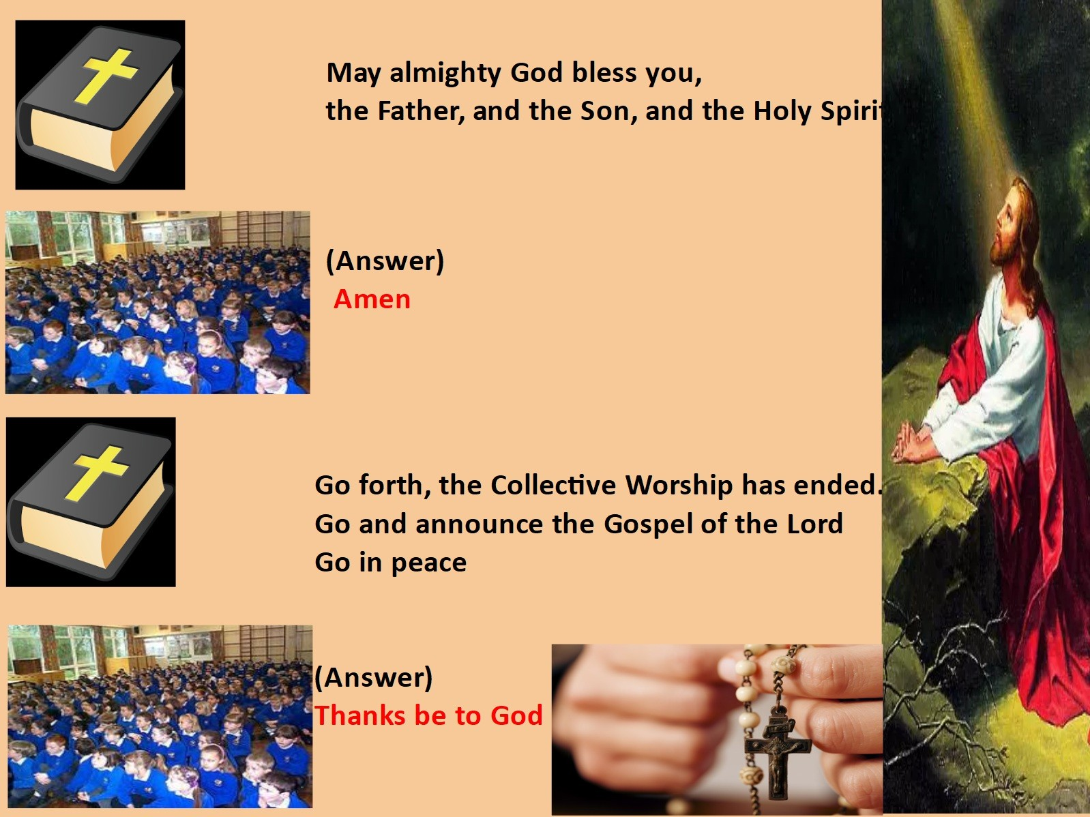
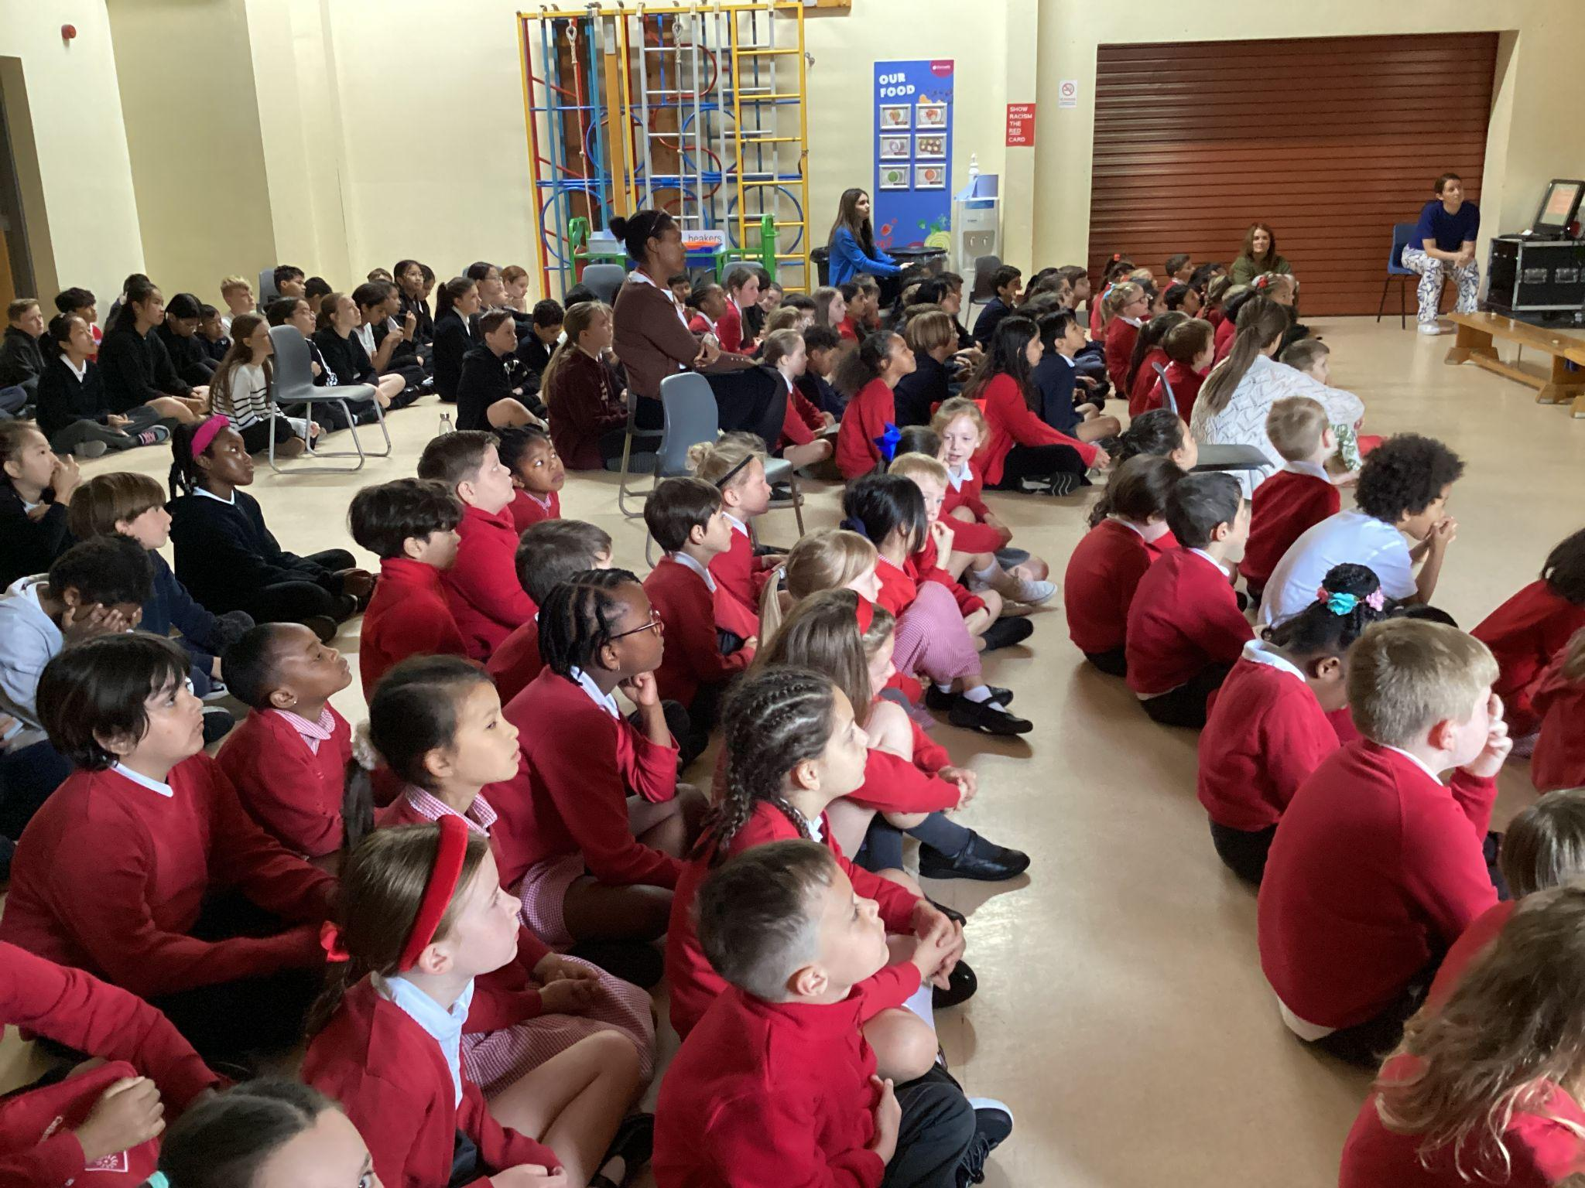
We Go Forth

Slide 18

Thank you for coming to the Celebration of the Word.

Slide 19
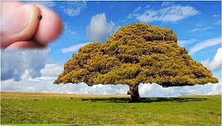
Mustard Tree

Slide 20
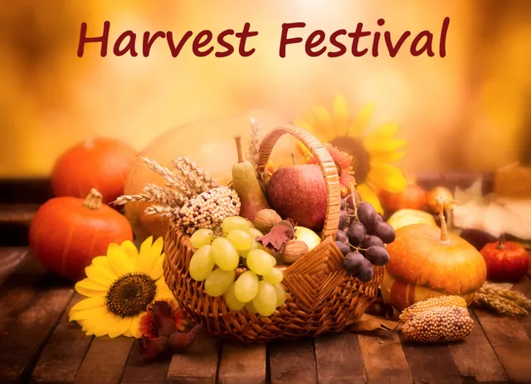



Slide 21
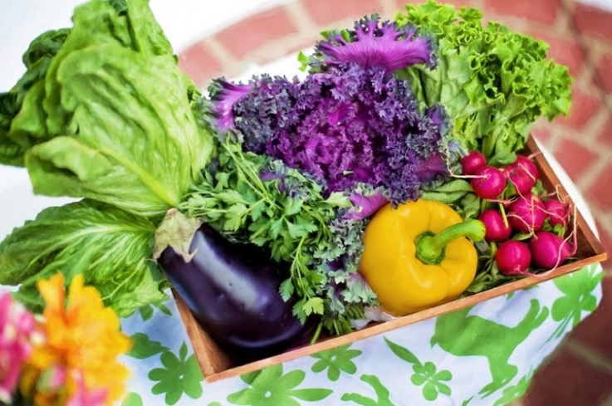
What Is Harvest Festival?
Harvest Festival is a celebration of the food that is grown on the land.
Celebrations giving thanks for our food happen in many countries around the world.
In Britain, Harvest Festival is often celebrated in churches by bringing baskets of food to give thanks to God. Many Christians celebrate Harvest Festival by singing, praying, listening to stories and decorating the church.

