Slide 1
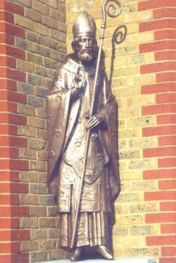
St Edmund Of Abington (1170-1240)

Slide 2
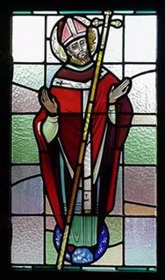
What is a saint?
A saint is a person, just like you and me that God gave special graces to in order for them to do special things.
All the saints were holy men and women who led good lives, serving God and serving other people.

Slide 3
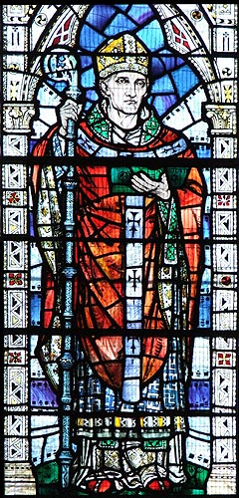
Early Life St. Edmund is known as St. Edmund of Abingdon because he was born in Abingdon, near Oxford, in 1175. His father was a wealthy trader, which is why he is sometimes also nicknames St. Edmund Rich. When he was about sixteen, Edmund’s mum sent him, with his brother Robert, to university in Paris.

Slide 4
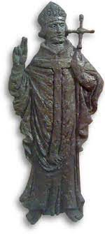
Career Edmund’s mother died when he was 23. When this happened he came home to England. He began teaching Latin and Maths at Oxford University. Six year later, he received a message in a dream from his mother telling him to go back to university. So he went back to Paris and studied theology before becoming a priest. He then returned to England to teach Theology at Oxford. Edmund loved to pray and he would stay up late talking to God. He would sometimes then fall asleep when he was supposed to be teaching. Edmund spent most of his salary on charity and taking care of his students.

Slide 5
Archbishop of Canterbury In 1233, England was on the verge of a civil war. Edmund went to the King and pleaded for peace. The King had not listened to his advisers, but he listened to Edmund and war was avoided. This is why St. Edmund is known as a peacemaker. In 1234 the Pope made Edmund Archbishop of Canterbury. As Archbishop, he spent a lot of time helping the poor and disadvantaged. He also spoke frequently to the King, King Henry III, and encourage him to support those in need also.

Slide 6
Death In 1240, St. Edmund travelled to Rome to ask the Pope to help him keep peace in England. On the way, Edmund felt sick in France and died. He was buried at an abbey and many miracles took place at his tomb. Within six years, the Pope declared him a saint.

