Slide 1

Black History Week

Slide 2
What is Black History Week?
Across Britain schools, libraries and community organisations have been celebrating Black History Month during October.
Each year, we at St Monica’s focus our learning for one week on recognising and appreciating the contribution of black people throughout history.
Black History Week is an opportunity to share in a celebration of the vast contribution of the black community to the world: a time to demonstrate pride in its creativity, respect for its intellectual prowess and a celebration of its cultural identity.

Slide 3
Why do we celebrate BHW?
Black History Month in the UK celebrates the history, arts and culture of black British people. Awareness of, and education about, the history of white British people is well-established, but black British history is underreported and underrepresented. Dedicating a month to it every year helps redress that balance, and helps us all learn more about our shared History as Britons.

Slide 4
Our Theme

Slide 5






Year Group | Focus
EYFS & Year 1 | Ancient Egypt
Year 2 | The Kingdom of Kush
Year 3 | Ancient Carthage
Year 4 | The Kingdom of Benin
Year 5 | The Zulu Kingdom
Year 6 | The Kingdom of Dahomey
Each year group will explore an African Kingdom or ancient civilisation from the continent of Africa.
Ensure the children are immersed in their given periods of history and have opportunities to develop their historical skills.

Slide 6
EYFS Learning Outcomes
Communication and Language – development involves children being provided opportunities to experience a rich language environment to develop their confidence and skills in expressing them selves and to speak and listen in a range of situations.
Understanding the World – involves guiding children to make sense of their physical world and their community through opportunities to explore, observe and find out about people, places, technology and the environment
Expressive Arts and Design – involves children to explore and play with a wide range of media and materials, as well as providing opportunities and encouragement for sharing their thoughts, ideas and feelings through a variety of activities in art, music, movement, dance, role-play and design technology

Slide 7
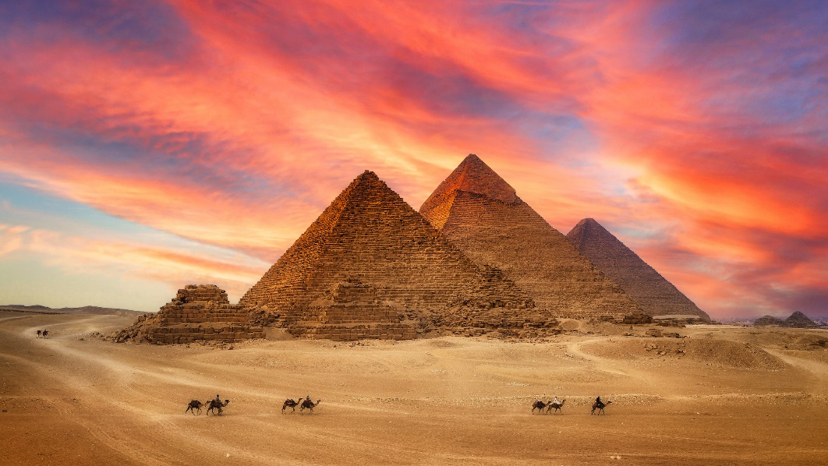
EYFS Expectations
Throughout the course of the week plan for the children to:
Explore Ancient Egypt in different ways (age appropriate)
Get the children to dance and sing
Create an art piece in relation to the topic
Read stories from or about ancient Egypt
Please document children’s work and words.

Slide 8
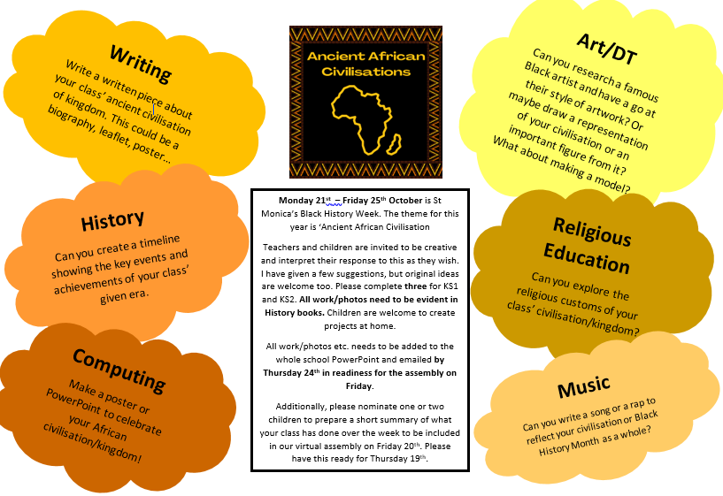
KS1 Expectations
Throughout the course of the week plan for the children to complete at least 2 activities:

Slide 9
KS2 Expectations
Throughout the course of the week plan for the children to complete at least 2 activities:

