Slide 1

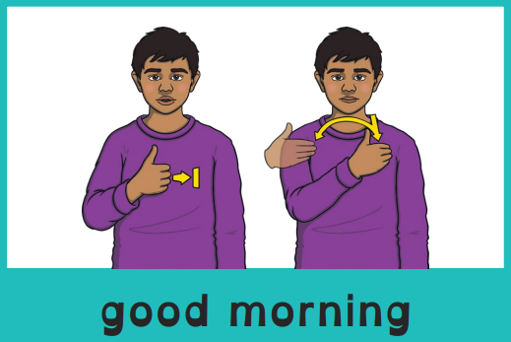

Good morning, everyone.
Celebration of the Word Assembly - 29/09/2025
Hajni

Slide 2



St Edmund’s Catholic Primary School
…Through Christ we learn…
Executive Headteacher: Mrs A. Ruthven
Head of School: Mr A. Antoniou
St Edmund’s Catholic Primary School Mission
Our Mission
Through Christ We Learn

Slide 3

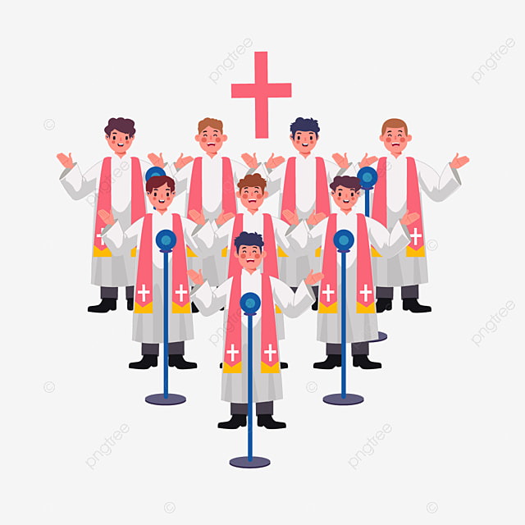

Slide 4
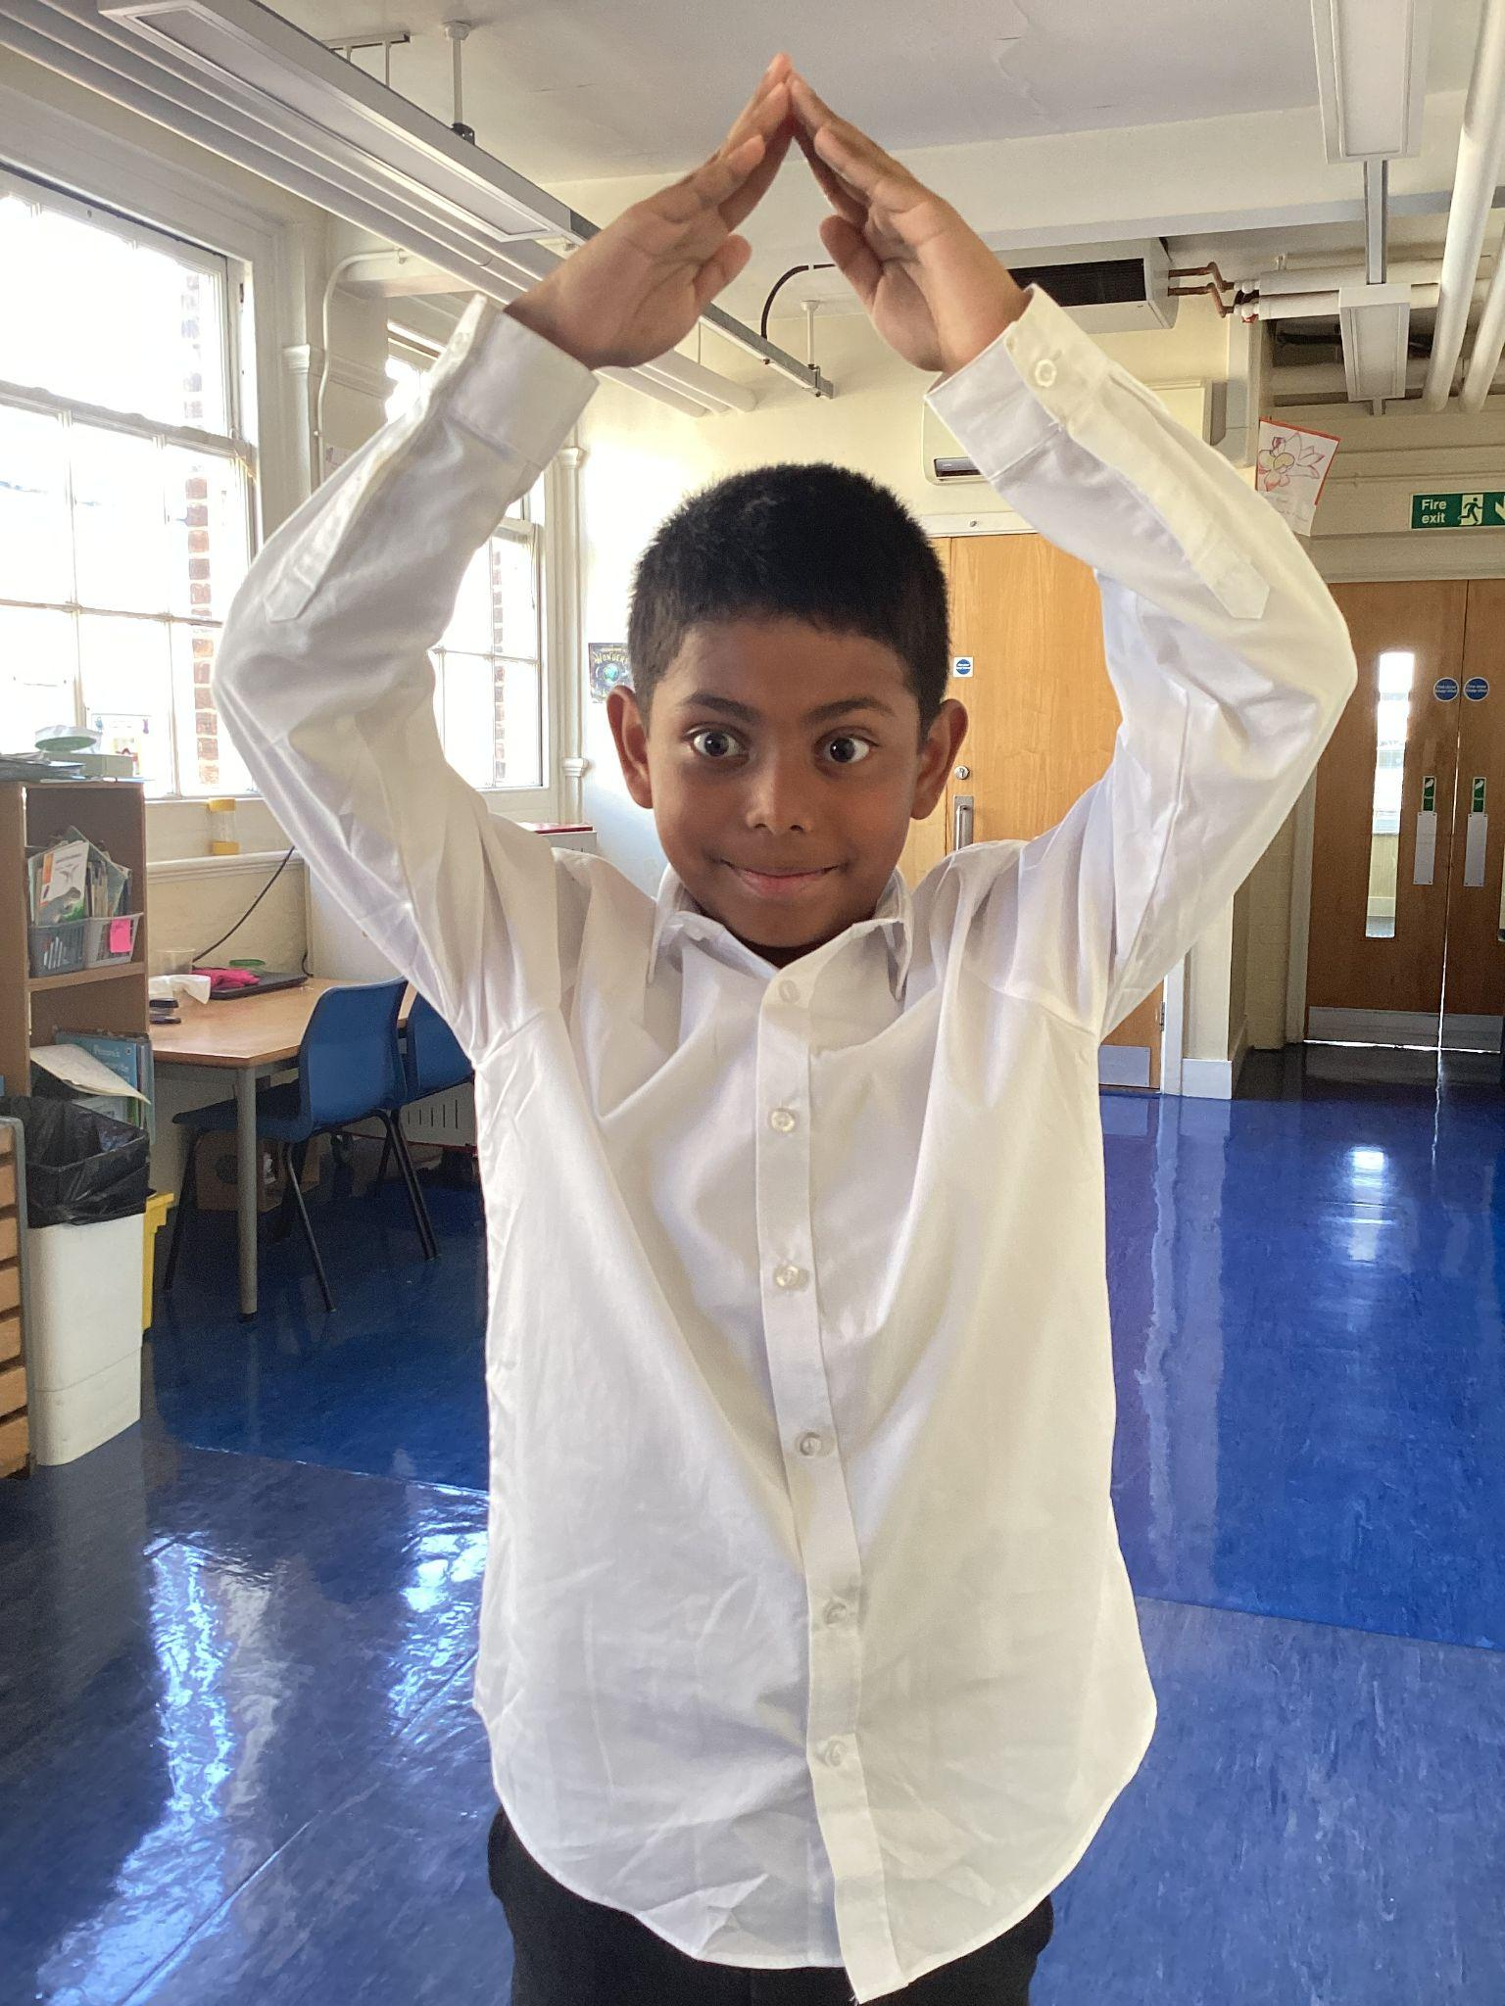
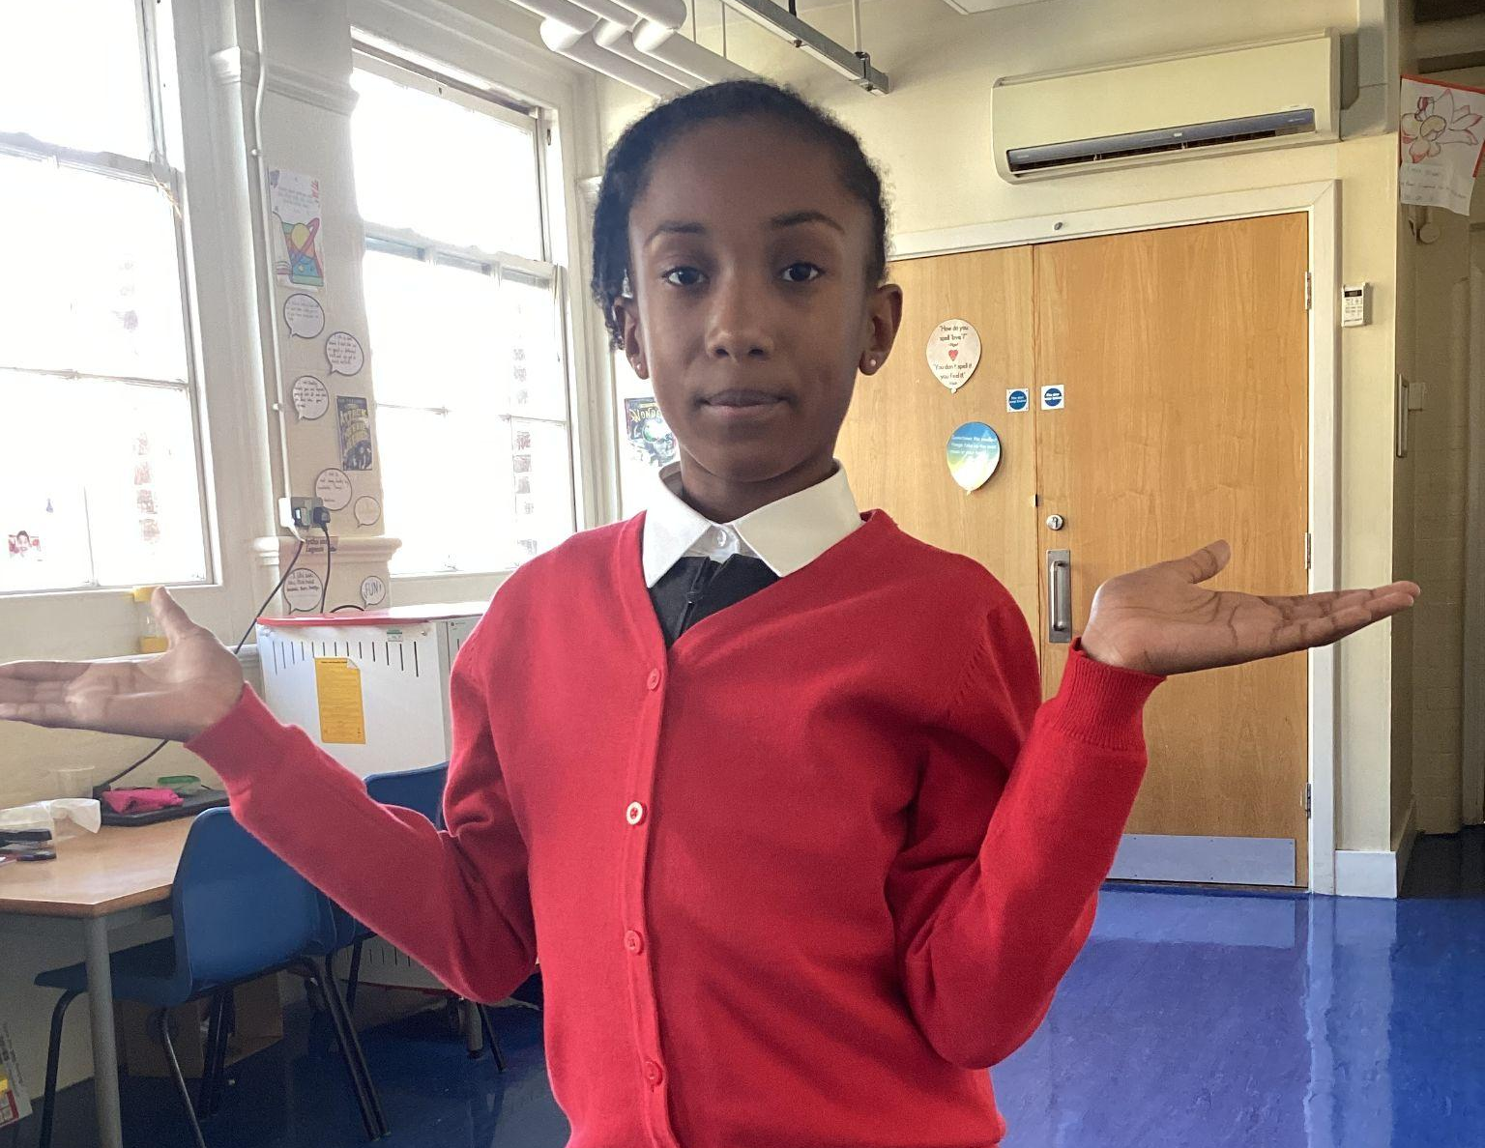
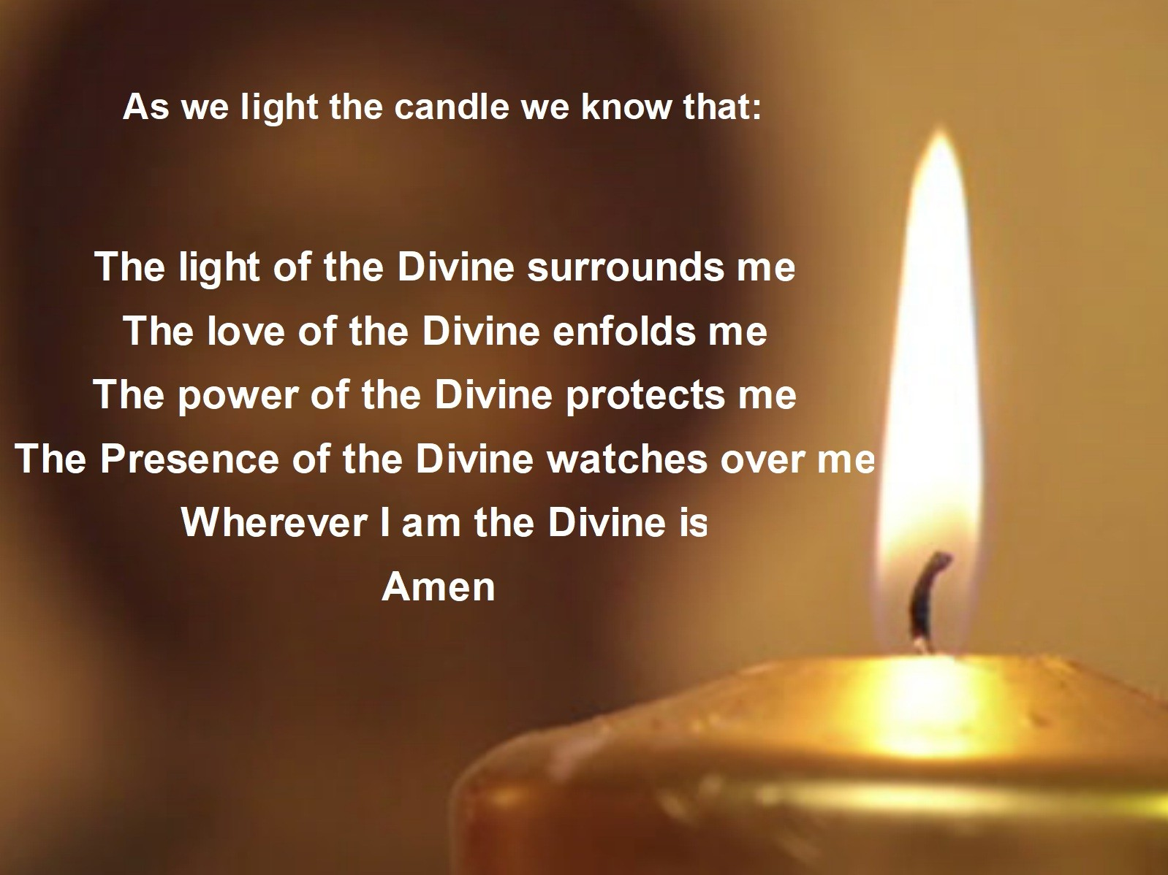
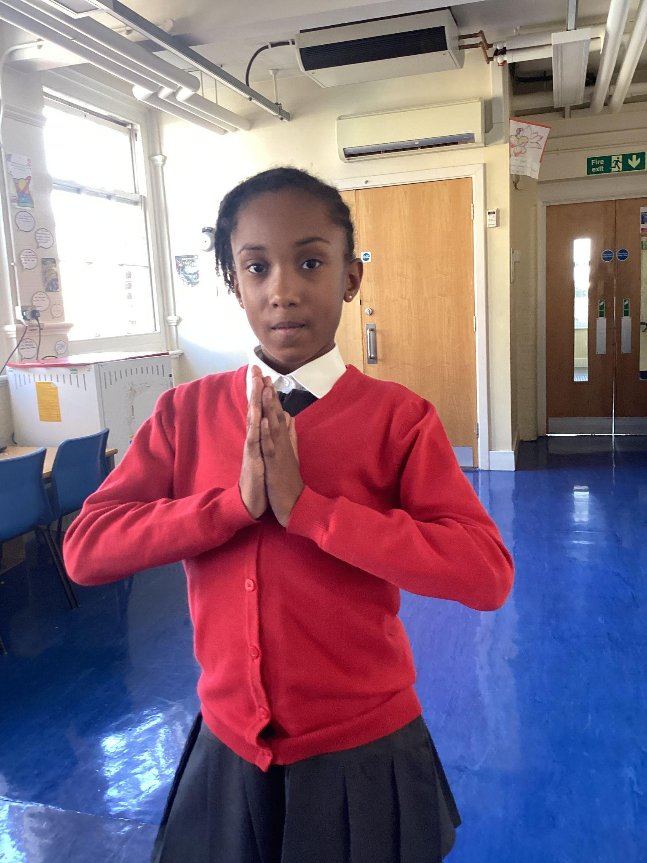
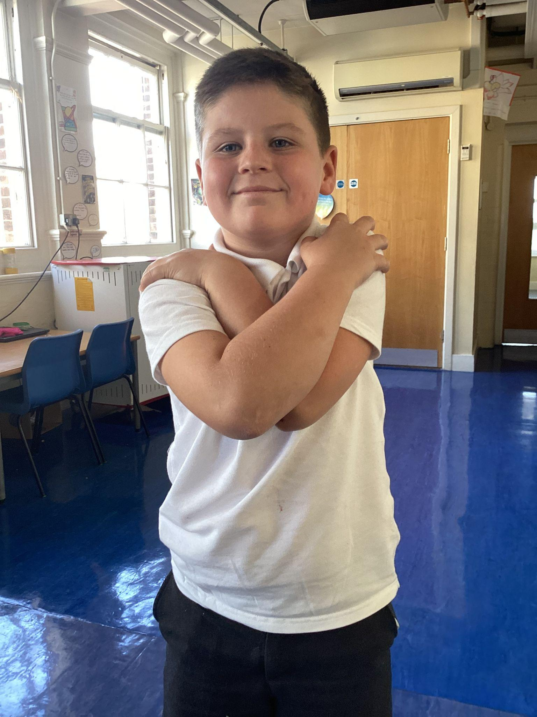
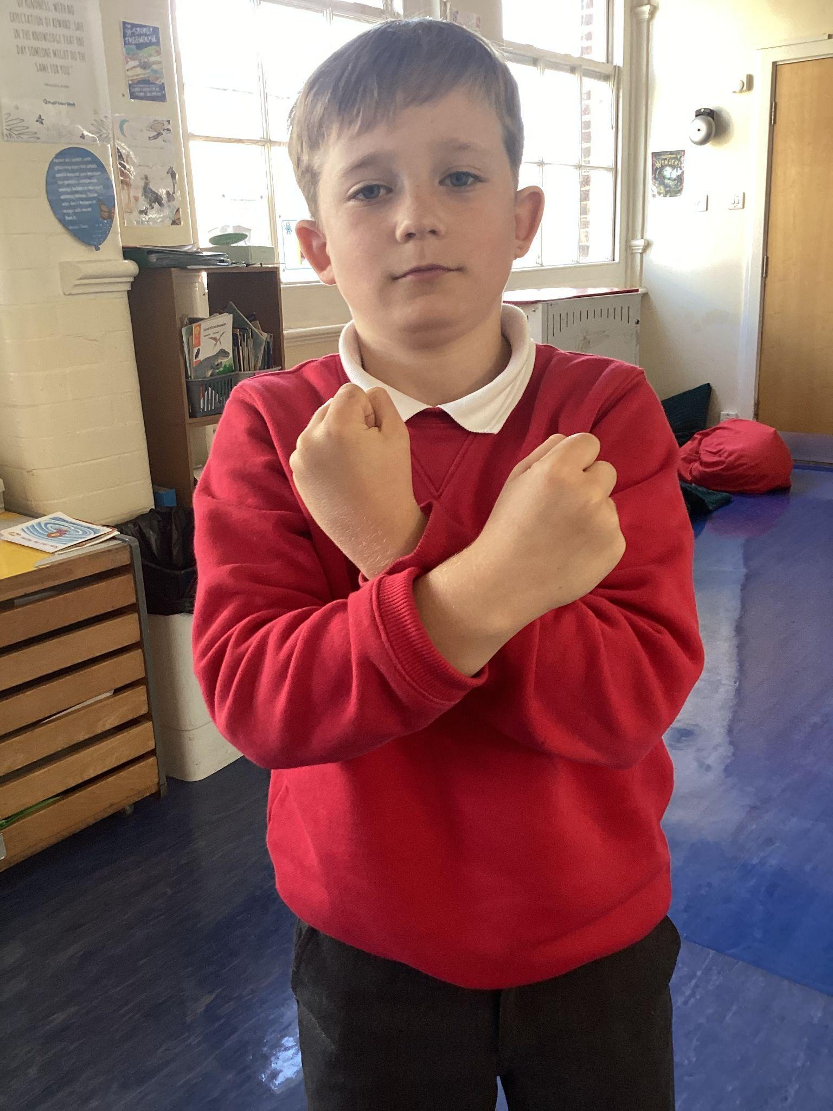
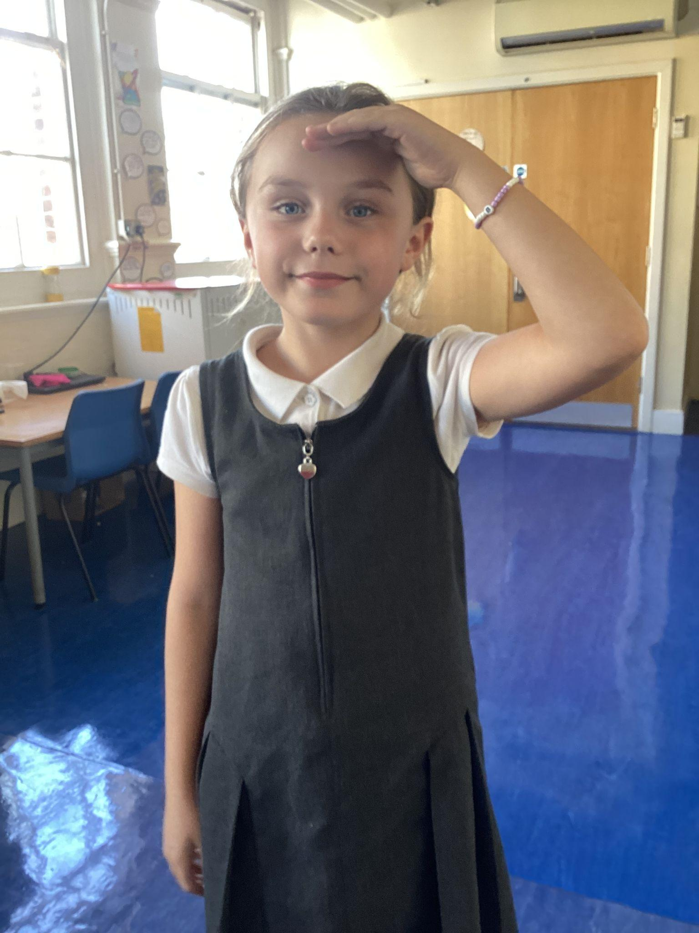
Please repeat after me
1 Light
5 Wherever I am.
2 Love
3 Power
4 Presence

Slide 5
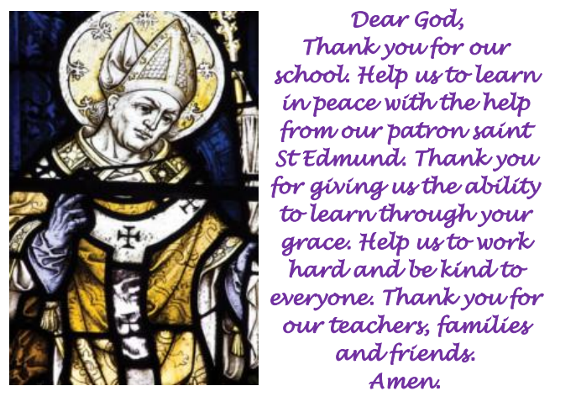
St Edmund’s School Prayer

Slide 6
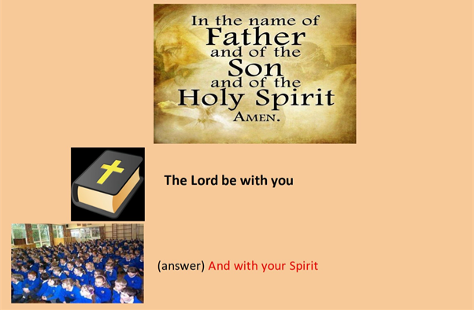
We are ready to receive the message of God.
Please make the sign of the cross

Slide 7

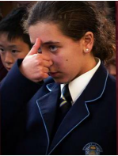
A reading from the Holy Gospel according to Luke.
All: Glory to You, Oh Lord.

Slide 8
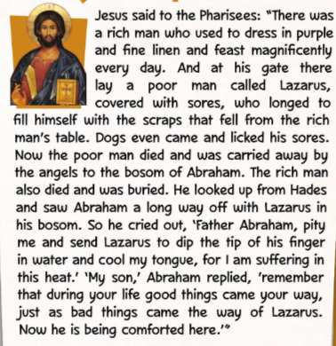
Luke 16:19-31
The Gospel of the Lord.
ALL: Praise to you Lord Jesus Christ.

Slide 9





What is this week’s Word?
SHARE

Slide 10


How does the Wednesday word link to
Catholic Social Teaching, RE or Scripture?
SHARE

Slide 11

Catholic Social Teaching
Catholic Social Teaching says God wants us to care for each other. “Share” means giving and helping — like sharing toys, food, or kindness. When we share, we show God’s love.

Slide 12
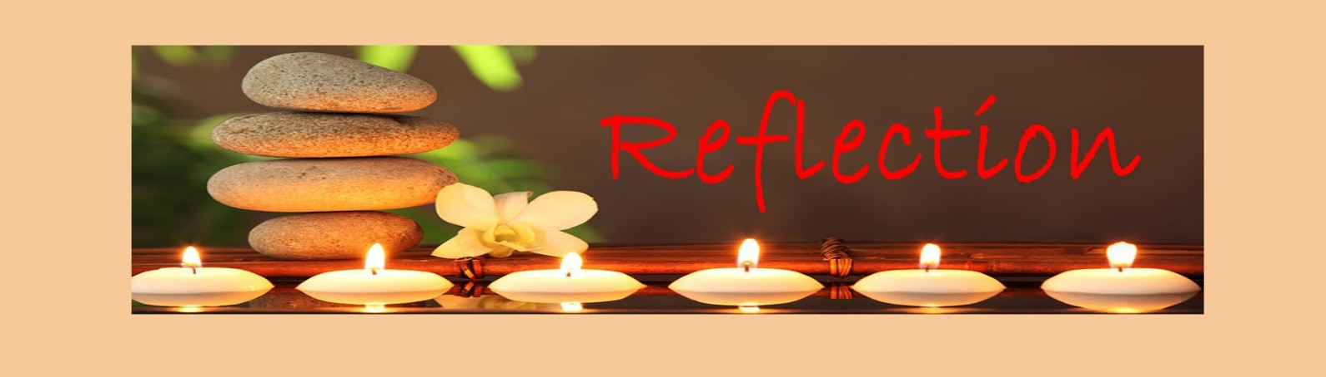
Close your eyes and accept Jesus in your hearts
God loves everyone and wants us to take care of each other. When we share, we make others happy and show kindness, just like Jesus did. Sharing toys, food, time, or even a smile can make the world a better place. Every time we share, we are showing God’s love.

Slide 13

We Respond
Dear Jesus,
Thank You for all You give me.
Help me to share with others,
to be kind, and to show Your love every day.
Amen.

Slide 14
Your Mission for this week
Try to share something with your family and friends this week.
It could be a toy, a snack, a hug, or helping your parents with a small task.
Show love and kindness while you share!

Slide 15
Act of Dedication
P&J: I promise to share with others, to be kind, and to show God’s love in everything I do.
All: We will share, be kind, and show God’s love every day!
All: Through Christ we Learn. Amen.

Slide 16
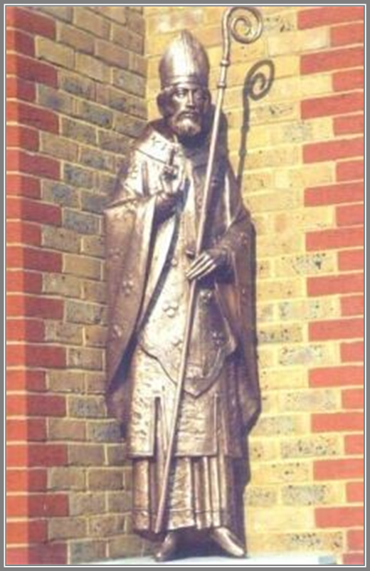
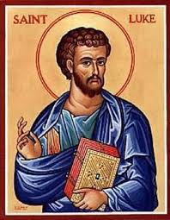
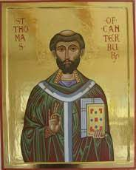
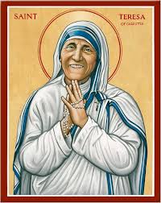
Litany of Saints
PJ: St. Edmund
All: Pray for us
PJ: St. Luke
All: Pray for us
PJ: St. Thomas Becket
All: Pray for us
PJ: St. Teresa
All: Pray for us

Slide 17
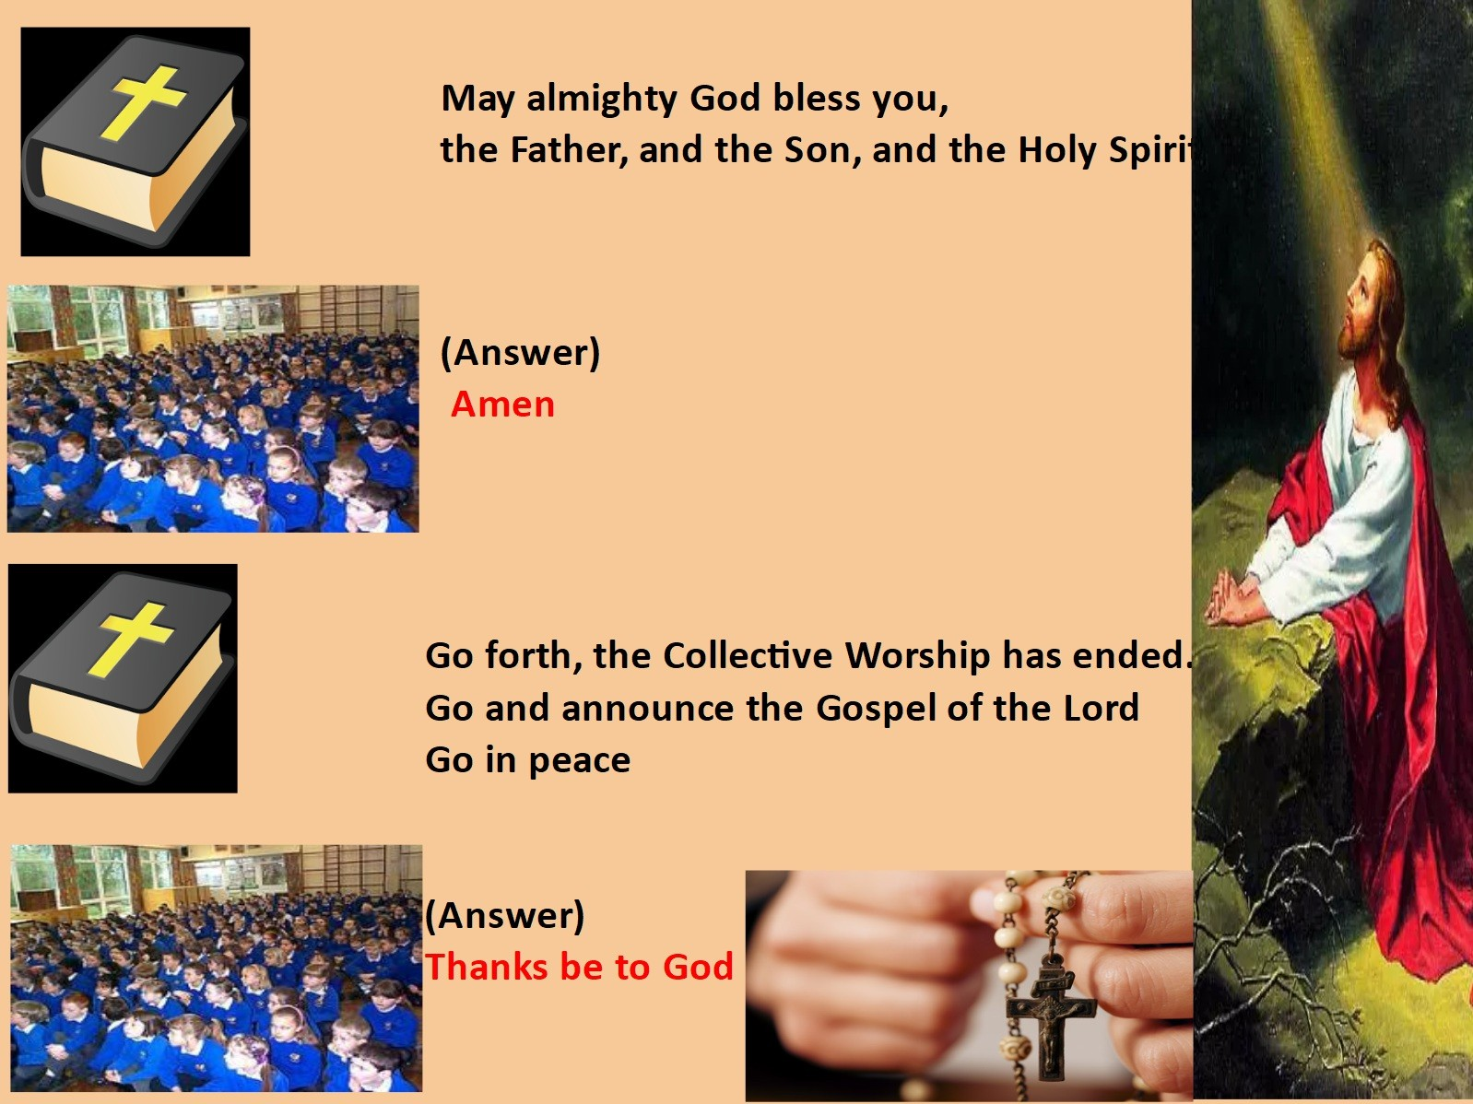
We Go Forth

Slide 18

Thank you for coming to the Celebration of the Word.

