Slide 1


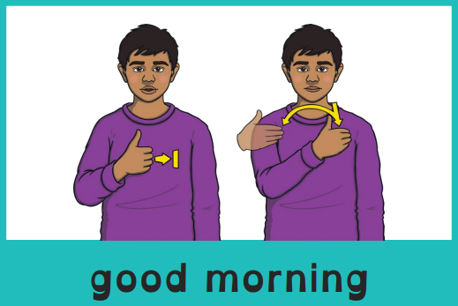
Good morning, everyone.
Celebration of the Word Assembly - 25/11/2025
Hajni

Slide 2

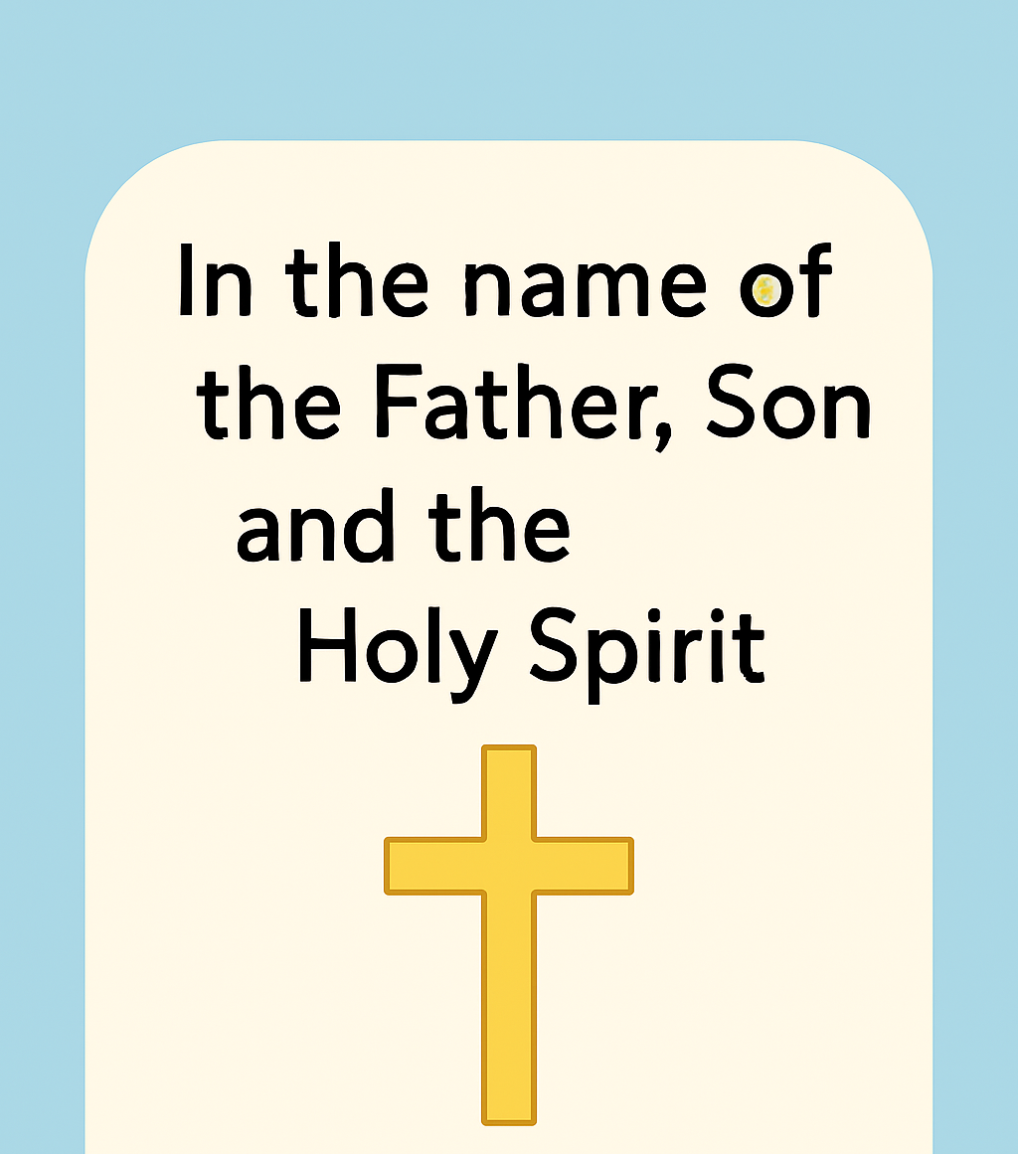
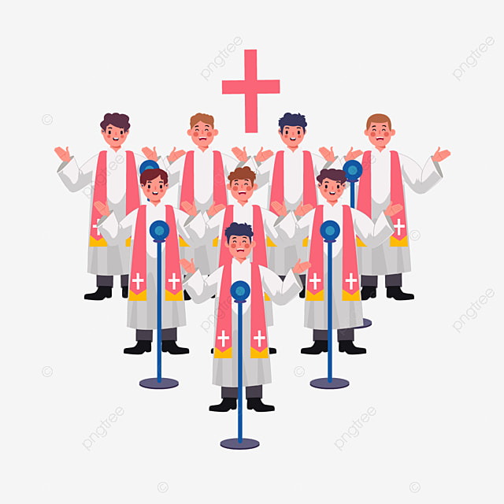
Through Christ We Learn

Slide 3
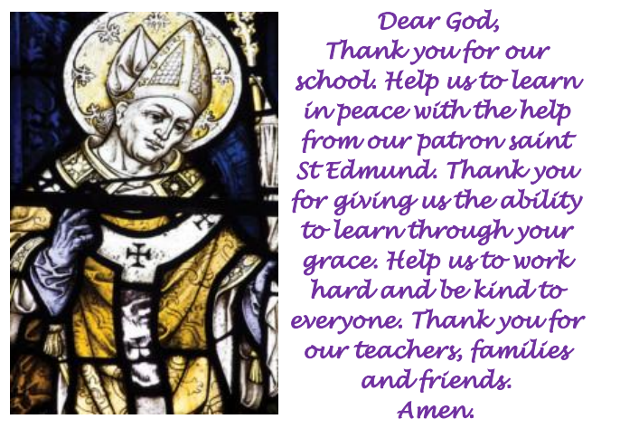
St Edmund’s School Prayer

Slide 4
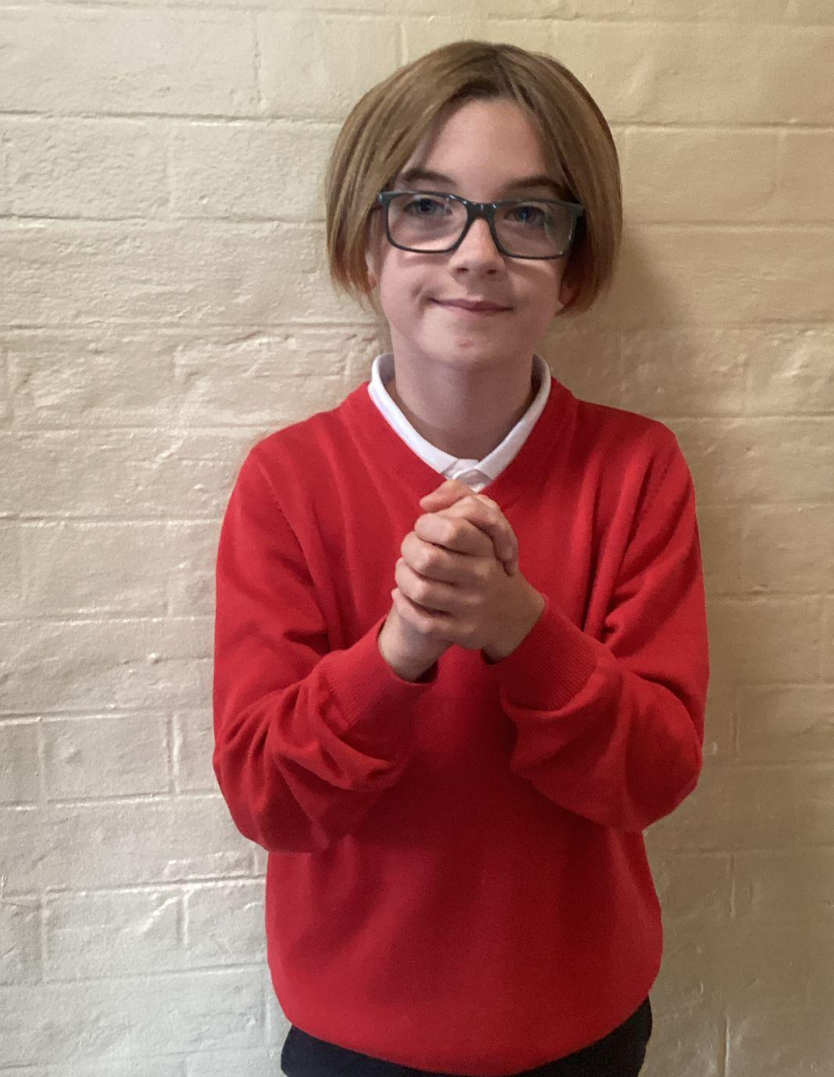
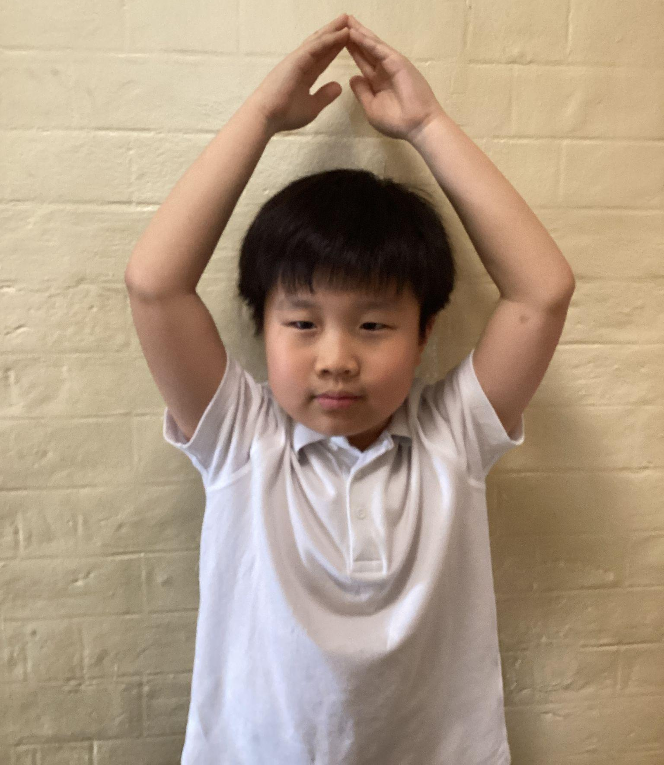
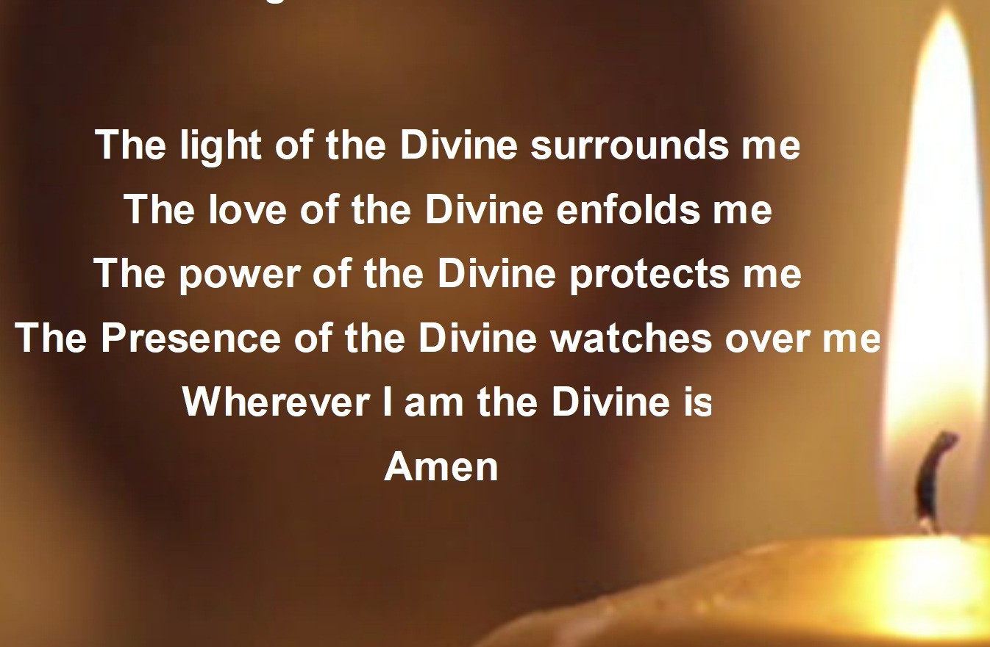
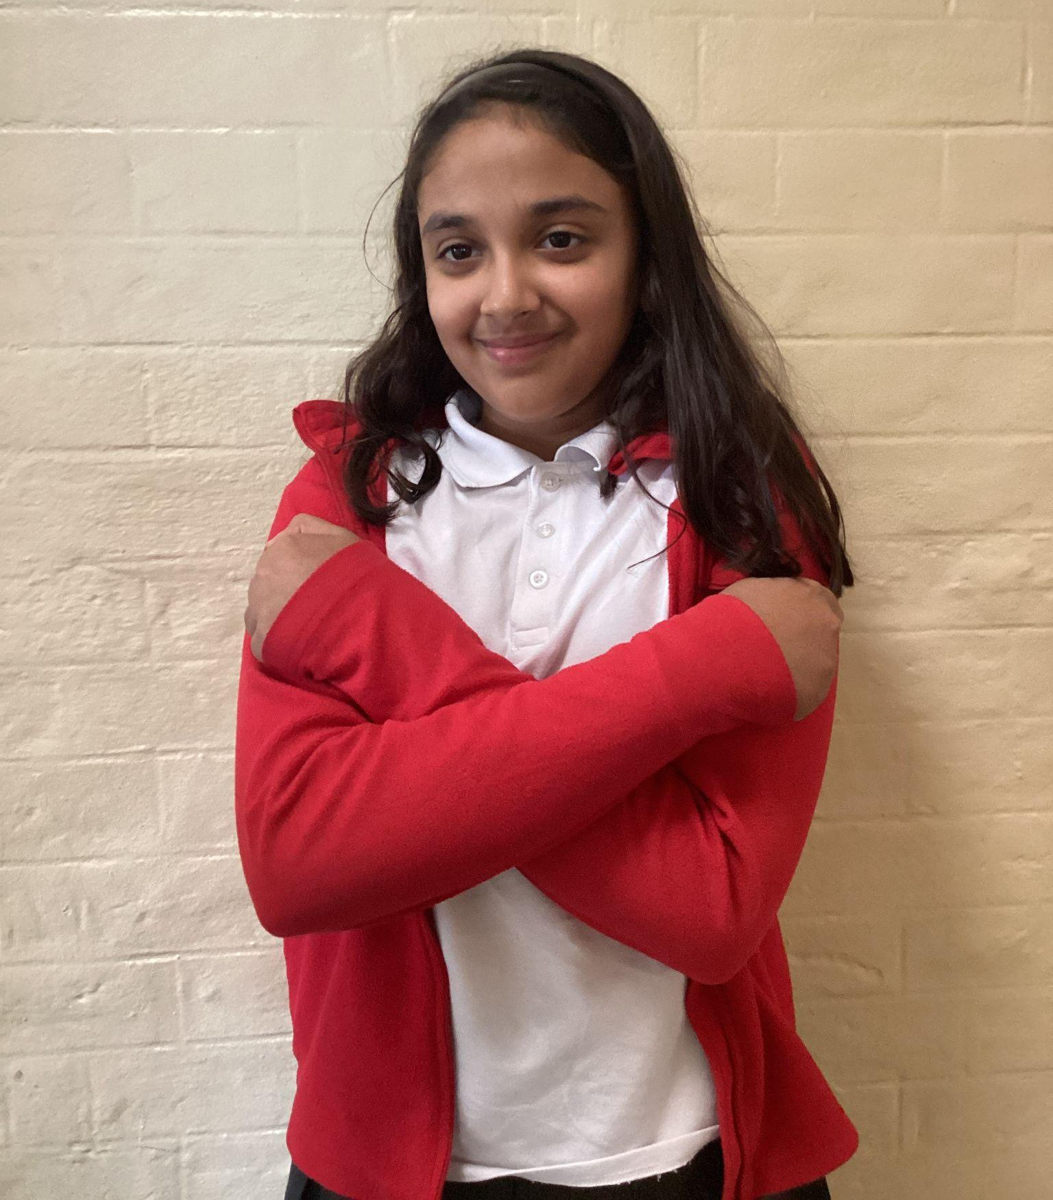
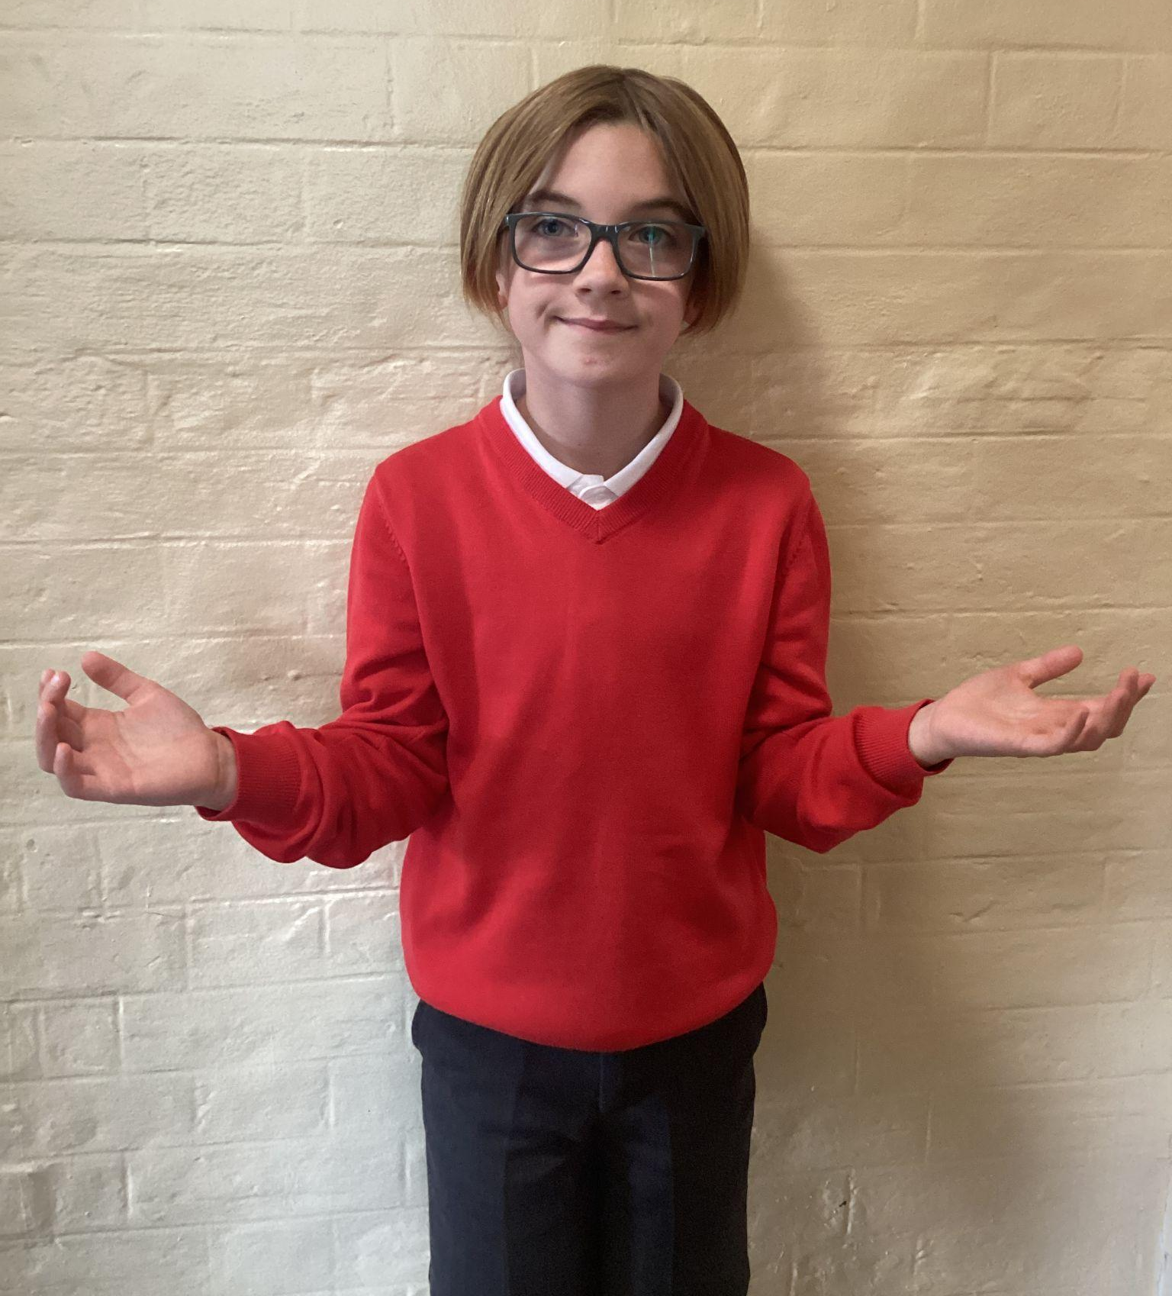
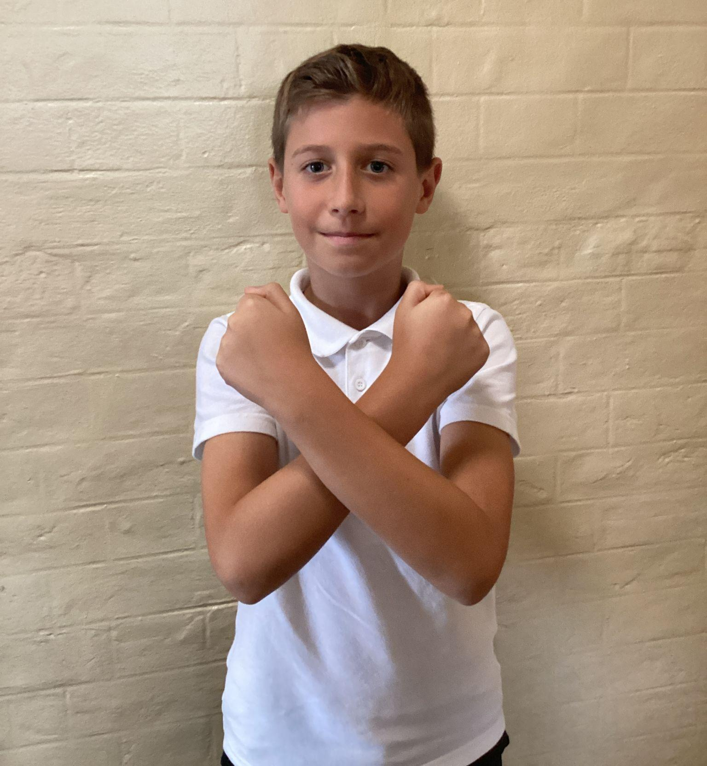
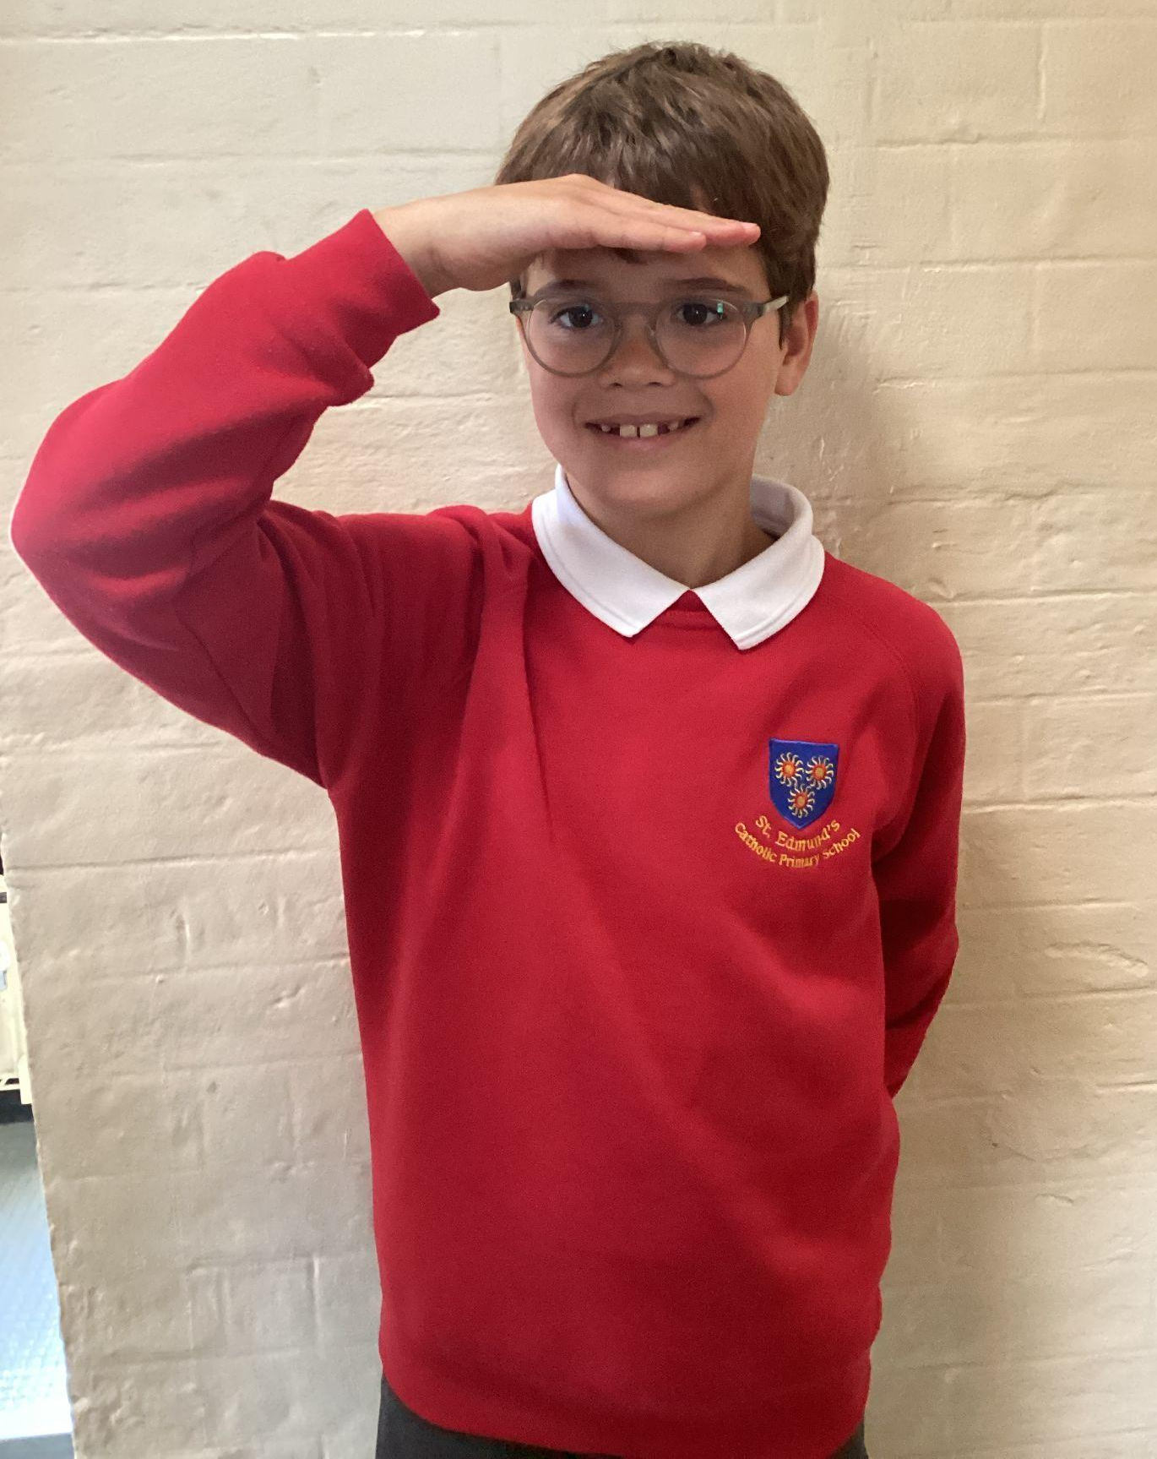
Please repeat after me
1. Light
6. Amen
2. Love
5. Wherever I am.
3. Power
4. Presence

Slide 5
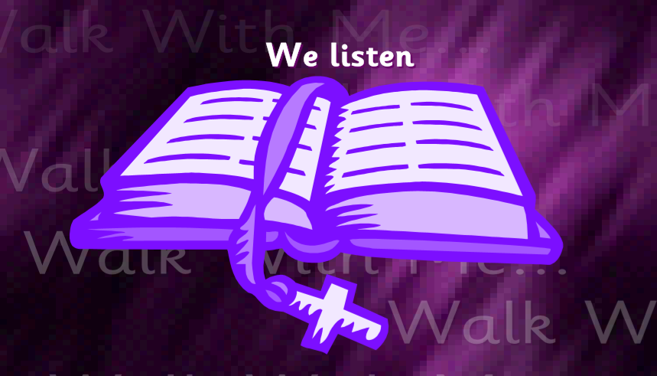
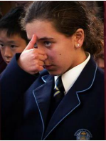
The Lord be with you.
All: And with your spirit.
A reading from the Holy Gospel according to Luke.
All: Glory to You, Oh Lord.

Slide 6
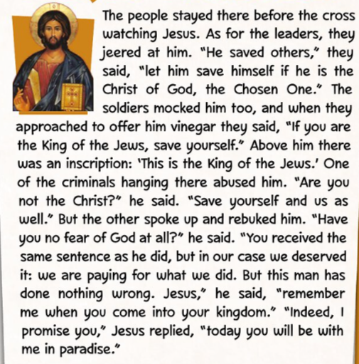
The Gospel of the Lord.
ALL: Praise to you Lord Jesus Christ.
Luke 23:35-43

Slide 7
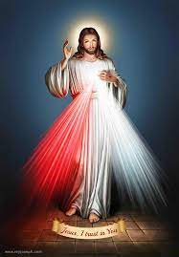
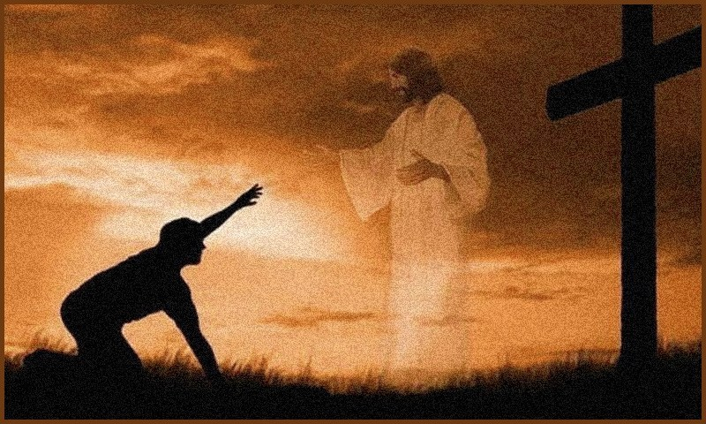
What is this week’s Word?
MERCY

Slide 8
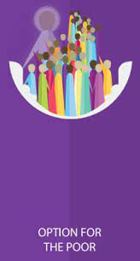

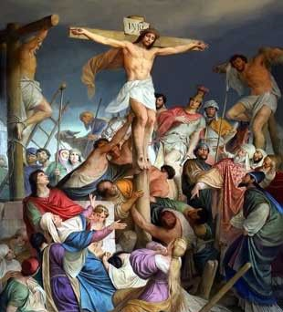
How does the Wednesday word link to
Catholic Social Teaching, RE or Scripture?
MERCY

Slide 9
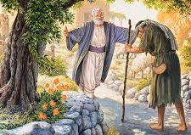
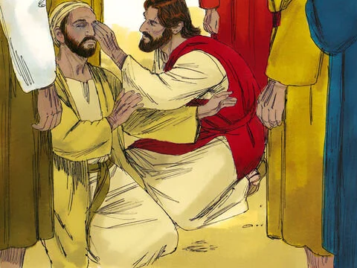
Are there any other scriptures that link to our Wednesday Word, Mercy?
The Prodigal Son
Luke 15:11–32
Jesus Heals the Blind Man Mark 10:46–52

Slide 10
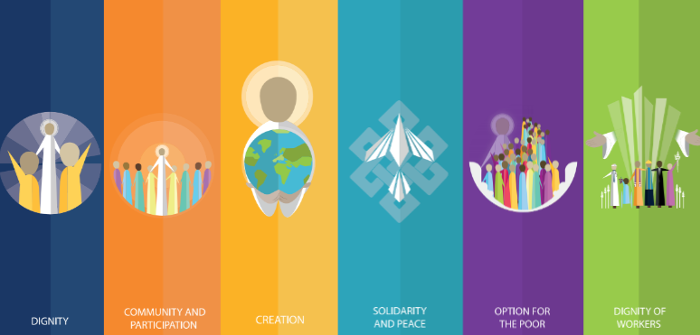
Catholic Social Teaching
Mercy means showing kindness, love, and forgiveness, just as Jesus teaches. In Catholic Social Teaching, it reminds us that everyone is loved by God. When we show mercy—by including others, sharing, helping those in need —we make our school happier and more like Jesus wants.

Slide 11
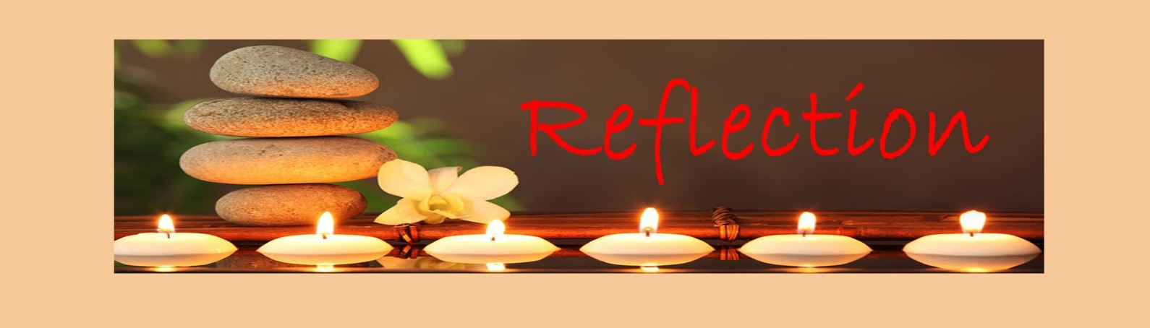
Close your eyes and accept Jesus in your hearts
Think about mercy—being kind, forgiving, and loving like Jesus. Picture someone who needs help or a friend you need to forgive. Imagine sharing, caring, and making others feel included. Feel God’s love in your heart and let it guide your words and actions. Each time you show mercy, you make your school and the world a little brighter.

Slide 12

We Respond
Dear Lord Jesus,
Help us to show mercy every day,
to be kind, to forgive, and to love others as you love us.
Amen.

Slide 13


Slide 14
Act of Dedication
P&J: Help us to care for others and make loving choices each day.
All: Lord, help us to be people of mercy.

Slide 15
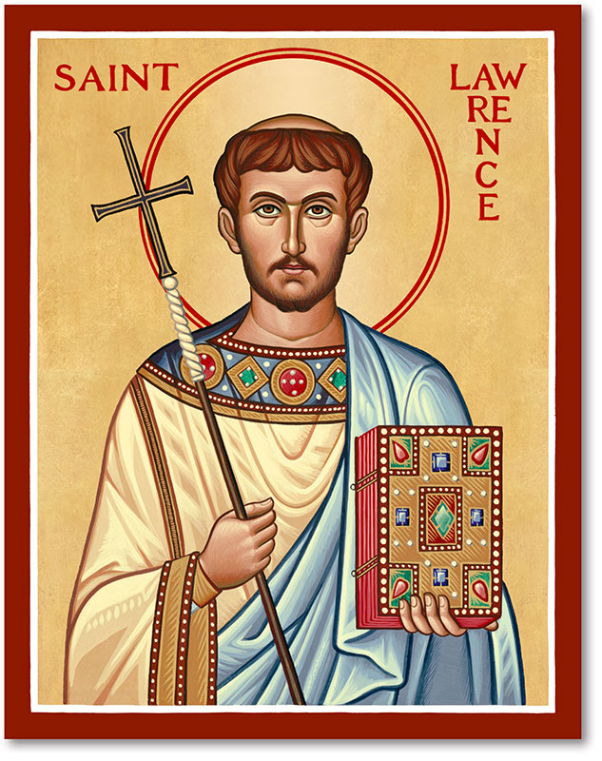
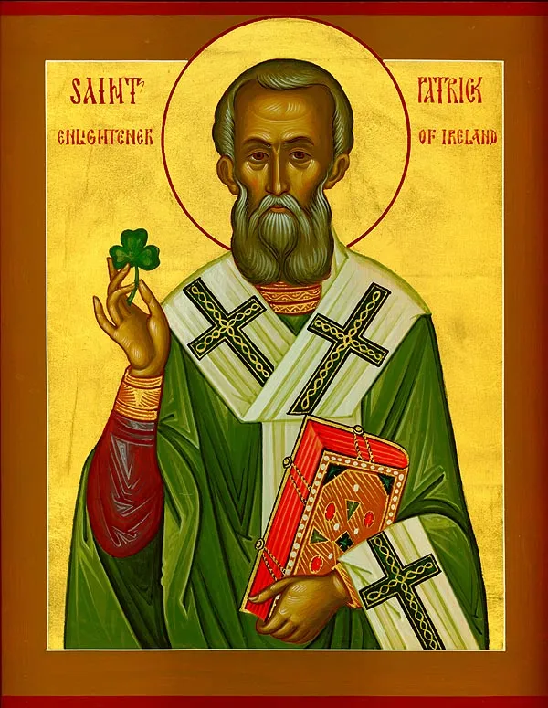
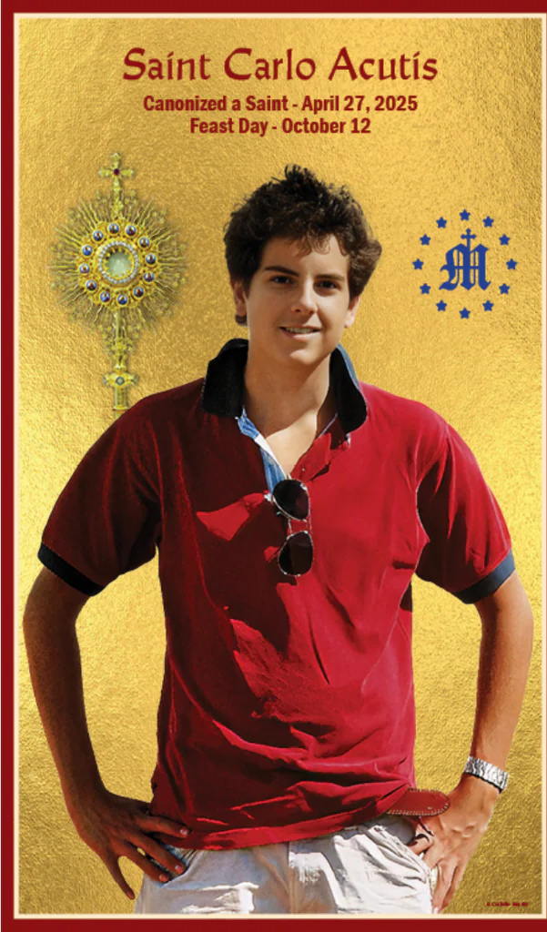
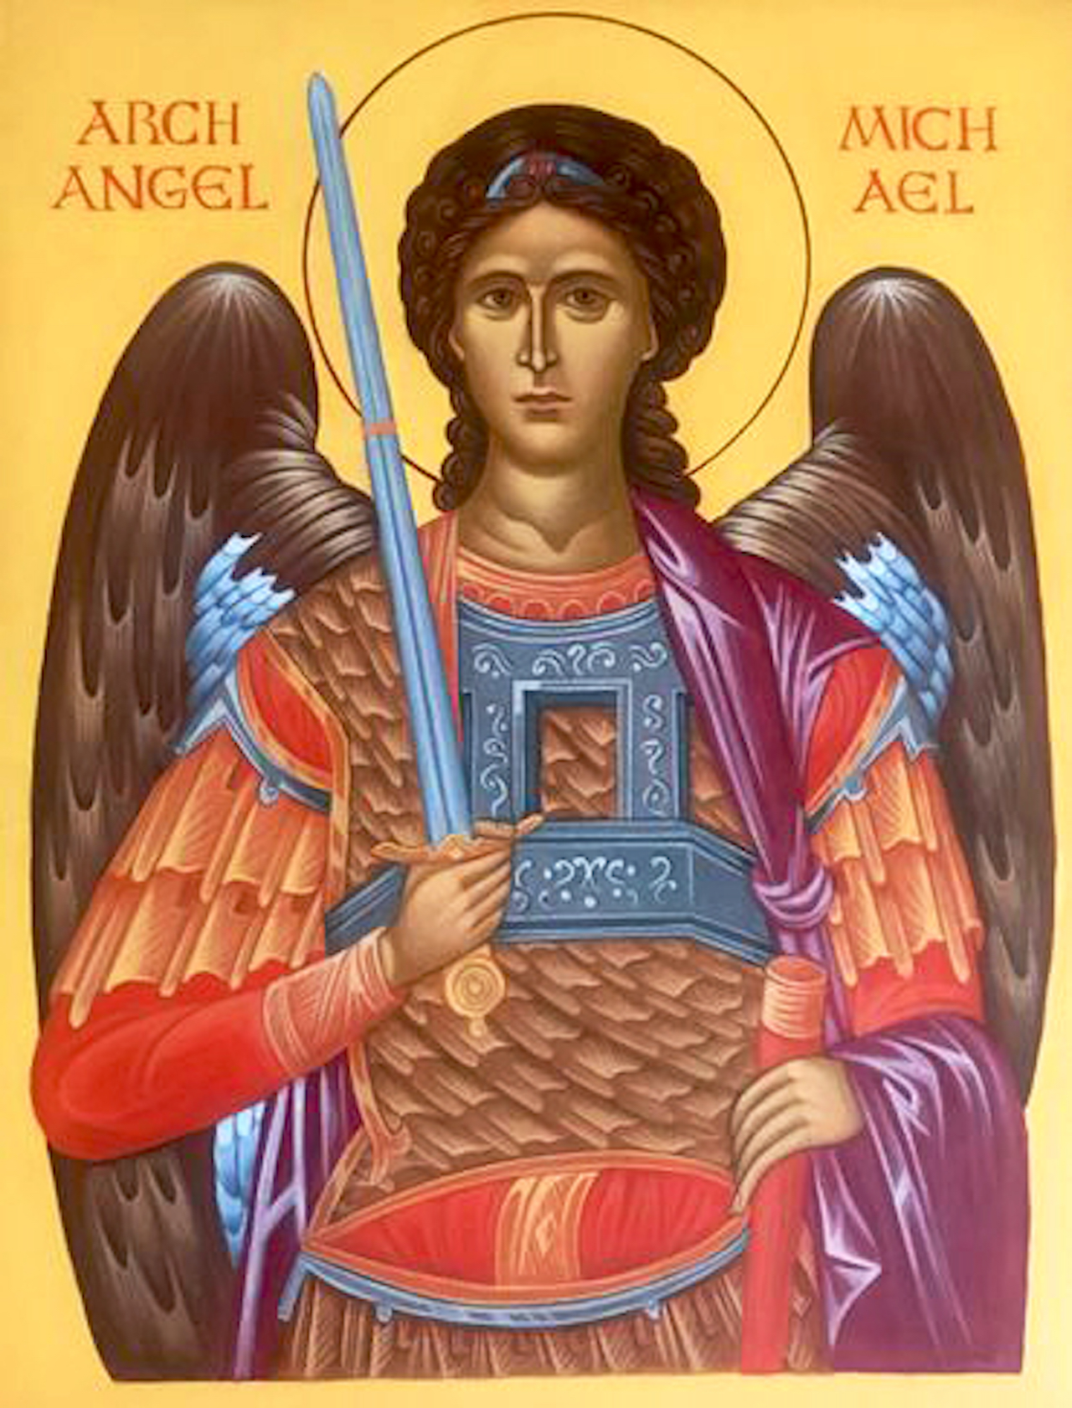
Litany of Saints
PJ: St. Lawrence
All: Pray for us
PJ: St. Patrick
All: Pray for us
PJ: St. Carlo Acutis
All: Pray for us
PJ: St. Michael
All: Pray for us

Slide 16
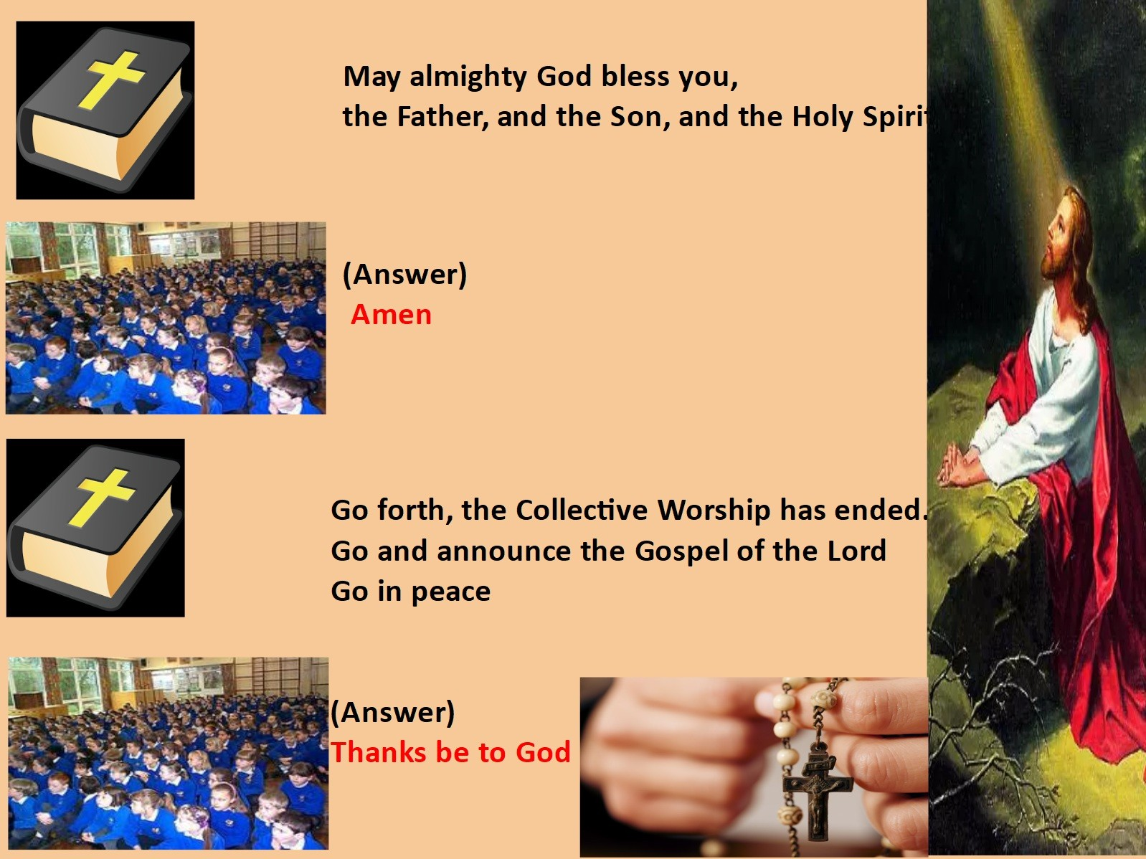
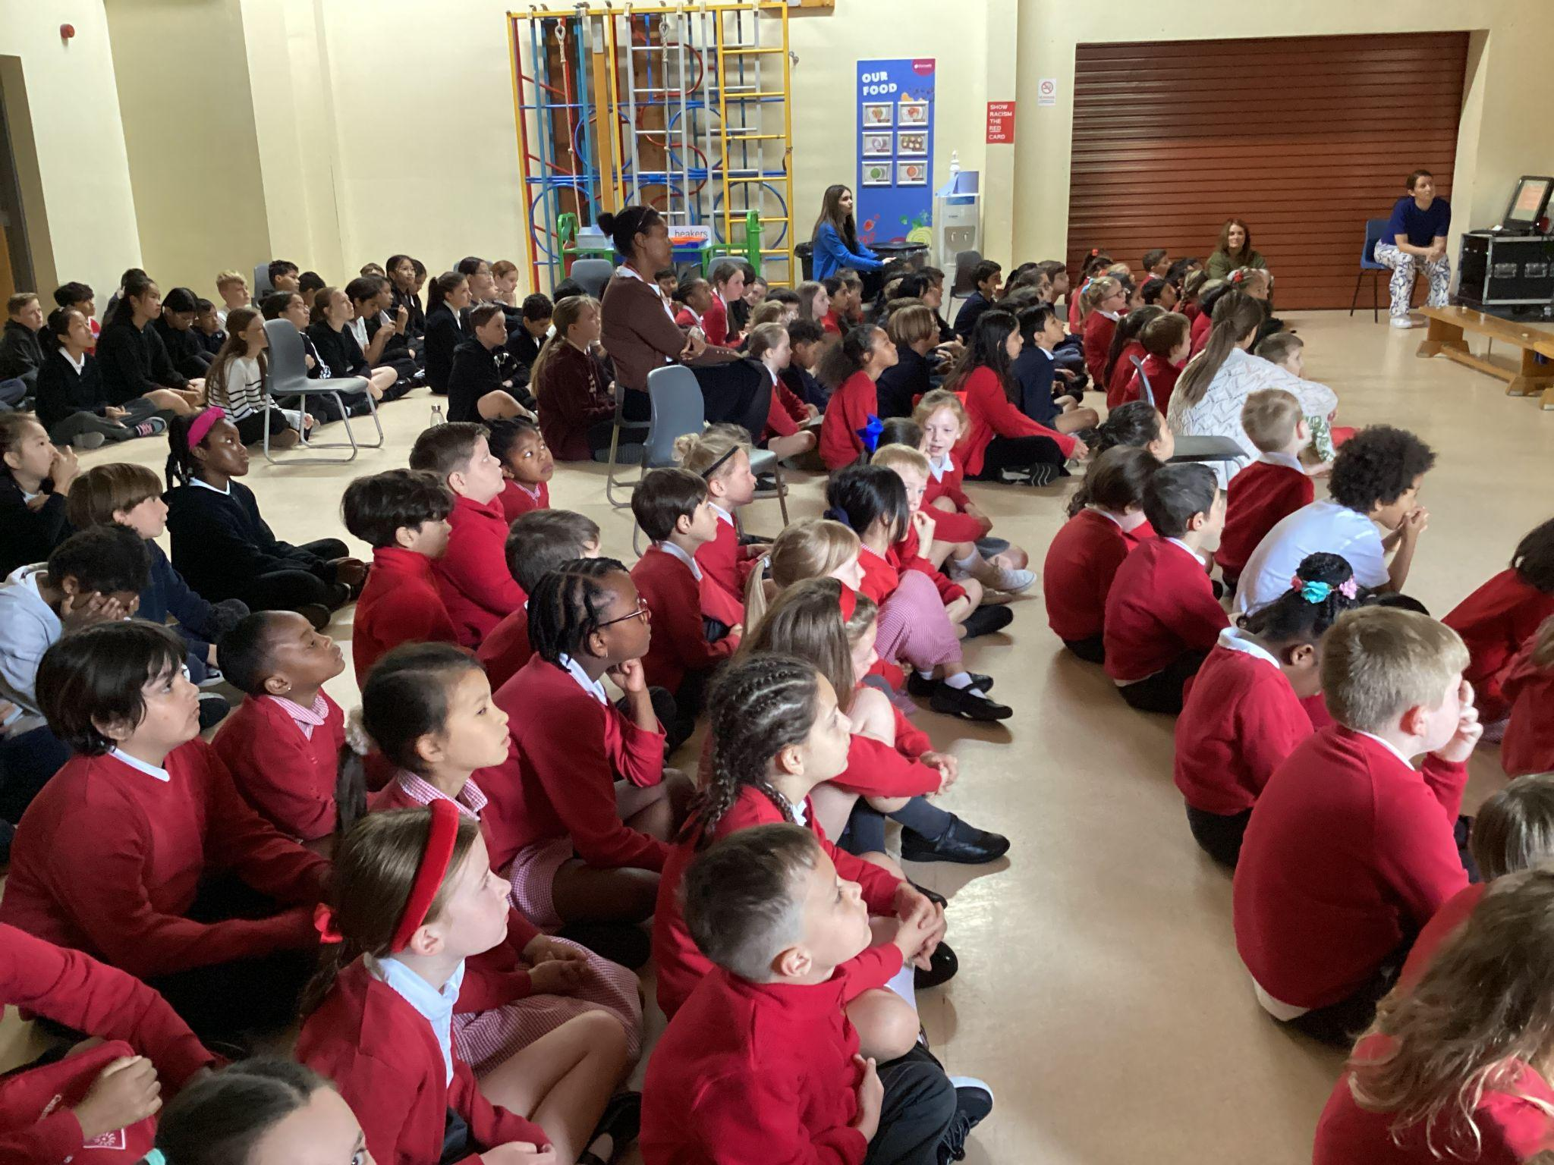
We Go Forth

Slide 17

Thank you for coming to the Celebration of the Word.

