Slide 1

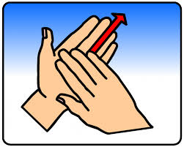
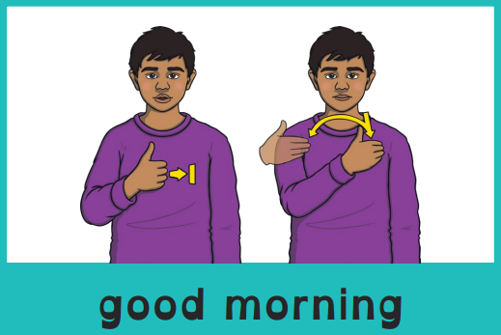
Good morning, everyone.
Celebration of the Word Assembly - 10/11/2025
Hajni

Slide 2

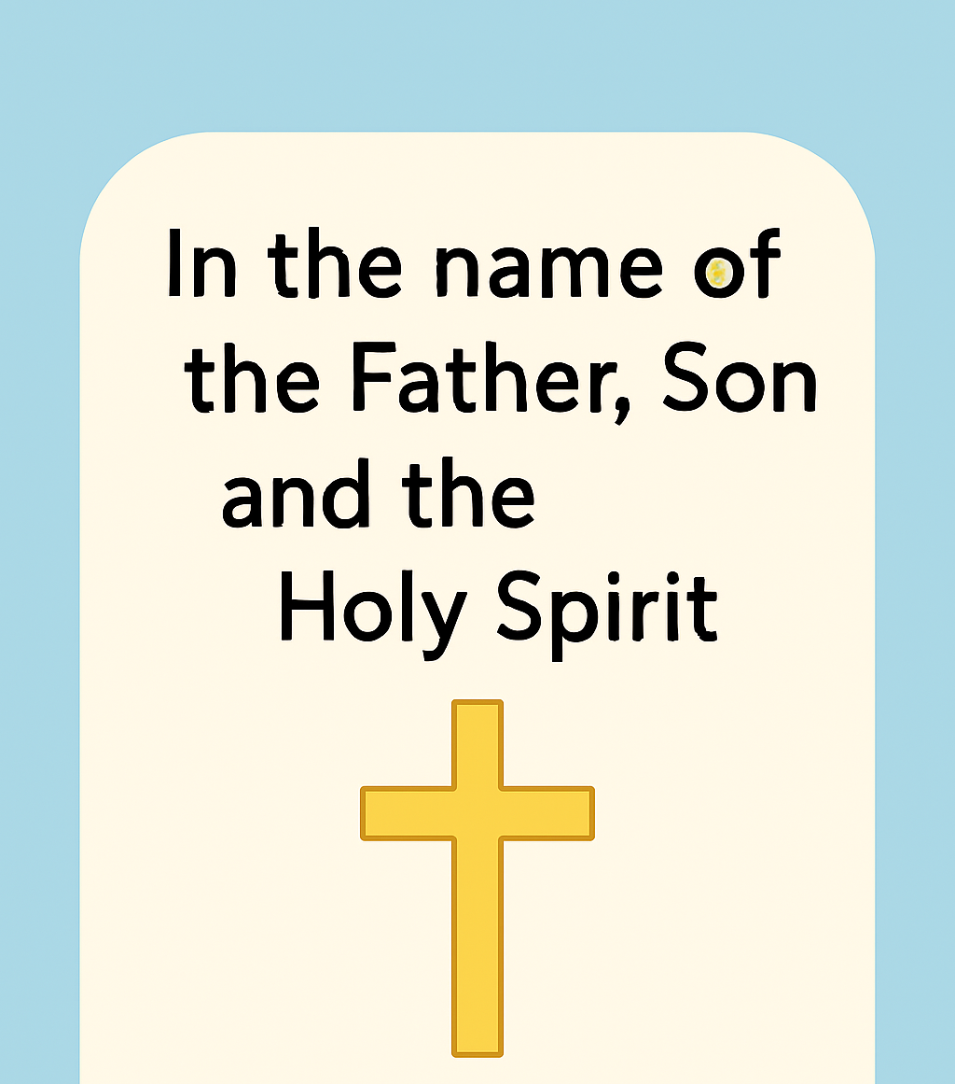
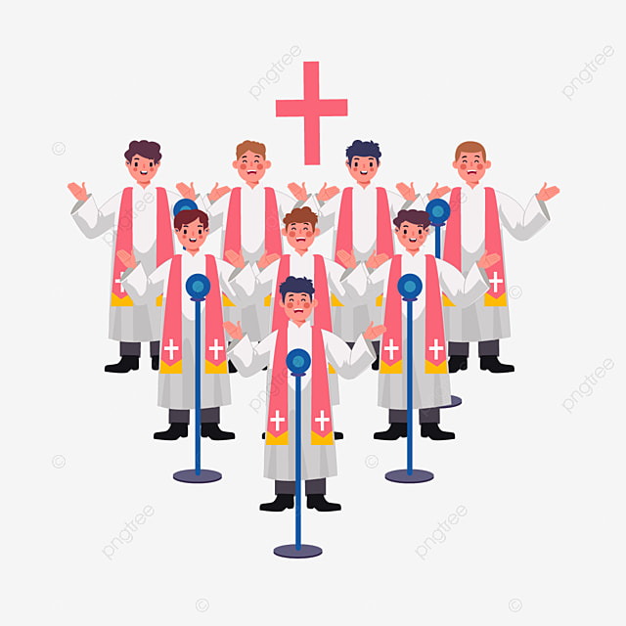
Through Christ We Learn

Slide 3
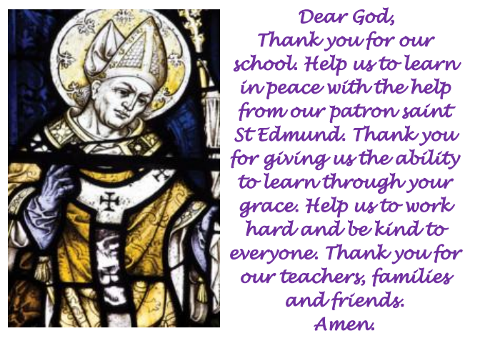
St Edmund’s School Prayer

Slide 4
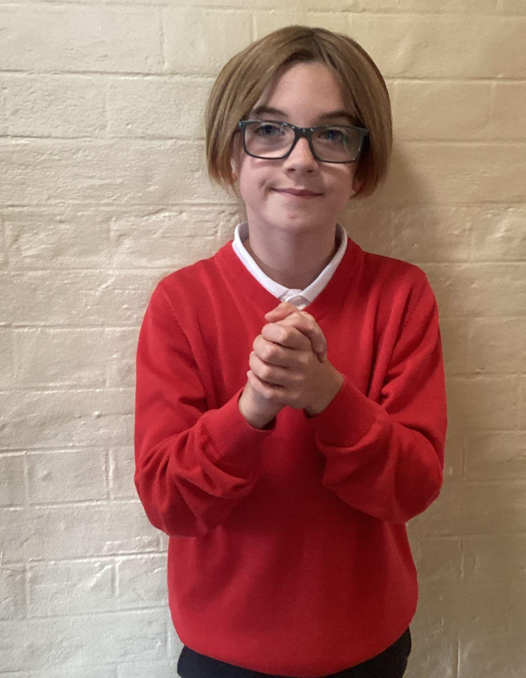
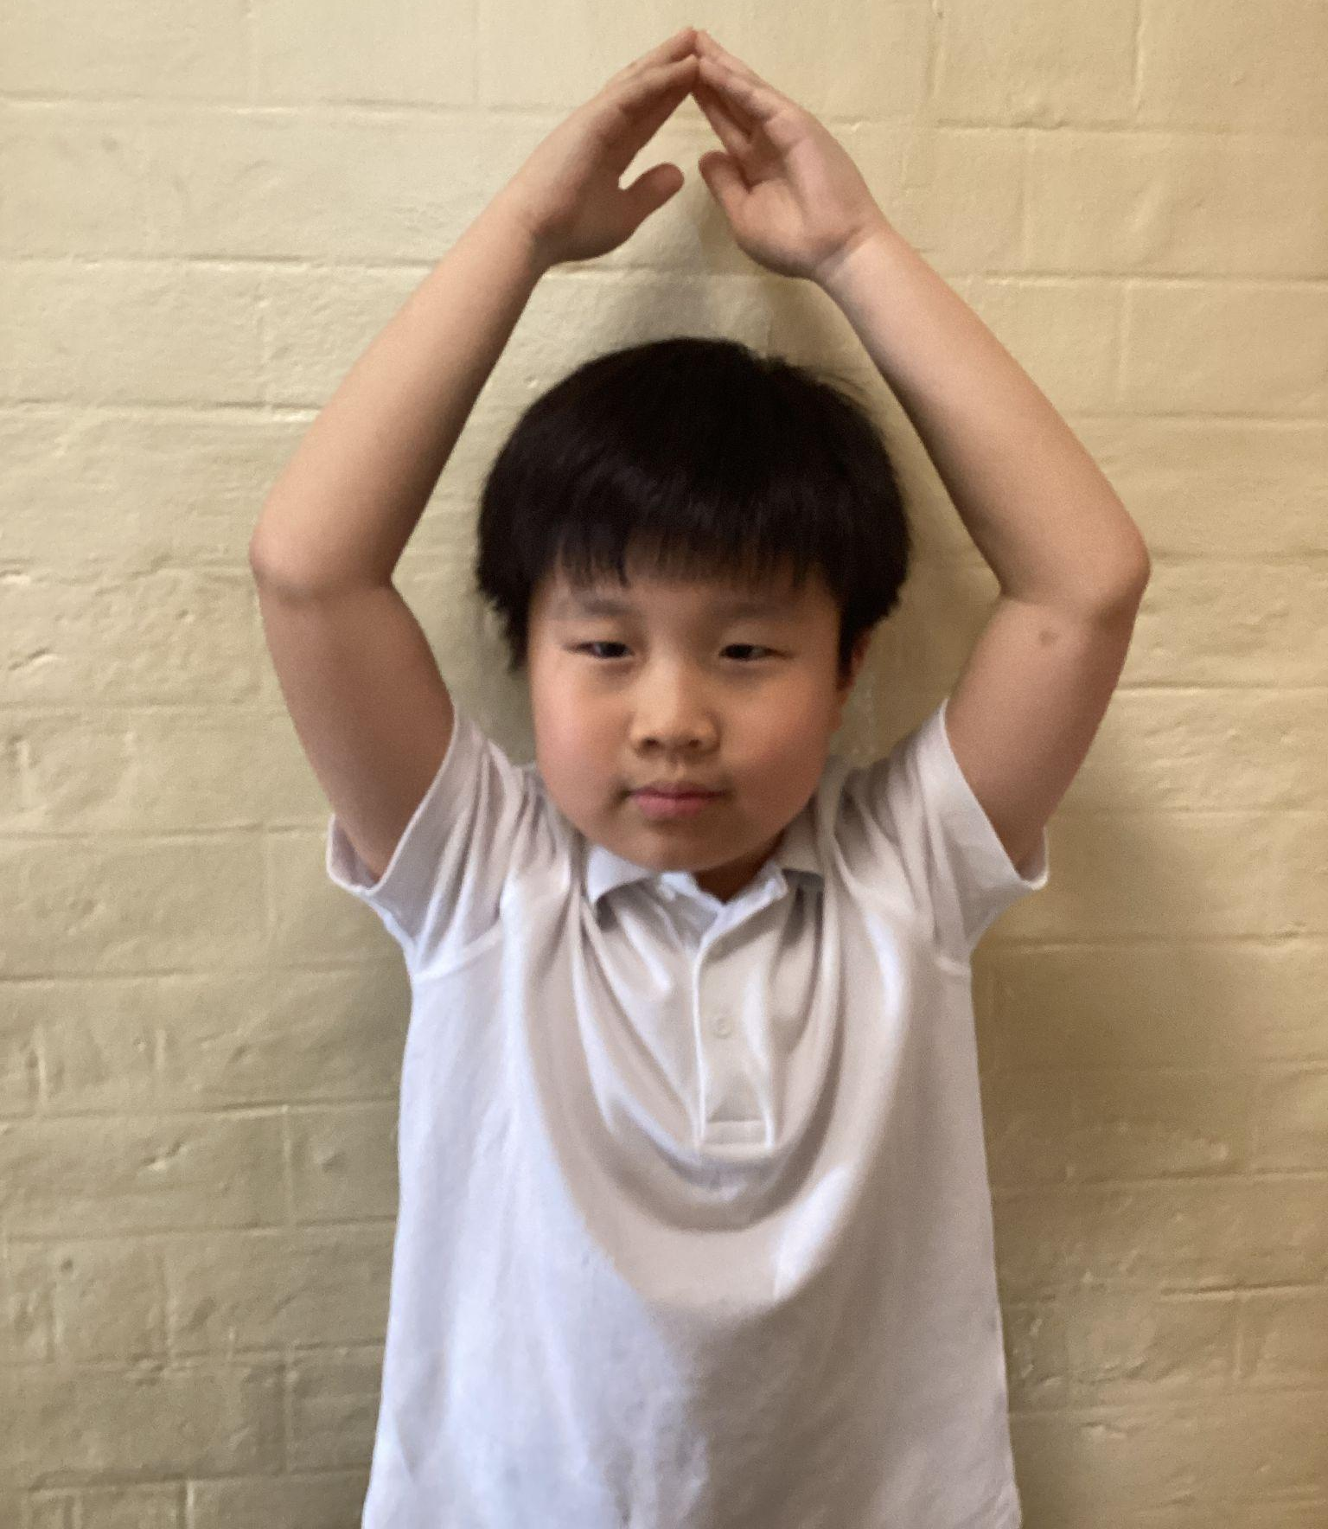
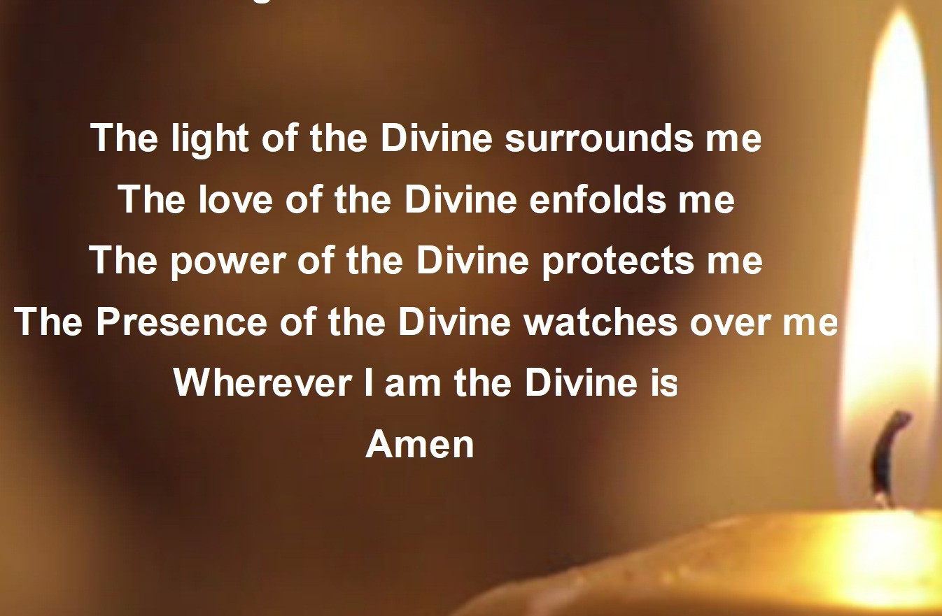
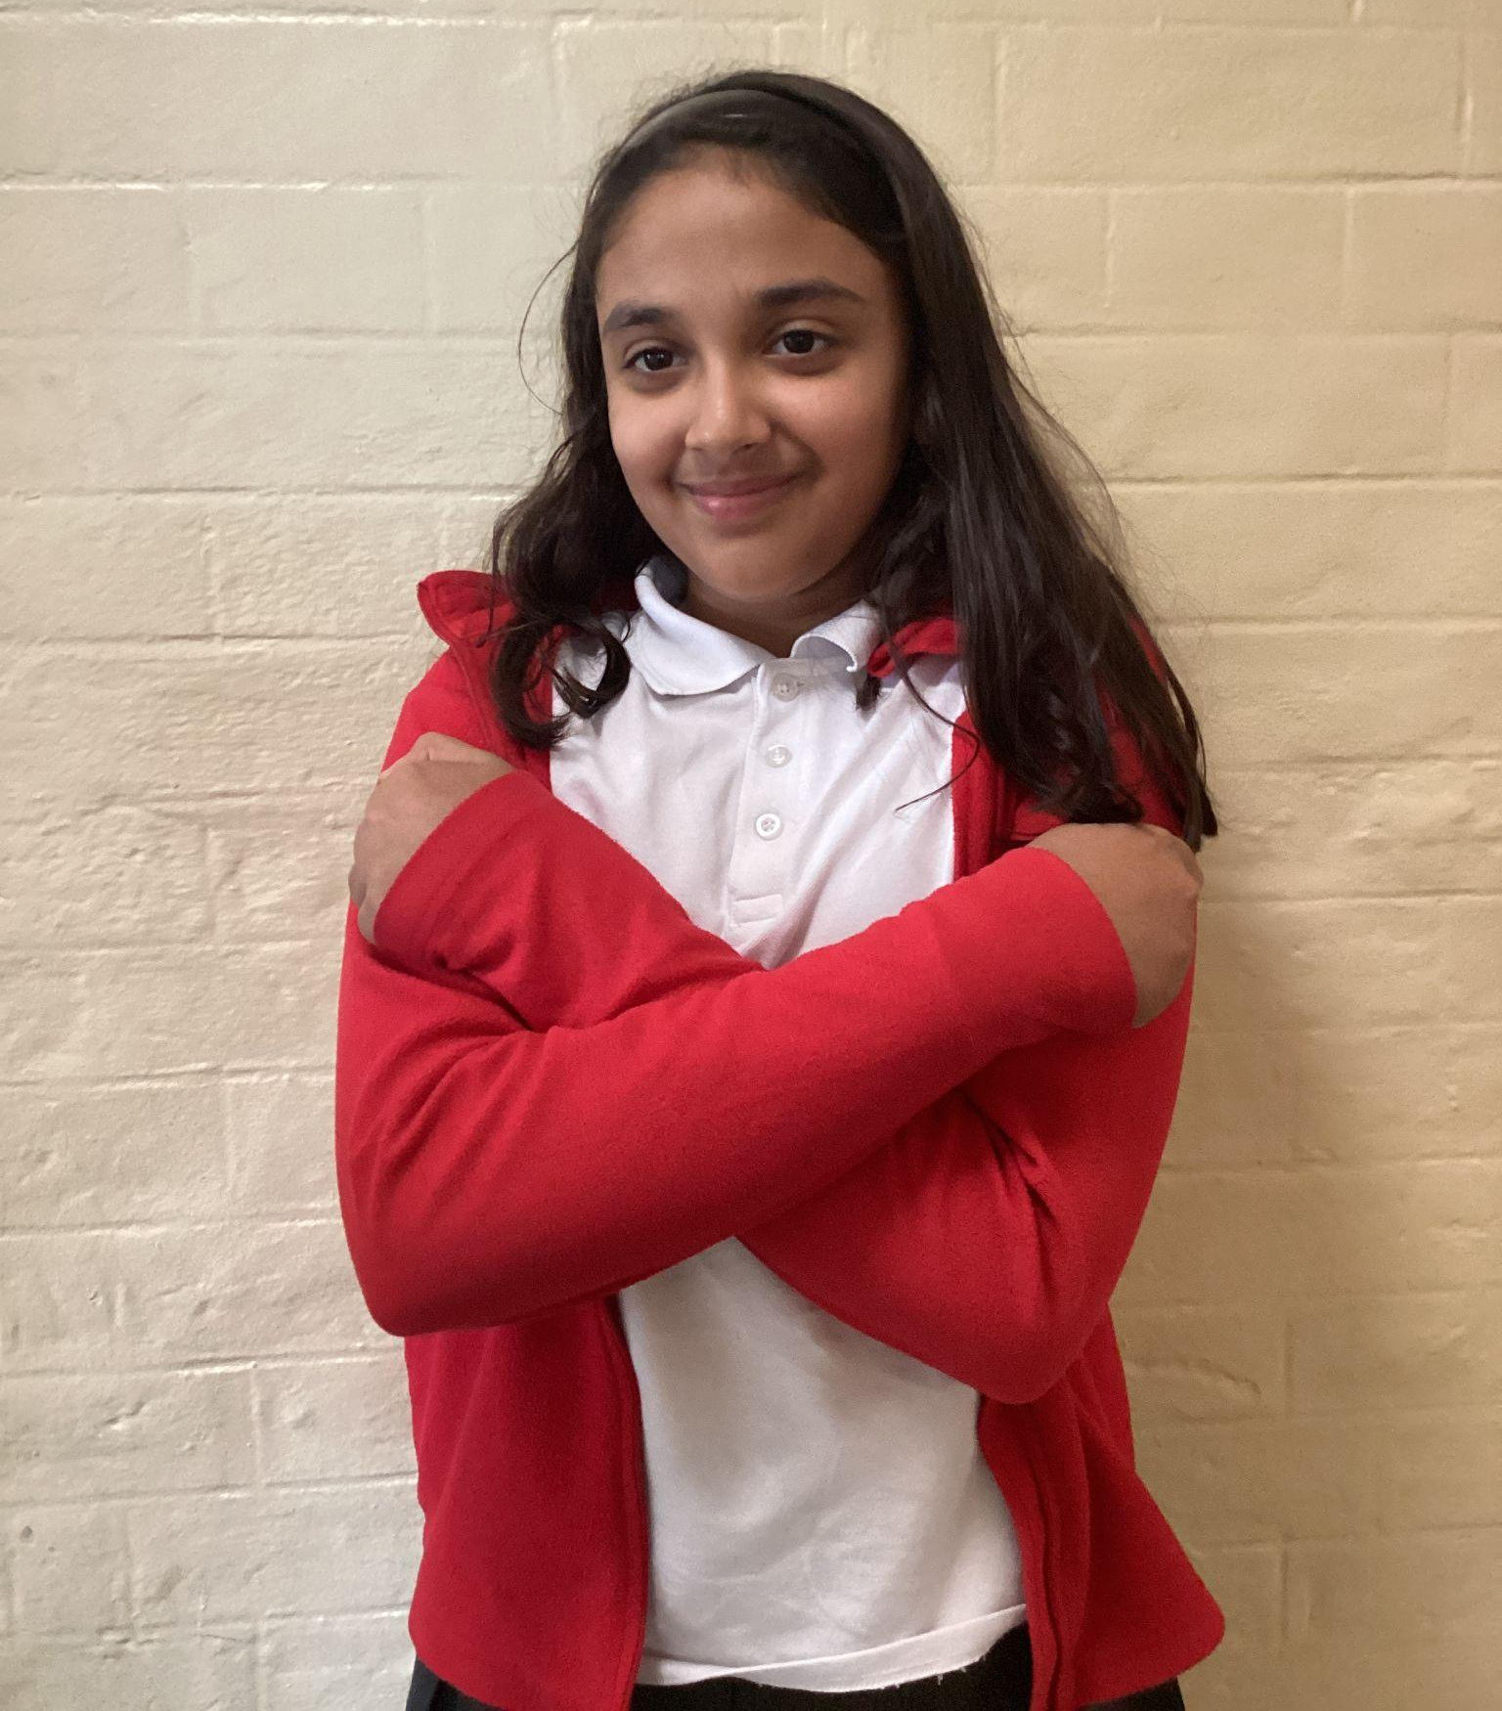
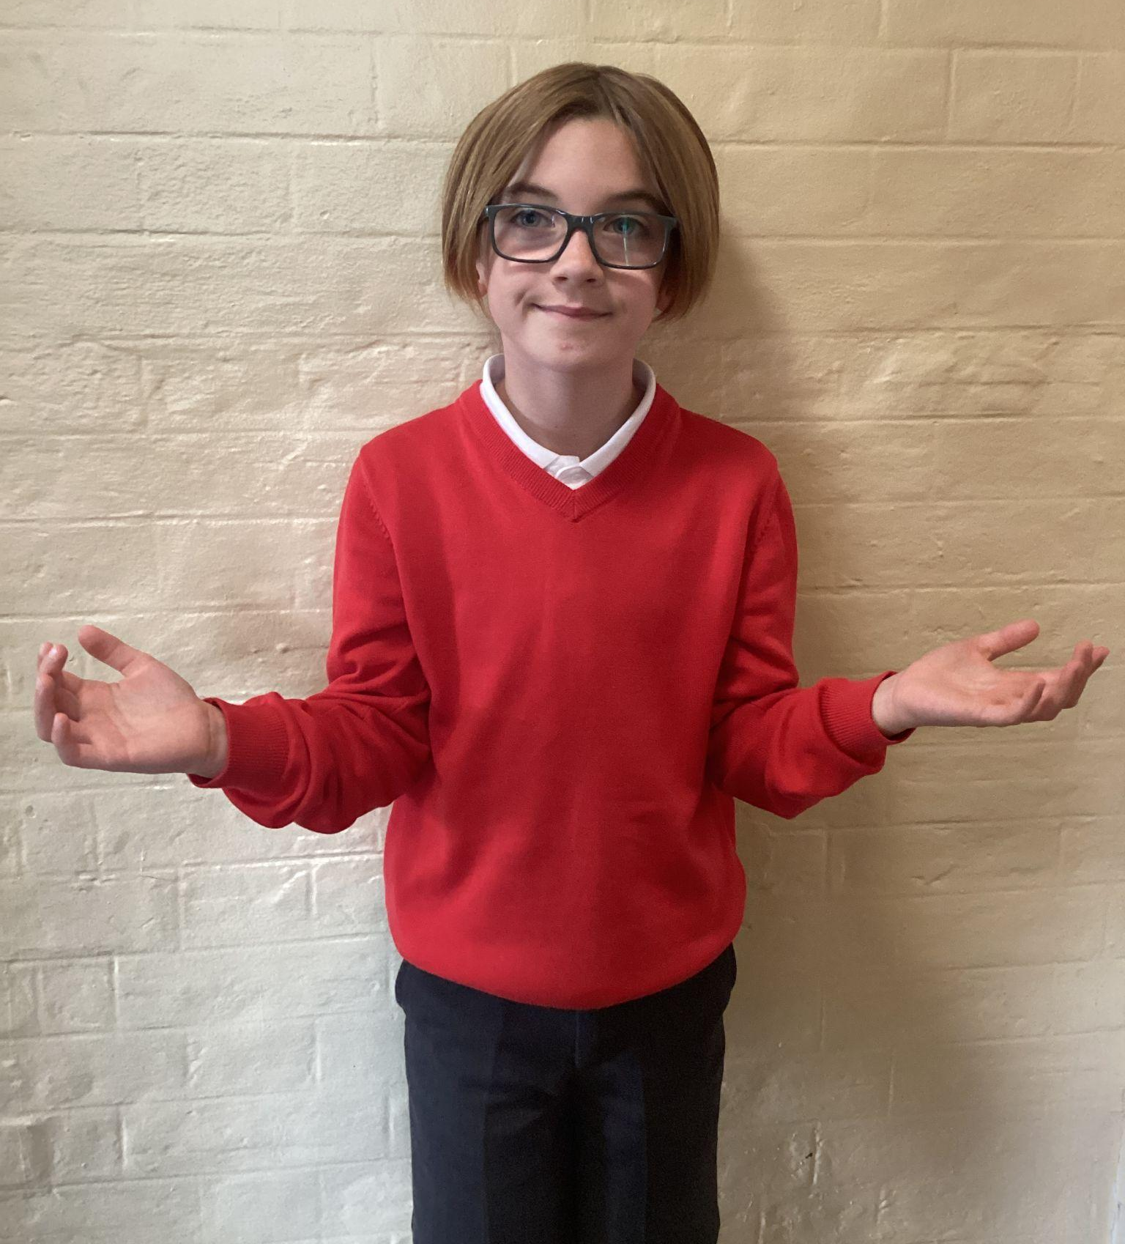
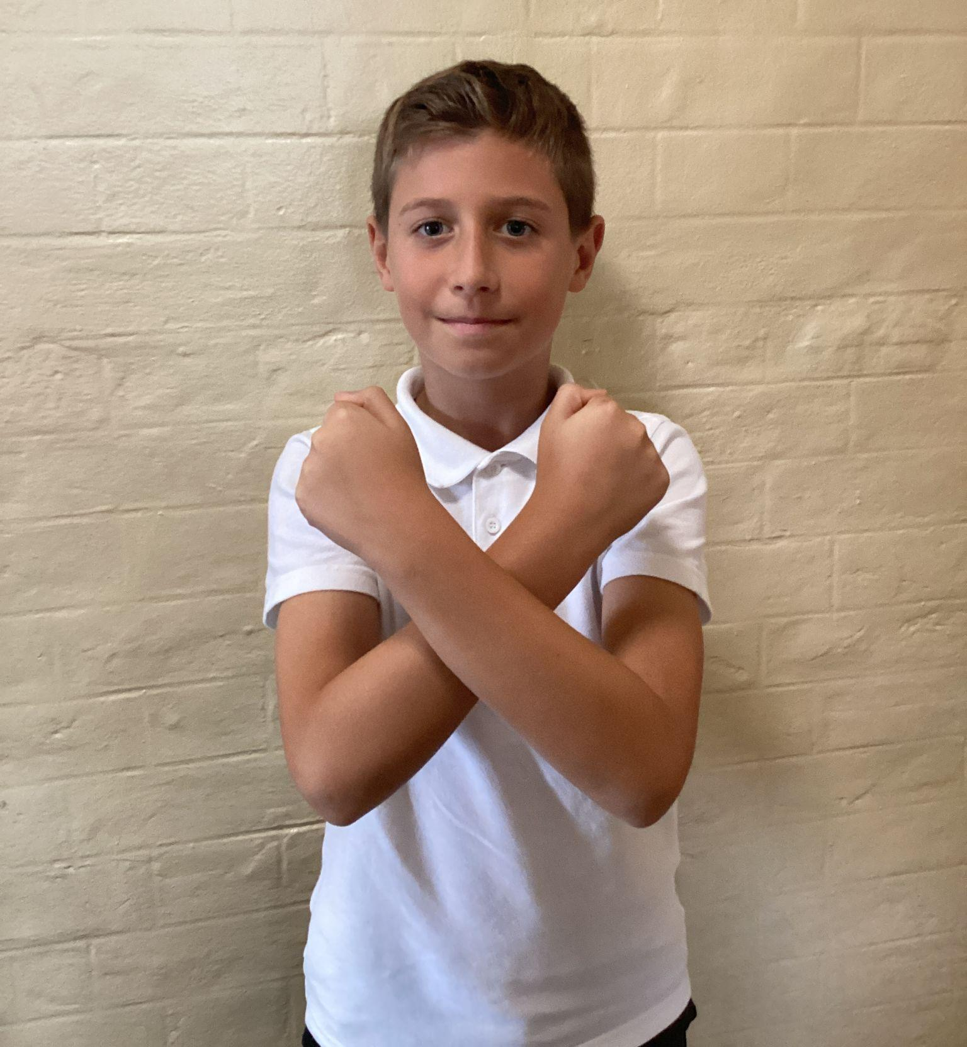
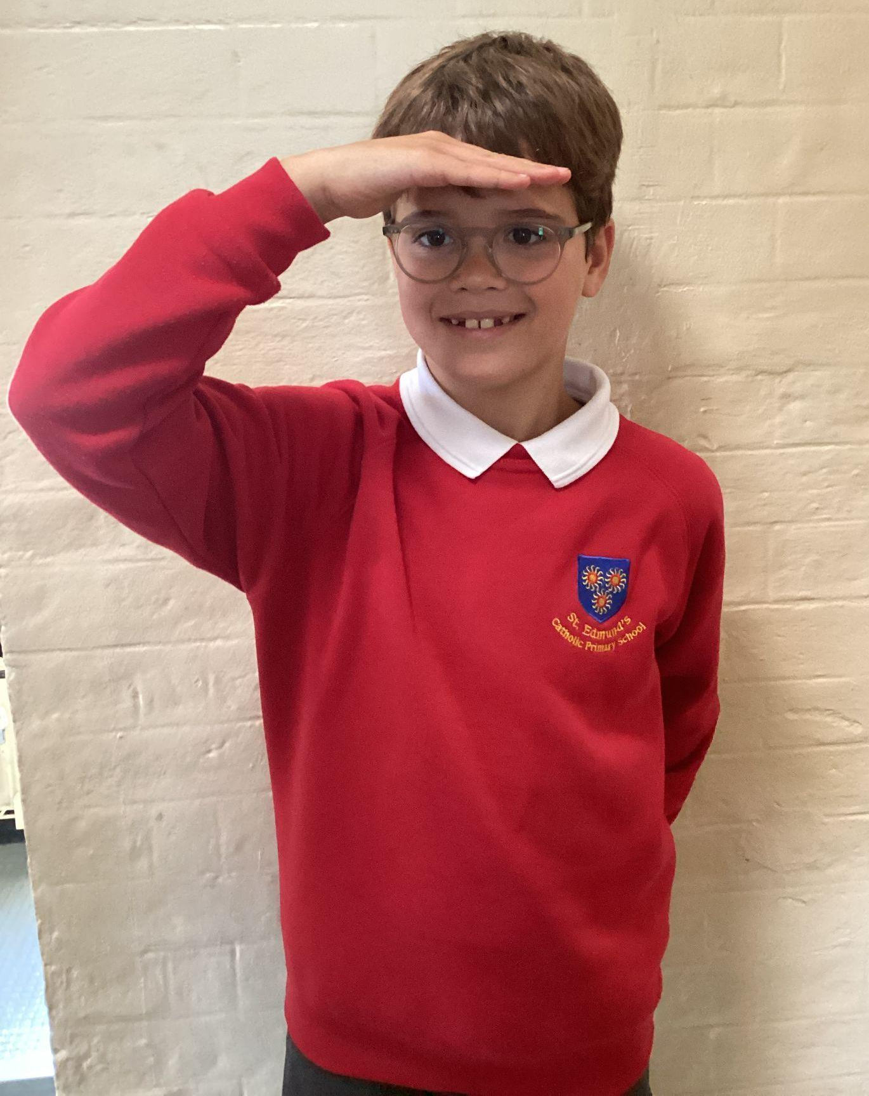
Please repeat after me
1. Light
6. Amen
2. Love
5. Wherever I am.
3. Power
4. Presence

Slide 5
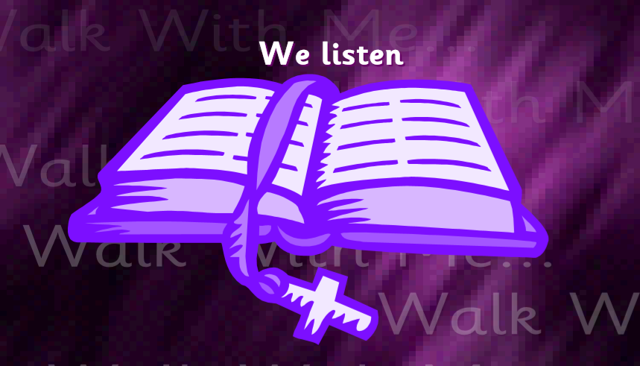
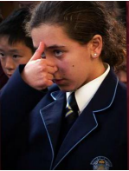
The Lord be with you.
All: And with your spirit.
A reading from the Holy Gospel according to John.
All: Glory to You, Oh Lord.

Slide 6
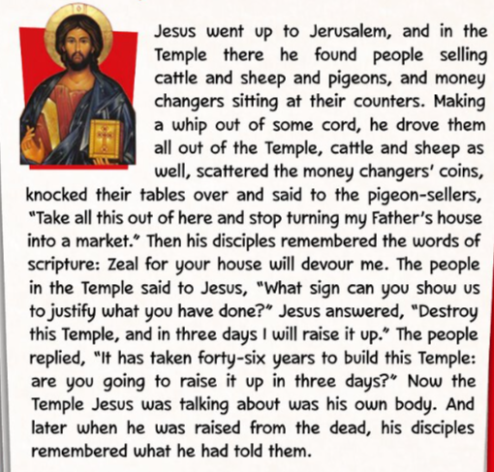
The Gospel of the Lord.
ALL: Praise to you Lord Jesus Christ.
John 2:13-22

Slide 7
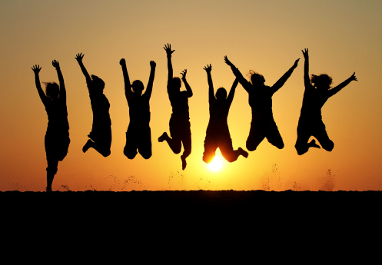
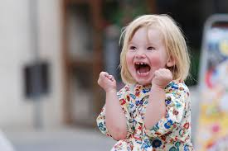
What is this week’s Word?
ENTHUSIASM
A big, happy feeling of excitement and interest in something, shown with lots of energy

Slide 8
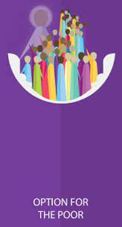

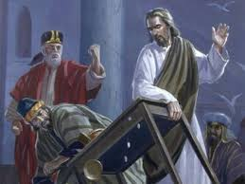
How does the Wednesday word link to
Catholic Social Teaching, RE or Scripture?
ENTHUSIASM

Slide 9
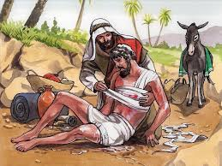
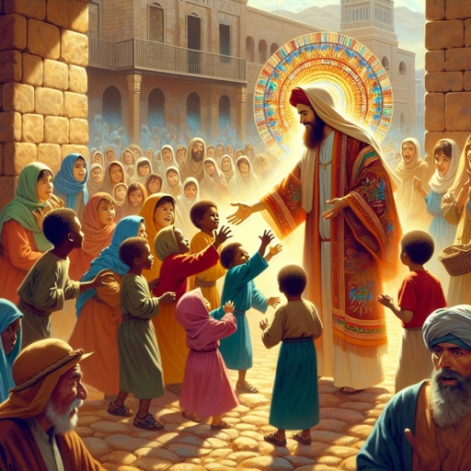
Are there any other scriptures that link to our Wednesday Word,
ENTHUSIASM?
Jesus blessing the children –
Mark 10:13-16
The Good Samaritan – Luke 10:25-37

Slide 10
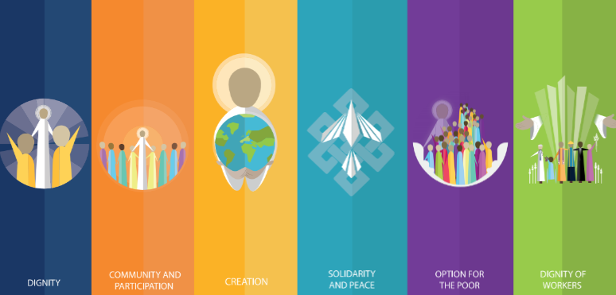
Catholic Social Teaching
Enthusiasm means being excited and happy to do good things. In Catholic teaching, it helps kids want to help others, be kind, and care for everyone, just like Jesus taught. Being enthusiastic makes helping people fun and makes the world a better place.

Slide 11
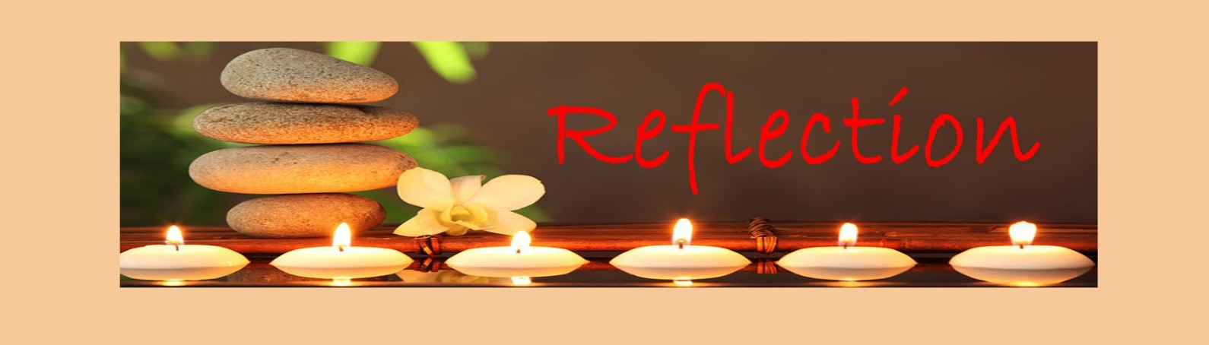
Close your eyes and accept Jesus in your hearts
Think about something good you can do today.
Imagine doing it with a big smile and lots of joy.
Feel your heart happy as you help others.
Thank God for giving you energy to do good.
Breathe out and carry your enthusiasm into the day.

Slide 12

We Respond
Dear God,
Thank you for giving me joy and energy.
May I share happiness and make the world a brighter place.
Amen.

Slide 13
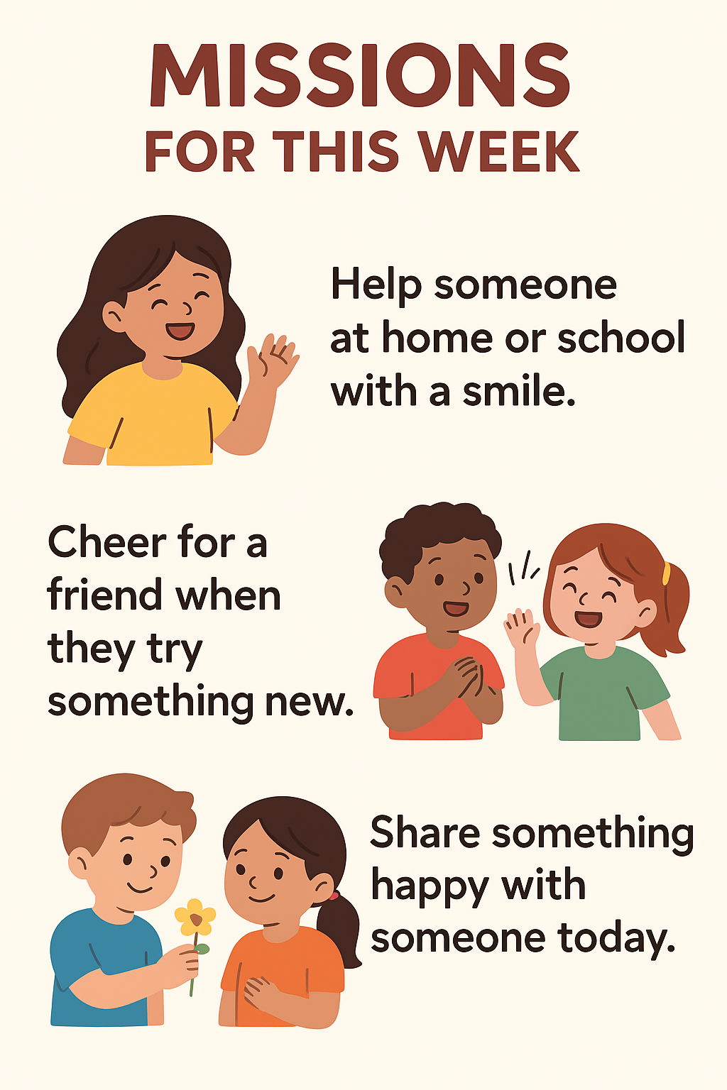

Slide 14
Act of Dedication
P&J: Dear God, help me to be excited about learning and to share Your love with my friends.
All: I will try my best to learn happily and follow You every day.
Amen.

Slide 15
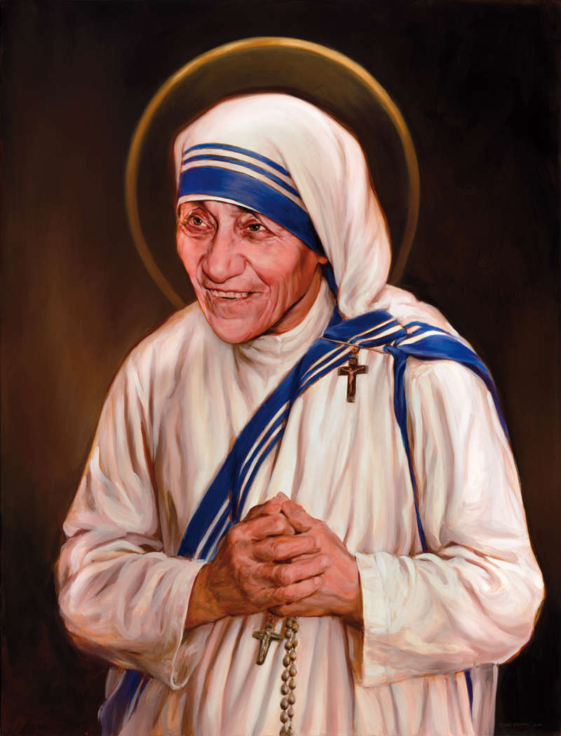
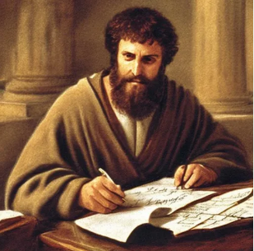
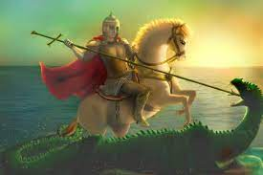
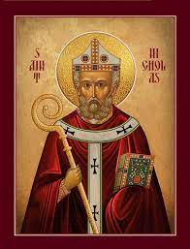
Litany of Saints
PJ: St. Paul
All: Pray for us
PJ: St. Teresa
All: Pray for us
PJ: St. George
All: Pray for us
PJ: St. Nicholas
All: Pray for us

Slide 16
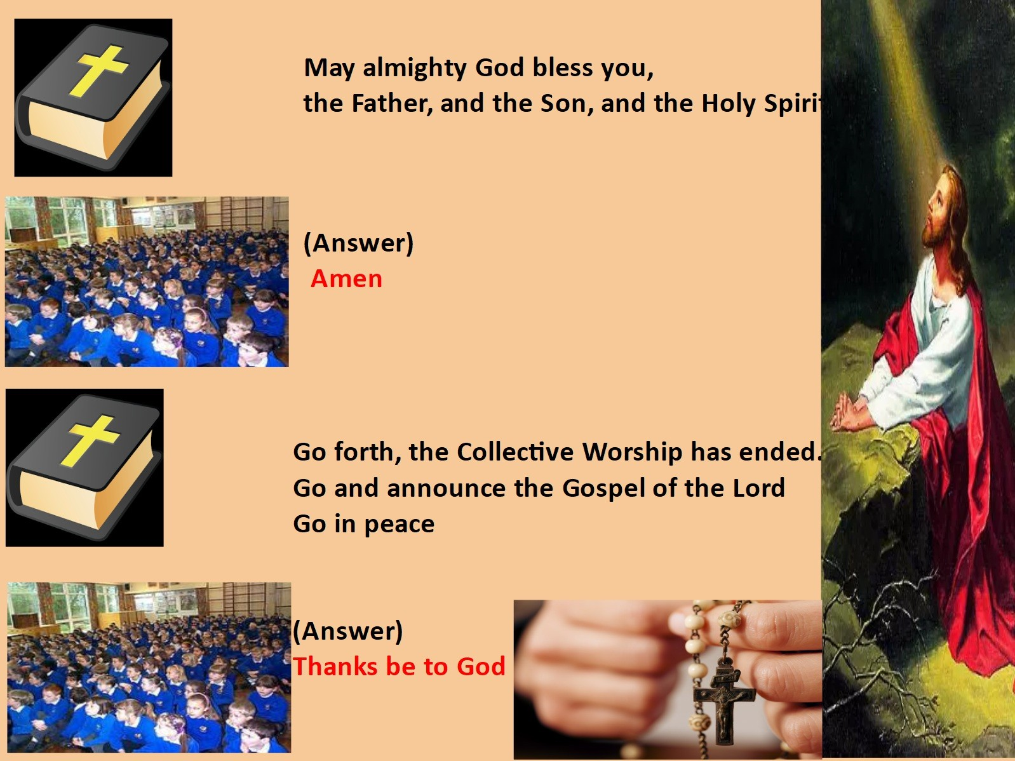
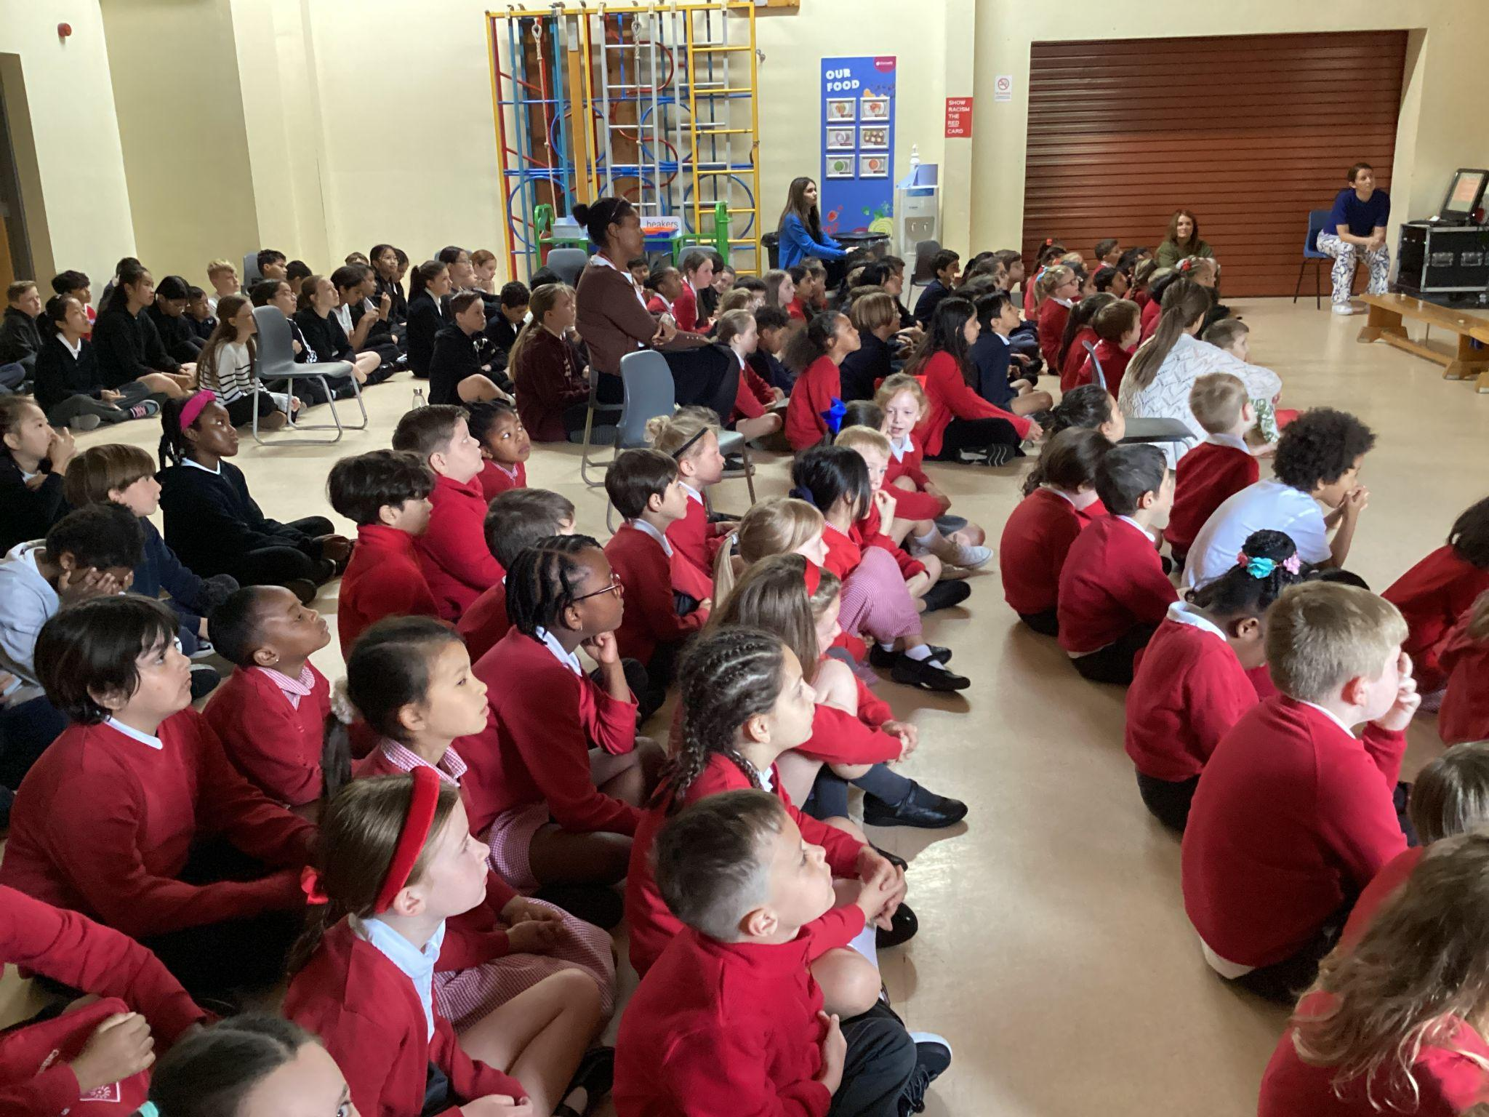
We Go Forth

Slide 17

Thank you for coming to the Celebration of the Word.

